Slide 1
ERCOT Frequency Events
July 2023
ERCOT
Operations Planning
PDCWG |August 16th, 2023

Slide 2
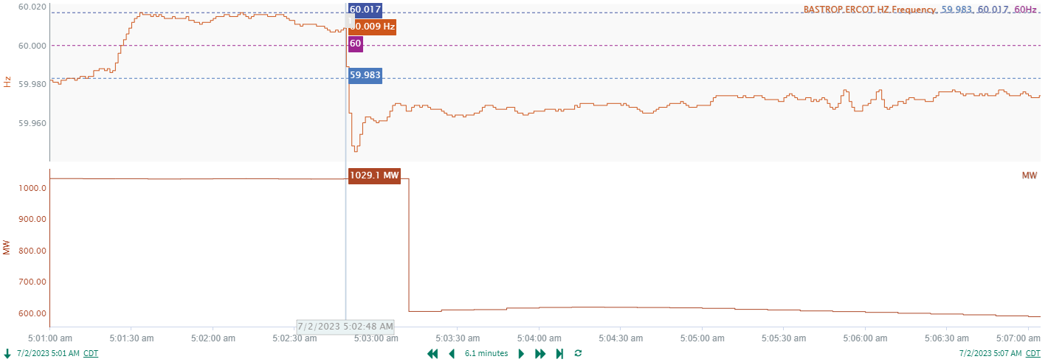
7/2/2023 5:02:48 (Non-FME)
Notes:
A unit tripped offline while carrying approximately 852MW gen
Starting Frequency: 60.008Hz
Minimum Frequency: 59.945 Hz
A-C Time : 5 seconds
Recovery Time(back to deadband): 7 minutes 54 seconds
ECRS Released: 0 MW
Trip Reason: Unknown.
Contextual Information: A total of 253 MW of regulation Up was deployed during the event.

Slide 3
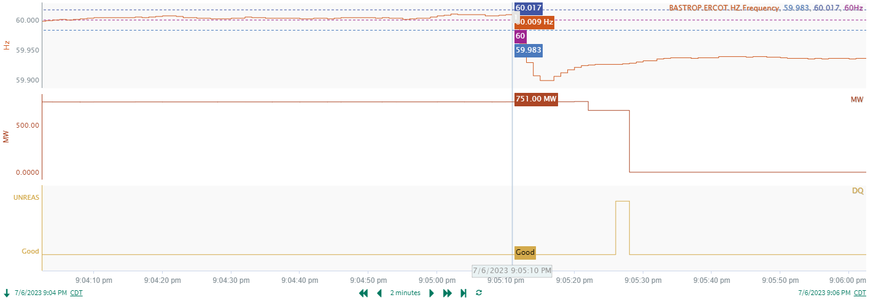
7/6/2023 21:05:09 (FME)
Notes:
A unit tripped offline while carrying approximately 751MW gen
Starting Frequency: 60.009Hz
Minimum Frequency: 59.899 Hz
A-C Time : 5 seconds
Recovery Time(back to deadband): 7 minutes 26 seconds
ECRS Released: 724 MW
Trip Reason: Unknown.
Contextual Information: A total of 461 MW of regulation Up was deployed during the event, along with a manual SCED run following ECRS release.

Slide 4
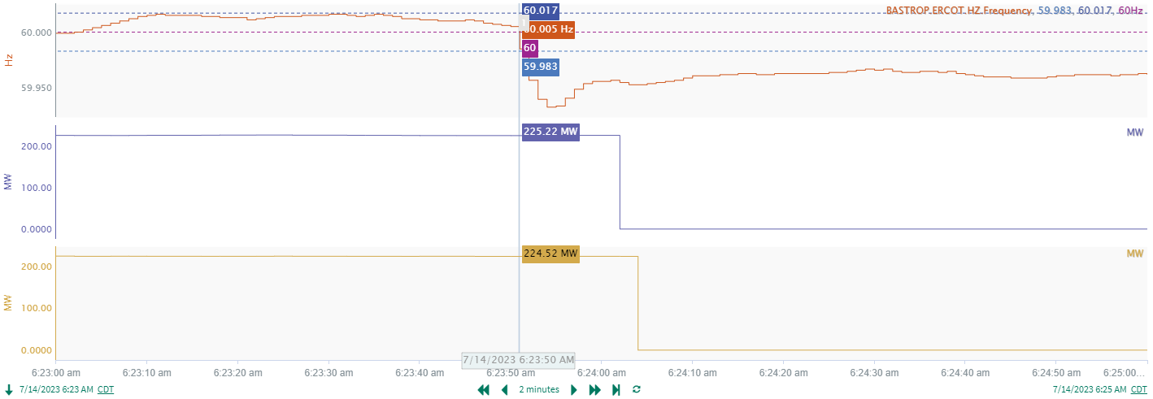
7/14/2023 6:23:49 (Non-FME)
Notes:
A unit tripped offline while carrying approximately 451MW gen
Starting Frequency: 60.006Hz
Minimum Frequency: 59.934 Hz
A-C Time : 6 seconds
Recovery Time(back to deadband): 4 minutes 41 seconds
ECRS Released: 0 MW
Trip Reason: Bus differential on gen bus
Contextual Information: A total of 304 MW of regulation Up was deployed during the event, and a 200 MW manual GTBD offset to SCED was also issued, along with a manual SCED run.

Slide 5
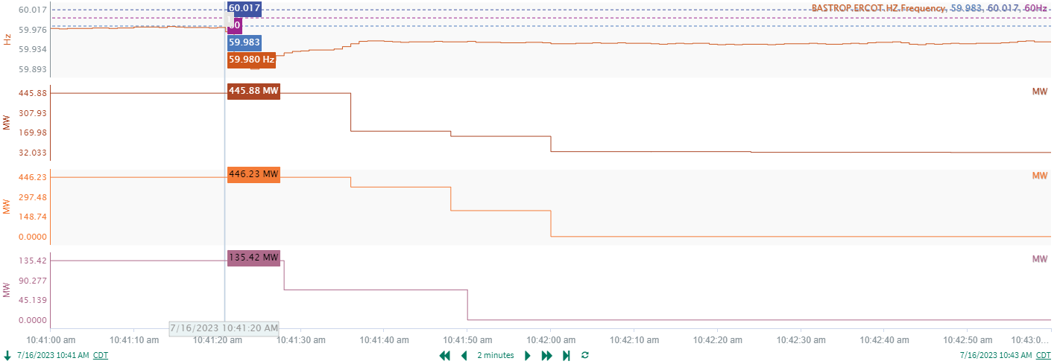
7/16/2023 10:41:20 (Non-FME)
Notes:
A unit tripped offline while carrying approximately 470MW gen
Starting Frequency: 59.980Hz
Minimum Frequency: 59.893 Hz
A-C Time : 4 seconds
Recovery Time(back to deadband): 4 minutes 44 seconds
ECRS Released: 133 MW
Trip Reason: Lightning strike
Contextual Information: A total of 622 MW of regulation Up was deployed during the event, and a 250 MW manual GTBD offset to SCED was also issued, along with a manual SCED run.

Slide 6
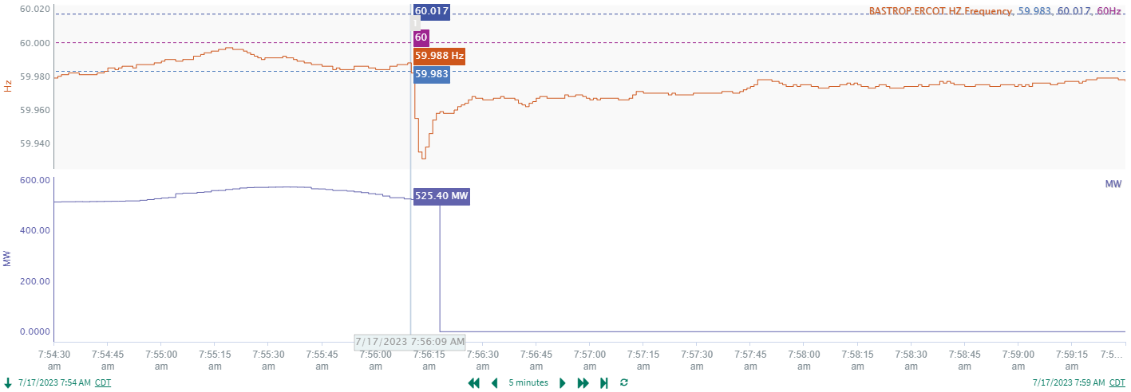
7/17/2023 7:56:10 (Non-FME)
Notes:
A unit tripped offline while carrying approximately 525 MW gen
Starting Frequency: 59.988Hz
Minimum Frequency: 59.931 Hz
A-C Time : 4 seconds
Recovery Time(back to deadband): 7 minutes 10 seconds
ECRS Released: 0 MW
Trip Reason: Boiler feed pump issue
Contextual Information: A total of 260 MW of regulation Up was deployed during the event, along with 2 manual SCED runs.

Slide 7
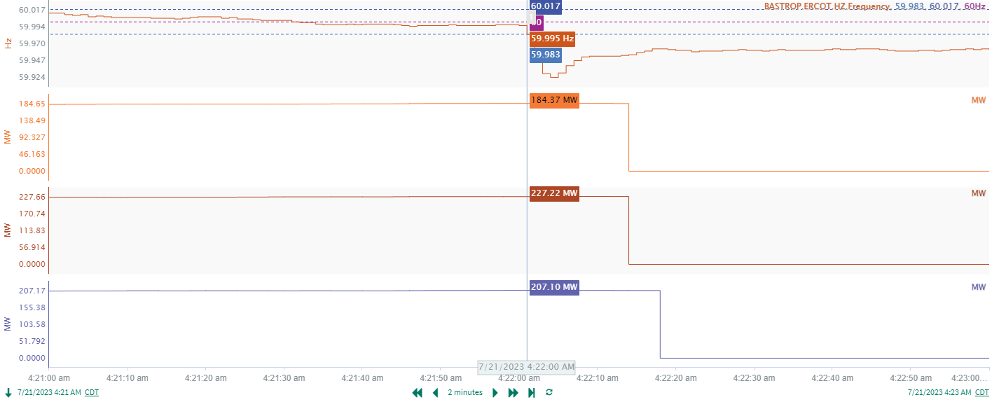
7/21/2023 4:21:59 (Non-FME)
Notes:
A unit tripped offline while carrying approximately 619 MW gen
Starting Frequency: 59.996Hz
Minimum Frequency: 59.924 Hz
A-C Time : 4 seconds
Recovery Time(back to deadband): 6 minutes 58 seconds
ECRS Released: 0 MW
Trip Reason: Unknown
Contextual Information: A total of 160 MW of regulation Up was deployed during the event recovery

Slide 8
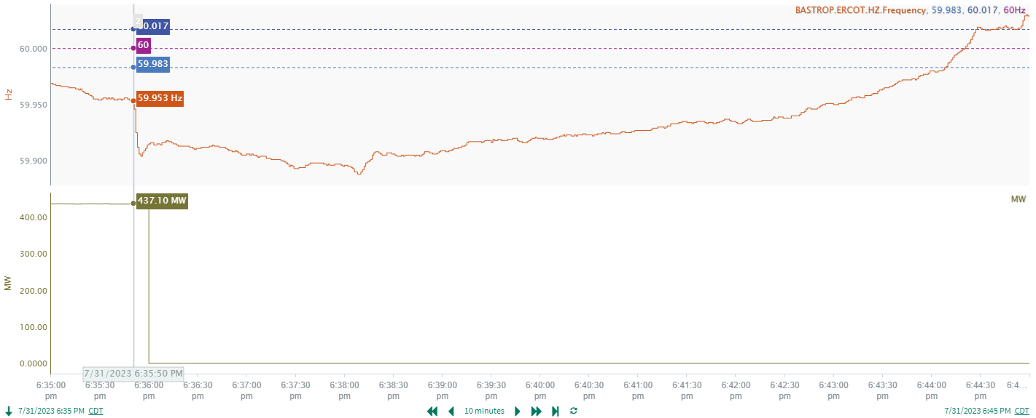
7/31/2023 18:35:50 (Non-FME)
Notes:
A unit tripped offline while carrying approximately 437MW gen
Starting Frequency: 59.953Hz
Minimum Frequency: 59.904 Hz
A-C Time : 5 seconds
Recovery Time(back to deadband): 8 minutes 18 seconds
ECRS Released: 657MW
Trip Reason: Unknown.
Contextual Information: A total of 375 MW of regulation Up was deployed during the event. A 500 MW SCED offset was applied as well, along with multiple manual SCED runs.

Slide 9
Questions?
Thank you!

