Slide 1
ERCOT Updates
NDSWG August 2023
ERCOT
8/14/2023

Slide 2
Topics
Project Updates
NPRR1164 Data Collection Kickoff
Change Request Comment Types
Preparations For End of Summer Restrictions
Manual Contingencies

Slide 3
Project Overview
Active/Upcoming Projects
SCR789 Node/Breaker Modeling for SSWG
Will require coordination between Operations modelers and Planners
Deadline for TDSP-provided data updates is 9/1
Upgrade to NMMS RHEL Operating System
In Planning phase
Upgrades the OS of additional NMMS systems
Upgrade to CIM16
Officially starting in end of August
Key dates and milestones to be determined during planning phase
Upgrades the NMMS database schema to meet the CIM16 standard
Updates the format of the XML models and incremental files

Slide 4
Data Collection for NPRR1164: Synchroscope and Synch Check
NPRR1164’s expected approval date is 10/1
Goal is for updated values to be provided to ERCOT prior to approval date
Bulk Update Process:
(ERCOT to send email with detailed instructions this week)
ERCOT will create TSP-specific spreadsheets pre-populated with currently modeled values
TSPs will review and modify spreadsheet
TSPs will create a CAMR attaching the updated spreadsheet
PLD to be in December
Ongoing Maintenance:
ERCOT is updating template to specifically request this data during instance creation
Future CR submissions should consider these values

Slide 5
Change Request Comments – Message ISO vs. Public Comment
There are two types of comments that can be submitted for Change Requests
Message ISO Only
Changes the CR status
NMMS email notification triggered
Public Comment
Does not change CR status
No notification sent
Use this option for most (all?) use cases

Slide 6
Example - ERCOT has asked TSP a Question in CR
Status of CR is “Additional Action Required”
A reply is needed from TSP to ERCOT
Notes:
TSP view.
ERCOT asks a question via CR in SGEM that needs an answer. ERCOT is either network model coordinator or network model maintenance engineer.

Slide 7
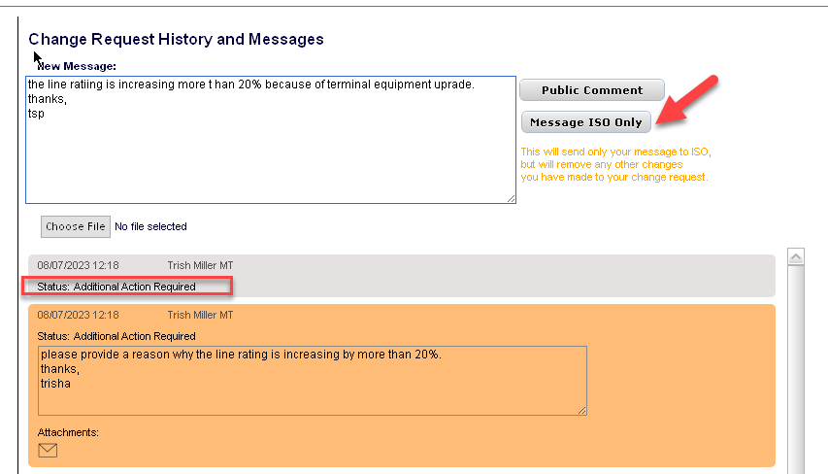
Example - Message ISO Only or Public Comment?
TSP enters reply to ERCOT
TSP selects Message ISO Only button
Notes:
TSP View.
A resubmit of data is not needed, just an answer to a question is needed.

Slide 8
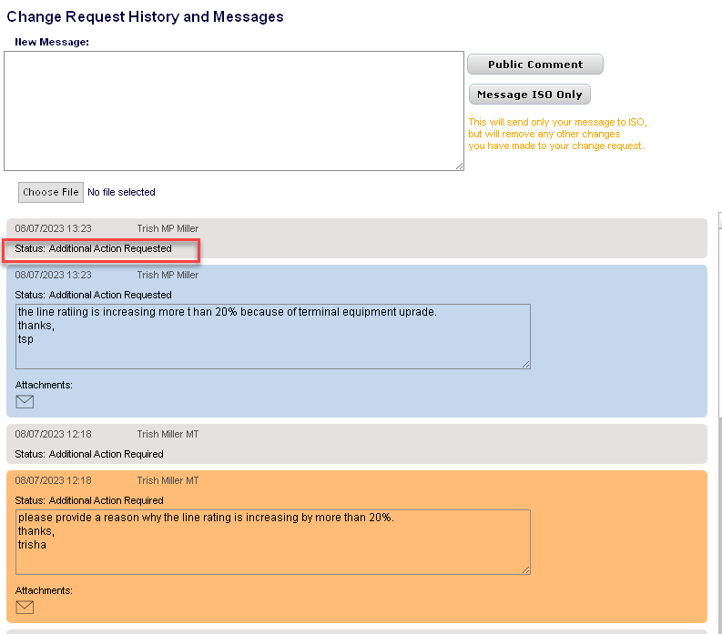
Example - Message Posted
Status of CR is now “Additional Action Requested”
ERCOT knows to review TSP reply
Notes:
TSP View.

Slide 9
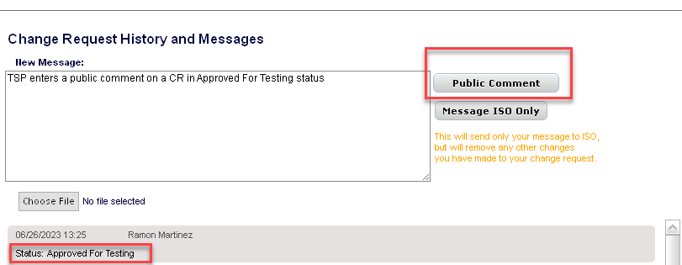
Example - Public Comment added by TSP
Status of CR is “Approved For Testing”
Notes:
TSP View.

Slide 10
Example - Public Comment Posted
Status of CR is still “Approved For Testing”

Slide 11
End of Summer Restrictions – Managing DPCs
TSPs should avoid defining manual contingencies through the DPC process
Summer outage restrictions will conclude on 9/15
There will be an increase in project work and energizations
Managing these energizations require before/after modeling
Manual contingencies must also be considered during these transitions
Review project phases to ensure all manual contingencies are modeled ahead of time
If done correctly, all manual-contingency-DPCs should be for enabling/disabling existing definitions

Slide 12
Supplemental Slides

Slide 13
CIM16 Project – Upgrading from CIM10 to CIM16
ERCOT produces Network Models following CIM standards and in an XML format
Since 2010, the Network Model Management System (NMMS) produces models using the CIM10 schema (with customizations)
In 2021, a process was developed a post-process to translate a CIM10 models into CIM16 allowing for downstream systems to upgrade their importers
ERCOT is formalizing a project to enhance NMMS to natively produce CIM16 model files
Reduce the need for ERCOT-specific legacy code in vendor applications
Currently collecting vendor estimates and determining resource loading
Tentatively scheduled to start in first half of 2023
Project duration is estimated at 18-24 months
ERCOT will no longer produce CIM10 models after project completion

Slide 14
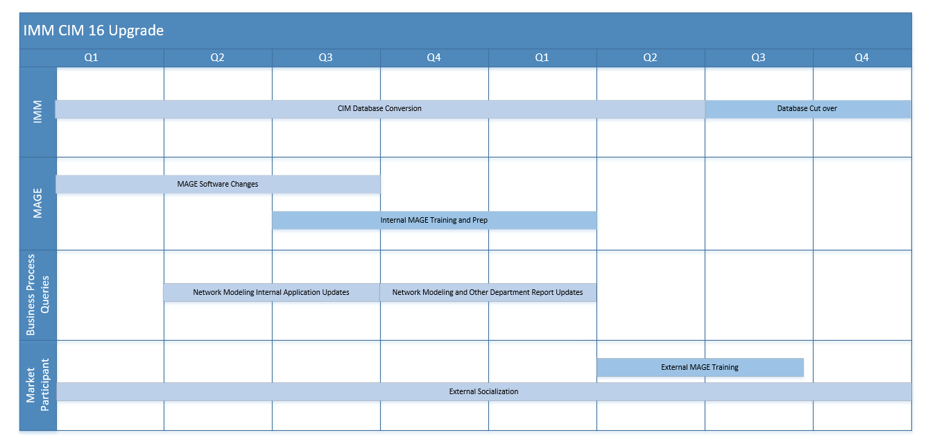
Estimated CIM 16 Project Timeline - Two Year Duration
Sample full CIM16 file already posted to Citrix folder
Incremental files will not be available until later in the timeline

Slide 15
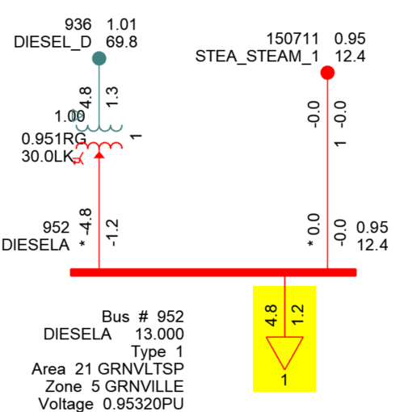
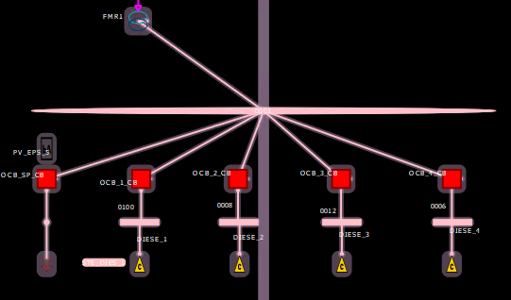
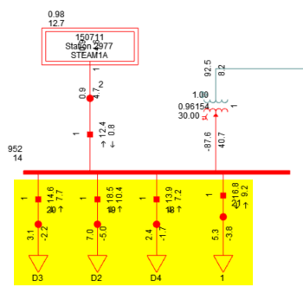
SSWG NOMCR Example: Deconsolidating Shunt Devices
Bus-Branch
The PSSE ID of many shunt devices must be updated to avoid consolidation during topology processing
Topology Processing
Loads are consolidated if their PSSE IDs are the same
Node-Breaker
Example: The operations model has 4 loads connected to the same Connectivity Node Group
Loads remain unaggregated if their PSSE IDs are different

Slide 16
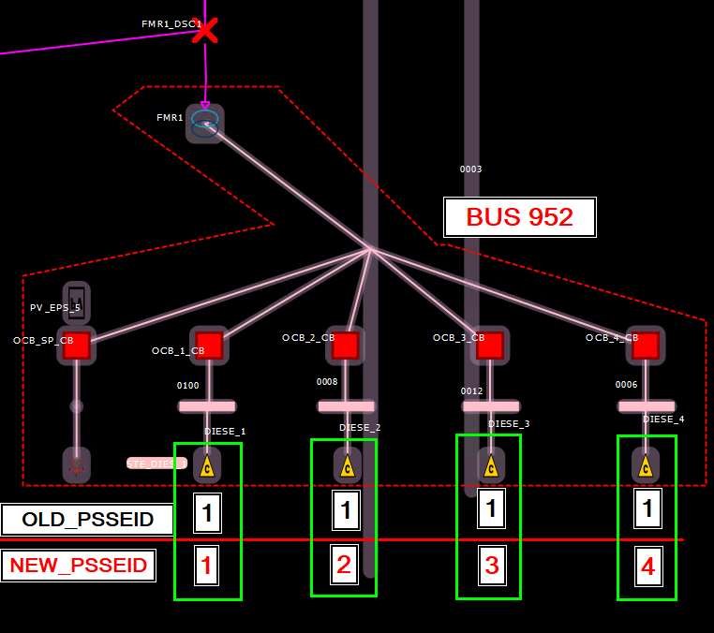
SSWG NOMCR Example: Deconsolidating Shunt Devices
Ongoing submissions must consider collisions with pre-existing PSSE IDs at the same ConnectivityNodeGroup

Slide 17
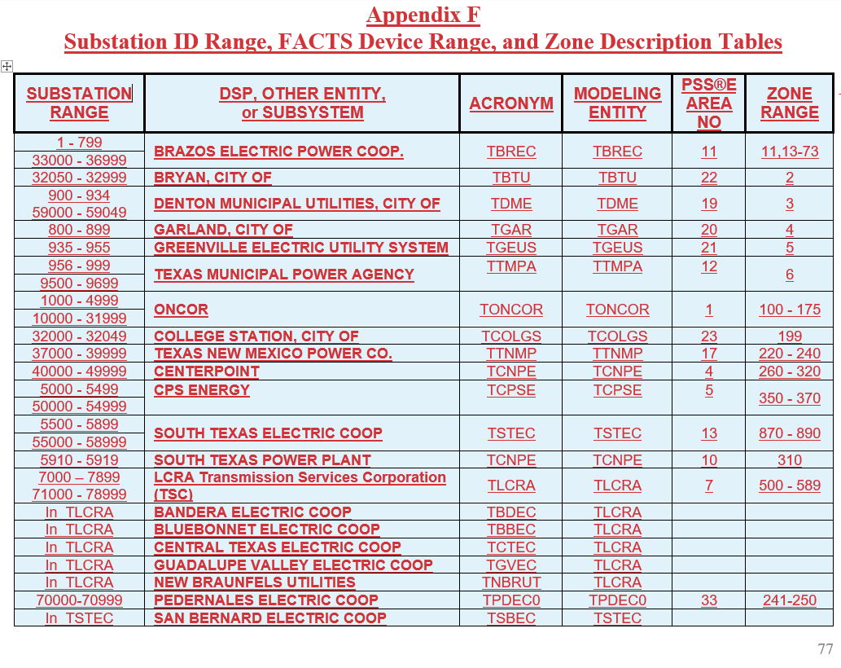
SSWG NOMCR Example: Substation Numbering
The Topology Processor will use the PSSE ID of Substation instances when creating node/breaker Planning models.

Slide 18
NPRR1164 – New Definitions
NPRR1164 creates 4 new definitions in section 2.1

Slide 19
NPRR1164 – 3.14.2 Updates

Slide 20
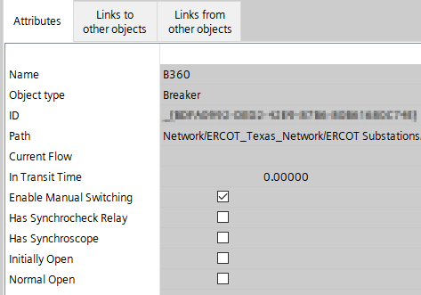
NPRR1164 – Updating in NMMS
Metrics from Network Operations Model:
Circuit Breakers (18,670)
Synchronism Check Relay: 286
Synchroscope: 1,341
Both: 158
Disconnectors (45,850)
Synchronism Check Relay: 0
Synchroscope: 0
Both: 0
Breaker and Disconnector instances already have attributes to hold this information

