Slide 1
Credit Exposure Update
Credit Finance Sub Group
ERCOT Public
August 2023

Slide 2
Monthly Highlights June 2023 – July 2023
Market-wide average Total Potential Exposure (TPE) increased from $1.46 billion in June 2023
to $2.66 billion in July 2023
TPEA increased due mostly to higher forward adjustment factors
Discretionary Collateral is defined as Secured Collateral in excess of TPE,CRR Locked ACL and DAM Exposure
Average Discretionary Collateral increased from $3.66 billion in June 2023 to $4.43 billion in July 2023
No unusual collateral call activity

Slide 3
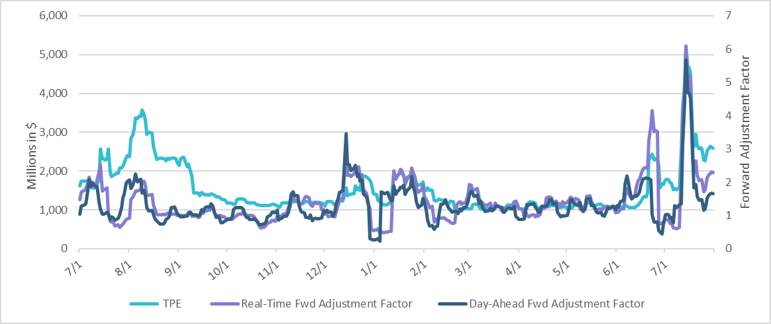
TPE and Forward Adjustment Factors Jul 2022 - Jul 2023
*TPE adjusted to exclude short pay entities eliminating data skew

Slide 4
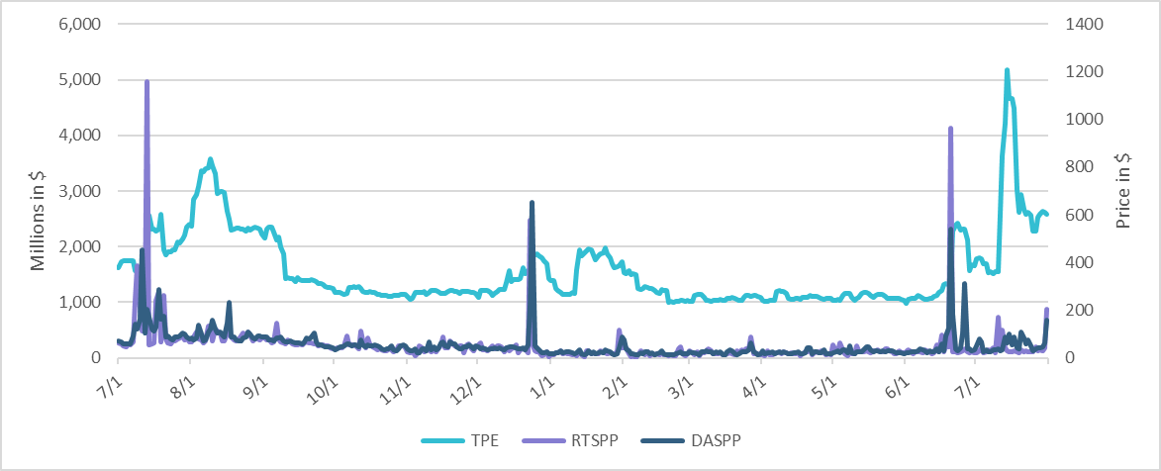
TPE/Real-Time & Day-Ahead Daily Average Settlement Point Prices for HB_NORTH Jul 2022 - Jul 2023
* TPE adjusted to exclude short pay entities eliminating data skew

Slide 5
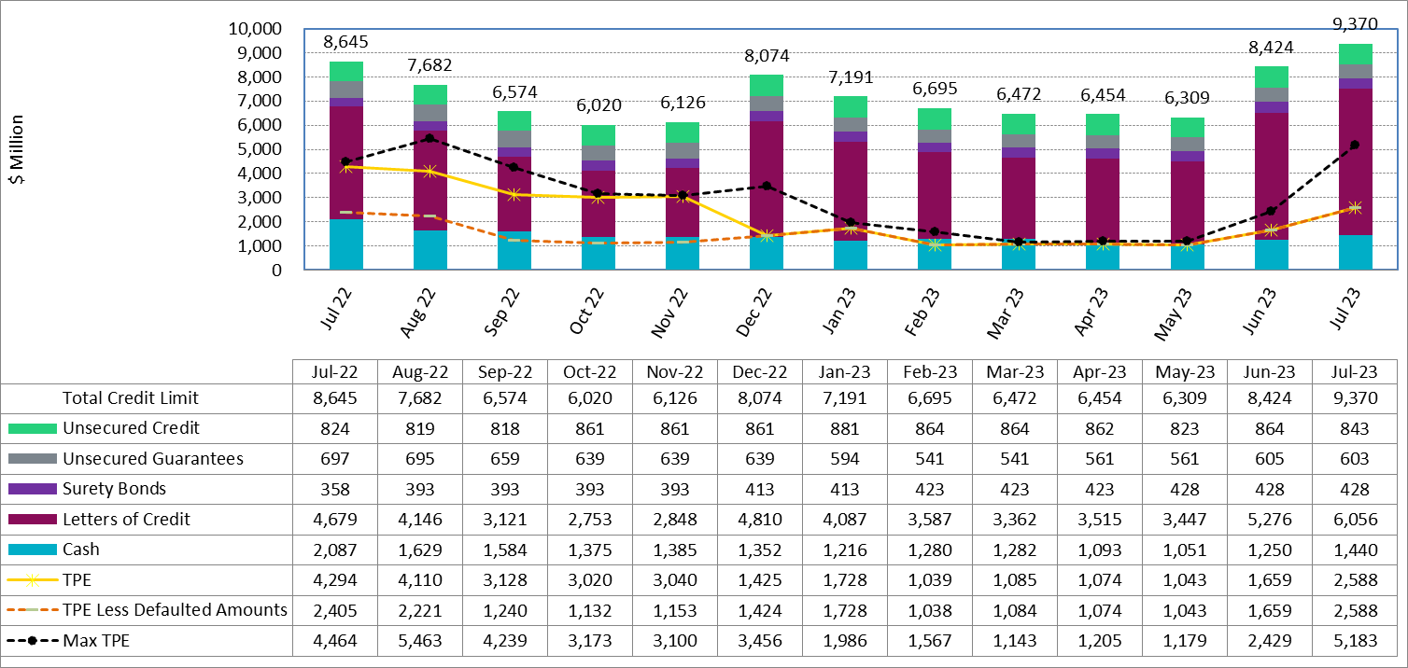
Available Credit by Type Compared to Total Potential Exposure (TPE) Jul 2022- Jul 2023
Numbers are as of month-end except for Max TPE
Max TPE is the highest TPE for the corresponding month
TPE less Defaulted Amounts: TPE – Short-Paid Invoices

Slide 6
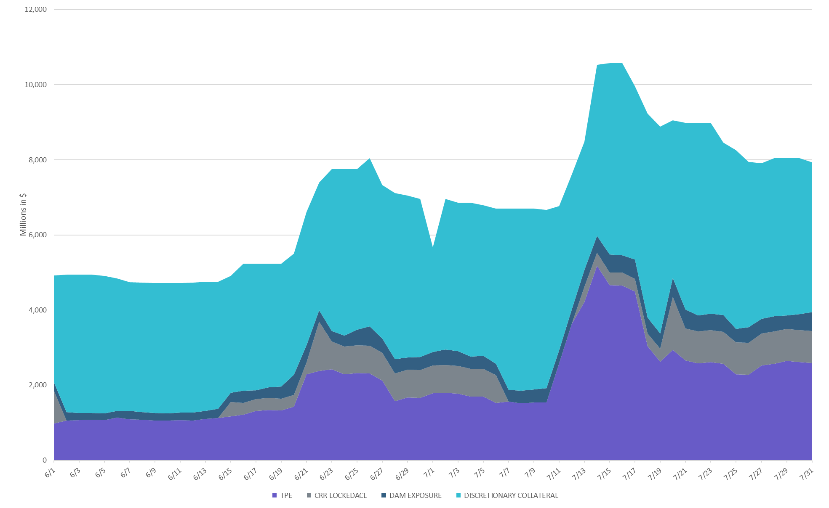
Discretionary Collateral Jun 2023 - Jul 2023
* Discretionary Collateral adjusted to exclude short pay amounts eliminating data skew

Slide 7
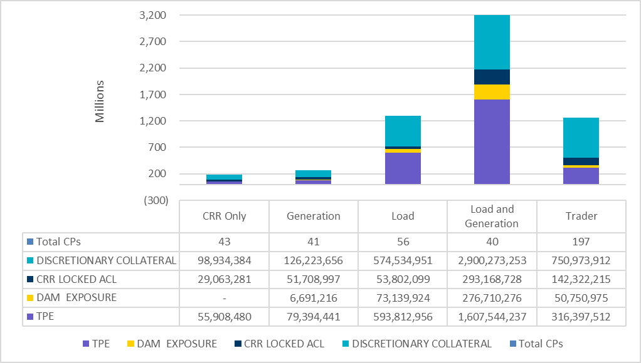
TPE and Discretionary Collateral by Market Segment - Jul 2023*
Load and Generation entities accounted for the largest portion of discretionary collateral
*Discretionary collateral doesn’t include Unsecured Credit Limit or parent guarantees

Slide 8
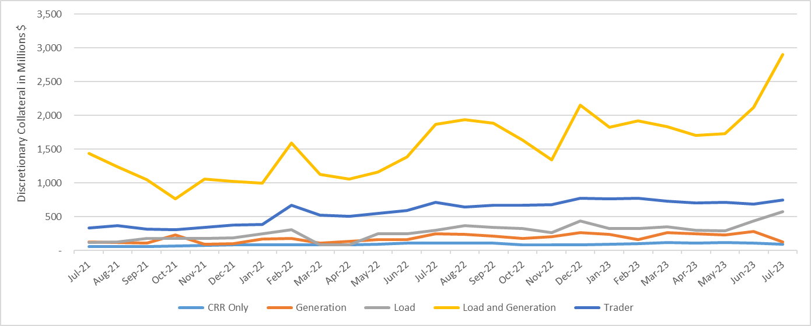
Discretionary Collateral by Market Segment Jul 2021 - Jul 2023
* Discretionary Collateral adjusted to exclude short pay amounts eliminating data skew

Slide 9
TPEA Coverage of Settlements Jun 2022 - Jun 2023
Invoice Exposure | Historical | Future
Existing Invoice Exposure | RTLCNS + UDAA | M1 Days (including current day) Forward Charge Invoice Amounts
New Invoice Exposure | 7 Days Back Net Invoice Amounts (Charges & Credits) | M1 Days (including current day) Forward Net Invoice Amounts (Charges & Credits); Excluding: 1) Securitization Invoices; 2) CRR Auction Invoices; and 3) Subchapter N Funds Distribution Invoice
TPEA closely approximates actual/invoice exposure
TPEA adjusted to exclude short pay entities eliminating data skew

Slide 10
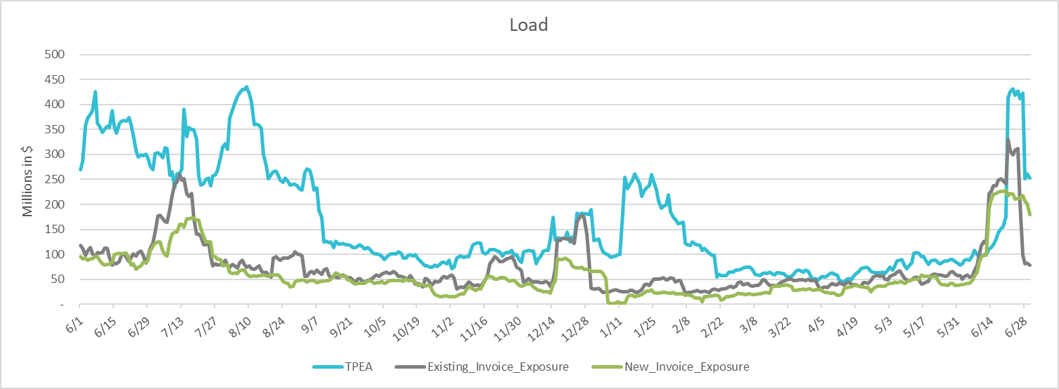
TPEA Coverage of Settlements Jun 2022 - Jun 2023
Invoice Exposure | Historical | Future
Existing Invoice Exposure | RTLCNS + UDAA | M1 Days (including current day) Forward Charge Invoice Amounts
New Invoice Exposure | 7 Days Back Net Invoice Amounts (Charges & Credits) | M1 Days (including current day) Forward Net Invoice Amounts (Charges & Credits); Excluding: 1) Securitization Invoices; 2) CRR Auction Invoices; 3) Subchapter N Funds Distribution Invoice
*TPEA exceeds invoice exposure
*TPEA adjusted to exclude short pay entities eliminating data skew

Slide 11
TPEA Coverage of Settlements Jun 2022 - Jun 2023
Invoice Exposure | Historical | Future
Existing Invoice Exposure | RTLCNS + UDAA | M1 Days (including current day) Forward Charge Invoice Amounts
New Invoice Exposure | 7 Days Back Net Invoice Amounts (Charges & Credits) | M1 Days (including current day) Forward Net Invoice Amounts (Charges & Credits); Excluding: 1) Securitization Invoices; 2) CRR Auction Invoices; 3) Subchapter N Funds Distribution Invoice
*TPEA generally exceeds invoice exposure

Slide 12
TPEA Coverage of Settlements Jun 2022 - Jun 2023
Invoice Exposure | Historical | Future
Existing Invoice Exposure | RTLCNS + UDAA | M1 Days (including current day) Forward Charge Invoice Amounts
New Invoice Exposure | 7 Days Back Net Invoice Amounts (Charges & Credits) | M1 Days (including current day) Forward Net Invoice Amounts (Charges & Credits); Excluding: 1) Securitization Invoices; 2) CRR Auction Invoices; 3) Subchapter N Funds Distribution Invoice
Invoice exposure generally exceeds TPEA
TPEA adjusted to exclude short pay entities eliminating data skew

Slide 13
TPEA Coverage of Settlements Jun 2022 - Jun 2023
Invoice Exposure | Historical | Future
Existing Invoice Exposure | RTLCNS + UDAA | M1 Days (including current day) Forward Charge Invoice Amounts
New Invoice Exposure | 7 Days Back Net Invoice Amounts (Charges & Credits) | M1 Days (including current day) Forward Net Invoice Amounts (Charges & Credits); Excluding: 1) Securitization Invoices; 2) CRR Auction Invoices; 3) Subchapter N Funds Distribution Invoice
* TPEA generally exceeds Invoice exposure

Slide 14
TPES Coverage of Settlements Jun 2022 - Jun 2023
Invoice Exposure | Historical | Future
Existing Invoice Exposure | RTLCNS + UDAA | M1 Days (including current day) Forward Charge Invoice Amounts
New Invoice Exposure | 7 Days Back Net Invoice Amounts (Charges & Credits) | M1 Days (including current day) Forward Net Invoice Amounts (Charges & Credits); Excluding: 1) Securitization Invoices; 2) CRR Auction Invoices; 3) Subchapter N Funds Distribution Invoice
*TPES exceeds actual/invoice exposure

Slide 15
Questions

