Slide 1
Monthly Review of Reliability Unit Commitment Market Impacts – July 2023
Wholesale Market Working Group
ERCOT Staff

Slide 2
RUC Resource-Hours
July 2023 | Total | Opt-Out | Non-Opt-Out
Instructed Resource-Hours
Total Count | 196.0 | 67.0 | 129.0
Effective Resource-Hours*
Total Count | 180.8 | 66.8 | 113.9
Average LSL | 29.7 | 34.5 | 26.9
Average LDL | 74.2 | 133.9 | 38.6
Average BP | 81.3 | 148.3 | 41.4
Average HSL | 162.2 | 220.3 | 127.5
* The difference between “Instructed” and “Effective” values is a result of Resources starting up, shutting down, receiving partial hour instructions, or otherwise not being dispatchable by SCED.

Slide 3
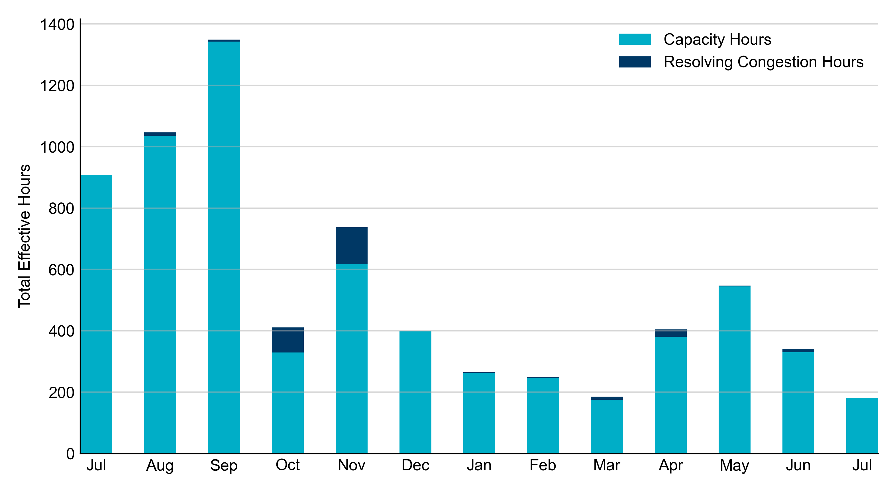
RUC Instruction Reasons: Last 13 Months RUCs in July 2023 were primarily driven by system-wide capacity concerns.

Slide 4
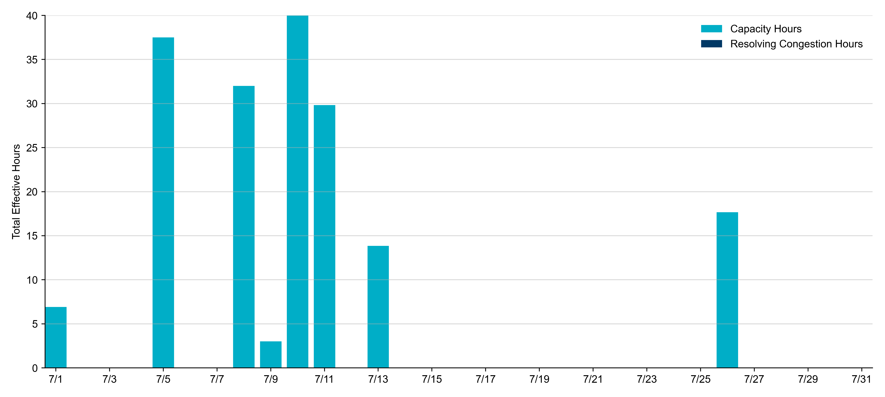
RUC Instruction Reasons in July 2023
180.8 effective RUC Resource-hours.
100% hours for capacity concerns.

Slide 5
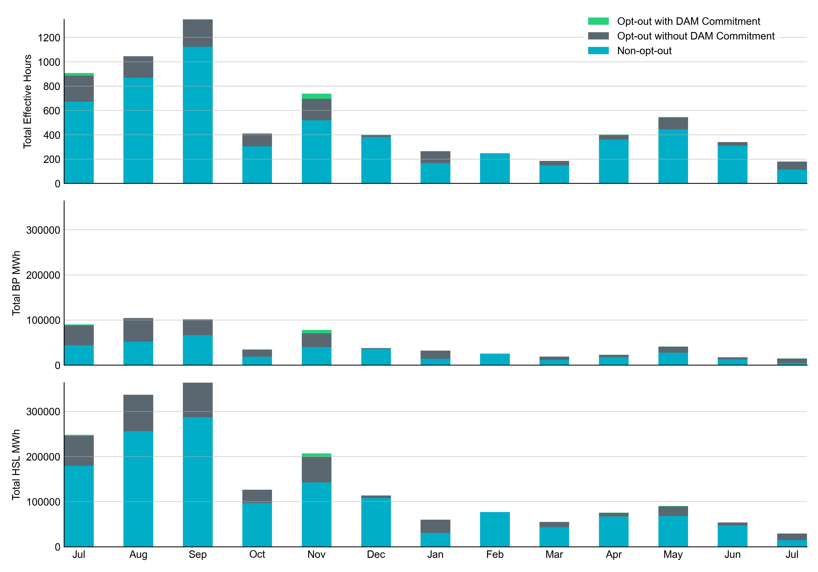
Non-opt-out and Opt-out Totals: Last 13 Months July 2023 had a total of 113.9 non-opt-out effective Resource-hours (63.03%) and 66.8 opt-out effective Resource-hours (36.97%).

Slide 6
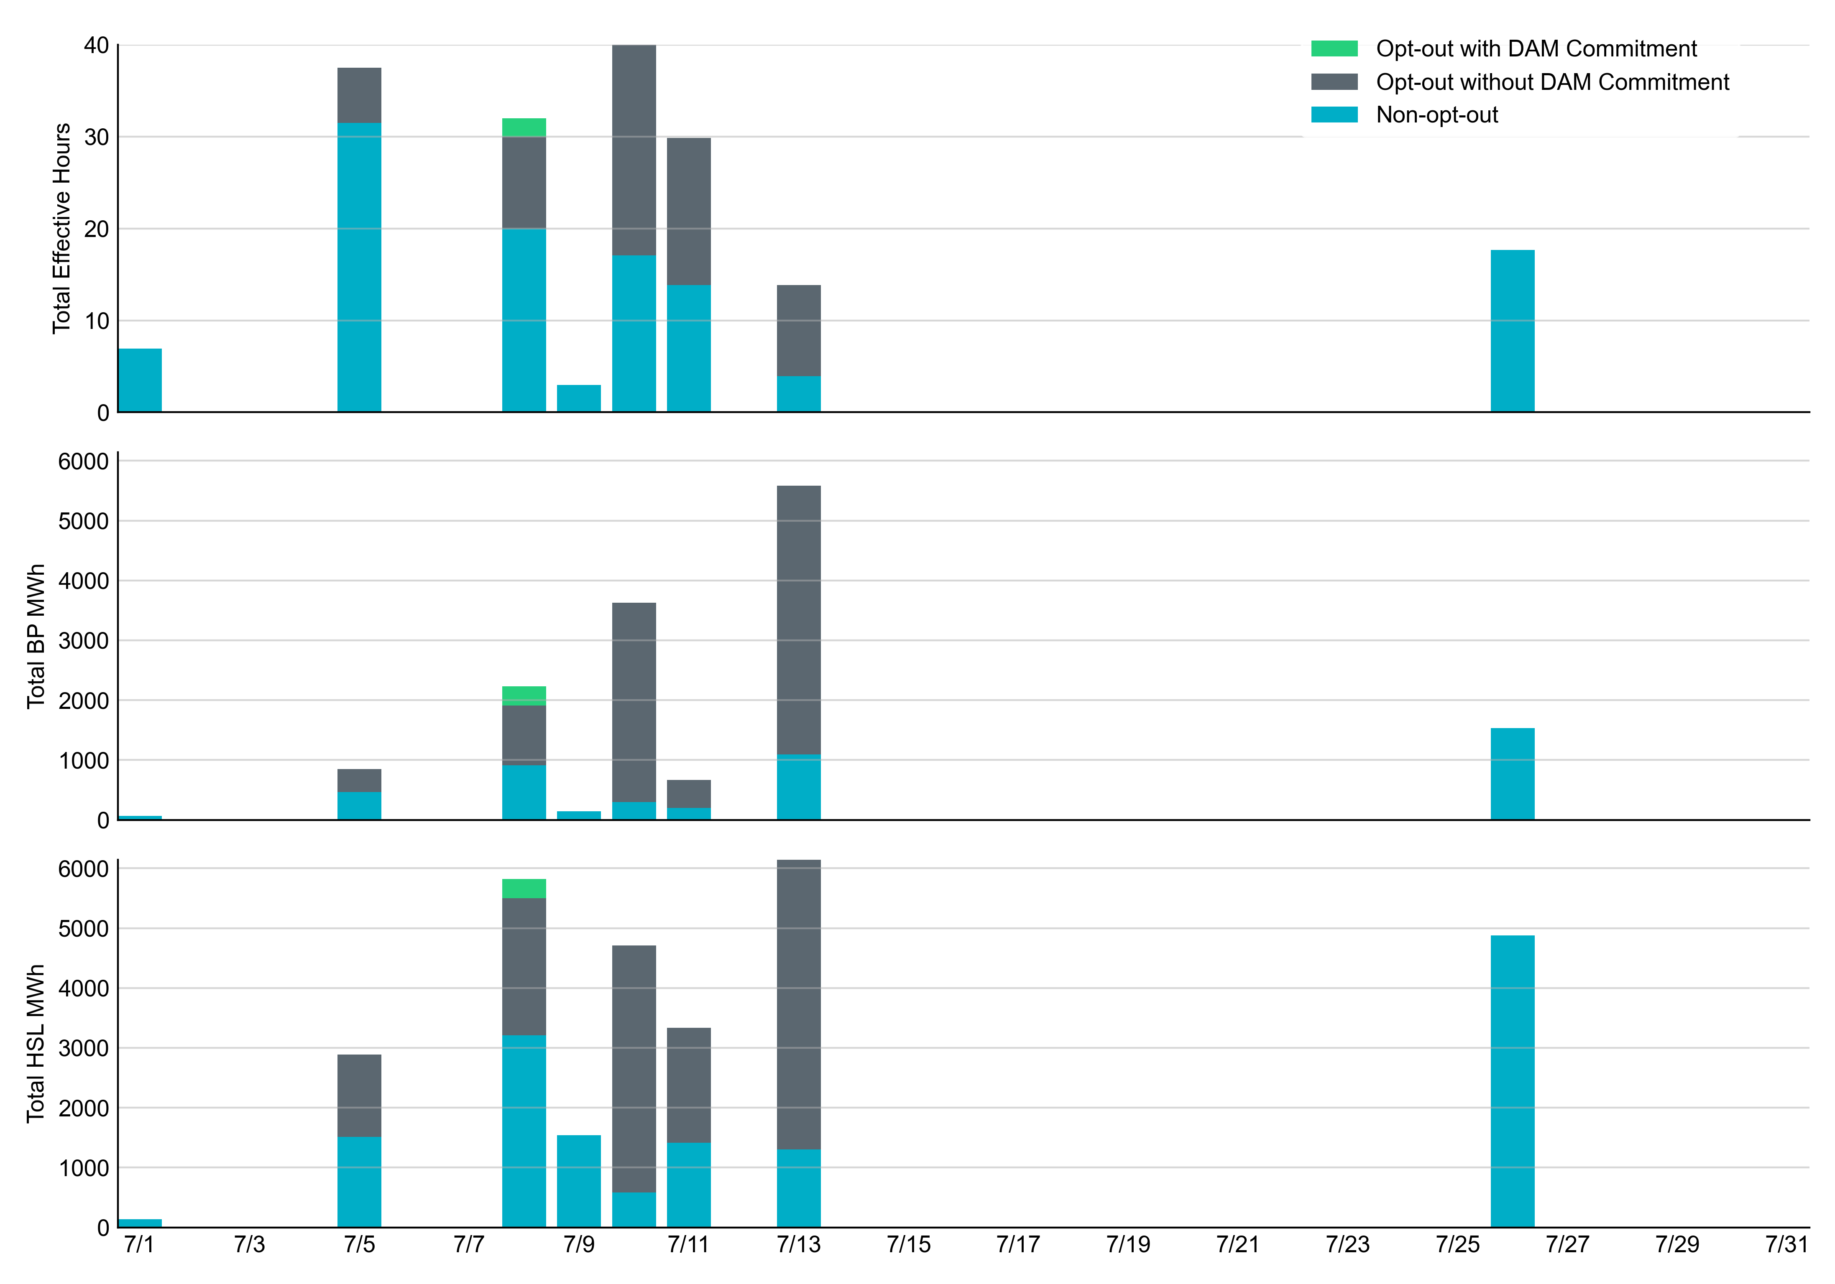
Non-opt-out and Opt-out Totals: July 2023

Slide 7
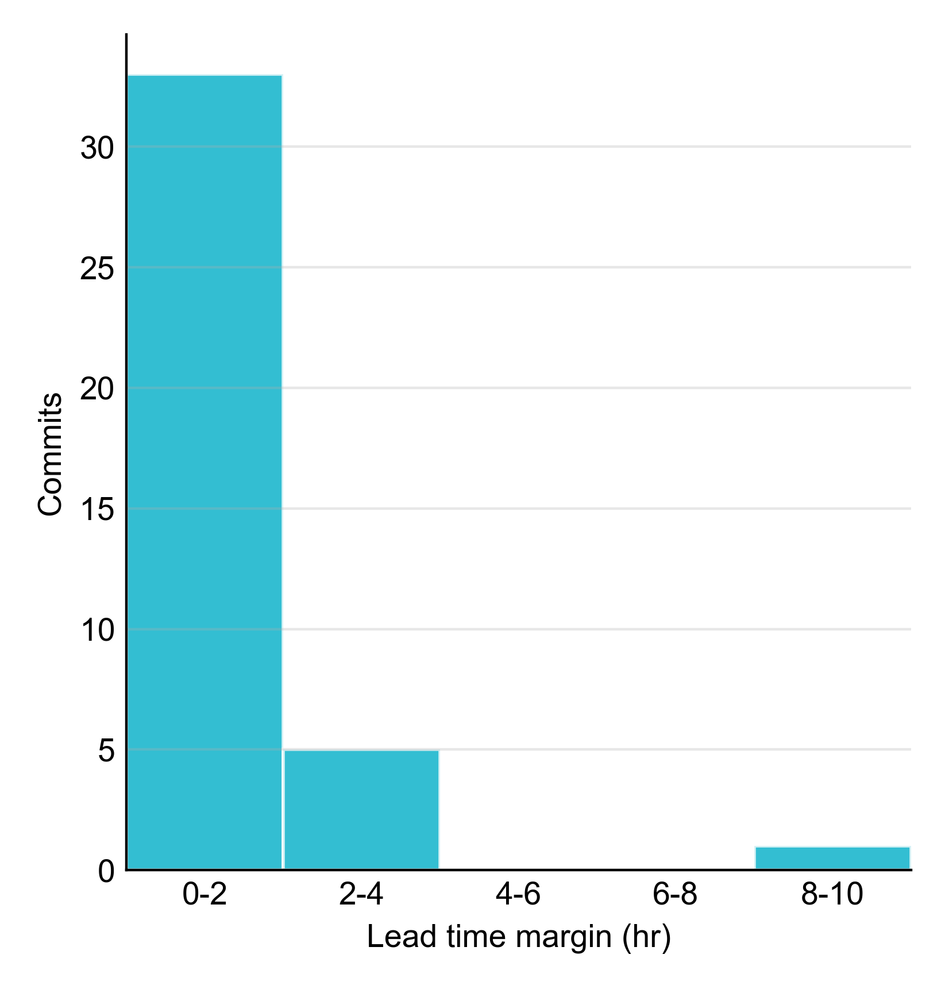
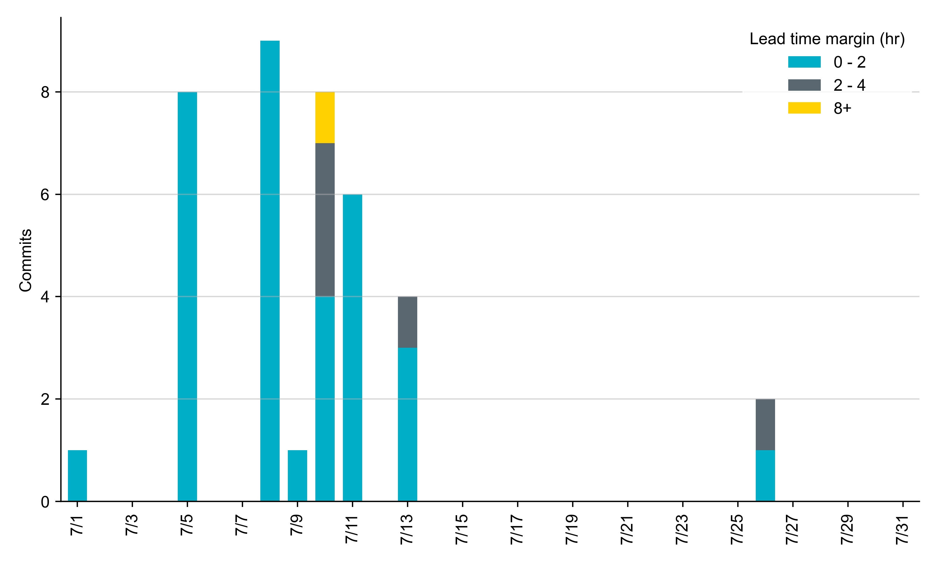
RUC Lead Time Margin: July 2023
Most RUC commit windows had lead time margin at or below 4 hours.
Lead time refers to the length of time between a RUC instruction and the start of the commitment window.
Lead time margin is the difference between lead time and the Resource’s startup time.
In cases where a Resource is committed for multiple back-to-back time blocks, lead time margin is calculated from the first instruction.
Notes:
The first bin is both-inclusive (i.e. [0, 2] ), while subsequent bins are left-inclusive (i.e. [2, 3), [3, 4), etc.).

Slide 8
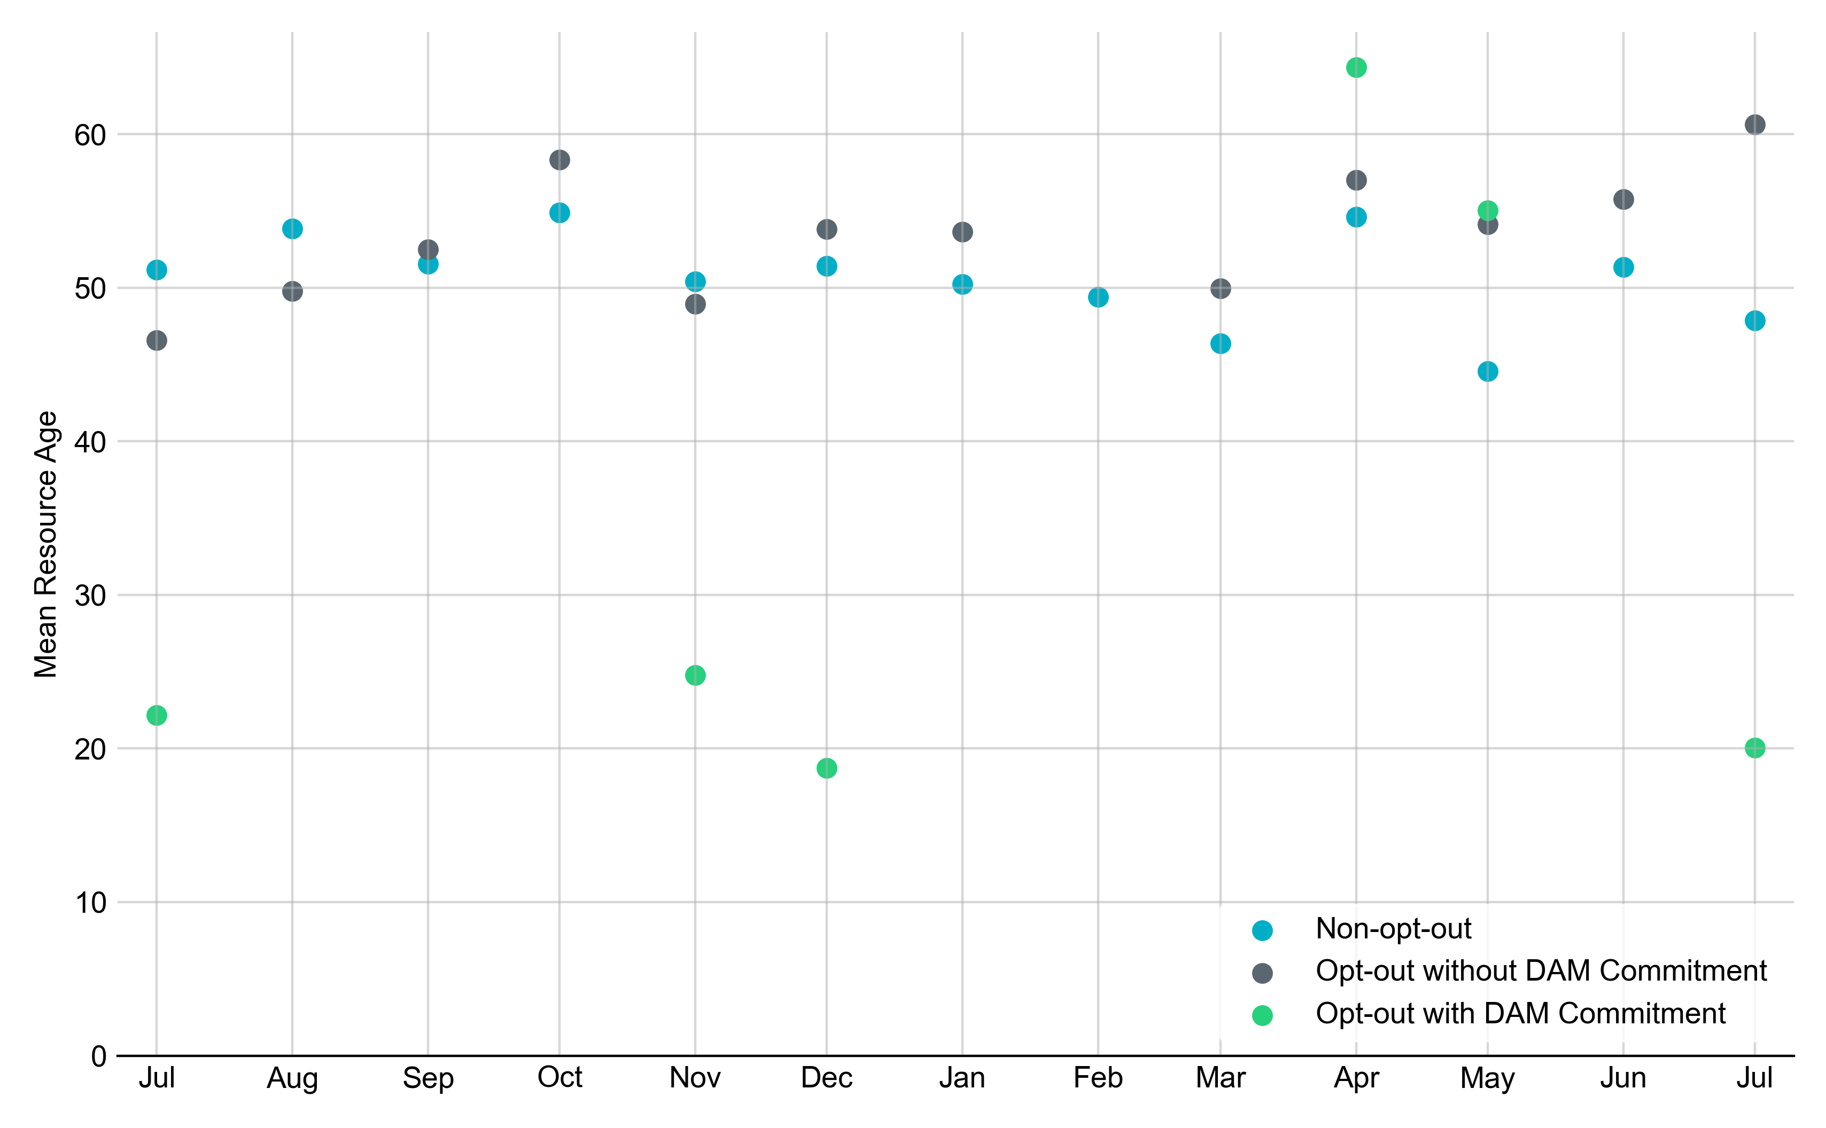
Average Resource Age: Last 13 Months In July 2023, the mean age of RUC-committed Resources was 47.9 years for Non-Opt-Out Resource-hours and 60.6 years for Opt-Out Resource-hours without DAM Commitments.
Note: For Resource configurations with multiple physical generators, the age of the oldest generator is used.

Slide 9
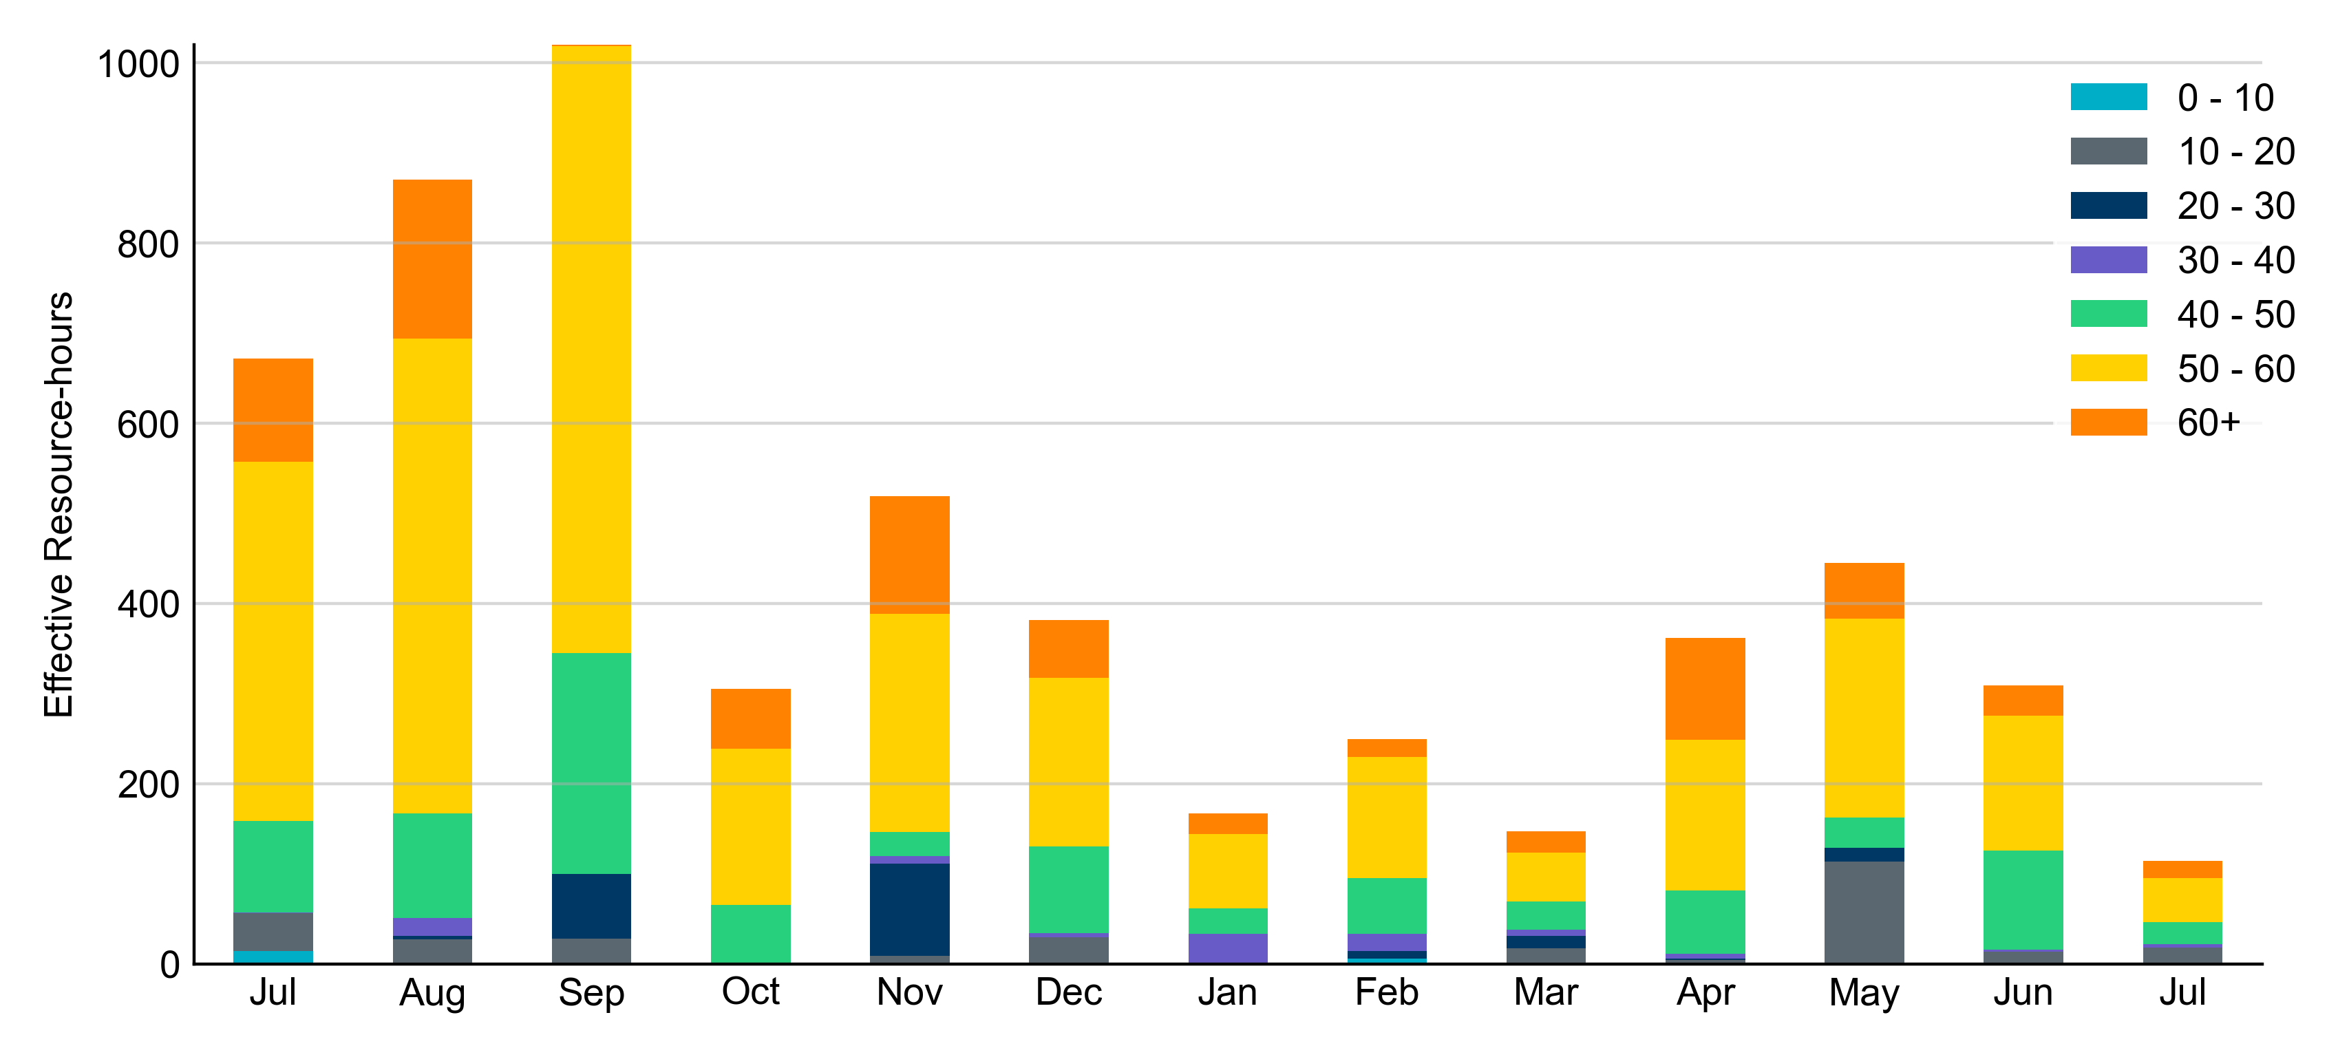
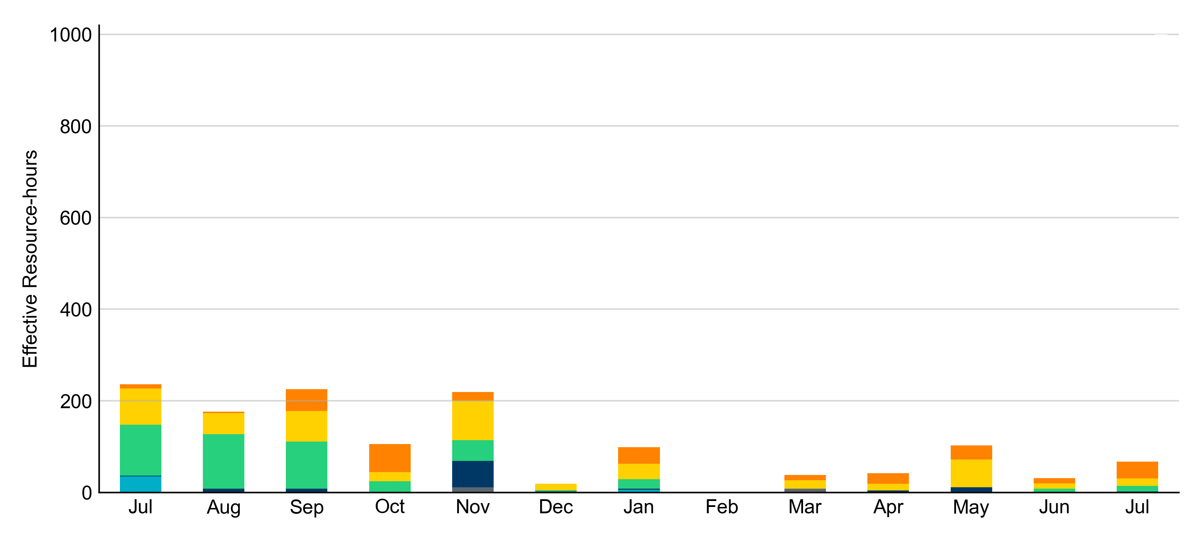
Age Category: Last 13 Months Most RUC-Committed Resources in July 2023 were older than 40 years.
Non-opt-out
Opt-out

Slide 10
RUC-Instructed Resource Dispatch above LDL
July 2023
When Resources did not successfully opt out, there were 9.9 effective Resource-hours for which the Resource was dispatched above its LDL.
For 5.2 of these Resource-hours, the LMP for the RUC-instructed Resource was above the RUC offer floor.
For 4.7 of these Resource-hours, the LMP for the RUC-instructed Resource was below the RUC offer floor.
For all these Resource-hours, the RUC-instructed Resource was mitigated.
There were no Exceptional Fuel Cost submissions for any RUC-Committed Resources in July 2023.

Slide 11
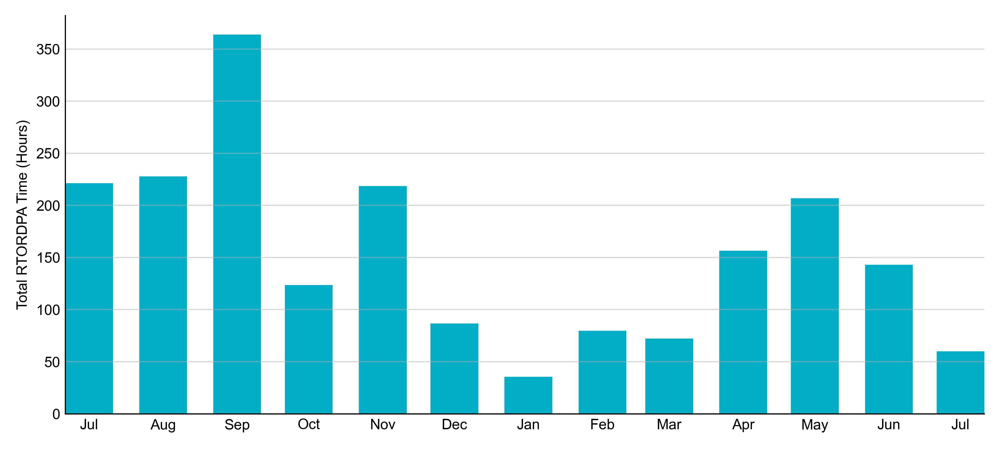
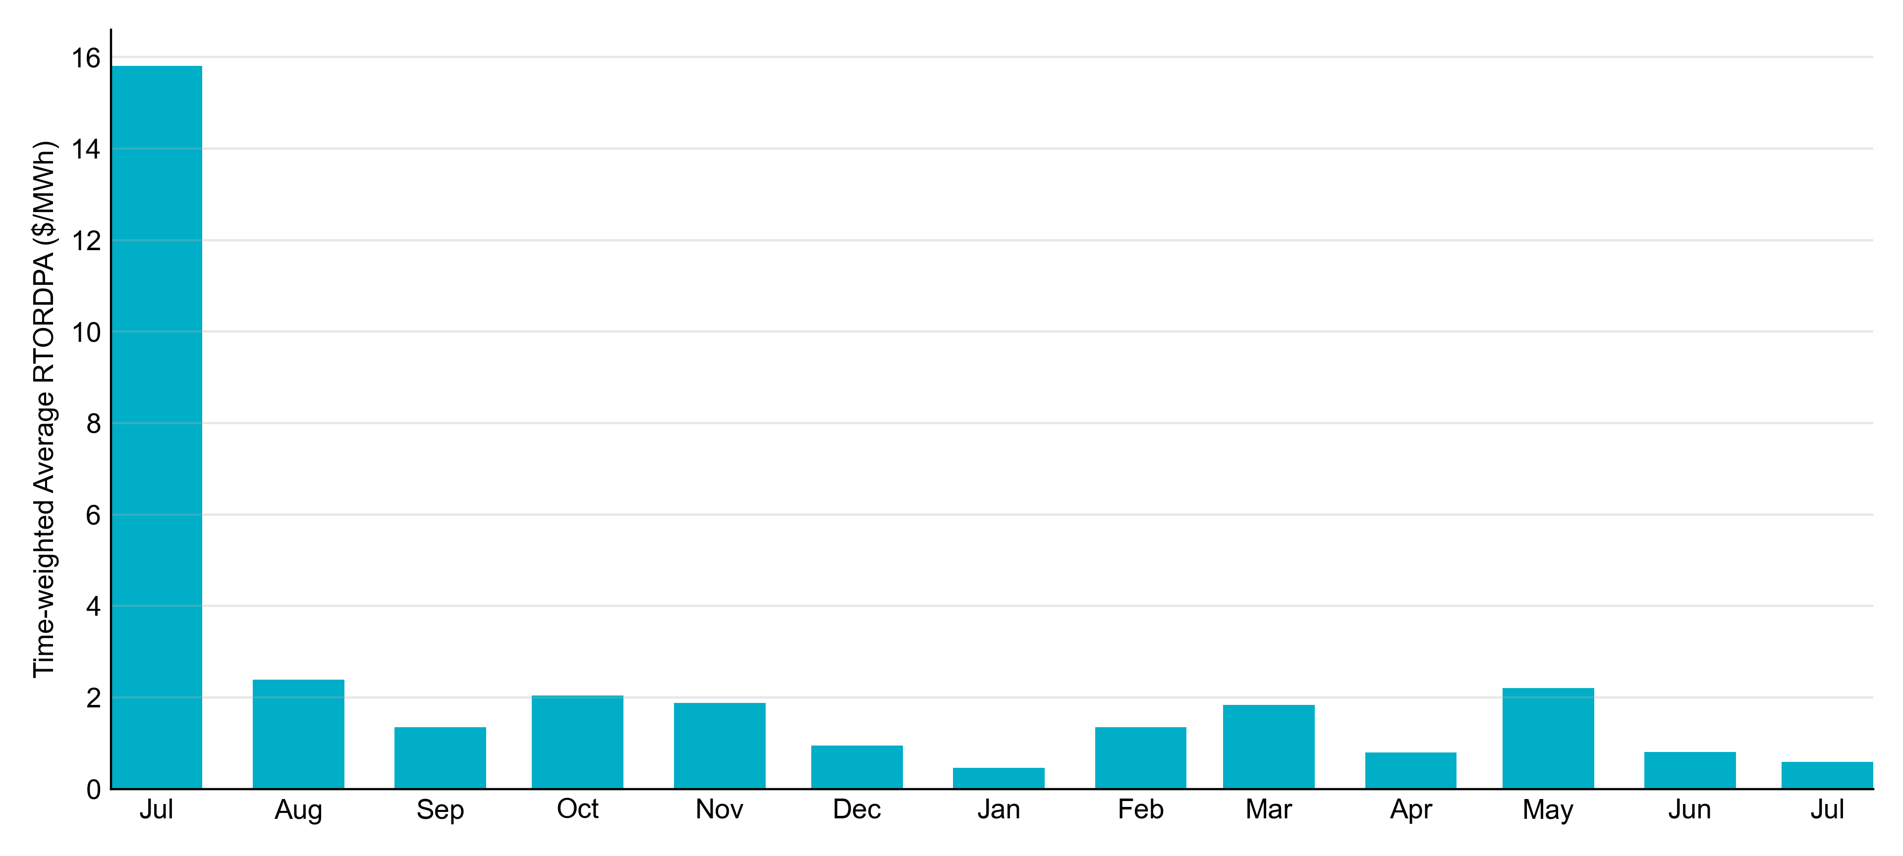
Reliability Deployment Price Adder: Last 13 Months July 2023 had a total of 59.95 RTORDPA hours with an average value of $0.59/MWh.

Slide 12
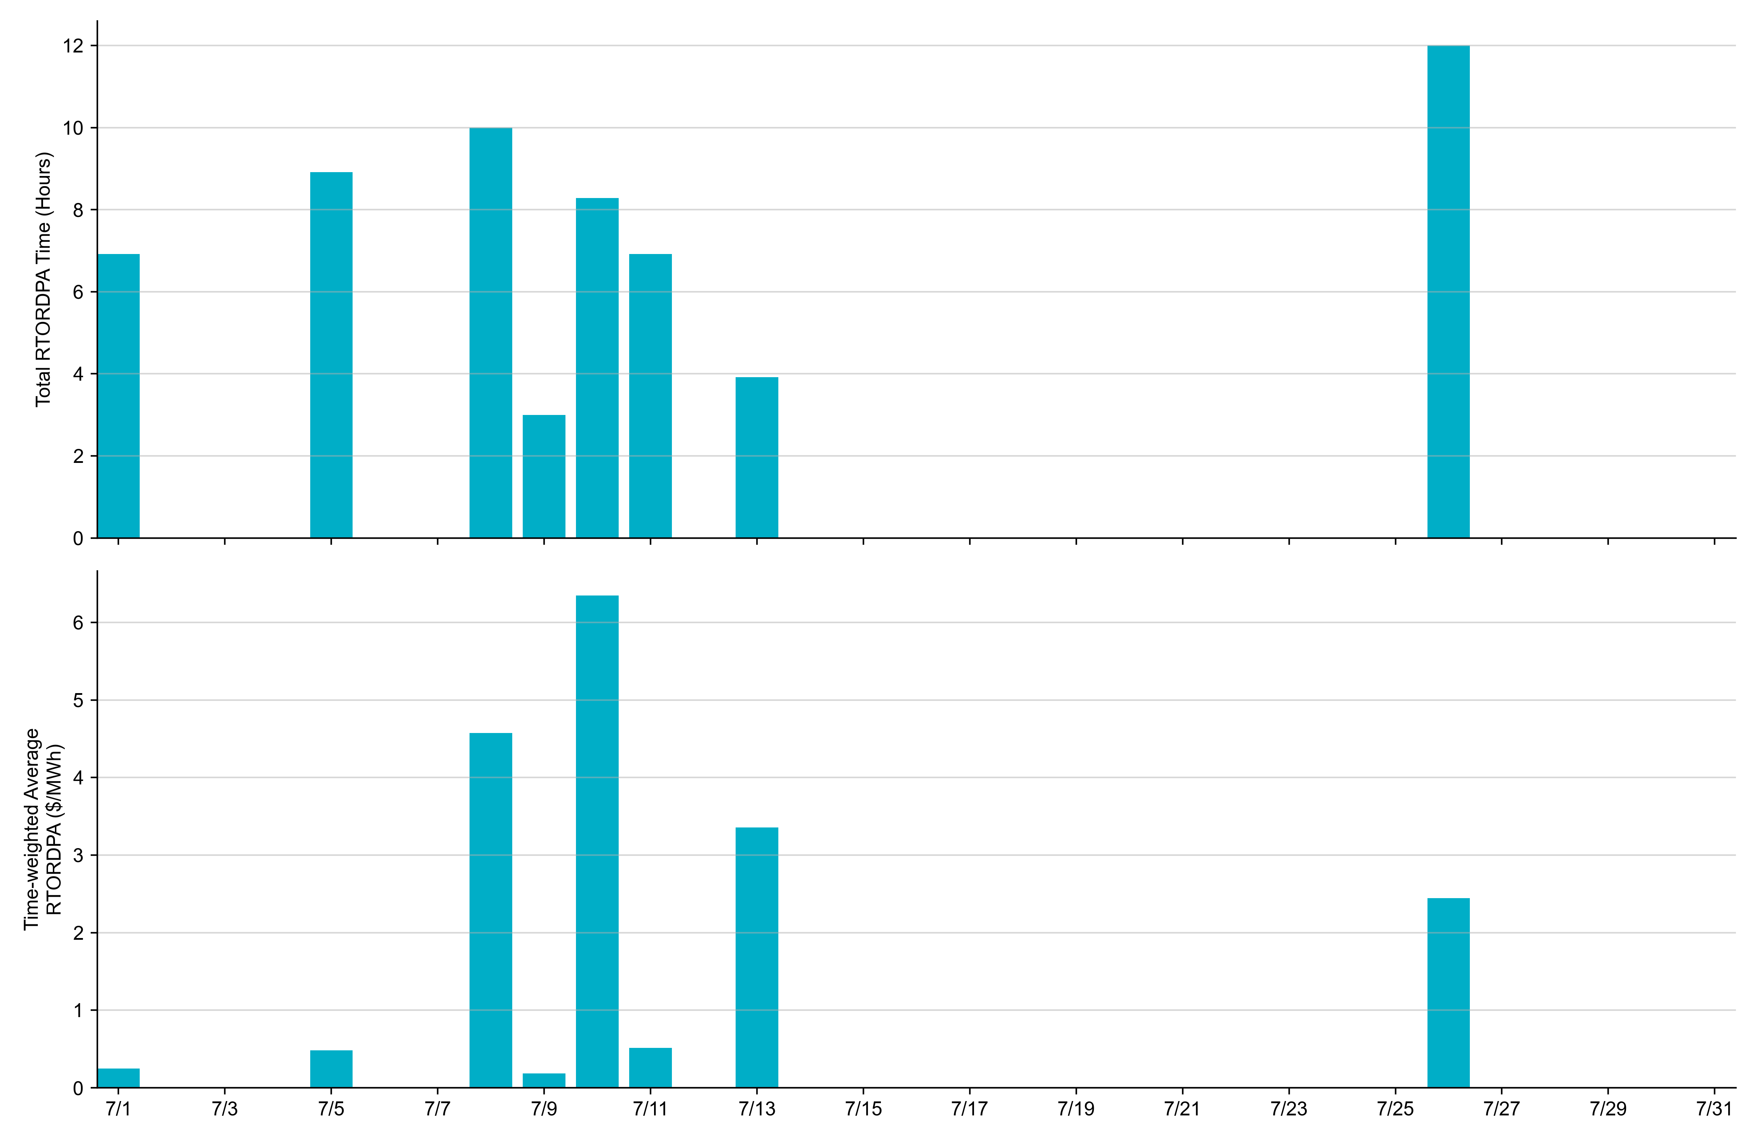
Reliability Deployment Price Adder: July 2023 OD 7/10 had the highest daily time-weighted average RTORDPA: $6.35/MWh.

Slide 13
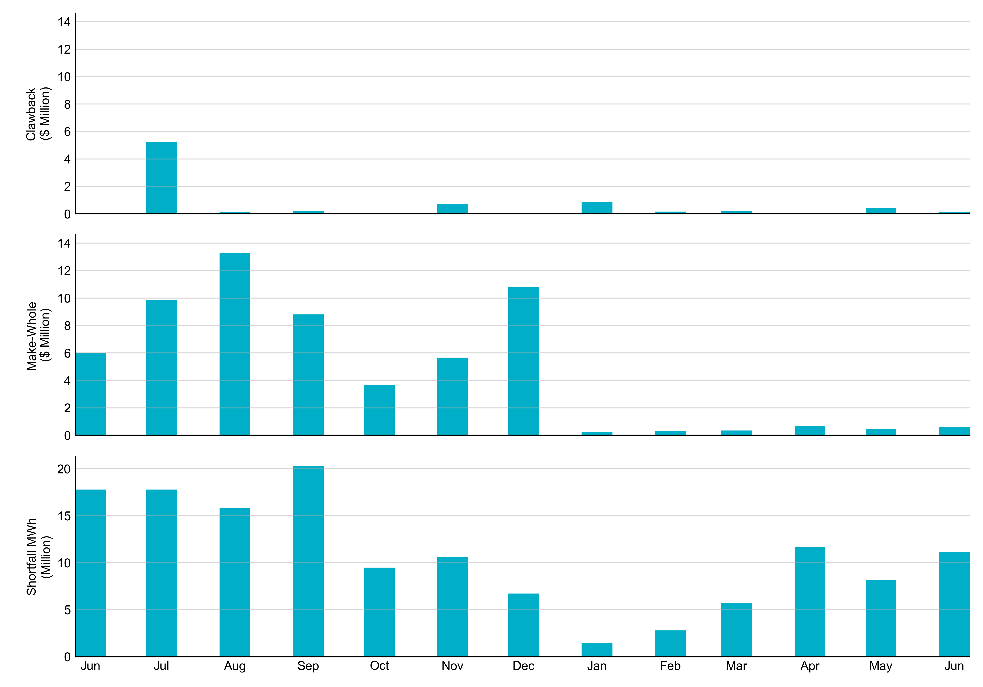
RUC Clawback, Make-Whole, and Shortfall For July 2023, the total Clawback charge was $0.219M. The total Make-Whole payment was $0.162M, which was almost entirely covered through capacity-short charges.
Of the $0.162M in Make-Whole paid out in July 2023, $0.92 was uplifted to load due to rounding.
The remaining amount was collected through Capacity Short Charges.
Data as of August 8th, 2023

Slide 14
RUC Make-Whole by Settlement Type
Month | Initial Settlement ($) | Final Settlement Change ($) | True-up Settlement Change ($) | Net as of August 8, 2023 ($)
Jul '22 | -1,282,874 | 0 | -8,558,242 | -9,841,116
Aug '22 | -3,464,254 | 0 | -9,809,538 | -13,273,792
Sep '22 | -4,666,217 | 0 | -4,139,983 | -8,806,200
Oct '22 | -851,291 | -37,747 | -2,785,833 | -3,674,871
Nov '22 | -809,352 | 0 | -4,855,881 | -5,665,233
Dec '22 | -1,479,207 | 0 | -9,288,953 | -10,768,159
Jan '23 | -141,639 | -59,381 | -100,426 | -301,446
Feb ‘23 | -295,131 | 0 | - | -295,131
Mar ‘23 | -343,491 | 0 | - | -343,491
Apr ‘23 | -687,506 | 0 | - | -687,506
May ‘23 | -426,974 | 0 | - | -426,974
Jun ‘23 | -600,652 | - | - | -600,652
Jul ‘23 | -161,994 | - | - | -161,994
Negative dollars represent a payment from ERCOT to a market participant
“-” indicates settlement has yet to be completed.

Slide 15
RUC Clawback by Settlement Type
Month | Initial Settlement ($) | Final Settlement Change ($) | True-up Settlement Change ($) | Net as of August 8, 2023 ($)
Jul '22 | 6,500,951 | - | -1,255,520 | 5,245,432
Aug '22 | 985,985 | - | -876,395 | 109,590
Sep '22 | 364,507 | - | -156,692 | 207,814
Oct '22 | 544,601 | -16,449 | -448,264 | 79,887
Nov '22 | 951,568 | 0 | -262,845 | 688,723
Dec '22 | 148,277 | - | -148,277 | -
Jan '23 | 835,738 | -6,526 | -6,864 | 822,349
Feb ‘23 | 158,319 | 0 | - | 158,319
Mar ‘23 | 179,783 | - | - | 179,783
Apr ‘23 | 53,643 | - | - | 53,643
May ‘23 | 426,519 | - | - | 426,519
Jun ’23 | 149,347 | - | - | 149,347
Jul ‘23 | 218,907 | - | - | 218,907
Negative dollars represent a payment from ERCOT to a market participant
“-” indicates settlement has yet to be completed.

