Slide 1
ECRS Update
August 4, 2023

Slide 2
Agenda
Additional analysis of June 20th deployment discussed at WMS
Review of July 10th ECRS deployment

Slide 3
ECRS Utilization Analysis
Methodology:
For each SCED interval:
Find total released ECRS MW: Sum(ECRS responsibility – ECRS schedule)
Find total utilized ECRS MW by SCED with following calculation:
Generation Resource:
Max(0, Base Point - (HSL – REGUP Responsibility – RRS responsibility – ECRS responsibility))
Controllable Load Resource:
Max((LPC + REGUP Responsibility + RRS responsibility + ECRS responsibility) - Base Point, 0)
For any Resource, if the value calculated above is greater than (ECRS responsibility – ECRS schedule), then it is capped at (ECRS responsibility – ECRS schedule) *
* Those cases were caused by Resources not following Base Point or numeric rounding. The methodology here is different from what we used for the original plot shared on 7/12/23 WMS where utilized ECRS MW from those resources were not counted, which underestimated the utilized ECRS MW.

Slide 4
ECRS released MW vs Utilized MW on OD 6/20/23
System-Wide prices were elevated during the study period.
Majority of Resources with ECRS MW released were dispatched to their HDLs.
A few Resources had released ECRS MW not utilized by SCED because of local transmission congestions and/or high energy offer curves.

Slide 5
Review of July 10th ECRS & NS deployment
On 7/10/2023 at 16:25, DELMSAN5: PAWNEE_SPRUCE_1 began binding in SCED.
From 18:55, the constraint started violating in SCED with the max shadow price of $4,500 and system lambda increased to $2,248.50.
From 19:00, as the dispatchable capacity available to SCED decreased and system lambda spiked, SCED was unable to manage the constraint DELMSAN5: PAWNEE_SPRUCE_1, resulting in an increased post-contingency flow in RTCA over 125% by 19:03.
At 19:18, the post-contingency overload peaked at 138.8% and a real-time study showed potential cascading if the contingency were to occur.
At 19:21, ERCOT deployed ECRS and Non-Spin to increase dispatchable capacity available to SCED. (Non-Spin deployed at the same time to help recall ECRS to prepare for any future deployments.)
By 19:35, DELMSAN5: PAWNEE_SPRUCE_1 dropped below its maximum shadow price and the constraint limit was no longer being violated. The post-contingency flow in RTCA reduced to 109.9%.
ERCOT continued to monitor the constraint and fully recalled ECRS at 19:43 and Non-Spin at 20:15.
Key Takeaway: On July 10, ERCOT deployed ECRS and Non-Spin to provide sufficient capacity that could be used reliably to serve system demand without causing a potential transmission system cascading event.

Slide 6
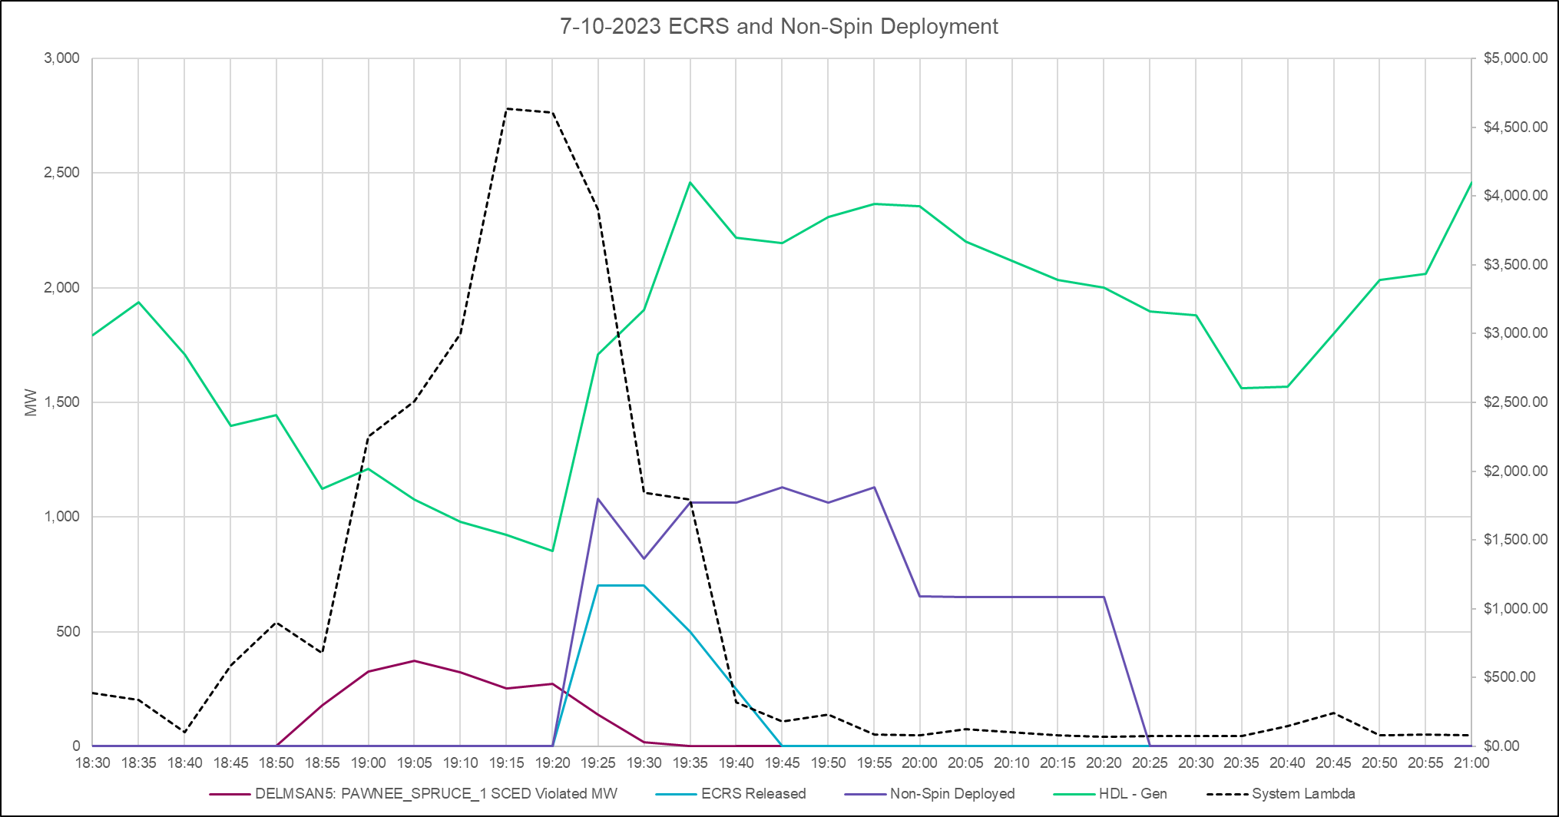
Review of July 10th ECRS deployment
Key Takeaway: ERCOT’s deployment of ECRS and Non-Spin was successful in keeping the transmission system secure.

Slide 7
ECRS released MW vs Utilized MW on OD 7/10/23
A portion of released ECRS MW was not utilized by SCED because of significant hurting Shift Factors to constraint DELMSAN5: PAWNEE_SPRUCE_1.
We noticed some quick-start units had LSL set to a non-zero value prior to deployment and those released ECRS MW were not utilized by SCED in the first few intervals after the release. We are reviewing their operations and will follow up with the responsible entities as needed.
Remaining difference was caused by other local congestion and/or high energy offer curves.

Slide 8
Next Steps
ERCOT is reviewing lessons learned and will discuss further at a future Operations Working Group meeting

