Slide 1
MarkeTrak and Inadvertent Gain Training

Slide 2
Antitrust Admonition
  To avoid raising concerns about antitrust liability, participants in ERCOT activities should refrain from proposing any action or measure that would exceed ERCOT’s authority under federal or state law. For additional information, stakeholders should consult the Statement of Position on Antitrust Issues for Members of ERCOT Committees, Subcommittees, and Working Groups, which is posted on the ERCOT website.¹

Slide 3

Notes
Morning Break
Please unmute yourself prior to speaking
Place yourself on mute when not speaking

Slide 4
MarkeTrak Online Training
MarkeTrak online training is available on www.ercot.com and includes the following modules:
MarkeTrak Overview
Inadvertent Gain/Loss
Cancel With/Without Approval
Switch Hold Removal
Data Extract Variance (DEV) LSE Subtypes
Email Functionality
Usage/Billing Disputes
Additional Day to Day Subtypes
Bulk Insert
Admin Functionality
Data Extract Variance (DEV) Non-LSE Subtypes
Reporting
Modules typically can be completed in 30 minutes or less.

Slide 5
MarkeTrak Training Objectives – Part 1
This training covers the following topics:
General MarkeTrak Navigation
Administrator Functionality
Email Notification
ListServ
Missing Enrollments
Usage & Billing
Siebel Changes
DEV LSE/Non LSE
Bulk Insert
Additional D2D Subtypes
Other Subtype
Background Reporting

Slide 6
MarkeTrak Training Objectives – Part 2
Part 2 covers the following topics:
Switch Holds
Inadvertent Gains
  Overview
  Rescission
  IAG Walkthrough
  Best Practices
  Reporting

Slide 7

What is MarkeTrak?
A web-based database application used to track and manage ERCOT Retail Market data discrepancies
The ERCOT Retail Market Issue Resolution System used by CRs, TDSPs, and ERCOT to initiate, communicate, and resolve issues
Discovery, visibility, tracking, historical reporting, and status of issues
Available to ERCOT market participants with a current Digital Certificate and the MarkeTrak role

Slide 8
What is MarkeTrak?
There are two primary MarkeTrak issue types
Day to Day
( D2D )
Data Extract Variances
( DEVs )
An issue that can be resolved with a transaction
For example: syncing transaction status in ERCOT system with TDSP and CR systems (Completed to Cancelled)
An issue that cannot be resolved with a transaction
For example: inserting a Service History Row (for the 727 extract)
Represents 99% of MTs submitted
Represents 1% of MTs submitted

Slide 9
MarkeTrak Subtypes
Below are the most commonly used issue subtypes:

Slide 10
MarkeTrak Training
General MarkeTrak Navigation

Slide 11
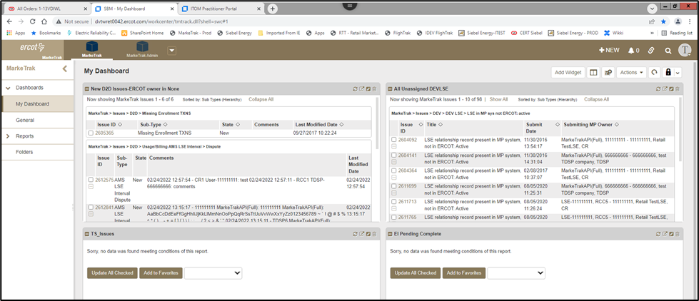
General Functionality: Navigating MarkeTrak
MarkeTrak Work Center
  Upon successful login, the user is taken to the MarkeTrak Work Center . The Work Center presents information to users in the form of dashboard views and toolbars. The MarkeTrak Work Center can be used as the starting point for viewing reports, activity views, and external Web pages in “widget” containers.

Slide 12
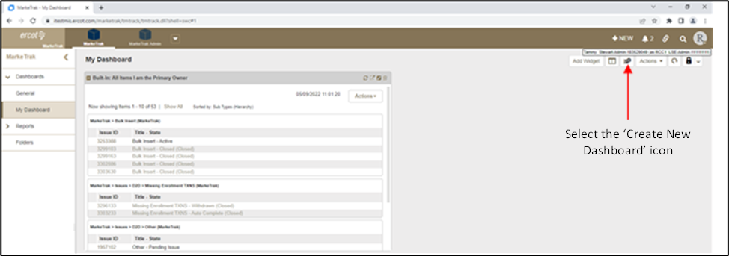
General Functionality: Navigating MarkeTrak
Dashboards(aka homepage)
  Select Dashboard from the side menu and then the Create Dashboard link at the top right corner of the screen.

Slide 13
General Functionality: Navigating MarkeTrak
You will be prompted to provide a name and description for your custom dashboard and then select Save.

Slide 14
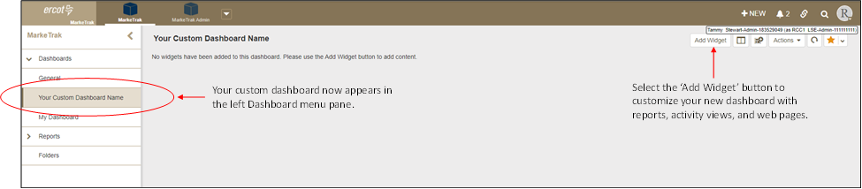
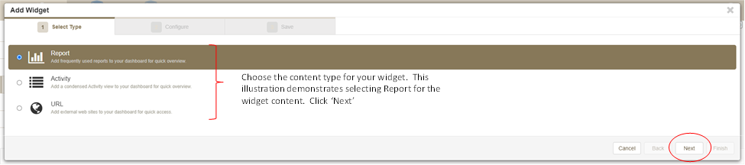
General Functionality: Navigating MarkeTrak
Your custom dashboard can be customized for your needs by adding widgets. To add widgets to your custom dashboard, select Add Widget from within your dashboard.
From here, you can select a widget type of Report, Activity or URL

Slide 15
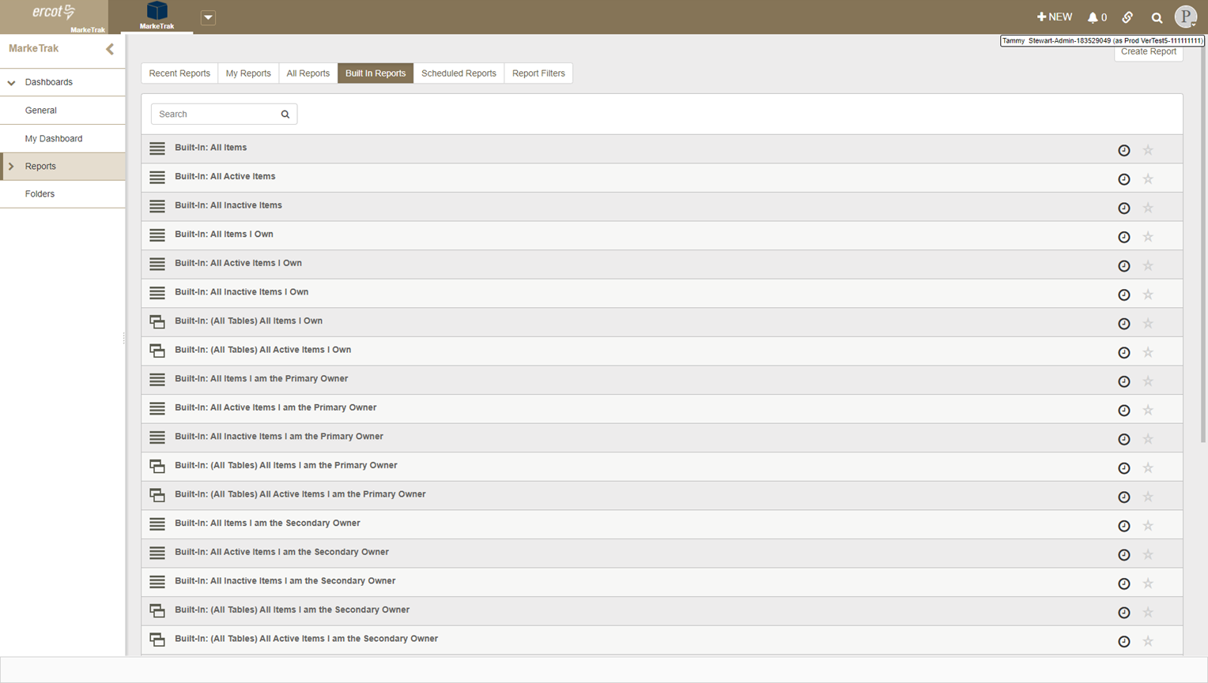
General Functionality: Navigating MarkeTrak
Click on the Built In Reports tab and select the report name

Slide 16
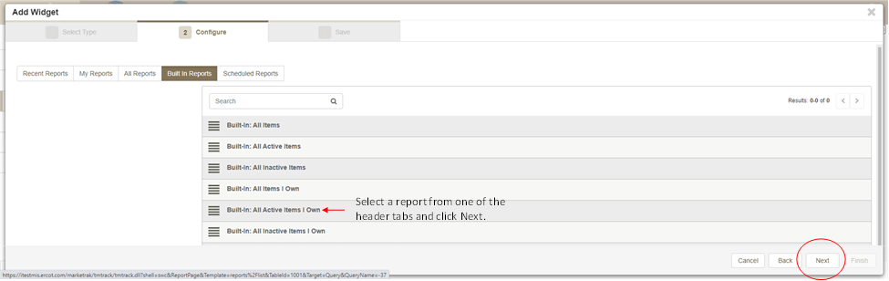
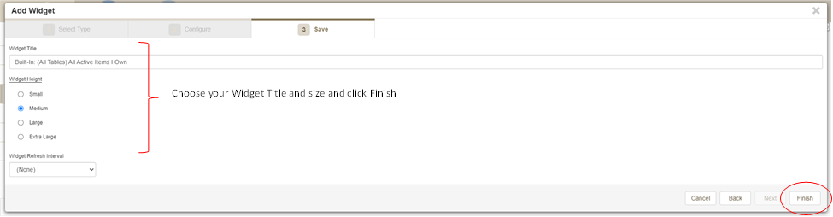
General Functionality: Navigating MarkeTrak
To finish creating your widget, select a name and size and click Finish

Slide 17
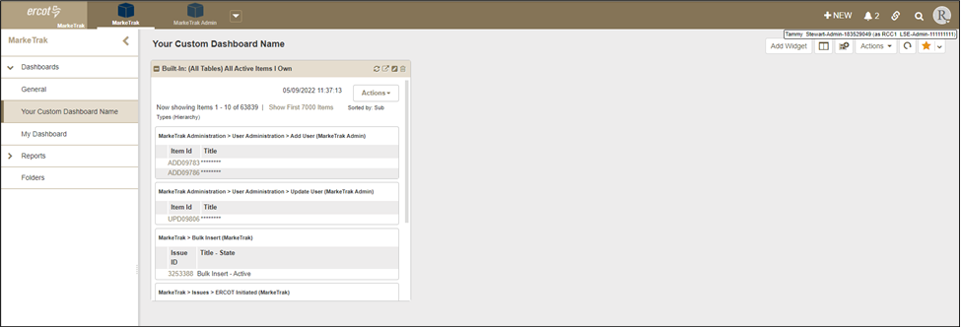
General Functionality: Navigating MarkeTrak
Your custom dashboard now contains the newly created widget

Slide 18
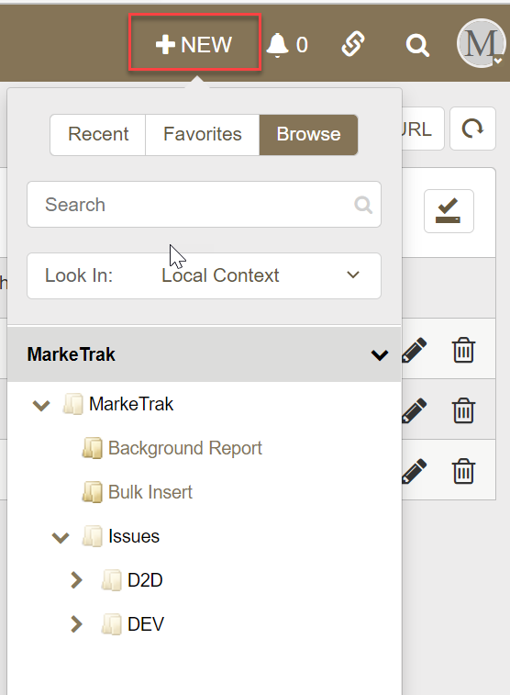
General Functionality: Navigating MarkeTrak
The toolbar at the top of the MarkeTrak Work Center screen offers links to commonly used areas of MarkeTrak such as submitting new MarkeTrak issues, view Notifications and access Quick Links, search for MarkeTrak issues and/or reports, and manage User Profile settings.
  +NEW : Click this link to submit a new MarkeTrak Issue. When you select the +NEW link, you will see three tabs: Recent, Favorites and Browse.
  Notifications – Use the Notifications link to view notifications you have received based on your subscriptions. You can subscribe to notifications in your user profile
  Quick Links – These are links updated to an individual user toolbar. This can include useful URLs such as ERCOT.com as indicated above or common reports a user may wish to access in one click
  Search – Populating this field with a numeric value returns a quick search of all Issue IDs that contain the value entered. When utilizing the Search box it is possible to search for multiple Issue IDs simultaneously. To do this simply input the Issue IDs you wish to retrieve with each entry separated by a space
  User Settings – This enables the user to modify name, phone number and email address

Slide 19
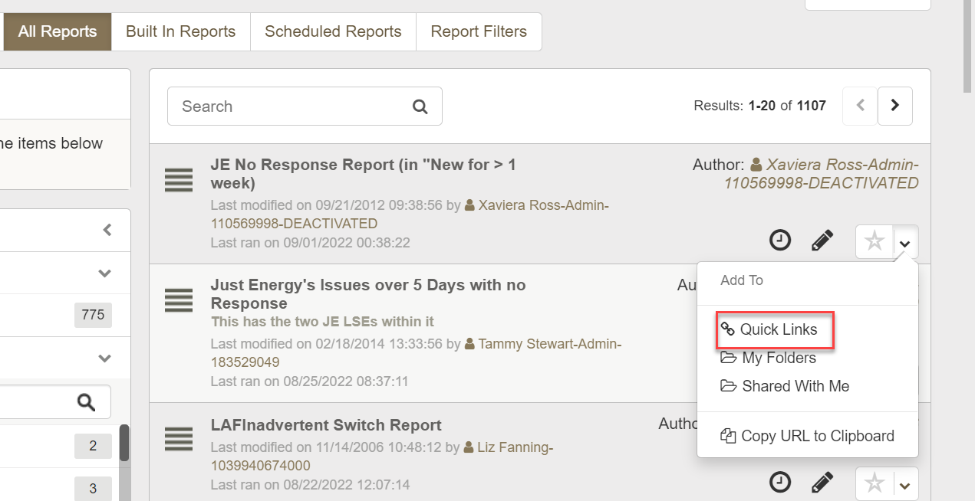
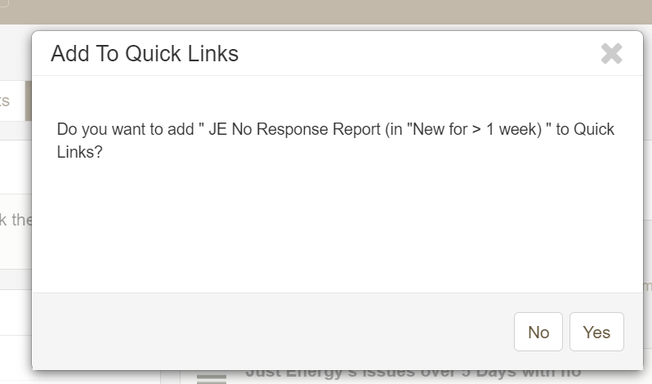
General Functionality: Navigating MarkeTrak
Quick Links: These are links updated to an individual user toolbar. This can include useful URLs such as ERCOT.com or common reports a user may wish to access in one click as demonstrated below:
To add a quick link:
  Locate the view or report that you want to add as a quick link.
  Click the drop-down list next to the star icon, and select Quick Links.
  Click Yes to add the quick link

Slide 20
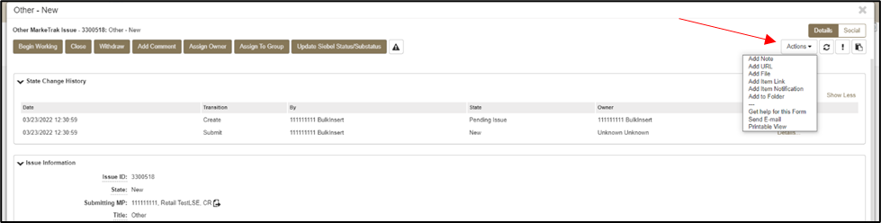
General Functionality: Navigating MarkeTrak
Actions dropdown: Available in the header of the issue details pane:
  Add Note: This allows the user to include a text message on the individual issue.
  Add URL: Creates a hyperlink on an individual issue to an external website.
  Add File: Allows the user to locate and attach an external file to an item which will be visible by all MPs Involved. This is not to be used to submit a file of ESI IDs to be researched on the issue.
  Add Item Link: This action gives the user the ability to create several different kinds of links to other issues within the MarkeTrak application. In order to successfully create these links, the current user must have visibility rights to both linked items.
  Add Item Notification: Selecting this action allows the user to choose one of five distinct item notifications. These differ from the system generated notifications in that they are selected individually on items by any user with visibility.

Slide 21
General Functionality: Navigating MarkeTrak
States and Transitions - All issues in the MarkeTrak tool are routed into one of several workflows based on the Type and Sub Type selected by the submitter. These Issue Type/Sub Types are: Day to Day Issues, Cancel with Approval, Cancel without Approval, and Inadvertent Gain related Sub Types as well as Data Extract Variance Issues- LSE Relationship.
States - A state is the position of an issue in the workflow process; this is often similar to the concept of an issue status combined with the issue’s current ‘owner’. Examples of this include: New (ERCOT), In Progress(Assignee), or Cancelled (Pending Complete).
Transitions - Transitions are the movement of an issue from one state to another. Available transitions are associated on the GUI with buttons. Selection of different buttons from the same state will typically result in the issue appearing in different states when the transition successfully completes. One example is a Day to Day Issue - Cancel with Approval currently in state In Progress with TDSP. If TDSP user selects transition button ERCOT Cancel, the item will move to state Auto Complete. Alternately if the TDSP user is unable to approve the cancel and selects transition button Unable to Cancel, the issue would appear in the submitting CR’s queue in state Unable to Cancel – (PC). Some transitions, such as Unable to Cancel, require additional steps to complete; in this case completion of a required field: Comments.

Slide 22
General Functionality: Navigating MarkeTrak
Issue Ownership: There are several varieties of ownership in the MarkeTrak application: Submitter, Responsible MP, MP’s Involved, and Assigned Owner.
  Submitter: The Submitter of the item is indicated near the top of each primary data pane on the issue details window. Submitter Duns number is also incorporated into the title of each issue and listed in the MPs Involved field discussed below.
  Responsible MP: Responsible MP is the single Duns number contained in the MPs Involved list that is considered to be the next participant responsible for transitioning the item towards a resolution. Examples include: the TDSP when an issue is waiting for approval to cancel a service order, ERCOT when the approval has been granted, and the CR when the cancel is complete and the issue is waiting for acceptance of the resolution.
  MP’s Involved: MP’s Involved is a list of all MP duns numbers which are party to an issue. As additional assignments are made to an item the MPs Involved field will be updated with the selected DUNs numbers, reflecting an increase in market participants with the ability to view the item. As ERCOT can always view any issue in the system, this will always be reflected in the MPs Involved list.
  Assigned Owner: Assigned Owner is null when an issue is initially assigned to a Market Participant. Assigned owners are individual users. These are assigned by the Responsible MP automatically as issue is acknowledged by way of transition, Begin Working. Taking this action will populate the associated individual’s user id as the Assigned Owner.

Slide 23
MarkeTrak Training
Admin Functionality

Slide 24
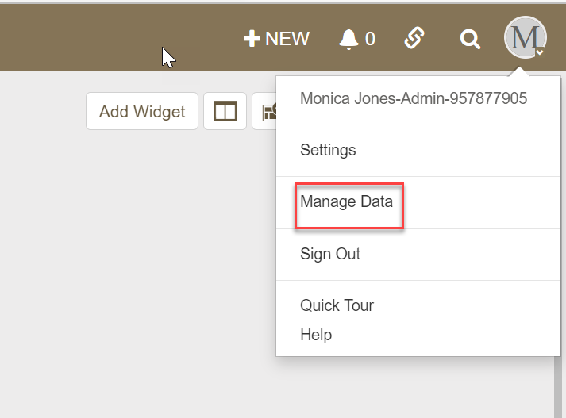
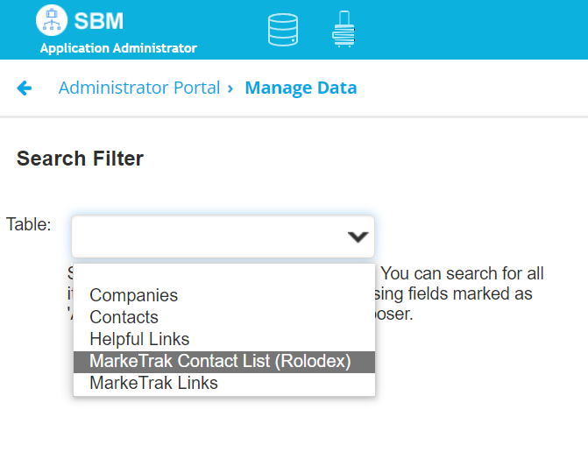
Admin Functionality: Roles & Responsibilities
The MP Administrator will be responsible for establishing and maintaining the users associated with their Market Participant organization. MP Administrators will only be able to establish or maintain users associated with their organization.
The MP Administrator will be responsible for maintaining the MarkeTrak Rolodex( which can be located in the manage data tab). This is the list owned by each MP Administrator which determines the destination of Notification Emails.
The MP Administrator will be responsible for maintaining the MarkeTrak Contacts List. This is the list owned by each MP Administrator which provides contact information for each MarkeTrak user for that company.
The MP Administrator will also be responsible for Report Management. – creating reports for use by multiple users registered under the same DUNS.

Slide 25
Marketrak SCR 815 Enhancement 3 - Downsize rolodex contacts from 24 categories to 6 categories.
The current rolodex is not maintained by Market Participants due to cumbersome process and multiple inputs. Escalation contact emails bounce back or go unanswered. Downsizing the escalation contacts from 24 categories to 6 categories will streamline the rolodex maintenance for MP Admins. New rolodex categories are as follows:
Inadvertent | Service/Transaction Issues | Usage & Billing | DEV | Switch Hold Removal | LPA
-Inadvertent Gaining | -997 Issues | -Usage & Billing - Missing | -In ERCOT system not MP | -Switch Hold Removal | -LPA
-Inadvertent Losing | -Cancel with Approval | -Usage & Billing - Dispute | -In ERCOT system with start date issues
-Customer Rescission | -Cancel without Approval | -AMS LSE Interval - Missing | In MP system not ERCOT
-Redirect Fees | -ERCOT Initiated | -AMS LSE Interval - Dispute | -LSE date change: StartTime
 | -Market Rule |  | -LSE date change: StopTime
 | -Missing Enrollment TXNS |  | -LSE in ERCOT system not MP
 | -Move Out With Meter Removal |  | -LSE in MP system not ERCOT: active
 | -Other |  | -LSE in MP system not ERCOT: de-engz
 | -Premise Type |  | -Status Assignment
 | -Projects |  | -Un-Retire ESIID
 | -Reject TXNs |  | -Zip Assignment
 | -Rep of Record
 | -Safety Net Order
 | -Service Address
 | -Service Order - 650
 | -Siebel CHG/Info

Slide 26
MarkeTrak Training
Email Notifications

Slide 27
Email Notifications
Automated Email Notifications
  An automated email generated by MarkeTrak’s Notification system is sent to each MP Administrator assigned contact nightly. Attached to the email is a list of issues that have exceeded the time allotted to complete the transition based upon the issue subtype.
  Examples of scenarios which trigger automated email notifications are:
      Issues that remain in a state of New for more than three calendar days
      Inadvertent Issues:
        Responsible MP Escalation: after 7 calendar days without transition
        ERCOT Escalation: 48 hours to update/transition the issue from the “New (ERCOT)” or “In Progress (ERCOT)” states
        Losing MP Escalation: The Regaining Transaction Status should be “Scheduled” or “Complete” within 72 hours of the “Regaining Transaction Submitted”
      All other D2D Sub Types without transition after 28 days

Slide 28
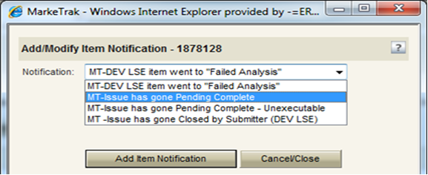
Email Notifications
Individual Email Notifications
  Each user with access to an item has the ability to manually select a notification related specifically to that individual issue. The email address entered in MarkeTrak for the user who selects this option from the Actions: drop down list will be the destination for this email notification.
Please Note: When notifications are established an email will be sent for every MT issue assigned to user.

Slide 29
MarkeTrak Training
ERCOT ListServ

Slide 30
ERCOT ListServ
To subscribe to an email distribution list on ERCOT ListServ, navigate to http://lists.ercot.com and create an account.
Suggested Subscriptions for Retail Market:
RMS
RMTTF
TxSET
TDTMS
Weather Moritorium
PWG
To unsubscribe to an email distribution list, users navigate to desired list and click “unsubscribe”.

Slide 31
Checkpoint Question
If a user no longer wants to receive notifications from the ListServ, what action should be taken?
Contact their ERCOT Account Manager
Reply to email requesting to be removed
Navigate to desired list and click unsubscribe
c. Navigate to desired list and click unsubscribe
Replying to the email will send the request to ALL subscribers and still will not remove you from notifications.

Slide 32
MarkeTrak Training
Missing Enrollment

Slide 33
D2D Issues: Missing Enrollment Transactions
Examples of missing enrollment transactions include a CR missing
  814’s
  867_04
  NOTE: The reprocessing of retail transactions by ERCOT is limited to one year from the original processing date. If the missing transaction is to be reprocessed, or dependent upon another transaction being reprocessed, the original transaction dates must be within one year of submission of the MarkeTrak issue.
Allow time for transaction processing to complete prior to submitting the MarkeTrak issue – especially new construction
A CR or TDSP can submit this subtype
Required Fields on Submit:
  Assignee
  ESI ID
  Original Tran ID
  Tran Type

Slide 34
MarkeTrak Training
Usage Billing Issues

Slide 35
D2D Issues: Usage Billing Subtypes
867/810s Usage & Billing
Missing – CR is missing 867_03, 867_03F, 810s
Dispute – CR has an issue with the data found on the 867and/or 810
AMS interval data/LSE files
Missing – No LSE file or interval data for a period of time
Dispute – CR has an issue with the interval data on the LSE file

Slide 36
D2D Issues: Usage Billing - Missing
Examples of Usage/Billing Issues – Missing:
If a CR is missing an 867_03 Monthly usage transaction
If a CR is missing an 867_03 Final usage transaction
If a CR is missing an 810 transaction
If a CR is missing an 867_03 and an 810 transaction
Allow time for transaction processing to complete prior to submitting the MarkeTrak issue.

Slide 37
D2D Issues: Usage Billing - Missing
Submitting a Usage/Billing – Missing Issue:
  The following fields must be populated for successful submission of Day to Day issue sub type Usage/Billing-Missing Issues: (For this example, the submitter selects the TDSP.)
    Assignee
    ESIID
    Original Tran ID (Optional except for 867_03 Final) - BGN02 of the 814_01, 814_16 or 814_24. The TDSP will see it as the BGN06 of the 814_03/814_25.
    Tran Type (select from drop down)
    TNX Date – same as the Service period start date (or is the current date)
    IDR/Non-IDR (IDR indicates true IDR meter, does not include AMS meters)
    Start Time = Service Period Start Date

Slide 38
D2D Issues: Usage Billing - Missing
Submitting a Usage/Billing – Missing Issue:
  The Comments field is optional. Please include any additional information in this box. New field added: Stop Time = Service Period Stop Date. Although optional it is encouraged to be populated. If left blank it will be assumed that the Stop date is the date up to the most current read date. The submitting MP will be validated as the ROR for the Start Time provided on the issue to prevent users from submitting invalid issues.
Comments are highly recommended!

Slide 39
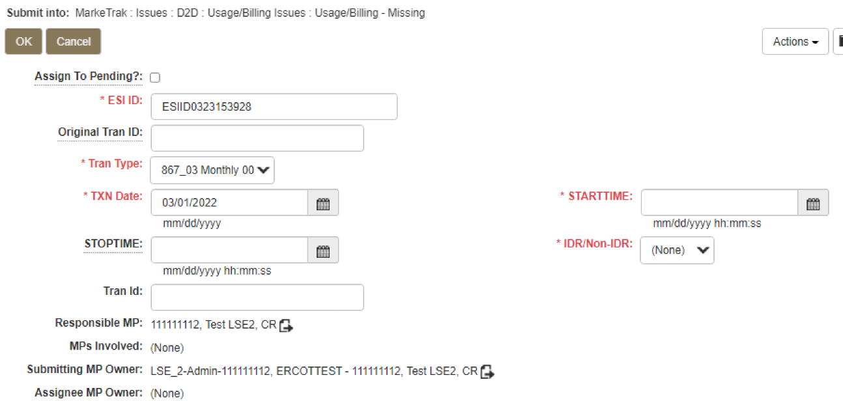
D2D Issues: Usage Billing - Missing
Submitting a Usage/Billing – Missing Issue (cont.):
TRAN TYPE:
867_03 F
867_03 Monthly 00- original
867_03 Monthly 01- cancel
867_03 Monthly 05- rebill
810_02 Monthly 00- original
810_02 Monthly 01- cancel
810_02 Monthly 05- replace
Select OK.

Slide 40
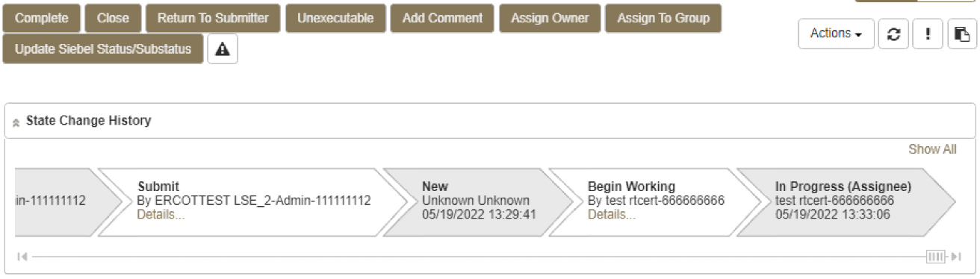
D2D Issues: Usage Billing - Missing
Submitting a Usage/Billing – Missing Issue (cont.)
  The issue enters TDSP queue in a state of New and is visible only by the Submitting CR and TDSP.
  The Submitting CR can Withdraw the issue at this point.
  The TDSP selects Begin Working and the issue is transitioned in a new state of In Progress-Assignee.
  At this point, the Submitting CR can no longer Withdraw the issue.
  TDSP reviews the issue and has the options:
    Unexecutable, which results in state Unexecutable- Pending Complete – requires comments
    Return to Submitter which requires comments and then the issue is transitioned back to the Submitter for additional information
    Complete which transitions to a state of Pending Complete. The Submitter has the option to close the issue by selecting Complete or the issue will be auto closed in 14 calendar days.

Slide 41
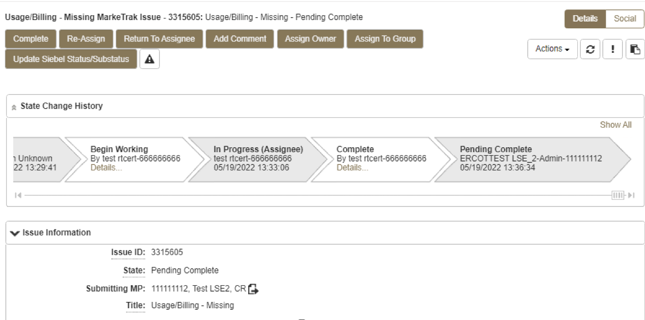
D2D Issues: Usage Billing - Missing
Submitting a Usage/Billing – Missing Issue (cont.)
  In this example the TDSP selects Complete, provides the required Tran ID of the missing transaction, and the issue is transitioned to the submitting CR in a state of Pending Complete. If the issue covers multiple service periods, information regarding those transactions should be provided in the comments.
  The Submitting CR has the option to close the issue by selecting Complete or the issue will be Auto Closed in 14 Calendar days.

Slide 42
D2D Issues: Usage Billing - Dispute
Examples of Usage/Billing Issues – Dispute:
  For use when a CR has an issue with any data found on an 867 or 810 which may pertain to one or more of the following examples:
    Consumption / Usage Data
    Bill Calculations – kW, kWh, power factor, meter multiplier
    Rate Issues – rate classifications/tariffs
    Discretionary Service Charge dispute
    Crossed Meter Situation
    Dispute of Estimated Bill
    Estimation Methodology

Slide 43
D2D Issues: Usage Billing - Dispute
Submitting a Usage/Billing – Dispute Issue:
The following fields must be populated for successful submission of Day to Day issue sub type Usage/Billing Issues: (For this example, the submitter selects the TDSP.)
  Assignee
  ESIID
  Original Tran ID (Optional except for 867_03 Final) - BGN02 of the 814_01, 814_16 or 814_24. The TDSP will see it as the BGN06 of the 814_03/814_25.
  Tran Type
  TXN Date
  Start Time - Service Period Start Date
  Dispute Category
    Priority Issue – defined as a subsequent MarkeTrak issue submitted/resubmitted due to initial MarkeTrak issue being auto closed without resolution or a follow-up MarkeTrak issue exceeding Market accepted SLA
    Consumption/Usage Issue
    Billing Calculations kWh
    Billing Calculations kW
    Billing Calculations Power Factor
    TDSP Charge Issue
    Rate Issue
    Crossed Meter Issues
    Non-Metered Issues
    Other – Comments Required
  Tran ID
  IDR/Non-IDR
Comments are highly recommended!

Slide 44
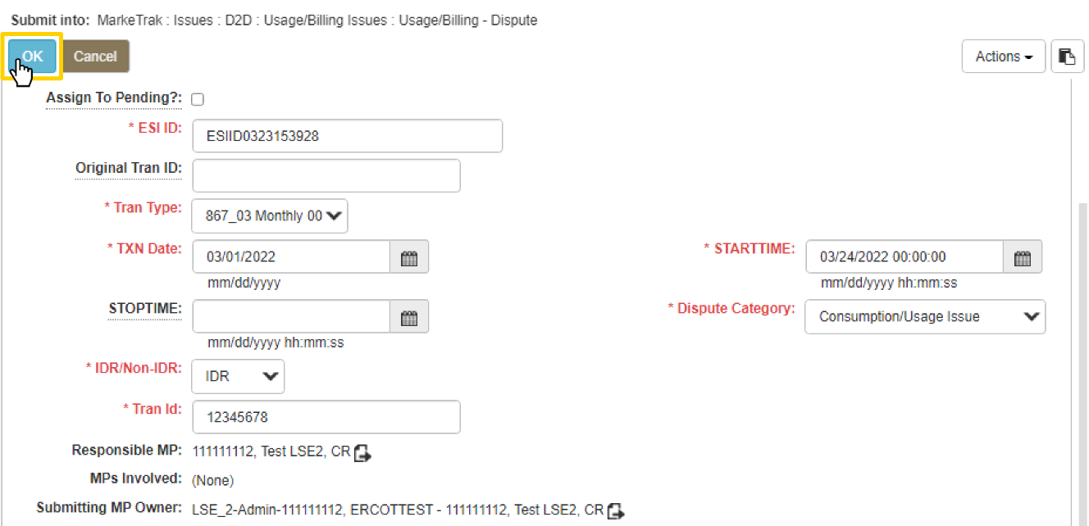
D2D Issues: Usage Billing - Dispute
Submitting a Usage/Billing – Dispute Issue (cont.):
NOTE: The Comments field is optional except when the Dispute Category is Other. Please include any additional information in this box. Stop Time = Service Period Stop Date. Although optional it is encouraged to be populated. If left blank it will be assumed that the Stop date is the date up to the most current read date. The submitting MP will be validated as the ROR for the Start Time provided on the issue to prevent users from submitting invalid issues.
Select OK.

Slide 45
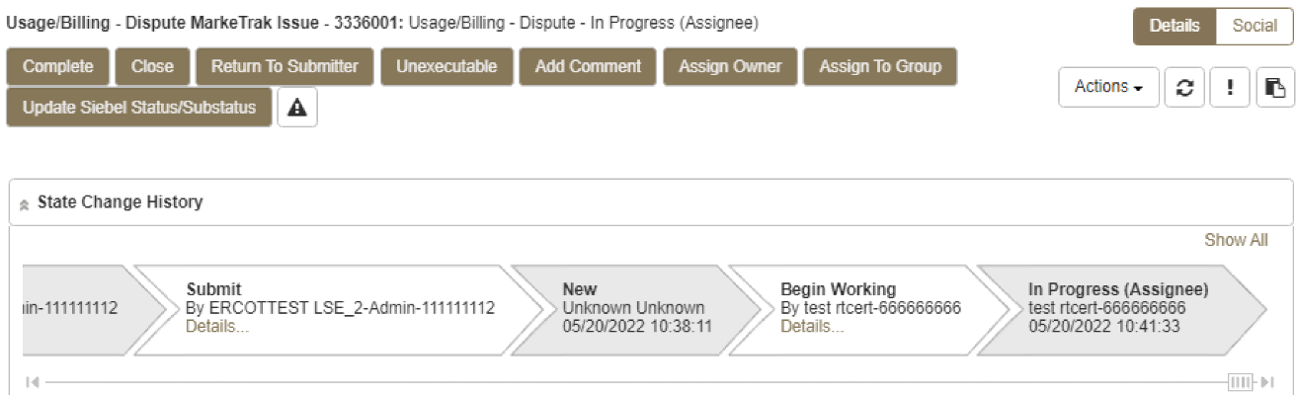
D2D Issues: Usage Billing - Dispute
Submitting a Usage/Billing – Dispute Issue (cont.):
The issue enters TDSP queue in a state of New and is visible only by the Submitting CR and TDSP.
The Submitting CR can Withdraw the issue at this point.
The TDSP selects Begin Working and the issue is transitioned in a new state of In Progress-Assignee.
At this point, the Submitting CR can no longer Withdraw the issue.
TDSP reviews the issue and has the options:
  Unexecutable, which results in state Unexecutable- Pending Complete – requires comments
  Return to Submitter which requires comments and then the issue is transitioned back to the Submitter for additional information
  Complete which transitions to a state of Pending Complete. The Submitter has the option to close the issue by selecting Complete or the issue will be auto closed in 14 calendar days.
In this example the TDSP selects Complete and the issue is transitioned to the submitting CR in a state of Pending Complete. The Submitting CR has the option to close the issue by selecting Complete or the issue will be Auto Closed in 14 Calendar days.

Slide 46
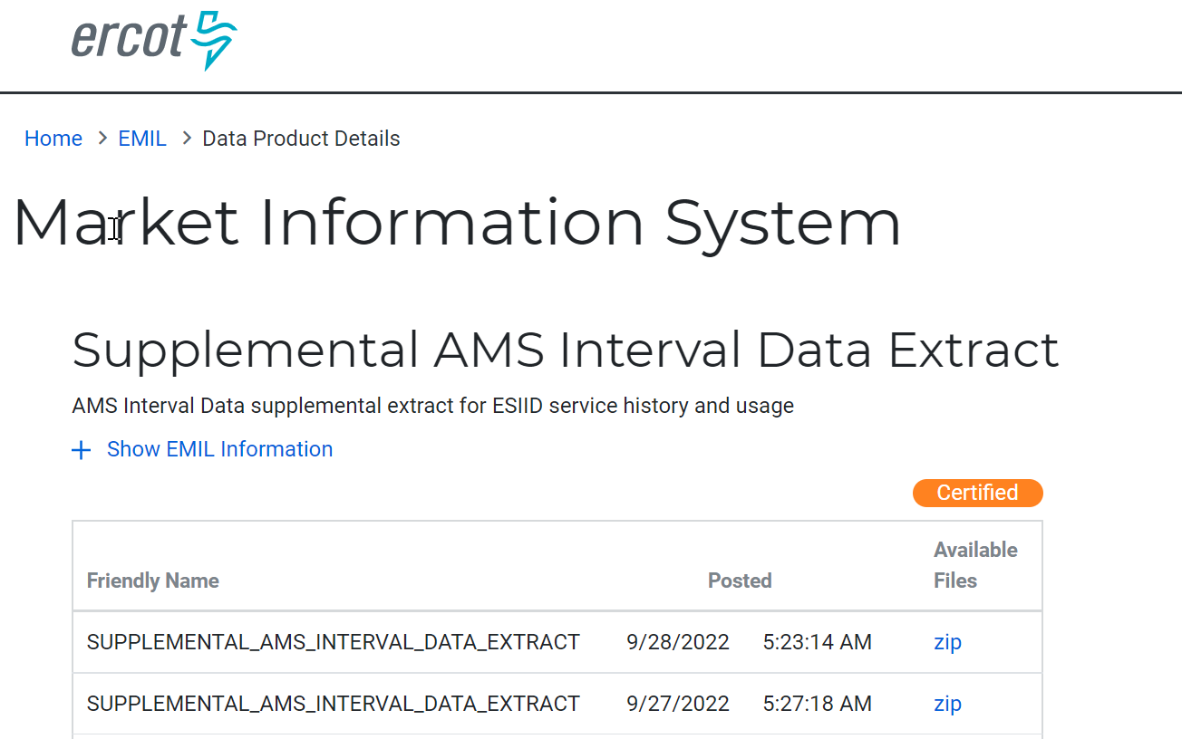
AMS LSE Interval Subtypes
AMS LSE Interval Subtypes are submitted for questions regarding AMS interval level data whereas questions regarding 867s or 810s are handled via Usage & Billing subtypes.
The Supplemental AMS Interval Data Extract is used as reference for AMS LSE Dispute subtype. The extract is posted daily to the ERCOT Market Information System (MIS) on ercot.com website.
Additional information about the extract can be found in the Supplemental AMS Interval Data Extract User Guide located on ERCOT.com.

Slide 47
AMS LSE Interval: Missing
Competitive Retailers (CRs) submit this Subtype when they discover an interval usage gap with the AMS LSE interval data from the TDSP.
Typically submitted requesting AMS data for one or more consecutive days of a service period. (Remember LSE files will have all 96 intervals completed for each day)
In order to submit this subtype, the following is required:
  The ESIID must have an AMS meter profile at ERCOT. (AMS Settlement Flag = true on Find ESI functionality)
  The CR must be the current Rep of Record for ALL usage days specified by the STARTIME and STOPTIME range.

Slide 48
AMS LSE Interval: Missing
How to submit this SubType?
From the MarkeTrak submit tree, under the D2D option:
  Select the Usage/Billing AMS LSE Interval Missing option.
  Enter the data for the required fields.

Slide 49
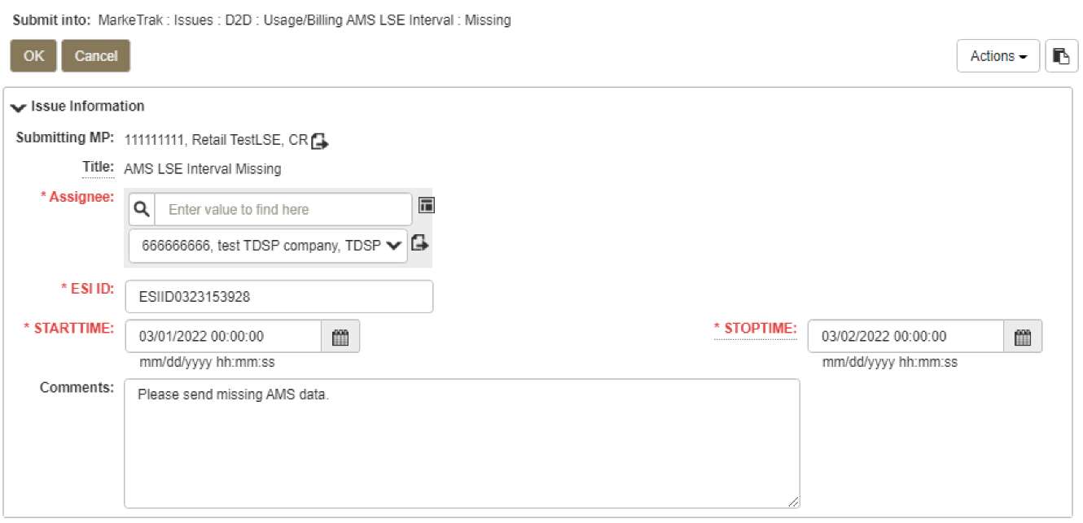
AMS LSE Interval: Missing
CR enters required information indicating STARTTIME and STOPTIME as formatted above for the missing period only and selects ‘OK’.

Slide 50
AMS LSE Interval: Missing
“Happy Path”
Requesting CR selects Missing under Usage/Billing AMS LSE Interval from the Submit Tree.
Requesting CR enters all required information and selects ‘OK’.
The issue is now in the state of ‘New’ with the TDSP as Responsible MP.
TDSP selects ‘Begin Working’.
The issue is now in a state of ‘In Progress (Assignee)’.

Slide 51
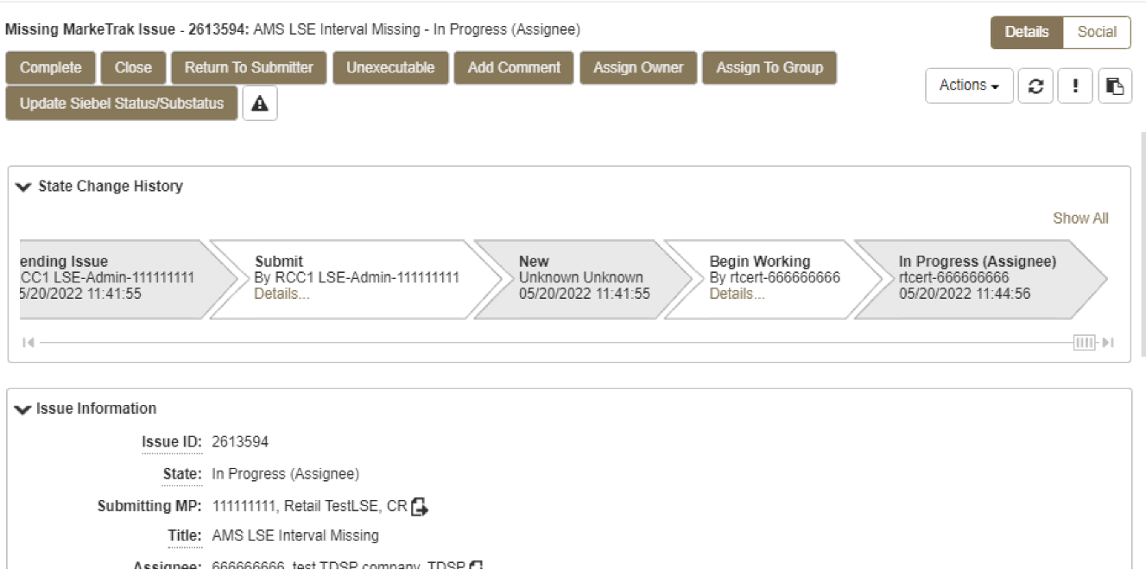
AMS LSE Interval: Missing
TDSP selects ‘Begin Working’ and then selects ‘Complete’ and enters optional Comments. TDSP selects ‘OK’.
NOTE: If CR is no longer ROR, SMT cannot be referenced and interval data should be attached to MarkeTrak.

Slide 52
AMS LSE Interval: Missing
“Happy Path” (cont.)
TDSP selects ‘Complete’, enters Comments (optional) and selects ‘OK’.
The issue is now in a state of ‘Pending Complete’ with the Submitting MP as the Responsible MP.
Submitting MP selects ‘Complete’ and the issue closes to ‘Complete’.

Slide 53
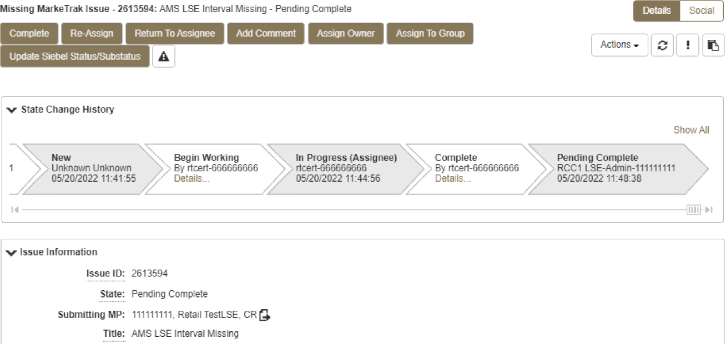
AMS LSE Interval: Missing
Submitting CR selects ‘Complete’ and the issue is closed to a state of ‘Complete.

Slide 54
AMS LSE Interval: Dispute
Competitive Retailers (CRs) submit this Subtype when they discover a discrepancy with the AMS LSE interval data from the TDSP.
Before submitting a Usage & Billing AMS LSE Dispute issue, the CR should allow 5 business days for transaction processing to complete.
In order to submit this subtype, the following is required:
  The ESIID must have an AMS meter profile at ERCOT.
  The usage data must be loaded in the ERCOT system and is identified by the unique identifier ‘UIDAMSINTERVAL’ from the Supplemental AMS Interval Data Extract. This code is retrieved and is a required field for this subtype.
Each issue should reflect the intervals from a single day or a consecutive period; a new issue should be created for each additional period.

Slide 55
AMS LSE Interval: Dispute
How to submit this SubType?
From the MarkeTrak submit tree, under the D2D section:
  Select the Usage/Billing AMS LSE Interval Dispute option.
  Enter the data for the required fields.

Slide 56
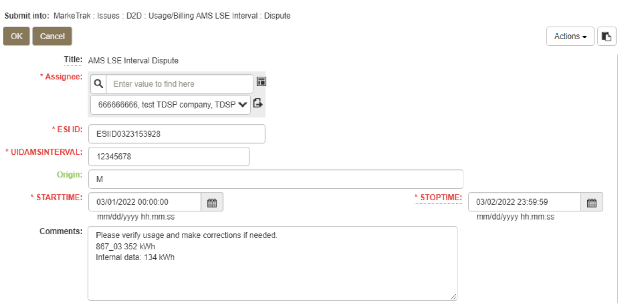
AMS LSE Interval: Dispute
Code retrieved from AMS Supplemental Extract for service interval in question or the last interval for the specific day or period in question. If past 30 days, enter the oldest date available
Comments are essential in efficiently and accurately processing the MT in a timely manner
STARTTIME = service period start time formatted as mm/dd/yyyy 00:00:00
STOPTIME = service period stop time (varies by TDSP)
mm/dd/yyyy 23:59:59

Slide 57
AMS LSE Interval: Dispute
“Happy Path”
Requesting CR selects Dispute under Usage/Billing AMS LSE Interval from the Submit Tree.
Requesting CR enters all required information and selects ‘OK’.
The issue is now in the state of ‘New’ with the TDSP as Responsible MP.
TDSP selects ‘Begin Working’.
The issue is now in a state of ‘In Progress (Assignee)’.

Slide 58
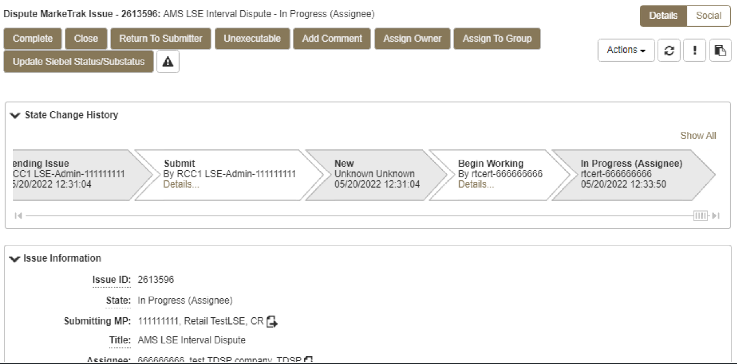
AMS LSE Interval: Dispute
TDSP selects ‘Begin Working’ and then selects ‘Complete’ and enters optional Comments. TDSP selects ‘OK’.

Slide 59
AMS LSE Interval: Dispute
“Happy Path” (cont.)
TDSP selects ‘Complete’, enters Comments (optional) and selects ‘OK’.
The issue is now in a state of ‘Pending Complete’ with the Submitting MP as the Responsible MP.
Submitting MP selects ‘Complete’ and the issue transitions to ‘Complete’.

Slide 60
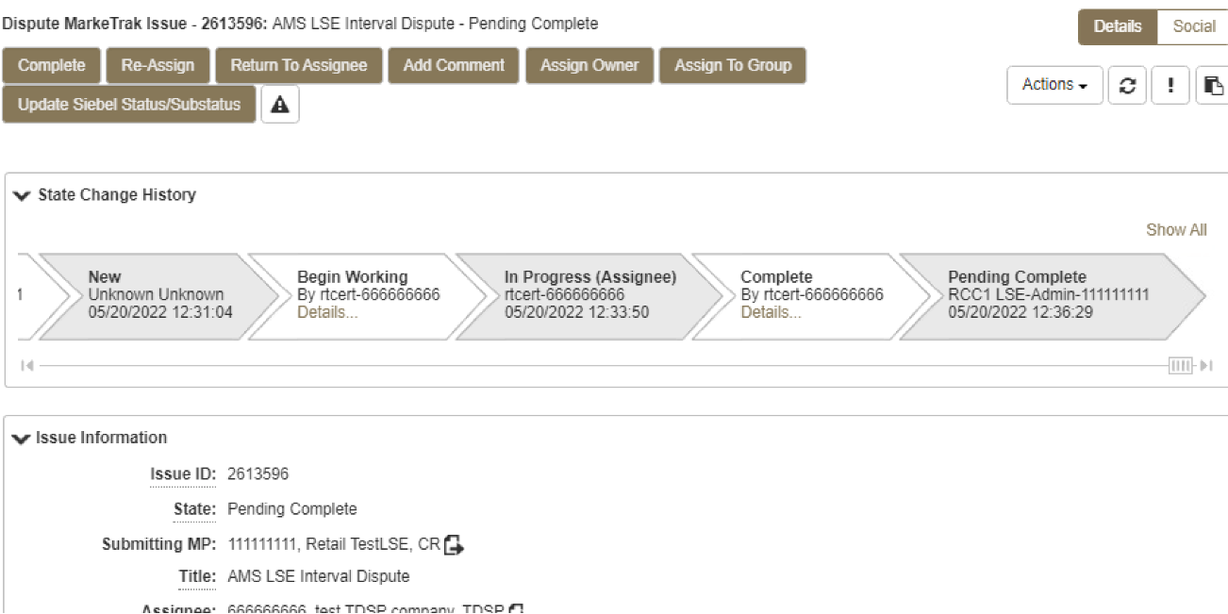
AMS LSE Interval: Dispute
Submitting CR selects ‘Complete’ and the issue is closed to a state of ‘Complete’.

Slide 61
Marketrak SCR 815 Enhancement 2 – Develop a list of Unexecutable Reasons for Usage and Billing and Missing Enrollment TXNs subtypes.
Add an Unexecutable Reason drop down field to the Unexecutable transition for Usage & Billing and Missing Enrollment TXNs subtypes. Providing common unexecutable reasons will improve the resolution time and reduce unnecessary comments. New Unexecutable Reasons per workflow are as follows:
Usage & Billing – Missing | Usage & Billing – Dispute | AMS LSE Missing | AMS LSE Dispute | Missing Enrollment TXNs
(None)* | (None)* | (None)* | (None)* | (None)*
Invalid StartTime/TimeStamp Formatting | Submitter is Not the REP of Record | Submitter is Not the REP of Record | Non-consecutive Bill Cycles | Enrollment TXNS on Construction Hold or Permit Pending
Cycle Date Not Scheduled | Inaccurate SubType Submitted* | Inaccurate SubType Submitted* | Variance Due to Inadvertent Gain/Loss | Enrollment TXNS was Cancelled
Submitter is Not the REP of Record |  |  | Invalid StartTime/TimeStamp Formatting | Enrollment TXNS is Future Dated
Inaccurate SubType Submitted* |  |  | Submitter is Not the REP of Record
 |  |  | Inaccurate SubType Submitted*
* If the default selection of ‘(None)’ is made, or if ‘Inaccurate SubType Submitted’ is selected, comments are required.

Slide 62
Escalation Timelines for Usage and Billing MarkeTraks
    First Point of Contact shall be an Email via MarkeTrak to the Assigned Agent for the MarkeTrak Issue as identified below:
      According to the MarkeTrak User Guide Section 1.9.2.3 “Working Issues”:
        Within seven (7) Business Days from creation, the MarkeTrak Issue shall be reviewed, analyzed and resolved by the Assigned Agent.
        If the MarkeTrak Issue cannot be resolved within seven (7) Business Days, the Agent Assigned to the Issue shall provide weekly status updates to the Submitter.
    After ten (10) Business Days has expired without any MarkeTrak Issue status update(s) or Issue resolution received from the Assigned Agent, Second Point of Contact may be the Escalation Contact(s) using the MarkeTrak Tool (exclamation mark icon).
    After fifteen (15) Business Days has expired without any MarkeTrak Issue status update(s) or Issue resolution received from either the Assigned Agent or Escalation Contact(s), the Third Point of Contact the REP’s Contact may notify TDSP’s Account Manager for MarkeTrak Issue investigation, status update and/or resolution.

Slide 63
Checkpoint Question
Which subtype should a CR submit if a customer is questioning the monthly consumption value they received on their monthly bill?
  Usage & Billing – Missing
  Usage & Billing – Dispute
  AMS LSE – Missing
  AMS LSE – Dispute
Usage & Billing – Dispute

Slide 64
Checkpoint Question
True or False
A CR should submit an AMS LSE – Dispute MarkeTrak as soon as they receive the 867_03 monthly from the TDSP.
FALSE

Slide 65
Checkpoint Question
True or False
When submitting any Usage & Billing MarkeTrak, if the STOP time is left blank it will be assumed it is the end of the 30 day period following the START time.
FALSE

Slide 66
Checkpoint Question
If a CR has submitted an 814_16 enrollment and has received an 814_05 and an 867_04, but has yet to receive the 867_03 (initial periodic), the CR should submit a ___________ MarkeTrak.
a) Missing Enrollment Transaction
b) Usage & Billing - Missing
c) AMS LSE - Missing
b) Usage & Billing - Missing
This is only after the scheduled meter read date has passed.

Slide 67

Questions

Slide 68
MarkeTrak Training
Siebel Change

Slide 69
Siebel Change
Siebel is the ERCOT Registration System of Record that maintains ESI ID activity.
A Siebel change is used to correct order status for an ESI ID’s past activity.
CR or TDSP can submit this subtype.
TXSET transactions cannot be utilized for Siebel system changes.
Upon acceptance and completion, a Siebel Change will align ERCOT’s Siebel system with the impacted Market Participant’s system.
The following fields are required to initiate a Siebel Change issue:
- Assignee
- ESI ID
- Original TranID
- Comments

Slide 70
Examples of Siebel Change/Info
Changing Service Order Status
  For out-of-sync scenarios when a transaction’s status is different on ERCOT MIS from the Market Participant’s systems.
  To inquire why a transaction was cancelled.
  To inquire why Siebel status is different than the status of the transaction(s) submitted by the TDSP.
  When changing Service Order Status from “Cancel” to “Complete” or vice versa.
Changing Start Time Discrepancies
  To inquire why an ESI ID is not in ERCOT’s system.
  When changing a start time of a Siebel service order.

Slide 71
MarkeTrak Training
Data Extract Variances (DEVs)

Slide 72
Data Extract Variance (DEV) Overview
Data Extract Variances (DEVs) are used to correct a “Service History Row” on the SCR727 ESI ID Service History & Usage Extract or ESI ID characteristics when corrections cannot be resolved with a TXSET transaction.
Two types of DEVs can be used when a discrepancy is identified:
  DEV LSE:
    Used to correct the MP's StartTime and/or StopTime for REP of Record (ROR) synchronization.
  DEV Non-LSE:
    Non-LSE DEVs are used to synchronize ESI ID characteristics, existence and/or usage data.

Slide 73
Checkpoint Question
Today is October 1st, what MarkeTrak subtype is used to correct service history rows for a REP of Record serving the ESI ID from August 1st – August 30th?
  Siebel Change
  DEV Non-LSE
  Inadvertent Gain
  DEV LSE
D) DEV LSE

Slide 74
Checkpoint Question
Today is October 1st, what MarkeTrak subtype is used to correct service history rows for a REP of Record serving the ESI ID from September 15th to today?
  Siebel Change
  DEV Non-LSE
  Inadvertent Gain
  DEV LSE
A) Siebel Change

Slide 75
MarkeTrak Training
Bulk Insert Process

Slide 76
Bulk Insert: Overview
MarkeTrak Bulk Insert functionality…
Allows for automated method of submitting multiple MarkeTrak issues of the same subtype
Uses a .CSV file containing data for each issue and is uploaded via the Bulk Insert workflow
Templates are available on ERCOT.com for each subtype’s .CSV file format. These contain the defined required field ordering for the specific issue type.

Slide 77
Bulk Insert: Validations
Two levels of validations are performed on this MT Subtype:
  Overall file format level validation is performed upon submission
  Business level validations on each row of data within .CSV file
    All validations will default to “off” unless otherwise flagged
    Any “blank” validation flag assumes validation is turned “off”
    If populated with “1” in the appropriate field, validation is “on”

Slide 78
Bulk Insert: File Format Validations
Performed on .CSV file by clicking “Attach and Validate”.
  Determine if correct # of columns were uploaded
  Comments will indicate # of rows that successfully uploaded (with correct # of columns) and # of rows not uploaded from .CSV file

Slide 79
Bulk Insert: Business Level Validations
Performed on required fields of template
Report posted to destination of choice: MarkeTrak attachment or MIS
Report includes the following five additional columns added at the end of each row, representing the following data:
  Success or Fail: “success” indicates successfully submitted via Bulk Insert and “fail” indicates issue was not submitted
  Error Code: if an issue fails, a code will populate in this field
  Error Message: field contains error message why the issue failed to submit
  Date/Time Stamp: contains date and time stamp of when the issue was submitted
  Issue ID: MarkeTrak issue ID for successfully submitted issues
Allow adequate time for processing individual issues. Average processing time is a few seconds per row.

Slide 80
Bulk Insert: .CSV File Validations
Validation | Populate “1” | Populate “0”
ESI ID Duplicate Check - validates ESID | Will not submit issue if duplicate issue exists containing the ESI ID for which submitter has access | Duplicate check overridden, issue will submit provided criteria is met
Global ID Duplicate Check – validates ESID and original Transaction ID | Will not submit issue if a duplicate issue is located in MarkeTrak system containing the ESI ID and original transaction for which submitter has access | Duplicate check overridden, issue will submit provided criteria is met
ESI ID Validation- must be enabled for Premise Type to return | Submit for validation of ESI ID against ERCOT registration system | Submit regardless if ESI ID is within ERCOT registration system
Evaluation Window Check – Global ID Validation must be enabled | Enables TRAN Type/Evaluation rules be applied for Cancel w/Approval issues | Ignores Evaluation rule and submits issue regardless of violation
Global ID Validation | Enables validation of Global ID against ERCOT registration system | Ignores validation of Global ID with ERCOT registration system
If Validation field is left blank, a “0” will automatically default and the check will not be performed.

Slide 81
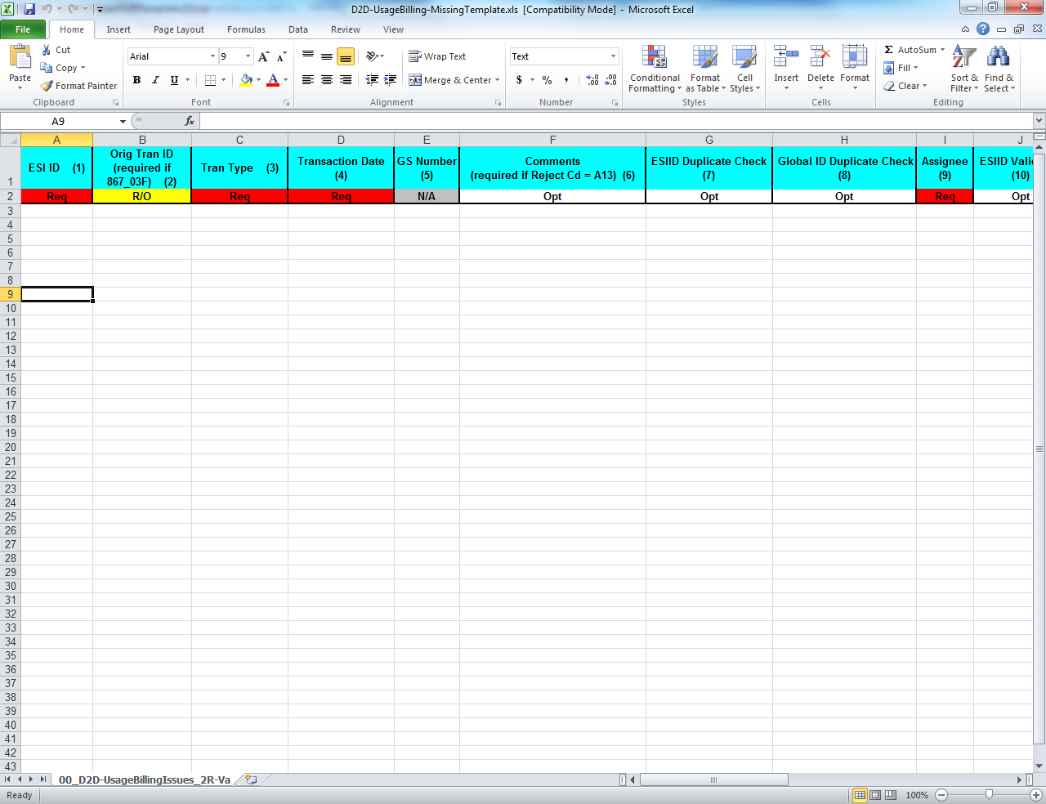
Bulk Insert: .CSV File Template
  Bulk Insert templates for every applicable subtype are available on the MarkeTrak Information Page. Below is a sample of the template for the Usage/Billing Missing subtype:
The definition of the data fields is as follows:
  Required (Req)
  Optional (Opt)
  Not Applicable (N/A)
  Required or Optional (R/O)
  Required or Not Applicable (R/NA)
  Optional or Not Applicable (O/NA)
  DateTime format = ccyy-mm-dd Thh:mm:ss eg: 2019-11-15T13:20:57
  Date format = ccyy-mm-dd eg: 2015-11-15

Slide 82
Bulk Insert: Tips & Tricks
Tip 1 – One template, one subtype
  Only submit multiple issues via bulk insert for the same subtype
Tip 2 – Request all validations occur
  Select all the validations to ensure data is valid and does not contain duplicates.
Tip 3 – Caution when copying ESI IDs
  Use caution when copying ESI IDs and pasting into the Excel Spreadsheet Bulk Insert Template.
  A normal copy and paste can result in the 17 digit ESI ID being automatically formatted by Excel in Scientific Notation Format (example 1.04437E+16).
  Changing the format of the cell in the spreadsheet will result in the last two digits of the 17 digit ESI ID to change to 00. This will cause the MarkeTrak issue to be created using the wrong ESI ID.

Slide 83
Bulk Insert: Tips & Tricks – cont.
Solution for accurate ESI ID format:
Open the Excel Spreadsheet Bulk Insert Template and Right Click in ESI ID cells.
Select Format Cells and choose Text from the list.
Copy ESI ID from source document and right click in the ESI ID cell and choose Paste Special and then choose Text.
This will paste the 17 digit ESI ID into the spreadsheet in text format and avoid Excel changing the ESI ID format.
Tip 4 – Avoid commas in comments
  Avoid commas (,) in any comment on the MarkeTrak issue via Bulk Insert. As a CSV (Comma Separated Value) file, any comma in a comment field will be recognized as a delimiter and misalign the column count causing the file to fail.

Slide 84

Bulk Insert: Tips & Tricks
Tip 5 – Correct format on dates and times
  ensure date/time field has correct format and populates the field in the T-format. If not formatted correctly, bulk insert file will fail validation.
Correct format on dates and times
Tip 6 – Ensure all rows are accounted for
  Before submission of the bulk insert CSV file the user should ensure all rows are accounted for in the file template to successfully pass validation for submission of the file.
Tip 7 – Delete the header row
  Once all data has been entered into required fields on the bulk insert template, the header row should be deleted before saving the file in the CSV format.
Tip 8 – Checking validation errors
  If you receive a validation error, go to notepad and open your CSV file to determine where the error has occurred and correct it. Once the error is corrected save the file with a new name. If you do not save with a new name your corrections will not be saved to the corrected file.
.

Slide 85
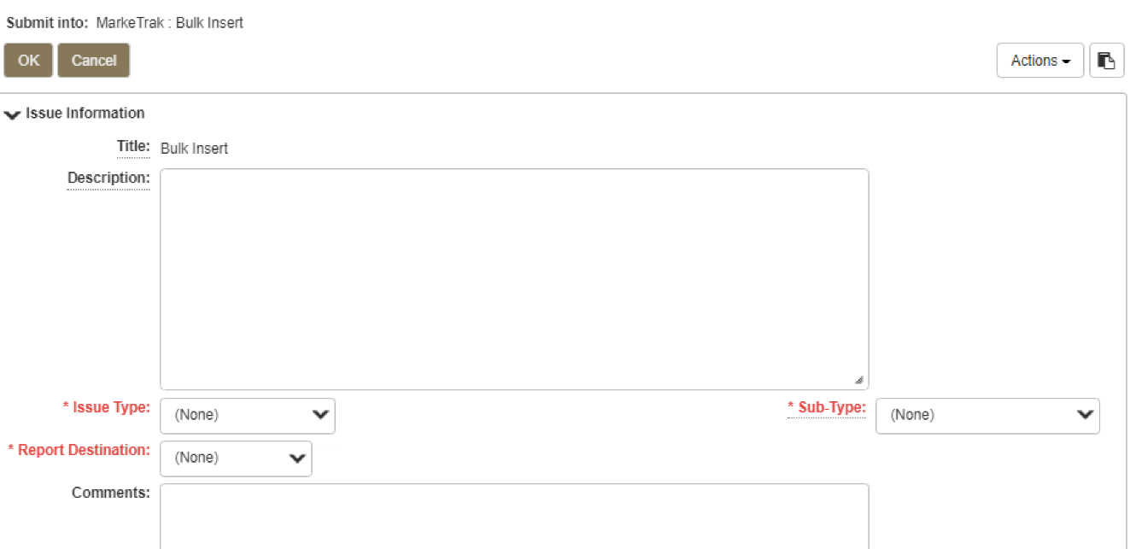
Bulk Insert: Submit
Submitting a Bulk Insert Issue:
  Following fields must be populated for successful submission of Bulk Insert:
    Issue Type
    Sub-Type
    Report Destination
  Submitter selects OK

Slide 86
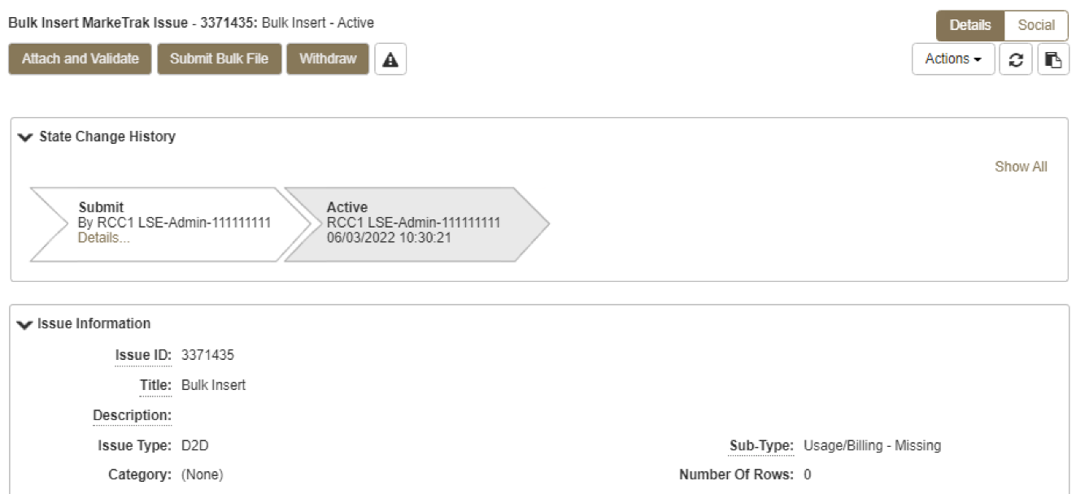
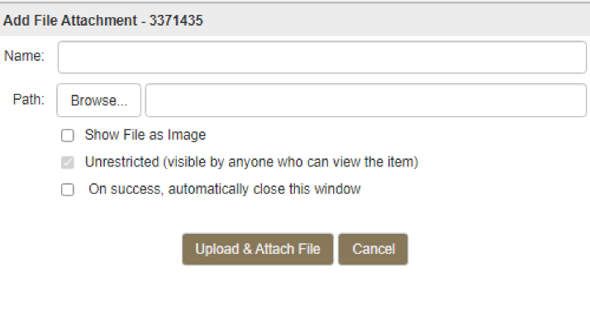
Bulk Insert: Submit (cont.)
From the Actions dropdown, select Add File
Select Browse, locate the CSV file, and press Upload & Attach File

Slide 87
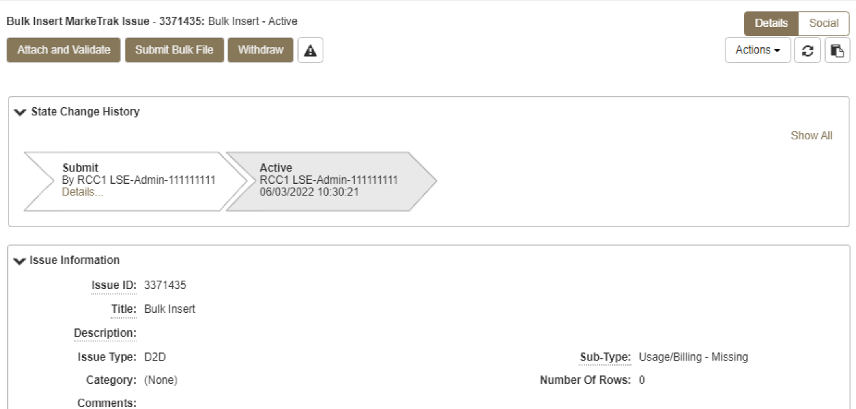
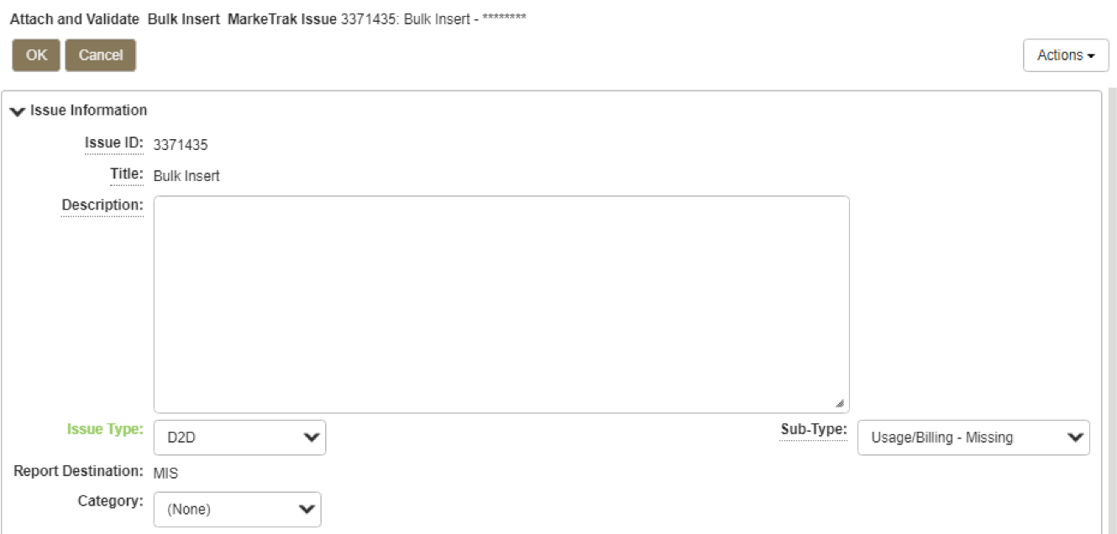
Bulk Insert: Submit (cont.)
Select Attach and Validate
Once the file has been attached select OK to validate the format of the CSV file

Slide 88
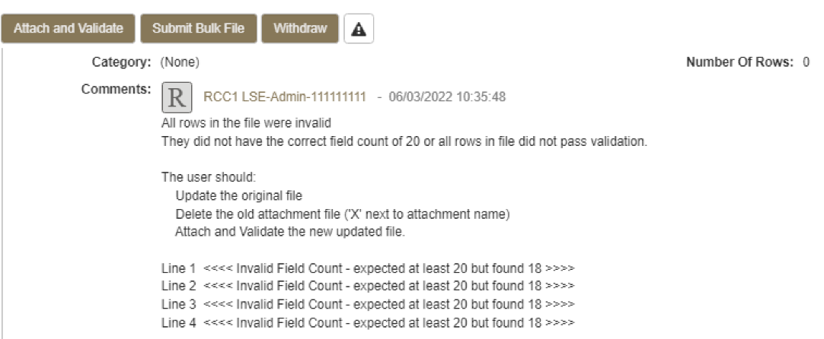
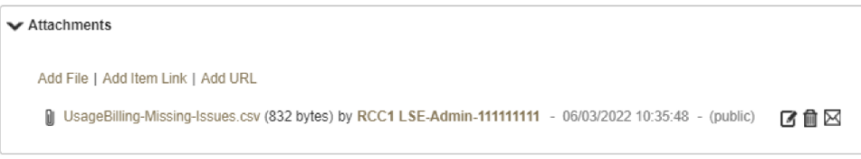
Bulk Insert: Submit (cont.)
Validation will be performed on the uploaded file
  File failure possibilities:
    incorrect number of columns
    formatted incorrectly
  Comments section to display failure message
  Failures must be corrected
  Once corrected, original file must be deleted before it can be reattached
    To delete the file, select trash can icon next to file name
    Select ‘delete file’

Slide 89
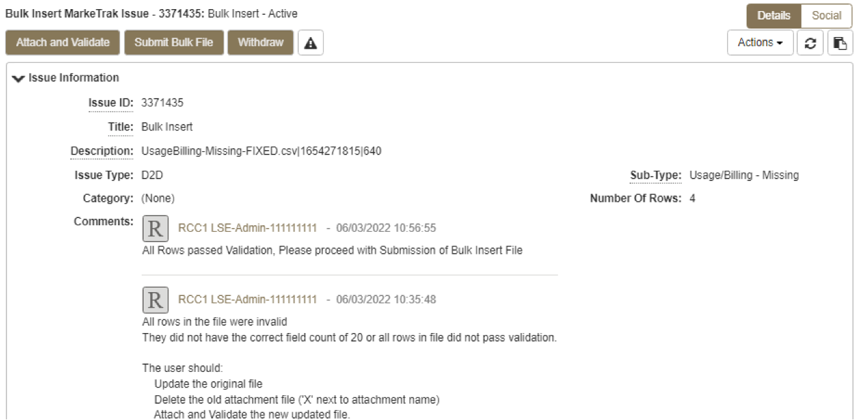
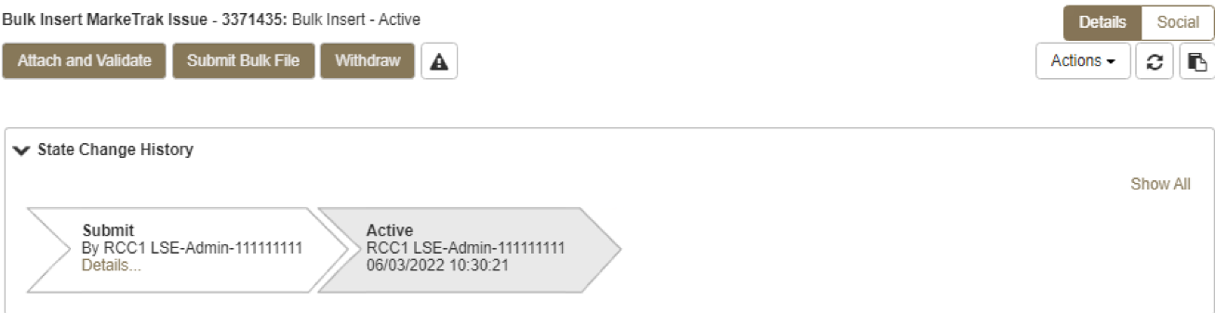
Bulk Insert: Submit (cont.)
If the upload is successful, a message indicating “All rows passed validation” will appear
Select ‘Submit Bulk File’ to create individual issues

Slide 90
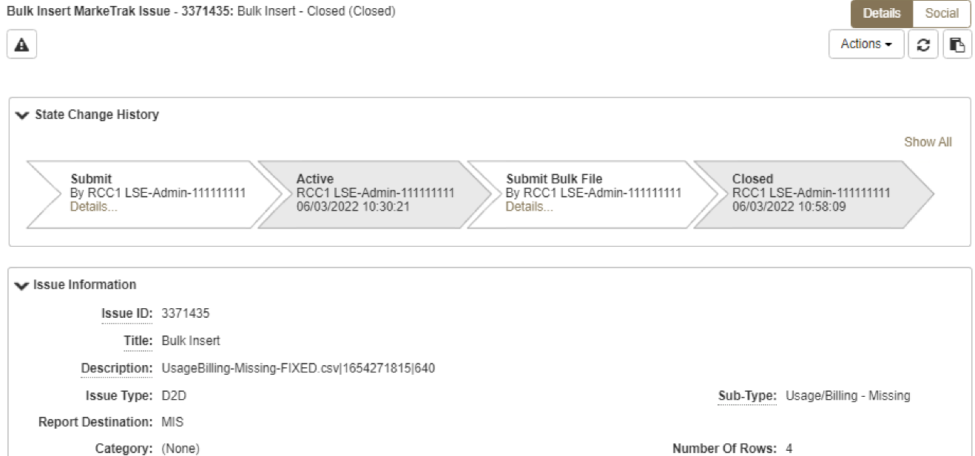
Bulk Insert: Submit (cont.)
After submitting the issue it will automatically close the Bulk Insert issue
Once submitted, Bulk Insert MarkeTrak Number becomes the “parent” and will be populated on each individual MarkeTrak issue (which are the “children”) created by the Bulk Insert

Slide 91
Bulk Insert: Report Destination Options
User chooses report destination as either:
file attached to the MarkeTrak issue
posted to reports section on MIS
  user to download the file via MIS
  access to MIS can be selected through the MarkeTrak GUI screen

Slide 92
Checkpoint Question
In what format should your Bulk Insert file be saved, prior to uploading into MarkeTrak?
  *.pdf
  *.txt
  *.csv
  *.xlsx
c) *.csv

Slide 93
Checkpoint Question
True or False:
Bulk Insert templates for every applicable subtype are available on the MarkeTrak Information Page.
True

Slide 94
MarkeTrak Training
Additional D2D Subtypes

Slide 95
Additional Day to Day Subtypes - Summary
Below is a summary of additional subtypes utilized for specific purposes:
Issue Subtype | Purpose | Submitter
Cancel w/ Approval | Manually cancelling an initiating transaction – MVI, MVO, or Switch Used by CR or TDSP when experiencing system issues CR requesting cancellation of a past-dated ‘scheduled’ transaction | CR or TDSP
997s | Verify if a 997 was sent or received | CR or TDSP
Projects | Project related requests, i.e. Meter Cycle change request | CR or TDSP
ERCOT Initiated | Used when exceptions are in ERCOT’s system (i.e. conflicting metering dates, etc.) | ERCOT
Safety Net Order | Request for follow up EDI transaction after CR submittal of safety net | TDSP

Slide 96
Additional Day to Day Subtypes – Summary – cont.
Below is a summary of additional subtypes utilized for specific purposes:
Issue Subtype | Purpose | Submitter
Move Out w/ Meter Removal | TDSP notification of meter removal if 650_04 is not sent Follow up request for MVO transaction upon 650_04 notification | TDSP
Redirect Fees | When an IAG results in a lights out situation, allows Losing CR to submit within 3 days of receiving 810_02 for recovery of any discretionary fees from Gaining REP | Losing CR
Market Rule | Flexible for operationalizing PUCT rulemaking, i.e. COVID ERP Program, AMS Opt-Out customer requests | TDSP or CR
Reject Transactions | CR or TDSP questions rejected transaction, i.e. invalid EDI, NFI, Dups | CR or TDSP

Slide 97
Additional Day to Day Subtypes – Summary – cont.
Below is a summary of additional subtypes utilized for specific purposes:
Issue Subtype | Purpose | Submitter
REP of Record | CR questions who ERCOT or TDSP show as ROR – i.e. used in Mass Transition process | CR or TDSP
Service Order – 650 Issues | Inquiries related to service orders – missing 650_02 responses or rejects of 650_01 | CR or TDSP
Premise Type | Out of sync conditions for premise types requesting TDSP to submit 814_20 to update premise type | CR
Service Address | CR requests TDSP to submit 814_20 to update a service address for an ESI | CR

Slide 98
MarkeTrak Training
‘Other’ Issues

Slide 99
D2D Issues: Other
Examples of Other Issues but not limited to:
  Questions pertaining to discrepancy between sum of AMS Interval data and the 867 consumption value
  Questions pertaining to Siebel Reports
  Questions pertaining to request for filenames
  Questions pertaining to 997 reports
  Questions pertaining to CSAs
  Questions pertaining to missing information on non-required EDI fields
  Request for reprocessing of transactions
  Questions pertaining to Texas SET Transaction Issues
  Questions pertaining to MIS Portal
A CR or a TDSP can submit this subtype
Required Fields on Submit:
  Assignee

Slide 100
MarkeTrak Training
Background Reporting

Slide 101
MarkeTrak Background Reporting
MarkeTrak Background Reports provide the following functionality:
  Allow users to run a report and work in the GUI at the same time
  Allow users to search multiple inputs, for example:
    Multiple Issue IDs
    Multiple ESI IDs
  Allow users to access archived information that is not available in GUI reports
  API users have the ability to execute and retrieve background reports

Slide 102
MarkeTrak Background Reporting
Available Background Reports
Report Name | Report Description
Average Days Open | Report to Provide average days open by subtype for the time frame specified.
Count of Active and Inactive Issues | Report to provide a count of Active and Inactive issues for the time frame specified.
Count of Issues Resolved Outside Benchmark | Returns a count of issues closed outside of the specified benchmark number of days for a particular time frame.
Count of Issues Resolved Within Benchmark | Returns a count of issues resolved within the specified benchmark number of days for a particular time frame.
Count of Issues in State | Report to provide the total number of issues in each state for the selected subtype(s) for the time frame specified.
Count of Issues by Sub-Type by Submit MP DUNS | Report to provide the count of issues by sub-type for a given submitting MP DUNS for the sub-type(s) selected.
Count of Issues by Submitting MP DUNS | Report to provide the total number of issues identifying the submitting MP type of CR or TDSP.
Count of Issues by Sub-Type | Report to provide the total number of issues submitted for the selected sub-type(s).

Slide 103
MarkeTrak Background Reporting
Available Background Reports
Report Name | Report Description
Details for Issues Resolved Outside of Benchmark | Returns details for issues closed outside of the selected benchmark number of days within the time frame specified.
Issue Details by ESIID | Issue Details for a select group of ESIIDs for the subtype(s) selected.
Issue Details by Issue ID | Issue Details for a select group of Issue IDs for the subtype(s) selected.
Time in State | Report to provide the days an issue spent in each distinct state both the first time it moves into the state as well as the last time if applicable.
Total No. Closed | Report to provide a count by subtype of all issues closed within the specified time frame.
Issues Open Outside Benchmark | Report to Provide the active issues that have been open outside of the selected benchmark number of days.
Issue Transition Details | Report to Provide by subtype the issue transition details. This report will also help with tracking the transition details for the Meter Tampering Switch Hold Issues.

Slide 104
MarkeTrak Training

Slide 105
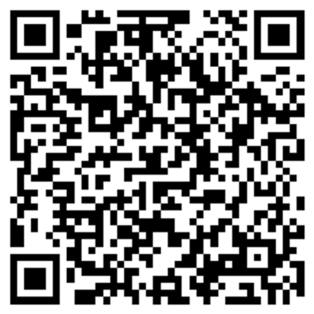
MarkeTrak Training
Survey
What did you like?
What didn’t you like?
What could we do better?
www.surveymonkey.com/r/ERCOTILT

