Slide 1
Switch Hold and Inadvertent Gain Training – Part 2

Slide 2
Antitrust Admonition
  To avoid raising concerns about antitrust liability, participants in ERCOT activities should refrain from proposing any action or measure that would exceed ERCOT’s authority under federal or state law. For additional information, stakeholders should consult the Statement of Position on Antitrust Issues for Members of ERCOT Committees, Subcommittees, and Working Groups, which is posted on the ERCOT website.¹

Slide 3

Notes
Morning Break
Please unmute yourself prior to speaking
Place yourself on mute when not speaking

Slide 4
MarkeTrak Online Training
MarkeTrak online training is available on www.ercot.com and includes the following modules:
MarkeTrak Overview
Inadvertent Gain/Loss
Cancel With/Without Approval
Switch Hold Removal
Data Extract Variance (DEV) LSE Subtypes
Email Functionality
Usage/Billing Disputes
Additional Day to Day Subtypes
Bulk Insert
Admin Functionality
Data Extract Variance (DEV) Non-LSE Subtypes
Reporting
Modules typically can be completed in 30 minutes or less.

Slide 5
MarkeTrak Training Objectives – Part 1
Part 1 training covered the following topics:
General MarkeTrak Navigation
Administrator Functionality
Email Notification
ListServ
Missing Enrollments
Usage & Billing
Siebel Changes
DEV LSE/Non LSE
Bulk Insert
Additional D2D Subtypes
Other Subtype
Background Reporting

Slide 6
MarkeTrak Training Objectives – Part 2
This training covers the following topics:
Switch Holds
Inadvertent Gains
  Overview
  Rescission
  IAG Walkthrough
  Best Practices
  Reporting

Slide 7
MarkeTrak Training
Switch Hold

Slide 8
Switch Hold
Purpose:
To ensure that the occupant responsible for the financial obligations at the premise satisfies and resolves any outstanding charges with the appropriate entities before switching to a new REP.
What it is:
According to PUCT Subst. Rule 25.126 & PUCT Subst. Rule 25.480, a Switch Hold can be placed on a premise by either a Retail Electric Provider (REP) for a Deferred Payment Plan (DPP) or by the Transmission and Distribution Service Provider (TDSP) due to Meter Tampering. The Switch Hold will remain in effect until the specified charges have been paid by the customer.
Types:
1) Deferred Payment Plan (DPP) – REP initiated
2) Tampering – TDSP initiated

Slide 9
Types of Switch Hold
Deferred Payment Plan (DPP) Switch Holds:
Initiated and removed by the REP of Record via 650_01 to TDSP.
Prevents customers from switching to another REP if they have outstanding charges with current REP of Record (ROR).
Current ROR must provide clear explanation (orally or written) to customer of the switch hold process before initiation of DPP Switch Hold.
Current ROR must receive customer’s agreement before initiation of DPP Switch Hold.
Switch Hold must be removed by ROR in a timely manner once all DPP obligations have been satisfied by the customer.

Slide 10
Types of Switch Hold
Tampering Switch Holds:
Initiated by the TDSP when Tampering is discovered at the premise.
TDSP must store evidence of Tampering discovery.
TDSP sends 814_20 to update ESIID status for Tampering.
TDSP sends Tampering charges on the 810_02 to ROR.
Switch Hold prevents customer from switching to another REP if they have outstanding Tampering charges with current ROR.
Switch Hold must be removed in a timely manner by current ROR via 650_01 once all outstanding Tampering charges are satisfied by the customer.

Slide 11
Switch Hold Removal for Purposes of a Move In
Scenario:
A Premise has a Switch Hold applied, however the customer vacates the premise. An entirely new customer tries to move in, yet encounters the Switch Hold on the Premise.
When this happens, the requesting REP cannot use a 650_01 to remove the Switch Hold, since they are not the initiators of the Switch Hold.
Instead, the requesting REP must follow the process outlined in Retail Market Guide Section 7.16.4.3 (for Tampering) or 7.17.4.3 (for DPP) associated with removal of a Switch Hold for purposes of a Move In.

Slide 12
Switch Hold Removal for Purposes of a Move In
How it works:
Using only one (1) MarkeTrak issue per ESI ID, the requesting CR must initiate the Switch Hold MarkeTrak (MT) issue type to begin the removal process.
The TDSP, current REP of Record, and requesting CR will collaborate to determine if the New Occupant is in any way associated with the Current Occupant who is subject to Switch Hold.
The requesting CR must provide supporting documentation for the New Occupant including a New Occupant Statement (NOS).
  Confirm a Switch Hold currently exists on the premise via MIS portal
  Ensure submitter is not ROR
  Documentation is valid and complete
If it is determined that the New Occupant is not associated with the Customer of Record (current occupant), the TDSP will remove any Switch Holds applied to the ESIID.
If an issue has been open for more than four (4) business hours without resolution, the TDSP will make the final decision as to whether or not the Switch Hold will remain.

Slide 13
Switch Hold Removal
What does it mean: Four (4) Business Hours?
MarkeTrak Switch Hold Removals are worked during Business Hours only (Monday-Friday, 8:00AM-5:00PM CPT)
Market Participant Timelines:
  TDSP “Initial” review: one (1) business hour
  Current REP of Record review: one and a half (1.5) business hours
  TDSP “Final” review: one and a half (1.5) business hours (or any remaining time within the four-hour period)
If issue remains unresolved at the end of a business day, the Responsible MP’s time will resume next business day at 8:00AM
  Example: REP of Record is assigned the issue at 4:00PM Friday. Business hours cease at 5:00PM Friday. Business hours resume 8:00AM Monday. REP of Record has until 8:30 AM Monday to respond, for a total of one and a half business hours as Responsible MP.

Slide 14
Switch Hold Removal Documentation
Standard Documentation Requirements
Per RMG 7.16 & 7.17, the Requesting CR must include the New Occupant Statement (RMG Appendix J2) AND one of the following:
Bill for natural gas/propane, water/sewer, electric, or cable/internet in Customer’s name dated within last two months from a different Premise (cell phone invoices are not accepted);
Copy of current signed lease by all parties;
Notarized affidavit of landlord;
Closing documents (Closing Statement signed by buyer and seller; Deed filed by county clerk noting street name and house number); or
Certificate of occupancy indicating new occupant.
Ensure documentation is valid and complete prior to submitting a MarkeTrak Issue.

Slide 15
Switch Hold Removal Documentation
Standard Documentation “Best Practices”
TDSPs will review all supplied documentation for completeness. For quickest resolution, the documentation provided should include:
Utility bill (Natural Gas/Propane, Water/Sewer, Electricity, Cable/Internet)
  Dated within last two months from a different Premise address and New Occupant’s name and service address should be visible
Current Signed Lease
  Customer name, service address, portion of lease signed by both landlord and tenant
  Dates on lease should align with Move In request
  Any expired agreements or agreement not signed by all parties will be rejected by TDSP
Affidavit of Landlord
  Notarized
  If form Appendix J9 is not used, the document must contain all data elements required within J9
Closing Documents
  Closing Statement with buyer/seller signatures
  Deed that has been filed with the county clerk, indicating street name and house number
  New Occupant’s name and service address should be visible
  Indicating transfer of ownership occurring after Switch Hold was applied
Certificate of occupancy
  Indicating new occupant being subsequent to the date of the switch hold applied to the Premise;

Slide 16
Switch Hold Removal
Continuous Service Agreement (CSA) Documentation Requirements
For a premise where a CSA agreement is present, only the CSA form in Appendix J4/J5 is required. The New Occupant Statement does not need to accompany the CSA form, and it does not need to be notarized.
The Requesting CR must be the CSA provider, established via 814_18 CSA Add transaction.
If there is not an actual CSA, the Requesting CR must use the previously mentioned process.
  New Occupant Statement + documentation
  Example: Non-CSA vacant agreement

Slide 17
Switch Hold Removal
“Happy Path” #1 – All users agree and switch hold is removed
Requesting CR selects Switch Hold Removal from Submit Tree.
Requesting CR enters all required information, attaches all valid and necessary documentation and chooses the ‘Submit’ transition.
The issue is now in the state of ‘New (TDSP)’ with the TDSP as Responsible MP.
TDSP selects ‘Begin Working’.
The issue is now in a state of ‘In Progress (TDSP)’.

Slide 18
Switch Hold Removal
“Happy Path” #1 – All users agree and switch hold is removed (cont.)
TDSP selects ‘Send to REP of Record’.
  Enters DUNS/company name via dropdown.
The issue is now in a state of ‘New’ with the REP of Record as Responsible MP.
REP of Record selects ‘Begin Working’.
Issue is now in a state of ‘In Progress (Assignee)’.
REP of Record selects ‘Agree’.

Slide 19
Switch Hold Removal
“Happy Path” #1 – All users agree and switch hold is removed (cont.)
Issue is now in a state of ‘New (TDSP) - Final Review’ with the TDSP as Responsible MP.
TDSP selects ‘Begin Working’.
Issue is now in a state of ‘In Progress (TDSP)- Final Review’ with the TDSP as Responsible MP.
TDSP selects the ‘Switch Hold Removed’ transition.
Issue is now in a state of ‘Pending Complete’ with Requesting CR as Responsible MP.
Requesting CR selects ‘Complete’, and issue is closed.

Slide 20
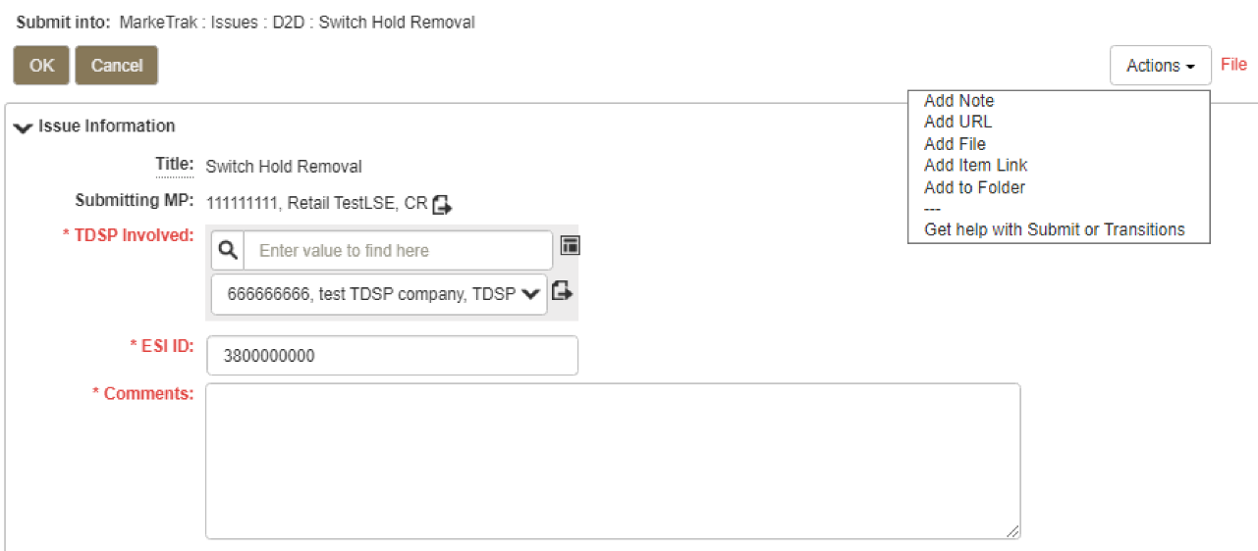
Switch Hold Removal
File attachment is required on the Submit transition.
Requesting removal of Switch Hold
CR enters required information and attaches file(s).

Slide 21
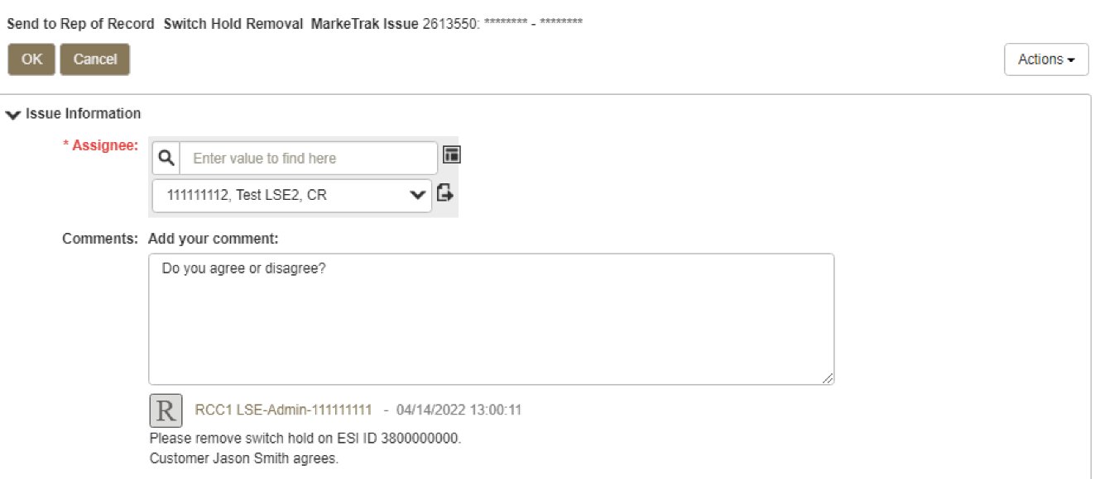
Switch Hold Removal
REP of Record DUNS is used by TDSP to assign issue.

Slide 22
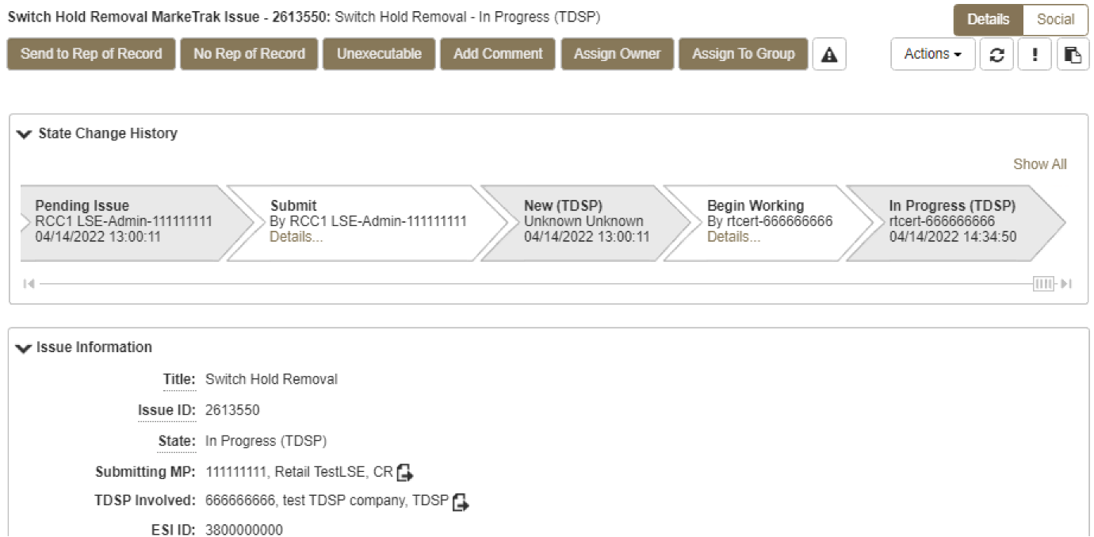
Switch Hold Removal
TDSP sends to REP of Record.

Slide 23
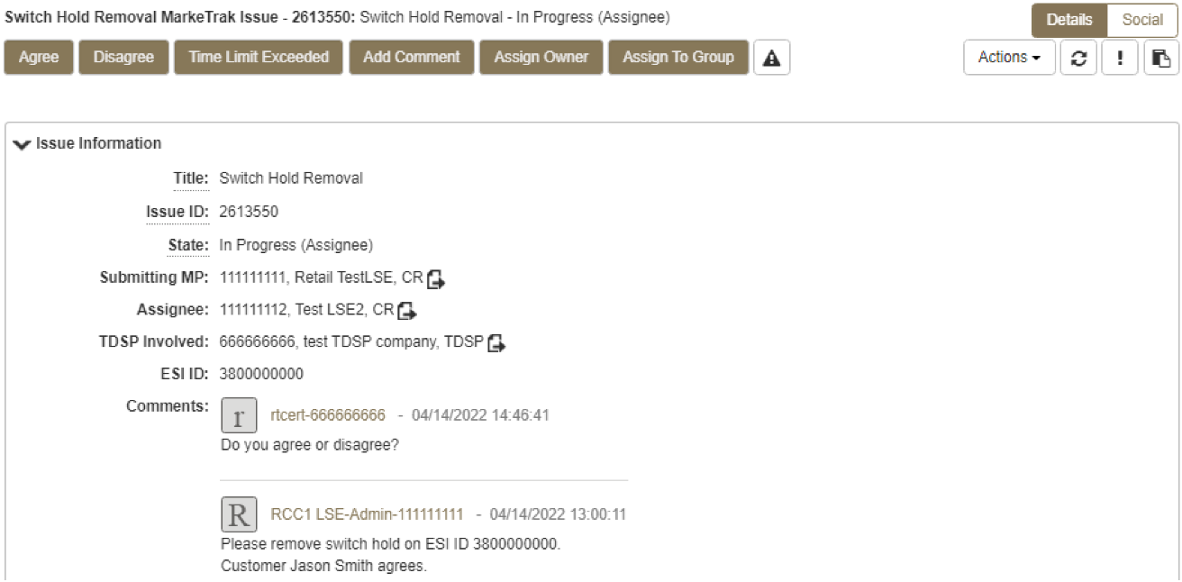
Switch Hold Removal
REP of Record agrees to release switch hold.

Slide 24
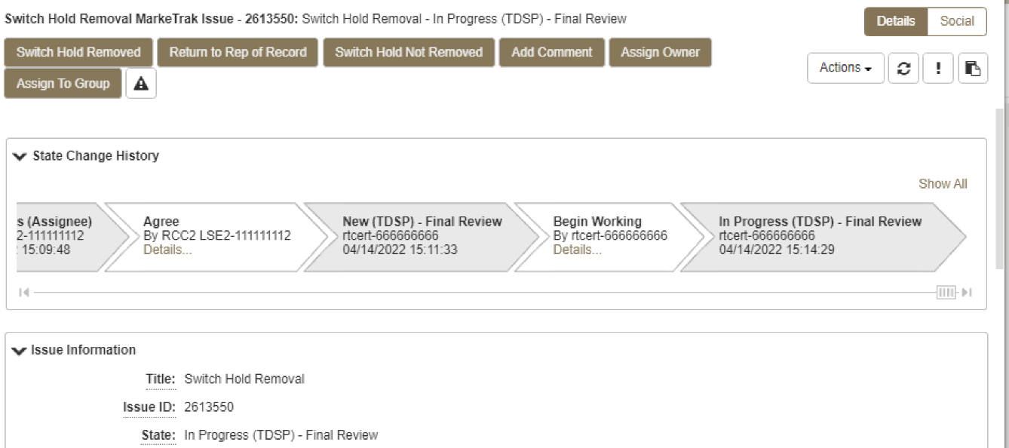
Switch Hold Removal
TDSP confirms removal of switch hold.

Slide 25
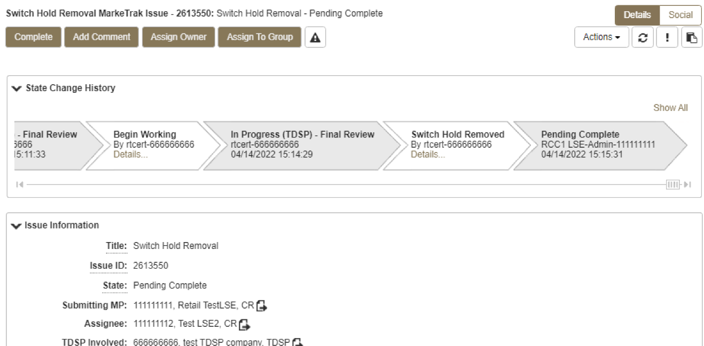
Switch Hold Removal
Submitting (Requesting) CR selects ‘Complete’ and the issue is closed.

Slide 26
Alternate Resolution Paths
Step by Step walkthrough of the following paths is located after the checkpoint questions:
REP of Record disagrees; TDSP declines to remove hold
REP of Record disagrees; TDSP still removes hold.
TDSP rejects issue during first step as Responsible MP.
REP of Record does not choose “Begin Working”, exceeds time limit.
REP of Record selects ‘Begin Working’, exceeds time limit.
‘Time Limit Exceeded’ used before one and a half business hours.
Ultimately the TDSP determines if the Switch Hold will be removed.

Slide 27
Switch Hold Overview
References and General Overview of Switch Hold Process:
PUCT Rule References:
PUCT Subst. Rule 25.126, Adjustments due to Non-Compliant Meters and Meter Tampering in Areas where Customer Choice has been Introduced
PUCT Subst. Rule 25.480, Bill Payments and Adjustments
Retail Market Guide References:
7.16, Business Processes & Communications Related to Meter Tampering
  7.16.4.3, Removal of a Switch Hold for Meter Tampering for Purposes of a Move In
7.17, Business Processes & Communications Related for Switch Holds Related to Deferred Payment Plans
  7.17.3.3, Removal of a Switch Hold for Deferred Payment Plans for Purposes of a Move In

Slide 28
Checkpoint Question
How long does the REP of Record have to review the Switch Hold Removal request, once the TDSP assigns the issue to them?
  1 hour
  4 hours
  1 ½ hours
  6 Hours
  None of the Above
Answer:
C) 1 ½ hours

Slide 29
Checkpoint Question
The TDSP assigns a Switch Hold Removal MarkeTrak issue to the REP of Record on Friday, at 4:30 pm. When does the REP of Record's review period expire?
  Friday at 6:00pm
  Saturday at 9:00 am
  Sunday at 9:00 am
  Monday at 9:00 am
  None of the Above
Answer:
D) Monday at 9:00am

Slide 30
Checkpoint Question
Which of the following documents is not an “acceptable” document for Switch Hold Removal consideration?
Utility bill from a different address dated within the last two months
Notarized Affidavit of Landlord
Closing documents executed after the Switch Hold was applied
Cell phone bill
All of the above
Answer:
D) Cell phone bill

Slide 31

Questions

Slide 32
MarkeTrak Training
Inadvertent Gain/Loss (IAG) Overview

Slide 33
What is an IAG?
An Inadvertent Gain/Loss (IAG) is an unauthorized change of a customer’s
Retail Electric Provider
Commonly referred to as either an Inadvertent Gain (IAG) or Inadvertent Loss (IAL), an inadvertent situation occurs when a customer or a premise is changed to a REP that is different than their expected REP of choice.
When resolving IAG issues, the ultimate goal is to return the Customer to their REP of choice in a quick and efficient manner with minimal inconvenience to the Customer.

Slide 34
Gaining CR and Losing CR
The Gaining CR is a competitive retailer who inadvertently gains an ESI ID and is responsible for returning the customer to the previous REP of Record.
  When initiating the MarkeTrak process the Gaining CR shall submit the Inadvertent Gain subtype.
The Losing CR is a competitive retailer who was the REP of Record prior to losing an ESI ID due to an Inadvertent Gain situation.
  When initiating the MarkeTrak process the Losing CR shall submit the Inadvertent Loss subtype.

Slide 35
Reference Documents
PUCT Subst. Rule §25.495, Unauthorized Change of Retail Electric Provider
ERCOT Retail Market Guide Section 7.3, Inadvertent Gain Process
MarkeTrak User’s Guide, Section 2

Slide 36
How does an IAG occur?
An Inadvertent Gain or Loss can occur under various circumstances:
Incorrect information provided by the Customer during enrollment – service address, ESI ID, wrong apartment number.
Incorrect information entered by the REP during enrollment
Unauthorized enrollments – slamming
Variety of different enrollment processes used by REPs

Slide 37
Invalid Use of the IAG Process (effective 1/1/2023)
RMG Section 7.3.2.1
After the Rescission Period
  Untimely notice of rescission does not constitute and should not be treated as an inadvertent gain or loss. Customer may select another REP and complete an enrollment.
Breach of Contract
  Not to be used to resolve an early termination fee issue between the Customer and the losing CR
  Not to be used to resolve a non-payment issue between the Customer and the gaining CR
Identity Theft
  Not to be used to resolve an issue where service is connected as a result of identity theft

Slide 38
Who does an IAG impact?
Customer
Gaining REP
ERCOT
Losing REP
TDU

Slide 39


How is the Market impacted?
Customer
  Confusion as to who is their REP
  Delayed Billing
  Possible Lights Out Situation
  Poor Customer Experience
Market
  Most used MT Subtype - represents over 49% of all MTs
  One of the longest MT issues to resolve
  It can create distrust and confusion in the Market
Cost
  Resource Commitments
  Consumption Write-offs
  IAG Fees from TDSPs

Slide 40
Questions

Slide 41
MarkeTrak Training
Customer Rescission Walkthrough

Slide 42
Right of Rescission
PUCT Subst. Rule 25.474(j) - Right of Rescission
A REP shall promptly provide the applicant with the terms of service document after the applicant has authorized the REP to provide service to the applicant and the authorization has been verified. For switch requests, the REP shall offer the applicant a right to rescind the terms of service without penalty or fee of any kind for a period of three federal business days after the applicant's receipt of the terms of service document. The provider may assume that any delivery of the terms of service document deposited first class with the United States Postal Service will be received by the applicant within three federal business days. Any REP receiving an untimely notice of rescission from the applicant shall inform the applicant that the applicant has a right to select another REP and may do so by contacting that REP. The REP shall also inform the applicant that the applicant will be responsible for charges from the REP for service provided until the applicant switches to another REP. The right of rescission is not applicable to an applicant requesting a move-in.

Slide 43
Right of Rescission
In other words …
Applicable to Switch requests only, not Move-Ins.
After receiving the Terms of Service, Customer is allowed three (3) federal business days to rescind without penalty or fees from the Gaining REP.
Ultimate goal is to return the Customer to their REP of choice quickly and efficiently with minimal inconvenience to the Customer.

Slide 44
Rescission vs. Inadvertent Switch
Strongly recommended that involved CRs share as much information as possible at the onset of issue creation to aid in resolution of Customer Rescission issue quickly and efficiently (e.g. Customer Name, Meter #, etc.)
Although Customer Rescission is part of the Inadvertent Switch ‘family’ within the MarkeTrak tool, resolution of a Customer Rescission does not follow the same criteria nor follow the same completion timeline.
If/when the customer requests rescission (within the 3 federal business day window), the ‘losing’ REP must promptly regain the Customer – no questions asked.
  The research and investigation normally pursued during resolution of an Inadvertent Switch is not utilized when resolving Customer Rescission.

Slide 45
Rescission vs. Inadvertent Switch
Handling of Fees/Charges Associated with IAG vs Rescission
(per TDSP tariff):
 | Customer Rescission | Inadvertent Gain/ Loss
Can CRs pass TDSP fees to customer? | No | Yes – TDSPs may charge Gaining CRs an IAG fee and/or pass-through charges. Gaining CRs may choose to pass these charges to the customer.
Can CRs pass kWh usage to customer? | No | Yes – because IAG reinstatement date can range from “DOL + 1” to “Date of MT submission +10”, Gaining CRs may choose to pass kWh charges (usage) to the customer.
Notes:
NEW SLIDE

Slide 46
Customer Rescission Guidelines
Only the Gaining CR may submit the rescission-based MarkeTrak
The issue must be submitted on or before the twenty-fifth (25th) calendar day following ERCOT’s established First Available Switch Date (FASD).
If a Customer Rescission issue has not been submitted within the specified timeframe above, the two CRs should work to resolve the issue through the IAG/IAL subtype.

Slide 47
Completion Timeline for Customer Rescission (SCR815)
Once a Customer Rescission MarkeTrak (MT) issue has been submitted, the Losing CR has two (2) business days to agree to the Customer Rescission MT issue.
  If the MT has not transitioned in two business days, an escalation email will be sent.
Once the Transmission and/or Distribution Service Provider (TDSP) has updated the MT issue to “Ready to Receive”, the Losing CR has another two (2) business days to send a backdated 814_16, Move-In Request.
  If the BDMVI has not been submitted in two business days, an escalation email will be sent.

Slide 48
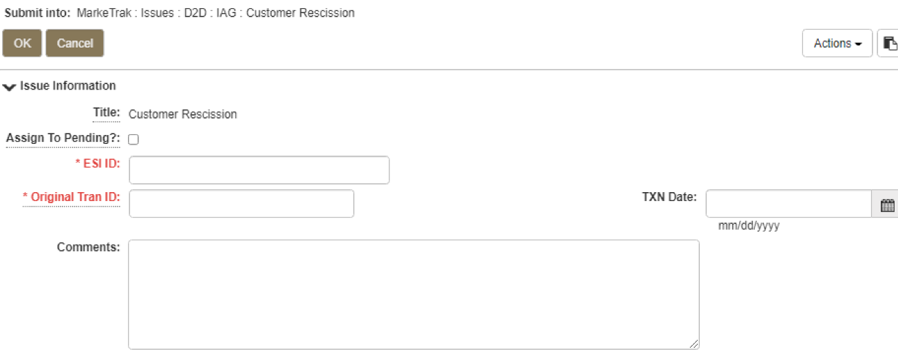
Rescission Walkthrough – Gaining CR
The following fields must be populated:
ESI ID
Original Tran ID
Comments (Recommended)

Slide 49
Rescission Walkthrough - Validations
ERCOT validates ESI ID, submission timeframe and valid originating transaction.
Upon passing validation, MarkeTrak issue is created and ERCOT updates the issue with the following information:
  Losing CR Name and Duns
  TDSP Name and Duns
  Gaining CR ROR = Y or N
  Gaining CR Start Date
  Regain Date – auto populated by ERCOT.
  (Gaining CR Start Date +1 calendar day)
MarkeTrak issue is assigned to the state of ‘New (Losing CR)’ with the Losing CR as the Responsible Party.
[Starts the 2 Business Day clock for Losing CR to Agree]
Losing CR user selects ‘Begin Working’.

Slide 50
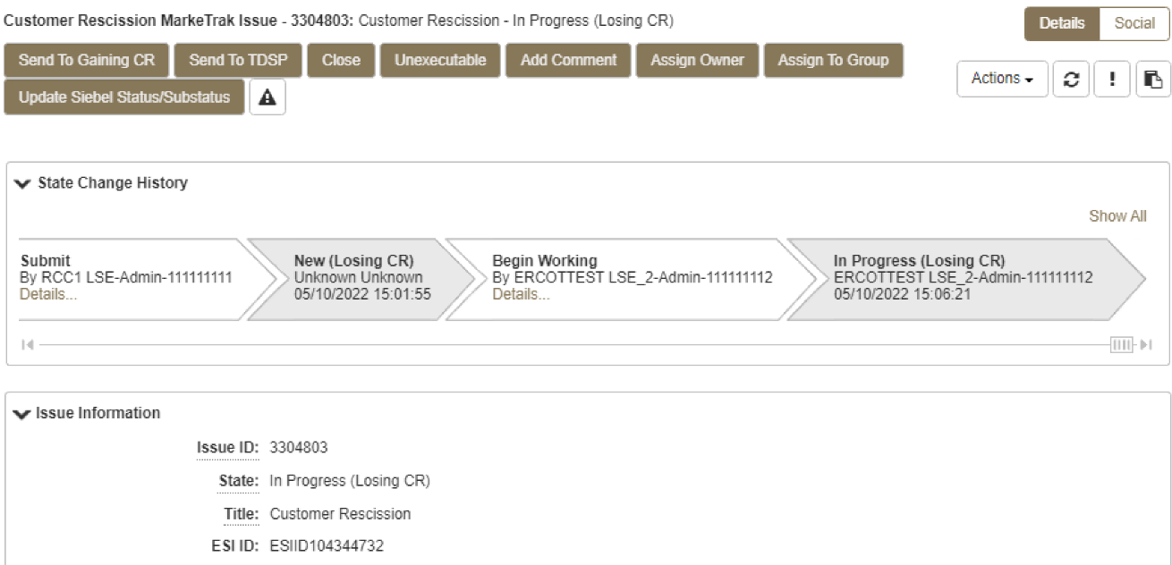
Rescission Walkthrough – Losing CR
MarkeTrak issue is assigned to the state of ‘In Progress (Losing CR)’ with the Losing CR as the Responsible Party.
Losing CR selects ‘Send to TDSP’.
[Implies “Agreement” & ends the 2 Business Day clock]

Slide 51
Rescission Walkthrough – TDSP
Issue is in a state of ‘New (TDSP)’ with TDSP as Responsible MP.
TDSP selects ‘Begin Working’.
Issue is in a state of ‘In Progress (TDSP)’ with TDSP as Responsible MP.

Slide 52
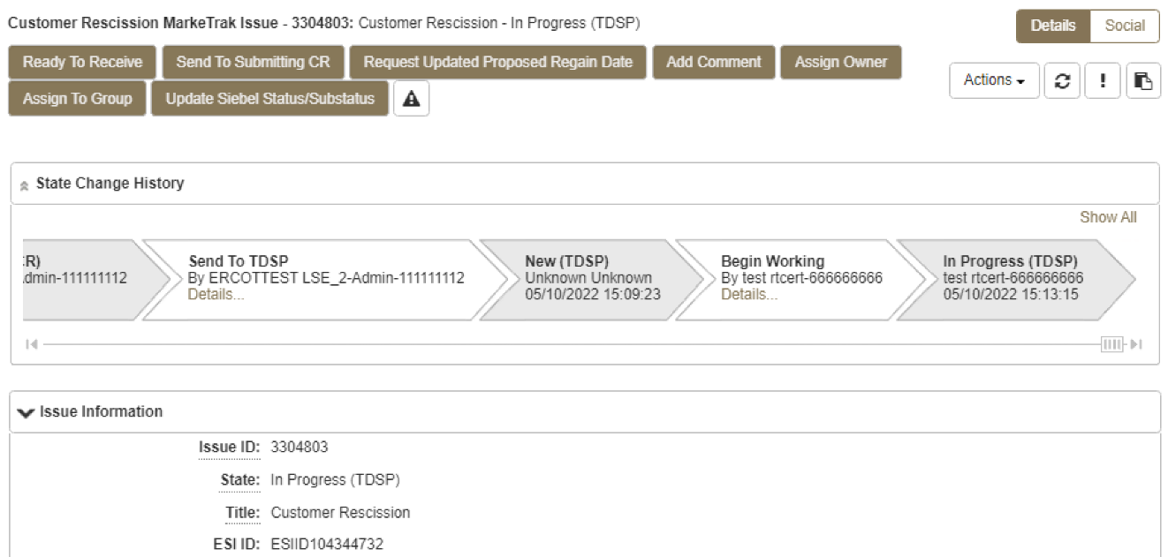
Rescission Walkthrough - TDSP
TDSP selects ‘Ready to Receive’
[Starts the 2 Business Day clock for Losing CR to submit BDMVI]

Slide 53
Rescission Walkthrough – Losing CR
Issue is in a state of ‘New (Losing CR Submit)’ with the Losing CR as Responsible MP.
Losing CR selects ‘Begin Working’.
Issue is in a state of ‘In Progress (Submit Regaining)’ with the Losing CR as Responsible MP.

Slide 54
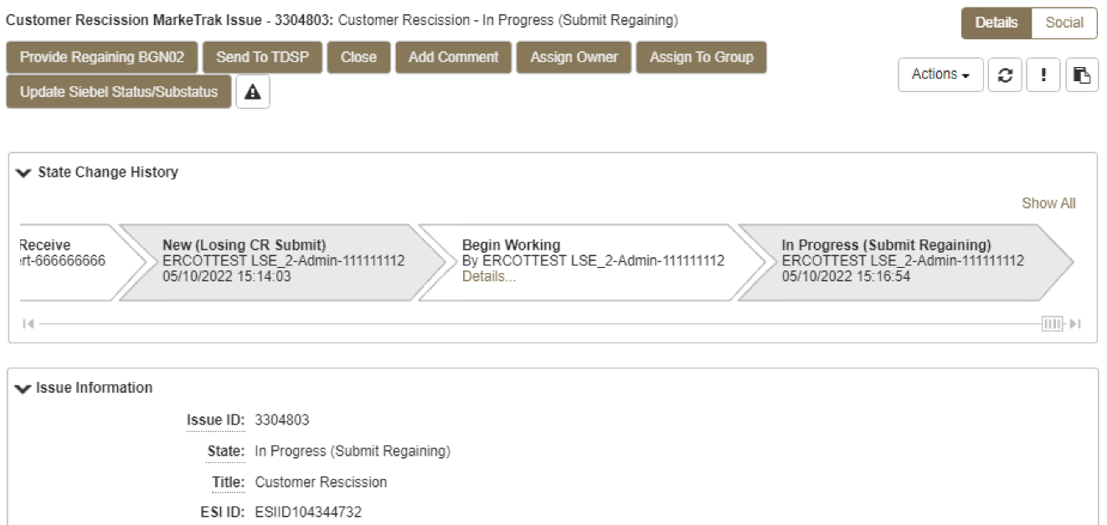
Rescission Walkthrough – Losing CR
Losing CR selects ‘Provide Regaining BGN02’.

Slide 55
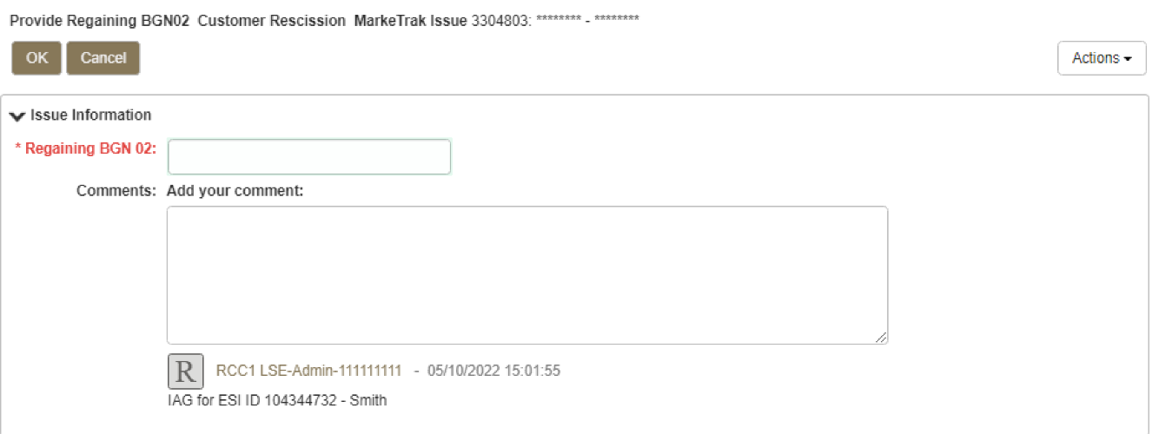
Rescission Walkthrough – Losing CR
Losing CR populates all required information:
  Regaining BGN 02

Slide 56
Rescission Walkthrough - Resolution
Issue is in a state of ‘Regaining Transaction Submitted (PC)’ with the Gaining (Submitting CR) as Responsible MP.
Once the regaining transaction (Backdated 814_16 MVI) has been successfully sent by (Losing/Original CR), Siebel will automatically:
  Check Regaining Transaction Siebel Status every 30 minutes using the BGN 02 from the new initiating transaction.
  Update the issue with the current Regaining Transaction Siebel Status.
The issue will move to a state of ‘Complete’ with the Submitting MP as the Responsible Party once the Regaining Transaction Siebel Status is Complete.
[Ends the 2 business day clock for the Losing CR]

Slide 57

Checkpoint Question #1
Who can submit a Rescission MarkeTrak?
  The Losing REP
  The Gaining REP
ANSWER
The Gaining REP – only the Gaining REP may initiate the Rescission process

Slide 58
Checkpoint Question #2
In order to efficiently process a Rescission MT, the customer name should be stated in the comments.
  True
  False
ANSWER
TRUE – providing any relevant information assists in the timely resolution of the MT

Slide 59
Checkpoint Question #3
A customer who has exercised their ‘right of rescission’ may receive fees from the Gaining REP.
  True
  False
ANSWER
FALSE – per PUC Subst. Rule 25.474(j), a customer has the right to rescind the terms of service without penalty or fee of any kind

Slide 60
Checkpoint Question #4
Once the Losing REP has agreed to the Rescission, they have _______ days to submit the BDMVI.
  10 days
  5 business days
  2 business days
  14 days
ANSWER
2 business days – once the TDSP has transitioned the MT to “Ready to Receive”

Slide 61
Questions

Slide 62
MarkeTrak Training
Inadvertent Gain (IAG) MarkeTrak Walkthrough

Slide 63
Inadvertent Gain
An inadvertent issue begins upon the discovery of an Inadvertent Gain or Move-In transaction submission.
Upon identification of an Inadvertent Gain, the CR will check the transaction status via the ERCOT MIS.
  If transaction Status is “In Review” or “Scheduled” with a ‘key date’ > 1 day and the Inadvertent CR is the submitting CR, then the CR will cancel their submitting transaction by submitting an 814_08 EDI cancel transaction.
  For “Completed” or “Scheduled” status where the ‘key date’ is the same day, or if the CR is not the submitter of the transaction, the CR will log a MarkeTrak Inadvertent issue.

Slide 64
Inadvertent Gain
CR’s will work together in a manner outlined in Section 7.3 of the Retail Market Guide (RMG) to determine appropriate resolution.
  CRs, both Losing and Gaining Reps, must investigate the matter and provide all necessary/relevant information – customer name, service address, meter number
  Bulk Inserts may only be used for submission of multiple IAGs for the same customer or in cases when a system processing issue occurred only with proper notification
If resolution requires a backdated move-in (BDMVI), the regain date should be Date of Loss + 1 (DOL+1) or at the latest 10 days from the date the MarkeTrak was submitted to avoid creating transaction business process exceptions at ERCOT and the TDSP.
  The Losing Rep shall submit the BDMVI 814_16 no later than 12 days after submittal of the MarkeTrak and shall be dated with the ‘proposed regain date’ as agreed in the MarkeTrak.

Slide 65
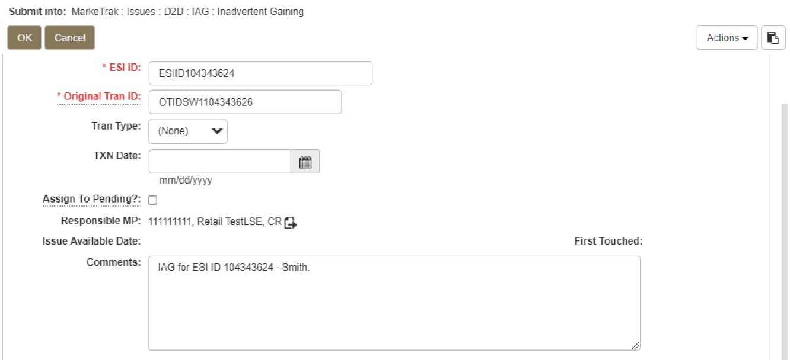
Inadvertent Gain
CR1 (Gaining/Original CR) will enter all required information.
  ESIID
  Original Tran ID – The original tran id of the other CR’s enrollment. (BGN06 of the 814_06).
  CRITICAL: The Comments field is technically optional; however, not providing the required information referenced in RMG Section 7.3.2(1) could result in a delay of issue resolution.
  Please include any additional information in this box.
        Customer Name (Always)
        Meter Number (If available)
        Any other pertinent information that will help expedite resolution

Slide 66
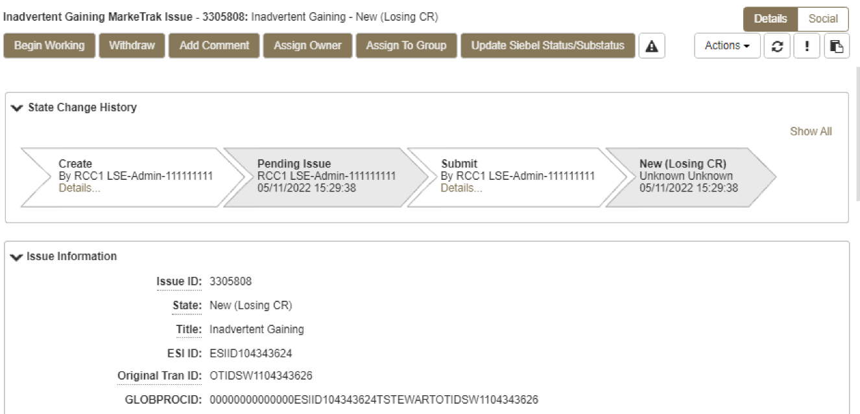
Inadvertent Gain
2. Select OK to create the IAG – Inadvertent Gaining MarkeTrak Issue. The issue enters the state of New (ERCOT) and is visible only by the Submitting CR and ERCOT.
The Submitting CR has the option to Withdraw the issue at this point
3. ERCOT will select Begin Working to provide the Gaining CR Start Date, if the Gaining CR is still the rep of record (Gaining CR ROR), assign CR2 (Gaining CR) and TDSP. ERCOT will then select “OK” to move the issue to CR2 (Gaining CR).

Slide 67
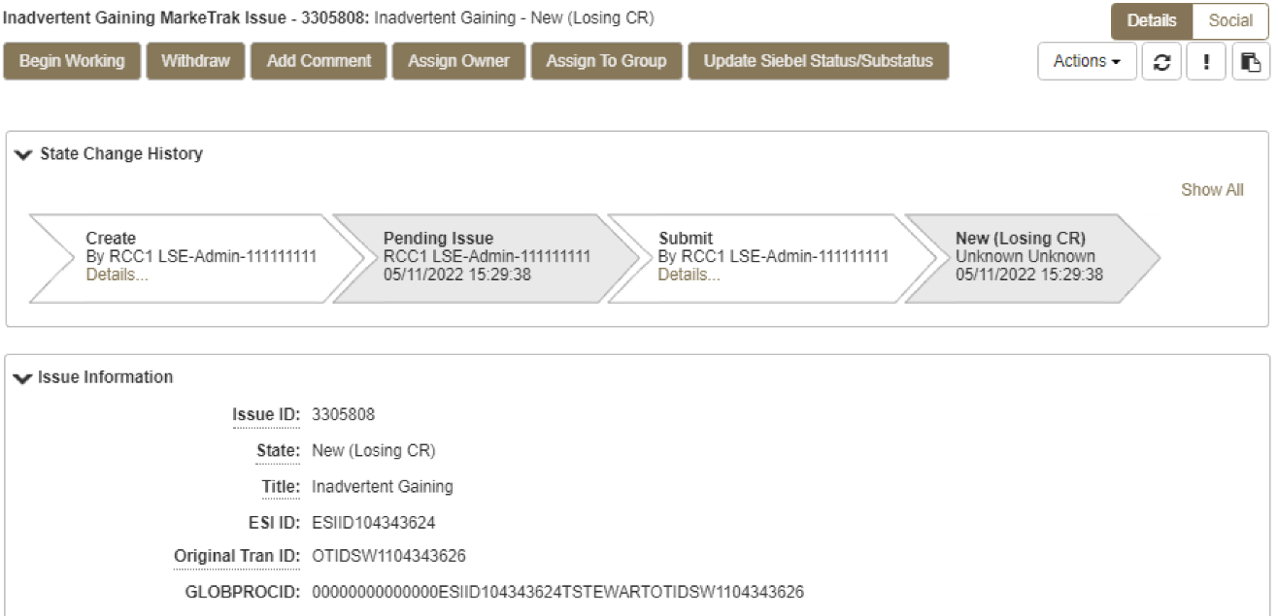
Inadvertent Gain
4. CR2 (Losing CR) will select Begin Working and Issue details and Investigate Market Conditions to determine the appropriate regain date.
CR2 (Losing CR) will select Begin Working and Issue details and Investigate Market Conditions to determine the appropriate regain date.

Slide 68

Inadvertent Gain
If CR2 (Losing/Original CR) determines that an Inadvertent Gain has NOT taken place, they have the option to select “Unexecutable” to stop the Inadvertent Gain process as outlined in Section 7.3.2.6 of the Retail Market Guide.
7.3.2.6 Valid Reject/Unexecutable Reasons
The Losing CR may reject the return of an inadvertently gained ESI ID from the Gaining CR for one of the following reasons only:
  A new transaction has completed in the market, including, but not limited to the following transactions:
    The 814_16, Move In Request; or
    The 814_01, Switch Request.
    Use “3rd Party CR has regained/transaction completed”

Slide 69
Inadvertent Gain
7.3.2.6 Valid Reject/Unexecutable Reasons
The Losing CR may reject the return of an inadvertently gained ESI ID from the Gaining CR for one of the following reasons only:
(b) Duplicate Inadvertent Gaining issue in MarkeTrak for the same Customer on the same ESI ID.
Use “Duplicate Issue”
(c.) The IAG was inappropriately submitted as described in Section 7.3.2.1 Invalid Use of the IAG Process.

Slide 70
Invalid Reject Reasons
The Losing CR shall not reject the return of an inadvertently gained ESI ID due to:
Inability to contact the Customer;
Past due balances or credit history;
Customer no longer occupies the Premise in question;
Contract expiration or termination;
Pending TX SETs; or
Losing CR serving the Premise under a Continuous Service Agreement (CSA).
Located under RMG 7.3.2.7 Invalid Reject / Unexecutable Reasons

Slide 71

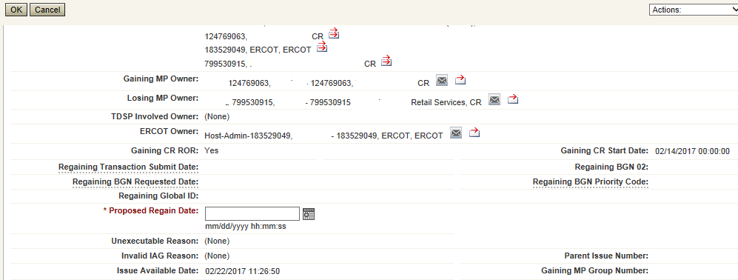
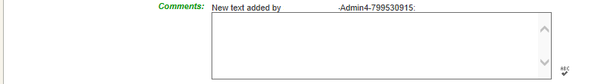
Inadvertent Gain
If CR2 (Losing/Original CR) determines they will need more information from CR1 (Gaining CR), then they will need to select Send to Gaining CR. This transition allows both CR’s to talk back and forth while transitioning the issue back and forth before a resolution is made.
If CR2 (Losing/Original CR) determines that an Inadvertent Gain has taken place, they will select Send to TDSP, enter the proposed regain date, add comments and select “OK” to move the issue to the TDSP. A validation will occur on the Proposed Regain Date: Validate that the date is less than “Submit Date” + 10 days. If not the following error message will be displayed “Proposed Regain Date is greater than 10 Calendar days from the submittal of MarkeTrak Issue, please update with valid Proposed Regain date.”

Slide 72
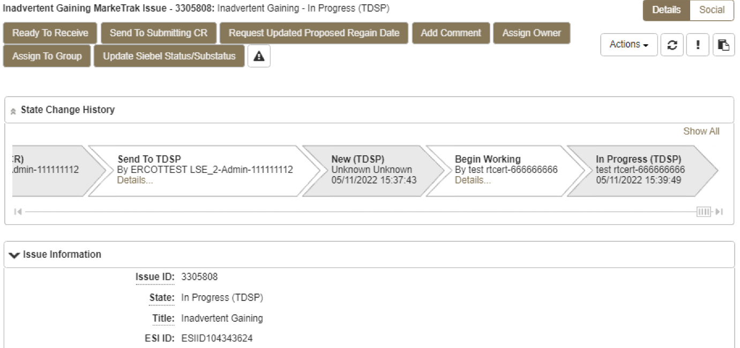
Inadvertent Gain
The TDSP will select Begin Working, investigate the issue details, then select one of the following:
Ready to Receive – The TDSP would select this transition to send the issue back to CR1 (Losing/Original CR). It is extremely important that CR1 (Losing/Original CR) wait for the TDSP to select Ready to Receive indicating TDSP’s systems have been prepared to receive the Original MP’s transaction before the EDI is actually sent. If not, the EDI will be rejected at the TDSP.
Send To Submitting CR – The TDSP would select this transition if they needed further information from CR1 (Losing/Original CR).
Request Updated Proposed Regain Date – The TDSP would select this transition if they do not agree with the proposed regain date that was provided. They would suggest a new date and send the issue back to CR1 (Losing/Original CR).

Slide 73

Inadvertent Gain
CR2 (Losing/Original CR) will select Begin Working then select Provide Regaining BGN 02. CR2 (Losing/Original CR) will provide the Regaining BGN02 and then select “OK”. When the regaining transactions process into ERCOT’s registration system, the Regaining Transaction Submit Date, Regaining BGN Requested Date and Regaining BGN Priority Code will be auto-populated on the MarkeTrak issue.
All parties should continue to monitor MIS and internal systems for the successful delivery and completion of the EDI transaction being sent by CR1 (Losing/Original CR) to the Market to regain a premise and resolve the associated Inadvertent Gain MarkeTrak issue.
Once the regaining transaction has been successfully sent to the Market by CR2 (Losing/Original CR), Siebel will update the status automatically.

Slide 74
Key Points to Remember
Provide as much information when opening Inadvertent Gain/Loss MarkeTrak in order to help facilitate quick resolution to the issue.
Suggested Information includes:
Customer Name (Always)
Meter Number (If available)
Any other pertinent information you may have that is crucial to help resolve issue.
Regain date should be:
Date of Loss (DOL) + 1
Date of Loss (DOL) less than or equal to 10 days from date MT was submitted when gaining on a prospective basis.

Slide 75
Losing REP VALID Reject / Unexecutable Reasons
RMG 7.3.2.6 Valid Reject / Unexecutable Reasons
The Losing CR may reject the return of an inadvertently gained ESI ID from the Gaining CR for one of the following reasons only:
  A new transaction has completed in the market, including, but not limited to the following transactions:
The 814_16, Move In Request; or
The 814_01, Switch Request.
Duplicate Inadvertent Gaining issue in MarkeTrak for the same Customer on the same ESI ID.
The IAG was inappropriately submitted as described in Section 7.3.2.1 Invalid Use of the IAG Process.

Slide 76
Gaining REP Valid Reject / Unexecutable Reasons
RMG 7.3.2.6 Valid Reject / Unexecutable Reasons
The Gaining CR may reject returning an inadvertently gained ESI ID to the Losing CR for one of the following reasons only:
A new transaction has completed in the market, including, but not limited to the following transactions:
The 814_16 transaction; or
The 814_01 transaction.
Duplicate Inadvertent Losing issue in MarkeTrak for the same Customer on the same ESI ID;
Gaining CR has confirmed with the Customer that the Customer’s CR of choice is the Gaining CR:
Gaining CR has a valid enrollment with the same Customer and provides the Customer name, service address and meter number (if available) in the comments section of the MarkeTrak issue.
In cases of Customer rescission, Inadvertent Losing MarkeTrak issue is rejected/unexecuted and a Rescission MarkeTrak issue is created

Slide 77
INVALID Reject Reasons
RMG 7.3.2.7 Invalid Reject / Unexecutable Reasons
The Losing CR SHALL NOT reject the return of an inadvertently gained ESI ID due to:
Inability to contact the Customer;
Past due balances or credit history;
Customer no longer occupies the Premise in question;
Contract expiration or termination;
Pending TX SETs; or
Losing CR serving the Premise under a Continuous Service Agreement (CSA).

Slide 78
Checkpoint Question #1
If a Losing CR receives an IAG MT and their customer does not occupy the premise, the Losing CR should Unexecute the IAG.
  True
  False
ANSWER
FALSE – this is not a valid reject reason, the Losing CR should regain the ESI ID and execute the Current Occupant process

Slide 79
Checkpoint Question #2
If a Losing CR has agreed to regain an ESI ID yet their customer at the time of the IAG no longer occupies the premise, the Losing CR may propose the following regain date:
  DOL + 1
  Date of MT submittal + 10
  Either
ANSWER
Either is applicable and is dependent upon the Losing CR’s business practices

Slide 80
Checkpoint Question #3
A back dated MVI (BDMVI) for an IAG must be submitted within _____ days.
  2 days of “ready to receive” status
  Date of MT submittal + 10
  12 days of MT submittal
  21 days
ANSWER
Per the RMG 7.3.2.5.1 Reinstatement Date, the Losing REP shall submit the BDMVI no later than 12 days after submittal of the MarkeTrak.

Slide 81
Checkpoint Question #4
A customer enrolled for service at the wrong apartment number. Their REP of choice should issue a MVO on the incorrect address and issue a MVI on the correct address.
  True
  False
ANSWER
Generally speaking, FALSE, issuing a MVO on an active ESI will create a lights out situation at the incorrect address. An Inadvertent Gain MT should be submitted to resolve the incorrect address.

Slide 82
Questions

Slide 83
MarkeTrak Training
Common IAG Issues,
Best Practices, & Quick Tips

Slide 84
MVO vs IAG
Issue:
MVO’s are incorrectly being submitted for IAG situations
Solution:
CR’s MUST NOT issue MVOs for active ESI IDs when IAG situations occur and/or while the MarkeTrak IAG/IAL process is in progress.
Best Practices:
Ask probing questions to ensure proper customer action is taken. (i.e. “Do you currently live here?”; “Was the original address provided incorrect?”)
For an incorrect address, review ERCOT’s MIS to see if the MVI resulted in an 814_06 Loss Transaction being sent to a Losing REP. If so, issue an IAG MT.
Transaction Flow for Inadvertent Gain situation
            814_01 CR to ERCOT
            814_03 ERCOT to TDSP
            814_04 TDSP to ERCOT
            814_05 ERCOT to CR
            814_06 ERCOT to Losing CR
            867_04 TDSP to CR
            867_03F TDSP to Losing CR

Slide 85
3rd Party Transactions
Issue:
3rd party transaction has occurred, nullifying the IAG MarkeTrak therefore causing the Gaining CR to be left with charges they may not be able to recover.
Solution:
Utilize the applicable market approved process to regain a lost ESI ID via MarkeTrak. Educate the customer as to what the process entails and set proper expectations with the customer.
Best Practices:
Identify IAGs in progress for ESI IDs by:
Identifying IAGs on daily basis utilizing ERCOT MarkeTrak reporting or notification
Flagging within your own system the ESI IDs that have been IAG/IAL to ensure subsequent transactions are not submitted to the market until the IAG is completed.
Timely resolution of IAG/IAL MarkeTraks

Slide 86
Escalation for resolution of IAGs
Issue:
MTs and/or Escalated MTs are not receiving responses or being completed in a timely manner
Solution:
Market participants should maintain “rolodex” contacts and work escalations on a daily basis.
Best Practice:
Designate one of the escalation contacts as a departmental mailbox instead of an individual
Escalation Path Recommendations :
    First escalation: email via MarkeTrak to the assigned agent working the issue.
    Second escalation: email via MarkeTrak to primary and secondary contact in Rolodex.
    Third Escalation: include REP Relations/ERCOT Account Manager
    Allow 3-5 business days between escalations.

Slide 87
Expected Level of Performance
Issue:
Untimely resolution of IAG issues
Solution:
Adoption of timelines stated in Retail Market Guide
Best Practice:
REPs to develop internal SLAs to address MTs aligning with market’s expected level of performance
MT Submission DAY 0
Auto generated email sent if remains in “New” state for 3 days
Responses thereafter no longer than 7 days
BDMVI to be sent no later than 12 days from MT submission
Initial Response Due no later than 10 days
Complete resolution 21 days
RMG Section 7.3 Inadvertent Gain Process -
Escalation emails will be sent after 7 days without a transition

Slide 88
No Current Occupant
Issue:
Losing REP responds to an IAG indicating:
  “their customer no longer occupies the premise”
  “no longer under contract”
  “cannot reach the customer”
  “Customer no longer wants us as REP of Record”
and attempts to ‘unexecute’ the IAG MT issue.
Gaining REP accepts an enrollment due to identity theft.
Solution:
These are NOT valid reasons for unexecuting MT (RMG 7.3.2.7 Invalid Reject/Unexecutable Reasons) or appropriate uses of the IAG process (RMG 7.3.2.2 Invalid Use of the IAG Process)
Best Practice:
Losing REP must regain ESI ID and initiate the Current Occupant process
Gaining REP should not use the IAG process and initiate the Current Occupant process
          Reference: PUCT Subst. R. 25.488 Procedures for a Premise With No Service Agreement

Slide 89
Switch Hold on IAG
Issue:
A switch hold is active on account which has been identified as having an IAG
Solution:
When IAG is submitted and accepted, the switch hold should be removed by the Gaining REP in order prevent BDMVI from being rejected and any delay in completing the MarkeTrak
Best Practice:
When working IAL/IAG issues identify if your ESI ID currently has an active Switch Hold and remove as needed
RMG Section 7.3.2.3 Resolution of Inadvertent Gains

Slide 90
Self-Service Portals (online enrollment/Multi-Family Portals)
Issue:
Customers use Self-Service portals to initiate MVI’s, Transfers of Service or MVOs
Solution:
Establish safeguards ensuring that customers who may have inadvertently selected an incorrect address do not cause a lights out situation.
Best Practice:
Limited functionality for transfers of service within XX amount of days.
Redirect the customer to contact call center in move out situations
Display FAQ’s regarding Inadvertent Switches

Slide 91
Linking IAL Issues with Customer Rescission
Issue:
Losing REP issues IAL MT prior to the Gaining REP being able to issue Customer Rescission MT
Solution:
Gaining REP should create Customer Rescission MT linking it to the Losing REP’s IAL MT.
Best Practice:
Rescission MarkeTrak should be created prior to unexecuting the Losing REP’s IAL
Linking the MT’s together allows for quicker resolution and tracking
Unexecute Losing REP’s IAL MT as a duplicate issue.

Slide 92
Questions

Slide 93
MarkeTrak Training
IAG / IAL Reporting

Slide 94
Monthly IAG/IAL Reporting
What information is reported?
Monthly IAG/IAL Statistics
Top 10 Monthly – IAG/IAL
Top 10 – 12 Month Average IAG/IAL
  % of the aggregated totals for the last 12 months
Explanation of the IAG/IAL Stats
Top REPs – 12 Month Average Rescission
% of the aggregated totals for the last 12 months
Explanation of Rescission Stats
18 Month Running Market Totals

Slide 95
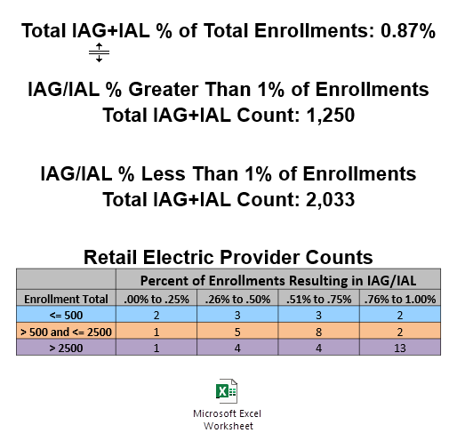
Monthly IAG / IAL Statistics
The above chart shows a count of REPs whose IAG/IAL percentage of their total enrollments is below 1%.
    Blue row shows counts of REPs that have less than 500 total enrollments by their % ranges
    Orange row shows counts of REPs that have between 500 and 2500 total enrollments by their % ranges
    Purple row shows counts of REPs that have greater than 2500 total enrollments by their % ranges

Slide 96
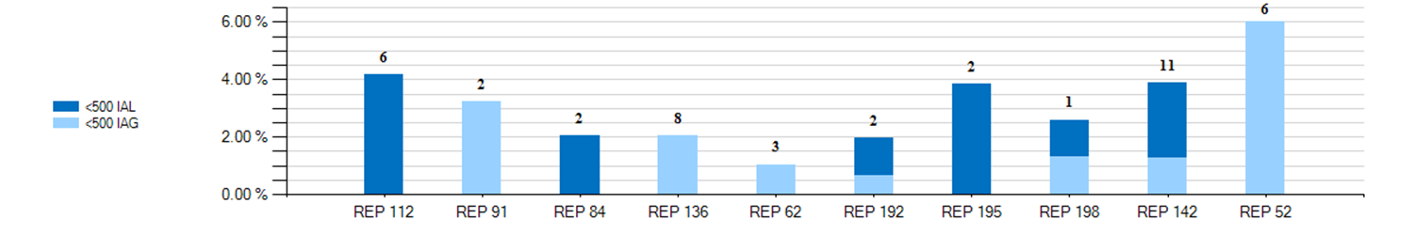
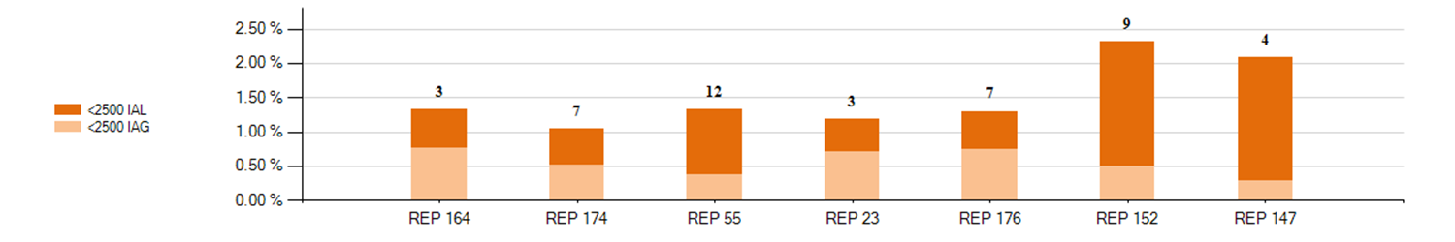
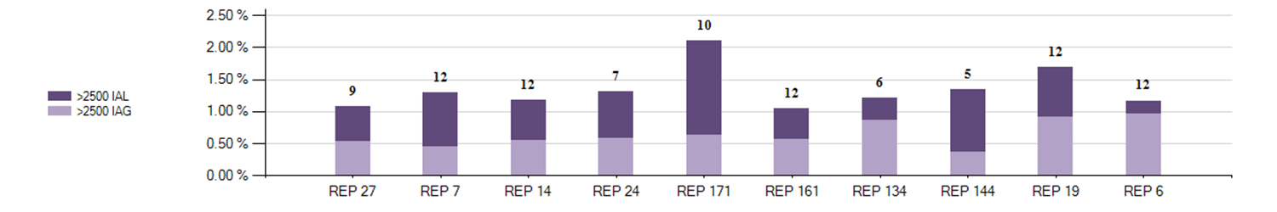
Monthly Top 10 – IAG / IAL Statistics
Top 10 – Monthly– IAG / IAL % Greater Than 1% of Enrollments With Number of Months Greater Than 1%
2
Retail Market Subcommittee

Slide 97
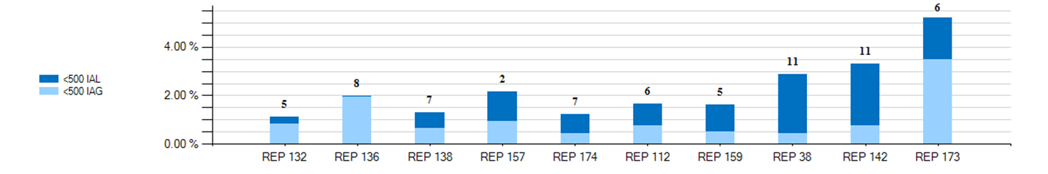
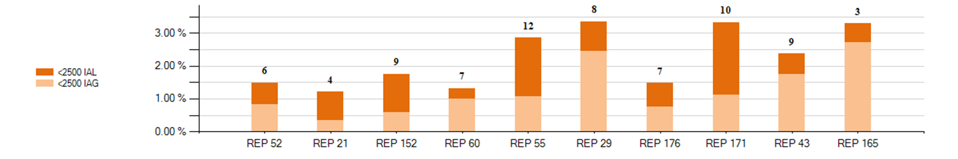
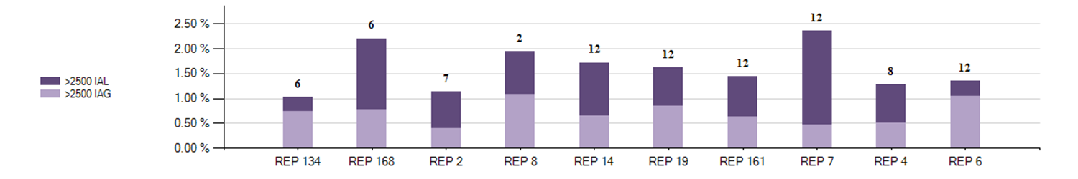
12 Month Average – IAG / IAL Statistics
Top 10 - 12 Month Average IAG / IAL % Greater Than 1% of Enrollments With Number of Months Greater Than 1%

Slide 98
Explanation of IAG / IAL Slides Data
Slide 97 charts show the top 10 REPs whose IAG/IAL percentage of their total enrollments is above 1%.
  The blue chart shows enrollment totals of less than 500 for the month being reported
  The orange chart shows enrollment totals between 500 and 2500 for the month being reported
  The purple charts show enrollment totals of over 2500 for the month being reported
  REPs with the lowest AG/IAL totals start on the left, and move to the highest counts on the right
Slide 98 charts show the top 10 REPs whose 12 month average IAG/IAL percentage of their total enrollments is above 1%.
  The blue chart shows enrollment total averages of less than 500 for the month being reported
  The orange chart shows enrollment total averages between 500 and 2500 for the month being reported
  The purple charts show enrollment total averages of over 2500 for the month being reported
  REPs with the lowest IAG/IAL averages start on the left, and move to the highest counts on the right
  Number labels represent the number of months the REP has been over 1% during the 12 month period

Slide 99
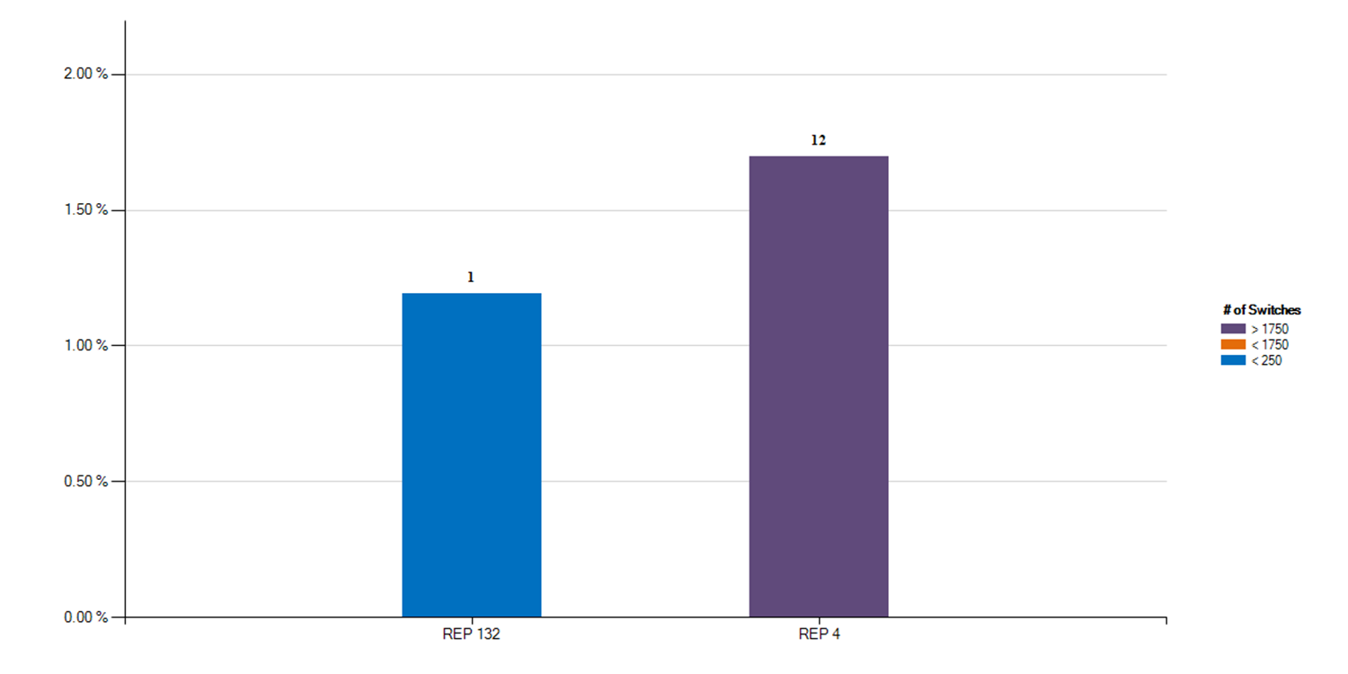
12 Month Average – Rescission Statistics
Top - 12 Month Average Rescission % Greater Than 1% of Switches With number of months Greater Than 1%

Slide 100
Explanation of Rescission Slide Data
NOTE:
A 10% chart range limit has been set. REPs data points that exceed 10% will be bordered in yellow. Please see the spreadsheet for actual percentages of these REPs.
Slide 100 charts show the top REPs whose 12 month average Rescission percentage of their total Switches is above 1%.
  The blue shades show switch totals of less than 250 for the month being reported
  The orange shades show switch totals between 250 and 1750 for the month being reported
  The purple shades show switch totals of over 1750 for the month being reported
  The REPs with the lowest count of rescission totals start on the left, and move to the highest counts on the right
  Number labels represent the number of months the REP has been over 1% during the 12 month period

Slide 101
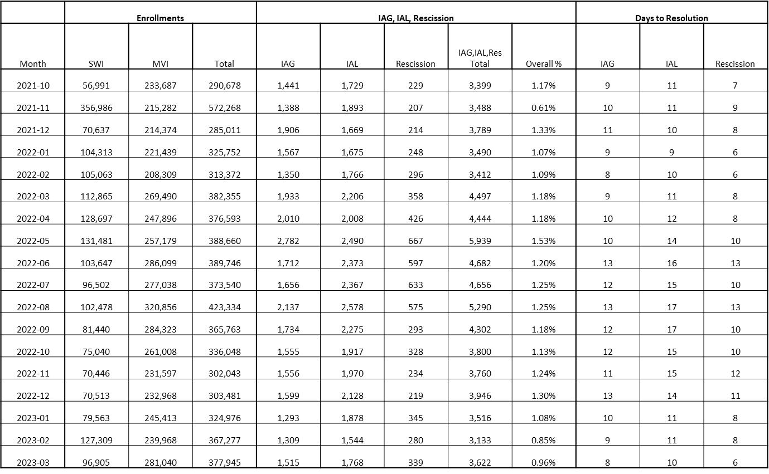
18 Month Running Market Totals

Slide 102
How can we drive efficiency? Reporting
Reporting to measure success … New format!!
Impact by REP
% of IAG/IALs to total enrollments by REP
Each REP is assigned a REP # - this # won’t change
Enrollments are MVIs+SWIs for IAG/IALs
For Rescissions, enrollments are SWIs only
IAG/IAL totals & % are calculated using the counts of the acknowledged Inadvertent Gaining REP only for both IAG & IAL issues.
If the Gaining REP in a submitted IAL issue does not agree to return the ESI to the Losing REP, that issue will not be counted
The Losing REP is not represented in any of the totals or % in any data
Two month lag in reporting to allow for IAG/IALs to be tied to enrollment transaction
MVI sent in November that resulted in an IAG MT submitted in December, will be reported on the % IAG/IAL total for November

Slide 103
Market Performance - Volumes
Overall % Change in IAS volume per enrollment:
2015 to 2016 = -6.62%
2016 to 2017 = -7.09%
2017 to 2018 = 5.38%
2018 to 2019 = 10.59%
2019 to 2020 = -17.7%
2020 to 2021 = -3.85%
2021 to 2022 = 2.07%

Slide 104
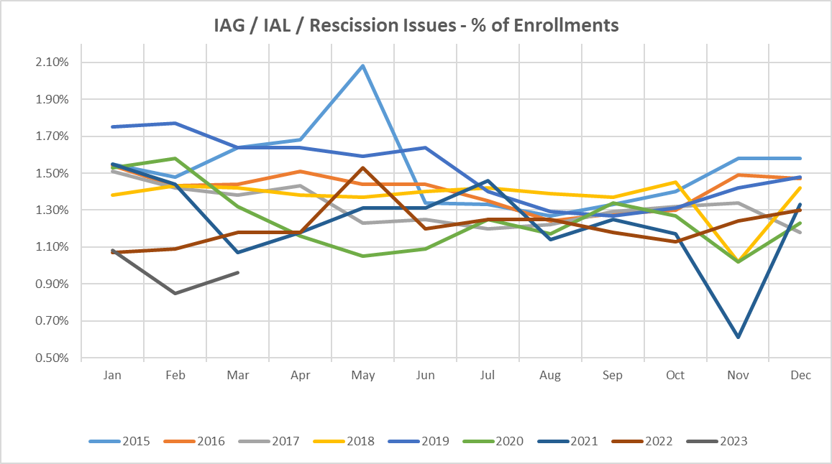
Market Performance - % of enrollments

Slide 105
Market Performance – Resolution Days
Valid IAG/IAL/RESC Issues by Close Date

Slide 106
Inadvertent Gain Process Timeline
TDTMS analyzed the results of over 44,000 IAGs/IALs from July 2019 to July 2020, breaking down time required for each transition to provide insight into opportunities for efficiency…

Slide 107
Inadvertent Gain Process Timeline – Data Analysis
Summary of the latest TDTMS analysis from Jul-Dec 2021 data (values in blue represent results from 2020 analysis) …
Over 55% (50%) of MTs are submitted within 7 days of the originating transaction
~50% of MTs are acknowledged same day they are submitted
96% (94%) of completed MTs – CRs reach an agreement within 7 days once opened
Hand-offs still exist in sending BDMVIs, however improved 5-6%
96% (90%) of IAGs are resolved in 21 days
91% (80%) of IALs are resolved in 21 days
CALL TO ACTION – REPs are encouraged to review and compare their performance to identify any opportunities to streamline their process
Posted to main TDTMS meeting page are the results of the two analyses conducted providing the performance of each REP (listed by respective REP#) https://www.ercot.com/committees/rms/tdtms:
  IAL Analysis 20201116 and IAG Analysis 20201116
  IAL Data Analysis Jul-Dec 2021 TDTMS and IAG Data Analysis Jul-Dec 2021

Slide 108


Market Challenge
Together we can make it a …

Slide 109
Checkpoint Question #1
An Inadvertent Loss MT submitted by the Losing REP will count toward which REP’s % total?
  The Losing REP
  The Gaining REP
ANSWER
The Gaining REP – valid IAG & IAL MTs will only count toward the Gaining REP’s total

Slide 110
Checkpoint Question #2
The assigned REP’s # on the IAG report will change each month.
  True
  False
ANSWER
FALSE – Assigned REP #s will remain consistent for the market reporting

Slide 111
Checkpoint Question #3
Driving down the number IAGs / IALs / Rescissions in the market will result in which of the following:
  Fewer customer complaints
  Improved customer experience
  Addressing customer issues faster
  Fewer back-off resources
  All of the above
ANSWER
All of the above – If all REPs work to drive efficiencies in their processes, the market will benefit

Slide 112
Questions

Slide 113
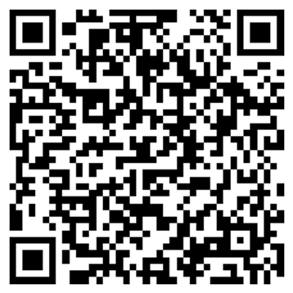
MarkeTrak Training
Survey
What did you like?
What didn’t you like?
What could we do better?
www.surveymonkey.com/r/ERCOTILT

