Slide 1
REP REGISTRATION PROCESS
Access Agreement begins on page 80 of the Tariff
Email to MarketOps@mylubbock.us
A reply email with the Welcome Packet and account number will be provided
A USB including the Welcome Packet and the presentation will be available at the Retailer
Workshop August 22nd - 23rd

Slide 2
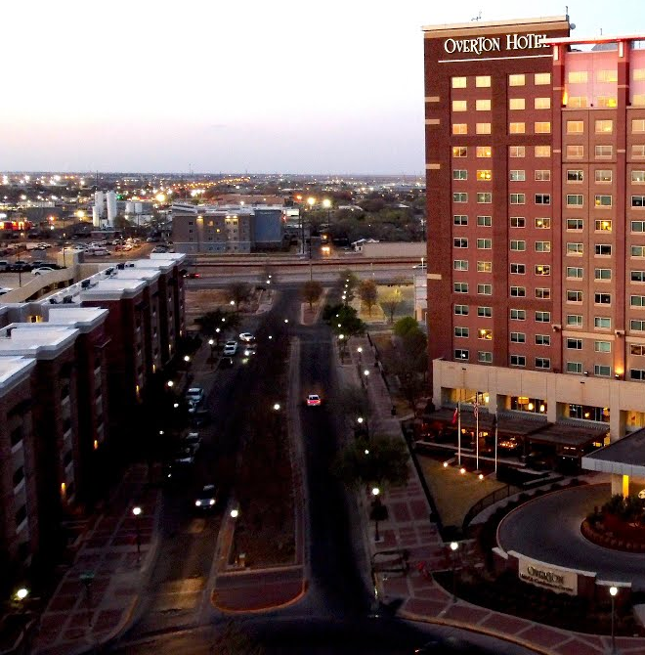
Lubbock Power & Light Retailer Workshop 2023
August 22nd & 23rd at the Overton Hotel and Conference Center
8/22 Welcome Reception – At Overton 6pm to 9pm
8/23 – Retailer Workshop 9:30am to 3:30pm
Meeting Kick Off
History of Lubbock and Future Growth
History of LP&L and our Journey to the Market
Our Organization & Meet the Market Operations Team
Transition Updates
Retailer Events Updates
Rates - the Path Forward
Future Projects: SMT & Retail Portal
Our Processes - Discussing the Life Cycle
Tampering
New Construction
Distributed Generation
Question Panel:
Open discussion with the Market Operations Team and Project Staff

