Slide 1
Lubbock
Retail Integration Task Force – LRITF
August 1st, 2023
Chris Rowley Michael Winegeart Sheri Wiegand

Slide 2


The Task Force continues to discuss major implementation items that must be resolved prior to LP&L entering competition:
Pro-Forma Retail Access Tariff – Project# 54212 was approved on consent at the 3/23 PUC Open Meeting. LP&L finalizing approval on Chapter 5 of tariffs and Customer Protection Rules.
CSA & Mass Transition Transaction Workflows –NPRR1159 and RMGRR171 have been approved by PUCT.
Customer Data Issue / Customer Choice Billing – HB2664/HB2663 have been signed by the Governor.
FERC Approval – required to transition remaining load from SPS to ERCOT; FERC settlement conference 7/25 was cancelled for Docket: ER23-1144-000
Major Implementation Items
Approved

Slide 3
LRITF meeting
7/11/23
The Task Force reviewed the following:
Flight Testing Requirements- CRs yet to be certified in LP&L territory will need to participate in the 1023 flight. Registration deadline is 9/6/23.
RMGRR 174 – reviewed revisions to Chapter 8 regarding munis and coops processes – included LP&L as well as NEC updates
Final review of Chapter 5, Customer Protection Rules, and complaint process

Slide 4
Completed Action Items
Q&A
Transition to Competition
Q: Will LP&L customers have the option of dual billing? A: No, HB2663 / SB1170 were approved by the Governor modifying PURA Section 40.057 to allow an opt-in MOU/EC the option of a single bill scenario through REPs as opposed to a customer’s choice of a dual billing scenario.
Customer Education
Q: Does LP&L currently deploy a CSA process, and will LP&L adopt a CSA process as other TDSPs? A: Yes, LP&L currently deploys a CSA process. With the approval of RMGRR171, upon transition, CSA activity will take the same path as the TDSP’s CSA process.
PUCT Requirements
Q: Will LP&L adopt a similar POLR process as utilized in competitive ERCOT? A: Yes, HB2663 / SB1170 were approved by the Governor modifying PURA Section 40.057 to allow an MOU/EC the option for PUC POLR selection designation. LP&L intends to utilize the PUC POLR selection process upon transition.

Slide 5
Completed Action Items
Q&A
ERCOT Market Requirements
Q: When will flight testing occur for LP&L and REPs planning to operate in LP&L’s territory? A: The special LPL0423 flight has concluded. REPs still interested in participating in the LP&L territory at market transition are encouraged to sign up for the 1023 flight (sign up deadline of 9/6/23) as LPL may not participate in the early flight of 2024 due to the transition. Q: Will LP&L submit LSE files to Smart Meter Texas for customer and REP access? A: LP&L is working with Smart Meter Texas to reach an agreement for utilization of the AMS data repository. It is expected LP&L will not integrate LSE files until Q2 of 2024 when SMT has planned a version update (v3.0). As a workaround, REPs may utilize ERCOT’s AMS Settlement extract to obtain daily interval data files (which is available at OD+4). With the delay of the transition, LP&L is hopeful an agreement is reached with SMT and REPs will be able to retrieve daily LSE files in the same manner as other TDUs.

Slide 6
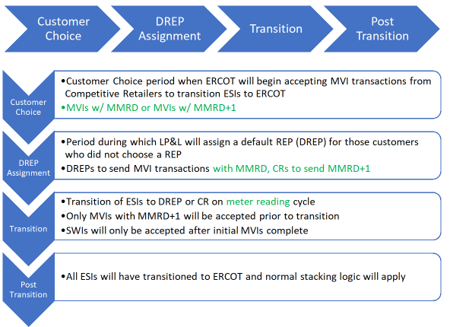
Completed Action Items
Q&A
ERCOT Market Requirements – cont.
Q: What transaction stacking logic will be in place during the transition? A: Below is summary of the phases of the transition and which transactions will be accepted during each phase. Please see the document posted to the main LRITF meeting page for additional information https://www.ercot.com/files/docs/2023/06/13/Solution-to-Transition-Stacking_final-final-notes_060623.docx

Slide 7

Completed Action Items
Q&A
ERCOT Market Requirements – cont.
Q: Which transaction will be sent by LP&L to cancel/unexecute a default MVI or a competitive MVI with an MMRD date as the requested date? A: The 814_28 with a reject code of T025 “Competing Transaction Scheduled for the Same Date” will be used during Customer Choice, DREP Assignment, and Transition phases.
TDSP Specific Activities
Q: How will critical care customers be established upon transition and what process will be utilized for enrolling new critical care customers? A: LP&L’s critical care process will mirror current TDSP practices. Upon transition, the CC flag will be passed onto the 814_05 response transaction and LP&L will follow up with an 814_20 transaction providing CC information and expiration. For new enrollments, the current PUC form will add LP&L as a drop-down option for submission. Q: What are LP&L’s Distribution Loss Factors? A:

Slide 8
Completed Action Items
Q&A
LP&L Rates
Below is a summary of the approved non-discretionary rates:

Slide 9
Activities timeline
Posted to LRITF meeting page

Slide 10
TIMELINE of Actions
Pro Forma Tariff
Access Agreement
POLR Process
Safety Net Process
Q4 2022
ERCOT Activities: SAC04s, Load Profiles
TSDP Activities: Critical Care, DLFs, Solar/DG, Switch Hold Files, BUSIDDRQ, Call Center, OGFLT, Weather Moratoriums, Proration
LP&L Rates
Customer Enrollment Process – Detailed Timeline
PUCT Complaint Process / Application of PUCT Rules
Transaction Timelines / TXSET Timelines
CSA Process
Q1 2023
Q2 2023
ESI IDs in TDSP Extract
RMG Chapter 8 Revisions
Historical Usage Requests
TDSP AMS Data Practices
Mass Customer Lists
Power to Choose website
Customer Forums/Town Halls
Flight Testing / Bank Testing
Q3 2023
CBCI files
Default REP Selection Process
DNP Blackout Period
Market Operations Group Established
Tampering Information Process
Smart Meter Texas
Q4 2023
GO LIVE – Transition to Competition ???
Delayed
Completed
Q3 2023
Q4 2023
Q1 2024

Slide 11
Lritf meeting
Held after RMS @ 12:30 PM
August 1st, 2023
AGENDA:
FERC Status
Flight Testing
RMGRR 174 Update
Chapter 5 & Customer Protection Rules – update
REP Registration Process
AMS Data Practices
LP&L REP Workshop – August 22nd – 23rd
Open Discussion

