Slide 1
Settlement Stability
2023 Q2 Update to WMS
Magie Shanks
Manager, Settlement Services
08/02/2023

Slide 2
8.2(2)(c)(i) Track number of price changes
Reporting Period: 2023 Q2
Operating Day | # of Corrected Prices |  |  |  |  |  | # of Intervals Affected |  |  |  |  |  | Market Notice
 | DASPP | MCPC | RTSPP | RTRMPR | ORDC Adders | RTESOGPR | DASPP | MCPC | RTSPP | RTRMPR | ORDC Adders | RTESOGPR
2/5/2023 | - | - | 984 | 937 | - | 241 | - | - | 2 | 2 | - | 2 | M-A022123-01
Notes:
The price changes reported on this slide display the price corrections that have been done after the Settlement Statement has posted for the Operating Day.

Slide 3
8.2(2)(c)(iv) Track number of resettlements due to non-price errors
Reporting Period: 2023 Q2
Operating Day(s) Resettled | Reason for Resettlement | Affected Charge Types | Market Notice Number
02/14/2021- 02/15/2021 | Alternative Dispute Resolution | HDLOEAMT, LAHDLOEAMT, LARTRNAMT, RTEIAMT | M-A040723-01 M-A040723-02 M-A040723-03

Slide 4
8.2(2)(c)(ii) Track number and types of disputes submitted
8.2(2)(c)(iii) Compliance with timeliness of response to disputes
YEAR | 2023 |  | 100% of dispute resolutions were timely.
CALENDAR QUARTER REPORTED | Q2
Disputed Charge Sub-Type | Submitted | Resolved | Denied | Granted | Granted with Exceptions
Ancillary Services-DAM | 1 | 0 | 0 | 0 | 0
Ancillary Services-RTM | 5 | 4 | 4 | 0 | 0
Emergency Operations | 0 | 1 | 1 | 0 | 0
Energy-RTM | 10 | 8 | 7 | 1 | 0
Gene. Res. Base Pt Deviation | 0 | 1 | 0 | 1 | 0
Firm Fuel Supply Service | 23 | 7 | 0 | 7 | 0
Make-Whole | 6 | 5 | 5 | 0 | 0
Reliability Unit Commitment | 113 | 108 | 0 | 108 | 0
TOTAL | 158 | 134 | 17 | 117 | 0
Submitted but not resolved disputes may be:
Not started
Open
Rejected
Withdrawn

Slide 5
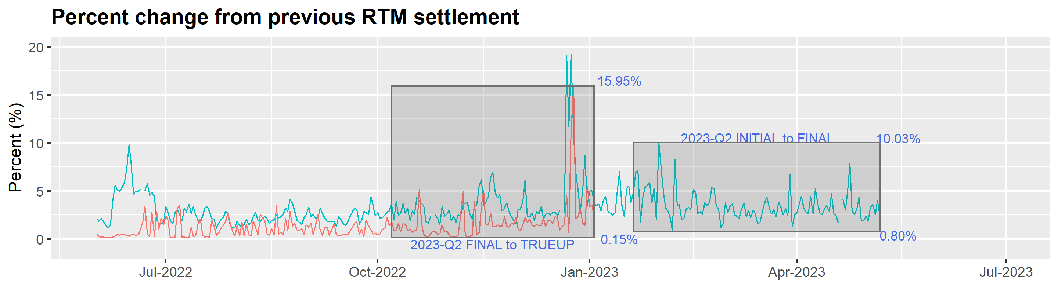
8.2(2)(c)(v) Other Settlement metrics
NOTE: ERS Final settlement OD data is not represented in graph.
Average percent change
YEAR | FINAL | TRUEUP
2011 | 3.49 | 0.41
2012 | 2.56 | 0.39
2013 | 2.83 | 0.33
2014 | 3.18 | 0.31
2015 | 2.99 | 0.25
2016 | 2.57 | 0.28
2017 | 3.01 | 0.27
2018 | 2.93 | 0.26
2019 | 2.66 | 0.20
2020 | 3.09 | 0.26
2021 | 3.53 | 0.46
2022 | 3.36 | 0.99
2023 | 3.58 | 3.07

Slide 6
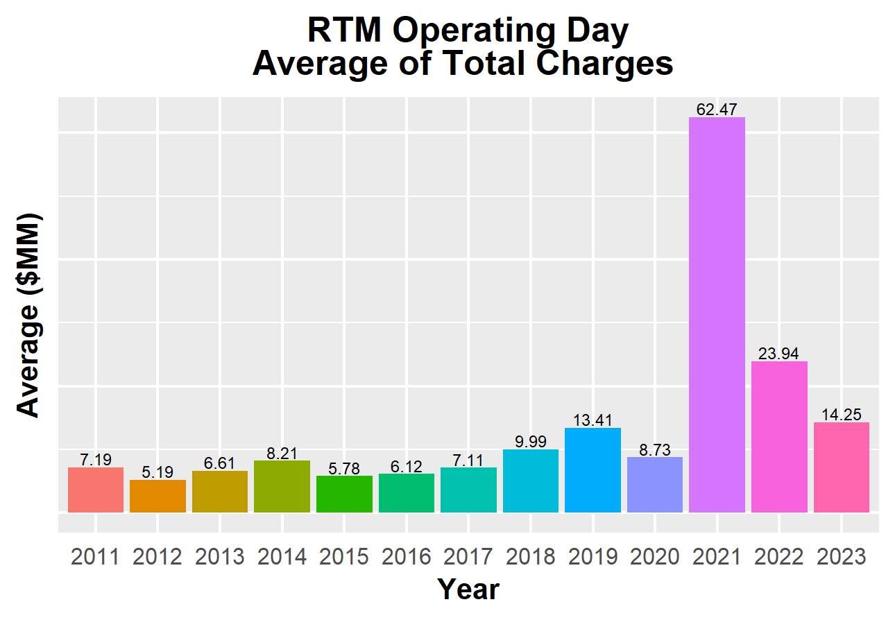
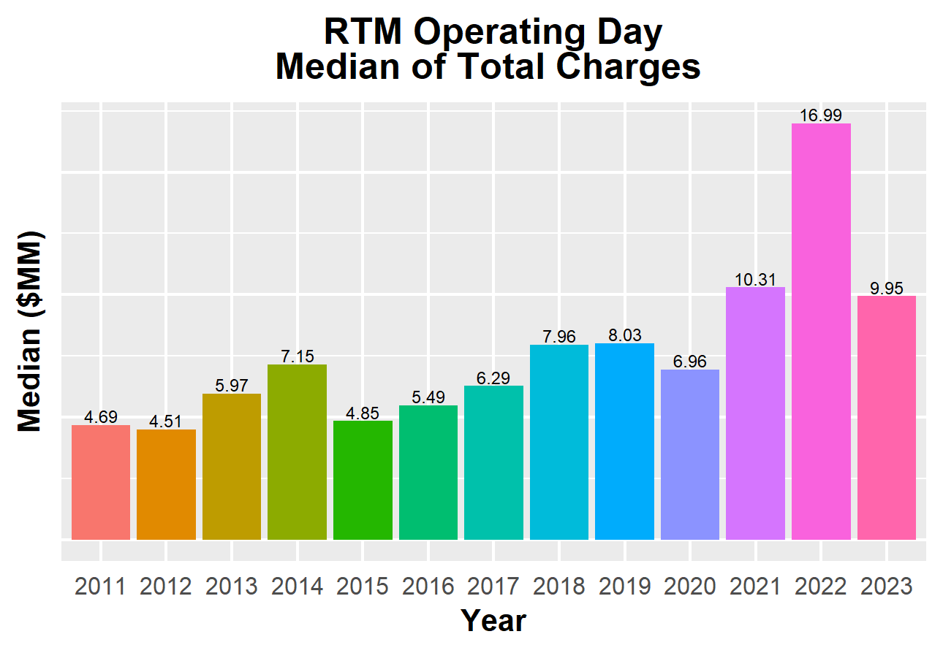
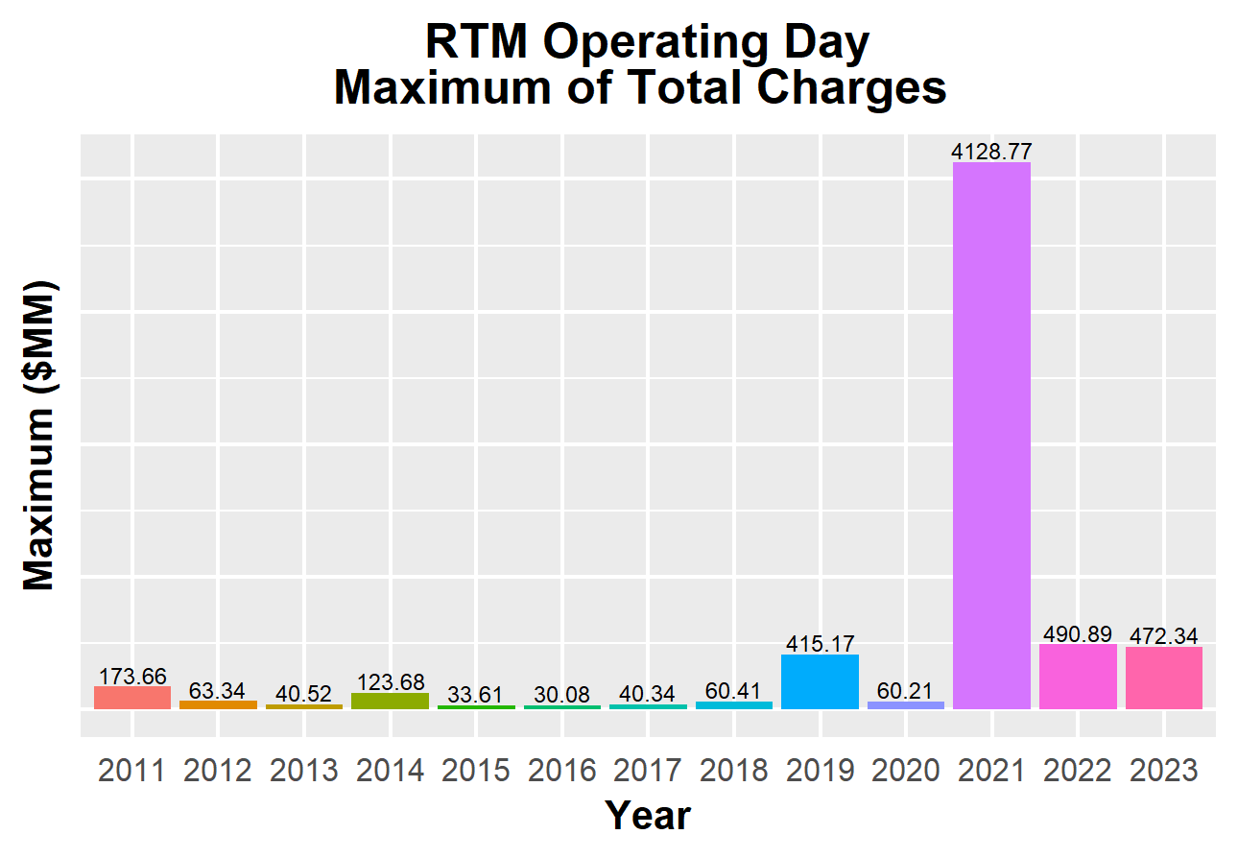
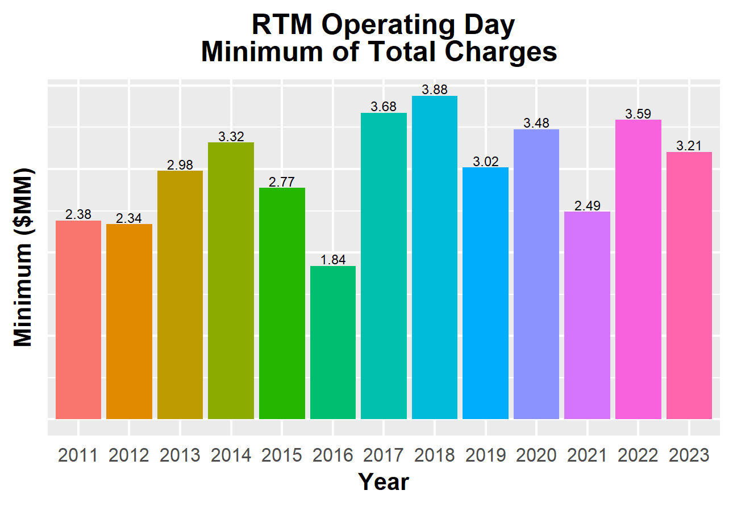
8.2(2)(c)(v) Other Settlement metrics

Slide 7
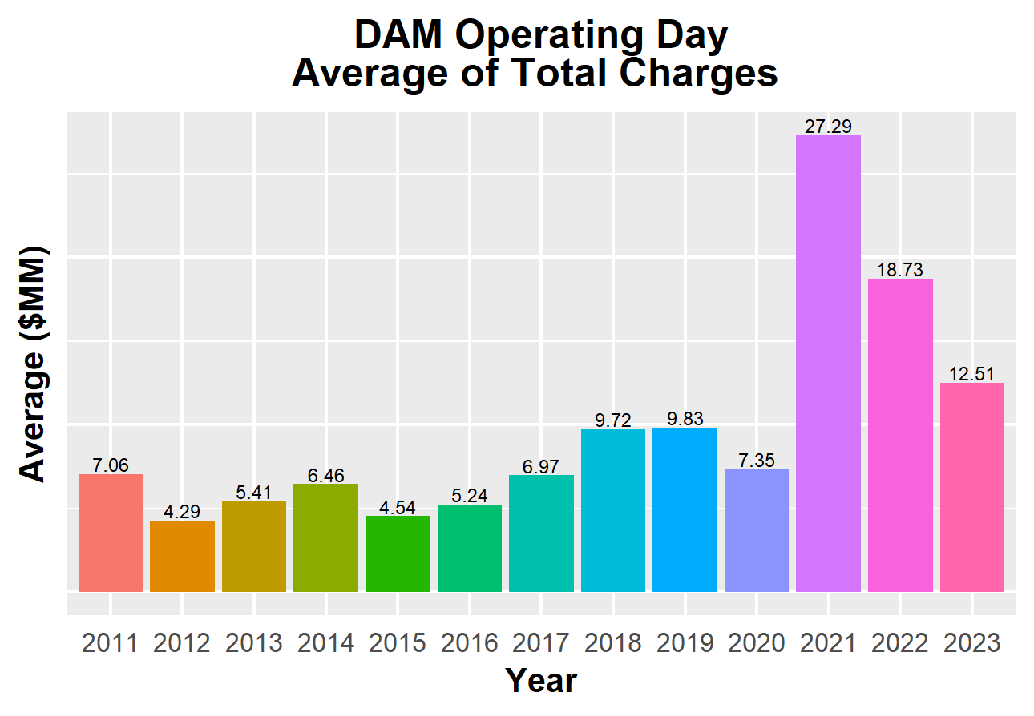
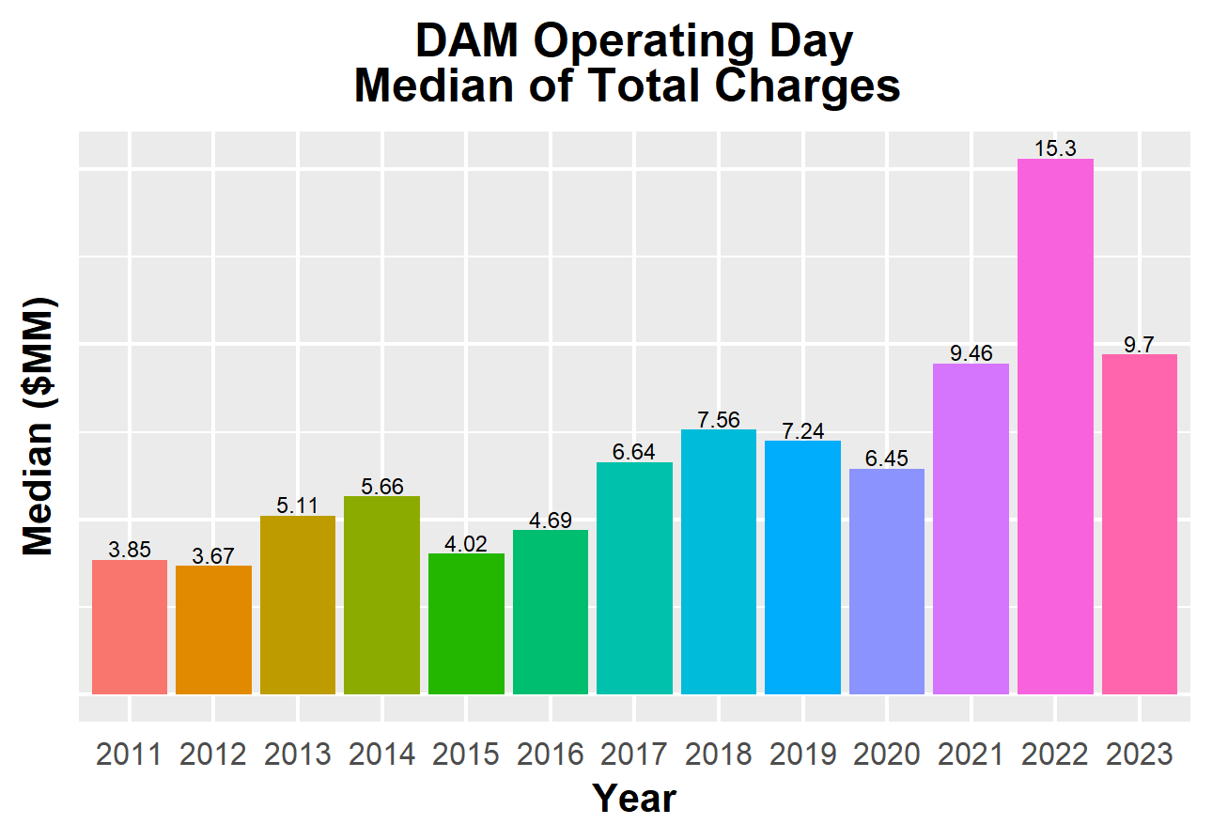
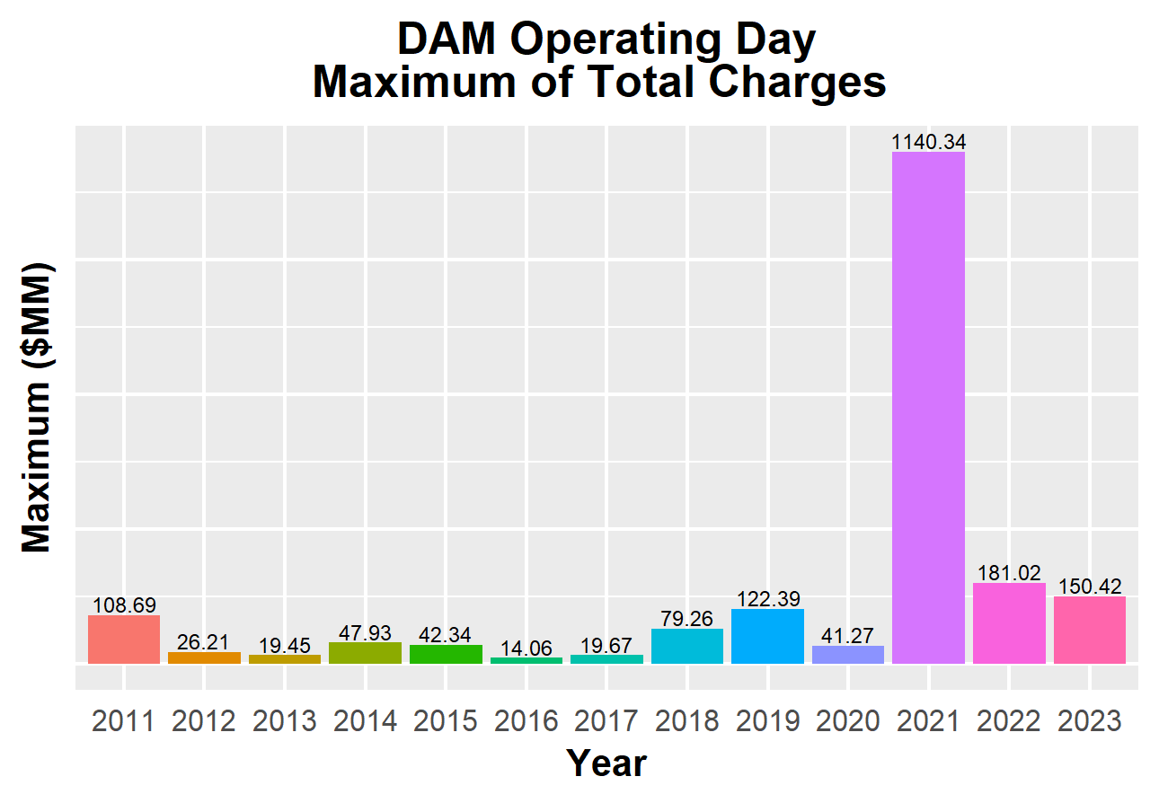
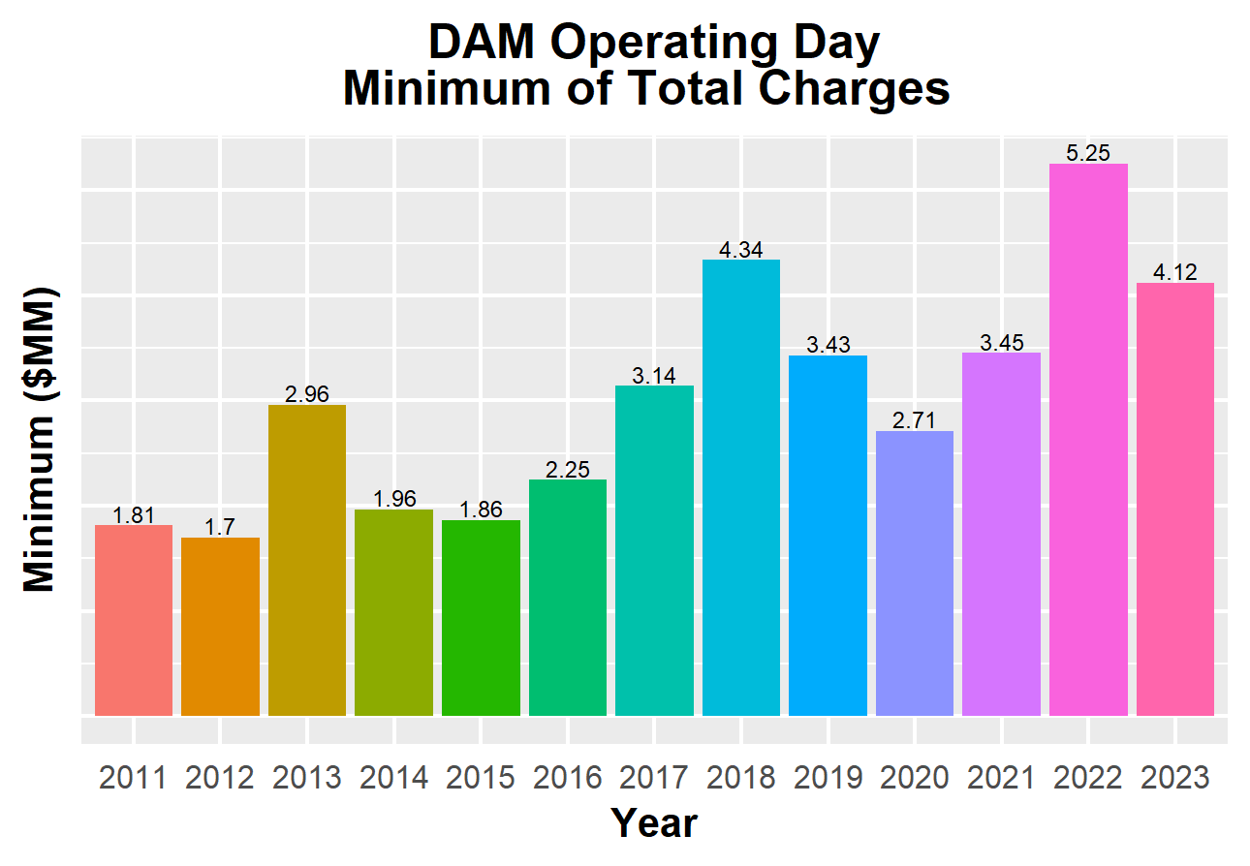
8.2(2)(c)(v) Other Settlement metrics

Slide 8
8.2(2)(c)(vi) Availability of ESIID consumption data

Slide 9
8.2(2)(c)(vi) Availability of ESIID consumption data

Slide 10
8.2(2)(g) Net Allocation to Load - Totals and $/MWh
NET ALLOCATION TO LOAD ($M)
 | Jun 2022 | Jul 2022 | Aug 2022 | Sep 2022 | Oct 2022 | Nov 2022 | Dec 2022 | Jan 2023 | Feb 2023 | Mar 2023 | Apr 2023 | May 2023 | Jun 2023
Ancillary Service Settlement | 106.0 | 251.7 | 71.4 | 37.1 | 57.1 | 31.6 | 179.8 | 23.4 | 26.7 | 40.4 | 40.0 | 53.1 | 273.7
Balancing Account Payout to Load | -43.1 | -40.6 | -19.2 | -7.9 | -14.5 | -11.5 | -31.9 | -13.1 | -4.2 | -10.2 | 0.0 | 0.0 | -35.2
Base Point Deviation Payments | -0.7 | -1.5 | -1.0 | -1.1 | -0.7 | -0.5 | -1.1 | -0.5 | -0.5 | -0.5 | -0.5 | -0.5 | -0.7
Black Start Service Settlement | 0.6 | 0.6 | 0.6 | 0.6 | 0.6 | 0.6 | 0.6 | 0.6 | 0.5 | 0.6 | 0.5 | 0.6 | 0.5
Block Load Transfer Settlement | 0.0 | 0.0 | 0.0 | 0.0 | 0.0 | 0.0 | 0.0 | 0.0 | 0.0 | 0.0 | 0.0 | 0.0 | 0.0
Emergency Energy Charges | 0.2 | 0.5 | 0.3 | 0.1 | 0.3 | 0.3 | 0.4 | 0.2 | 0.7 | 0.3 | 0.2 | 0.2 | 0.3
ERCOT Admin Fee Settlement | 23.4 | 25.5 | 23.9 | 20.8 | 17.9 | 17.4 | 18.8 | 18.0 | 16.8 | 17.7 | 17.1 | 20.3 | 23.7
ERO Pass-Through Fee⁵ | 1.8 | 1.8 | 1.8 | 1.8 | 1.8 | 1.8 | 1.8 | 2.1 | 2.1 | 2.1 | 2.1 | 2.1 | 2.1
ERS Settlement¹ | 3.9 | 3.9 | 3.9 | 3.9 | 2.1 | 2.1 | 5.0 | 5.0 | 5.0 | 5.0 | 0.0 | 0.0 | 0.0
Firm Fuel Service Settlement | 0.0 | 0.0 | 0.0 | 0.0 | 0.0 | 2.9 | 5.9 | 10.0 | 12.3 | 6.3 | 0.0 | 0.0 | 0.0
High Dispatch Limit Override | 0.0 | 0.0 | 0.0 | 0.0 | 0.0 | 0.0 | 0.0 | 0.0 | 0.0 | 0.0 | 0.0 | 0.0 | 0.0
Non-Zonal Auction Distribution | -47.3 | -25.1 | -24.6 | -26.2 | -49.0 | -44.9 | -41.8 | -35.1 | -28.7 | -49.3 | -53.4 | -54.3 | -49.0
ORDC Settlement | 1.3 | -18.9 | 4.9 | 4.3 | -1.2 | 2.4 | 2.5 | 1.0 | 1.8 | 0.3 | 1.3 | 1.4 | -0.1
Revenue Neutrality Total | 0.4 | -6.0 | 1.8 | 5.6 | 8.3 | 11.0 | -0.3 | 15.3 | 22.5 | 13.6 | 11.0 | 5.0 | 4.9
RMR Settlement | 0.0 | 0.0 | 0.0 | 0.0 | 0.0 | 0.0 | 0.0 | 0.0 | 0.0 | 0.0 | 0.0 | 0.0 | 0.0
RUC Settlement | 0.0 | -5.2 | -0.1 | -0.2 | -0.1 | -0.7 | 0.0 | -0.8 | -0.2 | -0.2 | -0.1 | -0.4 | -0.1
Voltage Services Settlement | 0.0 | 0.0 | 0.0 | 0.0 | 0.0 | 0.0 | 0.0 | 0.0 | 0.0 | 0.0 | 0.0 | 0.0 | 0.0
Zonal Auction Distribution² | -66.4 | -85.6 | -76.1 | -64.7 | -54.1 | -52.9 | -56.4 | -67.8 | -69.3 | -67.1 | -71.9 | -75.0 | -78.3
Total Allocation to Load | -19.9 | 101.1 | -12.4 | -25.9 | -31.6 | -40.5 | 83.3 | -41.7 | -14.5 | -41.0 | -53.7 | -47.5 | 141.8
Adjusted Metered Load (TWh) | 42.1 | 46.0 | 43.0 | 37.4 | 32.2 | 31.3 | 33.9 | 32.3 | 30.4 | 31.8 | 30.8 | 36.5 | 42.7
$/MWh³ | -0.5 | 2.2 | -0.3 | -0.7 | -1.0 | -1.3 | 2.5 | -1.3 | -0.5 | -1.3 | -1.7 | -1.3 | 3.3
Note: The Net Allocation to Load amounts provided in this presentation are for informational purposes only and cannot be relied upon for accurate measurements or forecasts of individual QSE charges and payments.
¹The total ERS charges have been evenly allocated across the contract period.
²Zonal Auction Distribution by 2003 Congestion Management Zone, shown below.
³The $/MWh value as calculated per PR 8.2 (2) g
⁴The $/MWh value by 2003 Congestion Management Zone, as calculated per PR 8.2(2) g
⁵Allocated to load from two years prior per the Electric Reliability Organization Fee Assessment and Collection Guide

Slide 11
8.2(2)(g) Net Allocation to Load - Totals and $/MWh
ZONAL AUCTION DISTRIBUTION PER CONGESTION MANAGEMENT ZONE ($M)
 | Jun 2022 | Jul 2022 | Aug 2022 | Sep 2022 | Oct 2022 | Nov 2022 | Dec 2022 | Jan 2023 | Feb 2023 | Mar 2023 | Apr 2023 | May 2023 | Jun 2023
HOUSTON | -4.1 | -8.5 | -6.6 | -7.2 | -6.2 | -2.9 | -3.6 | -6.5 | -5.0 | -7.3 | -5.3 | -7.3 | -8.6
NORTH | -14.6 | -18.6 | -16.5 | -9.5 | -6.2 | -9.5 | -9.1 | -15.2 | -14.0 | -11.9 | -10.1 | -10.4 | -13.7
SOUTH | -27.4 | -33.8 | -30.9 | -28.7 | -24.0 | -20.9 | -23.7 | -26.6 | -26.3 | -26.3 | -30.8 | -31.7 | -30.6
WEST | -20.2 | -24.7 | -22.1 | -19.3 | -17.7 | -19.6 | -20.0 | -19.4 | -24.0 | -21.6 | -25.7 | -25.5 | -25.4
TOTAL | -66.4 | -85.6 | -76.1 | -64.7 | -54.1 | -52.9 | -56.4 | -67.8 | -69.3 | -67.1 | -71.9 | -75.0 | -78.3
REAL-TIME ADJUSTED METERED LOAD BY CONGESTION MANAGEMENT ZONE (TWh)
 | Jun 2022 | Jul 2022 | Aug 2022 | Sep 2022 | Oct 2022 | Nov 2022 | Dec 2022 | Jan 2023 | Feb 2023 | Mar 2023 | Apr 2023 | May 2023 | Jun 2023
HOUSTON | 11.2 | 11.5 | 10.9 | 9.7 | 8.3 | 7.6 | 7.9 | 7.5 | 7.2 | 8.2 | 8.0 | 9.8 | 11.3
NORTH | 14.6 | 16.8 | 15.2 | 12.6 | 10.2 | 10.4 | 11.7 | 11.0 | 10.2 | 9.9 | 9.4 | 11.4 | 14.0
SOUTH | 11.4 | 12.3 | 11.6 | 10.2 | 8.8 | 8.4 | 9.2 | 8.6 | 8.1 | 8.6 | 8.3 | 9.8 | 11.7
WEST | 5.0 | 5.4 | 5.3 | 5.0 | 4.9 | 5.0 | 5.2 | 5.3 | 4.7 | 5.2 | 5.1 | 5.5 | 5.7
TOTAL | 42.1 | 46.0 | 43.0 | 37.4 | 32.2 | 31.3 | 33.9 | 32.3 | 30.4 | 31.8 | 30.8 | 36.5 | 42.7
ZONAL AUCTION REVENUE PER CONGESTION MANAGEMENT ZONE ($/MWh)
 | Jun 2022 | Jul 2022 | Aug 2022 | Sep 2022 | Oct 2022 | Nov 2022 | Dec 2022 | Jan 2023 | Feb 2023 | Mar 2023 | Apr 2023 | May 2023 | Jun 2023
HOUSTON | -0.4 | -0.7 | -0.6 | -0.7 | -0.7 | -0.4 | -0.5 | -0.9 | -0.7 | -0.9 | -0.7 | -0.7 | -0.8
NORTH | -1.0 | -1.1 | -1.1 | -0.8 | -0.6 | -0.9 | -0.8 | -1.4 | -1.4 | -1.2 | -1.1 | -0.9 | -1.0
SOUTH | -2.4 | -2.7 | -2.7 | -2.8 | -2.7 | -2.5 | -2.6 | -3.1 | -3.2 | -3.1 | -3.7 | -3.2 | -2.6
WEST | -4.0 | -4.6 | -4.2 | -3.9 | -3.6 | -3.9 | -3.8 | -3.7 | -5.1 | -4.2 | -5.0 | -4.6 | -4.5
TOTAL | -1.6 | -1.9 | -1.8 | -1.7 | -1.7 | -1.7 | -1.7 | -2.1 | -2.3 | -2.1 | -2.3 | -2.1 | -1.8
NET ALLOCATION TO LOAD PER CONGESTION MANAGEMENT ZONE ($/MWh)⁴
 | Jun 2022 | Jul 2022 | Aug 2022 | Sep 2022 | Oct 2022 | Nov 2022 | Dec 2022 | Jan 2023 | Feb 2023 | Mar 2023 | Apr 2023 | May 2023 | Jun 2023
HOUSTON | 0.7 | 3.5 | 0.8 | 0.2 | -0.3 | -0.4 | 3.6 | -0.6 | 0.4 | -0.5 | -0.5 | -0.1 | 4.2
NORTH | 0.1 | 3.1 | 0.3 | 0.1 | -0.2 | -0.9 | 3.3 | -1.1 | -0.3 | -0.8 | -0.9 | -0.3 | 4.0
SOUTH | -1.3 | 1.5 | -1.3 | -1.9 | -2.3 | -2.5 | 1.5 | -2.8 | -2.1 | -2.7 | -3.5 | -2.6 | 2.4
WEST | -2.9 | -0.4 | -2.8 | -3.0 | -3.2 | -3.9 | 0.3 | -3.4 | -4.0 | -3.8 | -4.8 | -4.0 | 0.5
TOTAL | -0.5 | 2.2 | -0.3 | -0.7 | -1.0 | -1.3 | 2.5 | -1.3 | -0.5 | -1.3 | -1.7 | -1.3 | 3.3

Slide 12
26.2 Securitization Default Charge
27.3 Securitization Uplift Charge
Subchapter M Invoice Month | Reference Month (RTM_FINAL data) | Monthly Uplift ($) (TSDCMA) | SDCMMATOT (MWh)
Jun-22 | Mar-22 | 3,713,235 | 195,041,993
Jul-22 | Apr-22 | 3,761,985 | 195,303,193
Aug-22 | May-22 | 3,761,985 | 208,449,380
Sep-22 | Jun-22 | 3,761,985 | 208,494,853
Oct-22 | Jul-22 | 3,761,985 | 219,876,436
Nov-22 | Aug-22 | 3,221,826 | 216,649,493
Dec-22 | Sep-22 | 3,221,826 | 208,508,389
Jan-23 | Oct-22 | 3,221,826 | 207,309,985
Feb-23 | Nov-22 | 3,221,826 | 197,630,131
Mar-23 | Dec-22 | 1,553,571 | 210,486,325
Apr-23 | Jan-23 | 1,553,571 | 219,896,875
May-23 | Feb-23 | 1,553,571 | 201,029,340
Jun-23 | Mar-23 | 1,553,571 | 214,898,428
Subchapter N¹ Invoice Month | Monthly Uplift ($) (MTSUCDA) | Non-Optout RTAML (MWh) | $/MWh
Aug-22 | 13,847,762 | 28,398,581 | 0.49
Sep-22 | 13,401,060 | 22,857,910 | 0.59
Oct-22 | 13,847,762 | 19,150,129 | 0.72
Nov-22 | 13,669,290 | 17,666,745 | 0.77
Dec-22 | 13,669,290 | 18,667,381 | 0.73
Jan-23 | 14,580,576 | 18,384,944 | 0.79
Feb-23 | 11,261,768 | 17,682,254 | 0.64
Mar-23 | 12,468,386 | 17,836,765 | 0.70
Apr-23 | 11,261,768 | 16,069,789 | 0.70
May-23 | 12,789,922 | 20,716,157 | 0.62
Jun-23 | 12,385,027 | 24,724,672 | 0.50
¹The data provided is grouped by the month the amount was invoiced.

