Slide 1
Unregistered Distributed Generation Report:
2023 Q2 Update
Resource Adequacy
8/2/2023

Slide 2
2023 Q2 Unregistered Distributed Generation Report
Totals may not match the sum of their columns/rows due to rounding
Notes:
Competitive vs. NOIE breakdown:
Competitive: 1,286 MW
NOIE: 1,011 MW
NOIE data is submitted through surveys. Competitive TDSP data is submitted through load profile codes.

Slide 3
2023 Q1 → Q2 Change
Totals may not match the sum of their columns/rows due to rounding

Slide 4
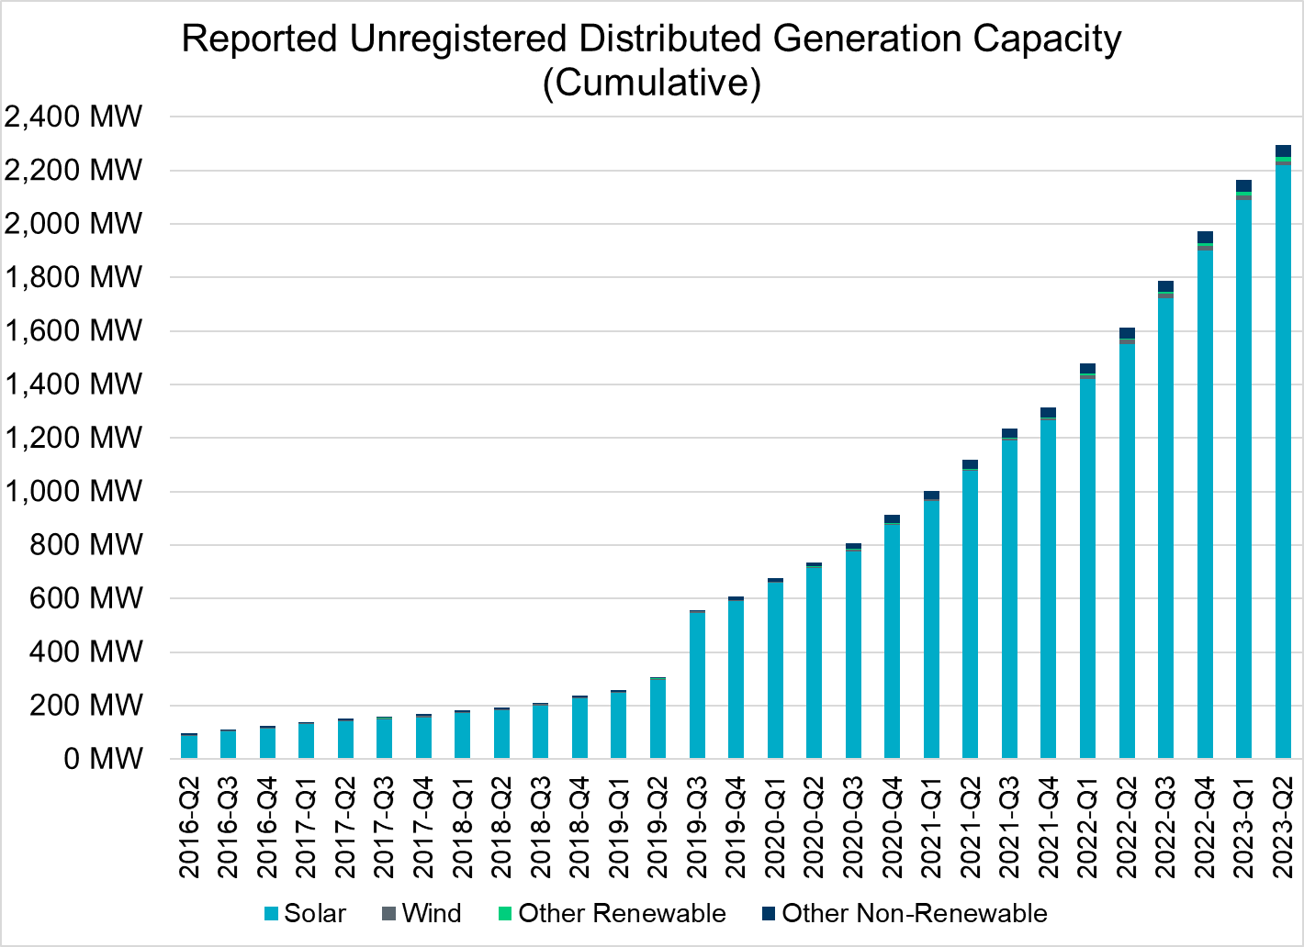
Unregistered DG Growth: 2016-Q2* to 2023-Q2
Large increase due to reporting requirement change**
* 2016-Q2 was the first report published after implementation of report changes per NPRR794/COPMGR044
** 2019-Q3 was the first report published after implementation of report changes per NPRR891

