Slide 1
Market Coordination Team Update
RMS: August 01, 2023

Slide 2
July 19th
Combined meeting with Texas SET
Reviewed feedback on Texas SET Guide Redlines 650s, 810s, 820s, 824, 867s, 997, T series
  Draft redlines and draft SEF Files have been posted to the MCT page
Questions regarding SCR817

Slide 3
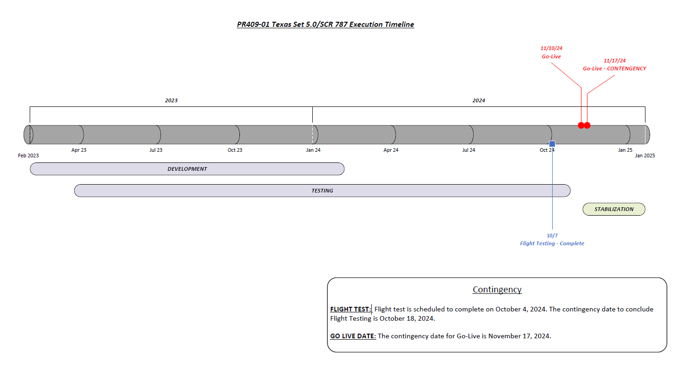

Slide 4
Future Meetings
August 16th
September 20th

