Slide 1
TEXAS SET UPDATE
RMS: August 1, 2023

Slide 2
Meeting
Joint meeting with MCT
Recommending that MCT and TEXAS SET hold joint meetings when agendas merit
Suggested to MCT that an informative session be held on 5.0

Slide 3
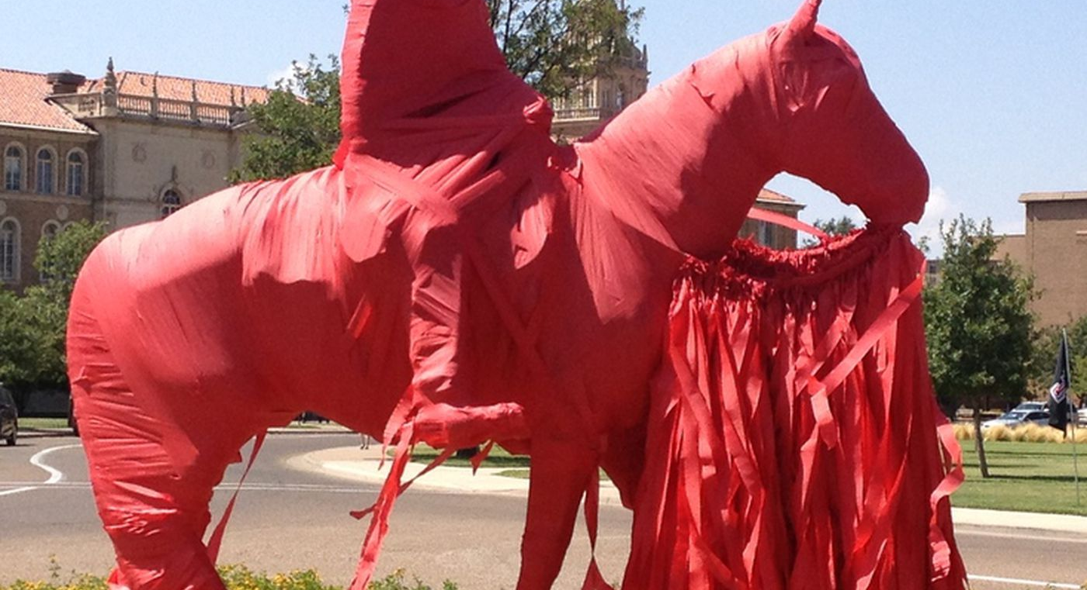
LUBBOCK
All CRs will perform Penny and Connectivity in LPL0423
Approximately 90+ CRs registered for flight and 5 CRs will perform end to end testing with LPL
Flight LPL0423 Complete

Slide 4
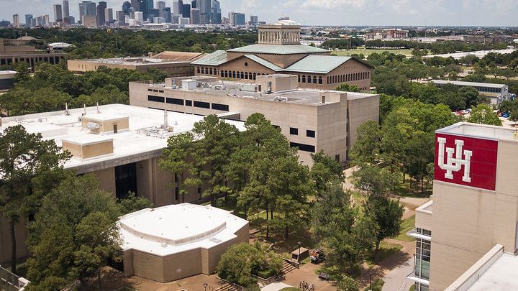
NEXT MEETING
August 16, 2023 @ 1PM
WebEx Only

