Slide 1
Credit Finance Sub Group update to the Technical Advisory Committee
Brenden Sager, Austin Energy, Chair
Loretto Martin, NRG, Vice Chair
25 July 2023

Slide 2
General Update
19 July CFSG meeting
Voting matters
NPRR 1175 on background checks
Operational NPRR’s without credit impacts
Discussion items
New invoice report
New voting member
Change in ERCOT collateral forms
Volt default update
Credit calculation discussion
Regular credit exposure updates

Slide 3
NPRR’s Reviewed
1164NPRR Black Start and Isochronous Control Capable Identification
1171NPRR Requirements for DGRs and DESRs on Circuits Subject to Load Shedding
1174NPRR Market Participant’s Return of Settlement Funds to ERCOT Following Receipt of Overpayment
1175NPRR Revisions to Market Entry Financial Qualifications and Continued Participation Requirements
1185NPRR HDL Override Payment Provisions for Verbal Dispatch Instructions
1189NPRR Updates to Language to Clarify the Allowable Regulation Ancillary Service Trades
CFSG voted to consider operational without credit implications

Slide 4
Change in Collateral forms discussion and vote
Working on changes to credit-related forms: letters of credit, surety bonds and parental guaranties. ERCOT NPRR not filed yet and under discussion.
Parental guaranties effectively eliminated with NPRR 1112 disallowing unsecured credit in the ERCOT market October 2023. And assuming that NPRR 1165, which would get rid of financial-statement only guarantee agreements, is approved by the Board.
Changes to Letters of Credit reflect market standard electronic communications (pdf’s via email vs hard copies by courier or faxed)
Agency rating applied to U.S. Branches of foreign banks still under review
Potential for up to six banks to not meet new standards; ERCOT credit will inform MP’s if implementation would require replacement
Surety bonds will require AM Best ratings under review

Slide 5
NPRR 1175 on background checks
A QSE must be able to demonstrate to ERCOT’s reasonable satisfaction that it does not pose an “Unreasonable Financial Risk.” risk of financial default posed to ERCOT or its Market Participants by Entity or Principals. Indicators of Unreasonable Financial Risk may include, but are not limited to:
past market manipulation, trading violations, or other finance-related violations based upon a final adjudication in state or federal regulatory or legal proceedings;
financial defaults in ERCOT or other energy markets resulting in losses or uplifts; or indications of imminent bankruptcy or insolvency
past civil judgement or criminal conviction that reflects problematic behavior on the part of the Entity or its Principals.
PRS recommended approval of NPRR1175 as amended by the 6/26/23 CFSG comments. 7/19 approval captures CFSG’s official opinion on the credit implications for TAC.

Slide 6
NPRR 1175 on background checks cont’d
Language has also been added to alleviate concerns that instances such as mere phone calls from a regulatory agency must be disclosed to ERCOT. This is not ERCOT’s intent. ERCOT clarified that only such investigations that are “formal” must be disclosed.
Adds "formal" in the following: Any complaint, formal investigation, or disciplinary action concerning financial matters initiated by or with the Securities and Exchange Commission (SEC), Commodities Futures Trading Commission (CFTC), Federal Energy Regulatory Commission (FERC), a self-regulatory organization, Independent System Operator or Regional Transmission Organization, or a state public utility commission or securities board involving the applicant, its predecessors, Affiliates, or Principals within the last ten years;
In addition, ERCOT added language to clarify the intention that the background checks required by NPRR1175 will be conducted by a third-party, not ERCOT. ERCOT’s role will be to review the background check reports and make a determination based on the information in those reports.
CFSG voted to endorse 1175 100% in favor as having positive credit implications

Slide 7
Discussion on Credit Calculations
Shams Siddiqi/Rainbow Energy withdrew NPRR 1146 which proposed to alter the credit calculation resulting in collateral obligations to ERCOT based on substantial instances of overcollateralization
Proposed to alter calculation based on billed and unbilled settlements, transition day counts and forward adjustment factors
Primary concern during Uri that MP’s faced collateral obligations when ERCOT owed them money resulting in economic disincentives to provide power to grid (specifically on DC ties)
ERCOT researched and agreed with Rainbow’s fundamental premise that double counting does occur in credit calcs. Will research to address this problem along with other variables
DC Energy preparing a related presentation in August
Group offered to form MP task force to assist in analysis and future proposals

Slide 8
Discussion new invoice report
Vice Chair Loretto Martin (NRG) requested ERCOT staff develop an invoice report so MP’s could track what is outstanding at June CFSG
Austin Rosel discussed with ERCOT staff and believes this is a feasible deliverable to MP’s
Report would include 30 days of posted invoice however could not indicate payment status
Group discussed considered this to be an acceptable start
Report is under development without a delivery date

Slide 9
Discussion on Volt default
ERCOT has received the proceeds of the Letter of Credit amounting to $500,000 posted by Volt Electricity Provider, LP (Volt) with the PUC.
Volt is a REP that defaulted in February 2021 during winterstorm URI.
The proceeds will be applied to shortpaid invoices attributable to Volt’s unpaid invoices.
ERCOT expects to distribute the funds to recipients of those shortpaid invoices in the next month.

Slide 10
New CFSG Voting Member
Name: Anthony Lerch
Position/Title: Senior Analyst, Credit Risk
ERCOT Member Name: Constellation Energy Generation
ERCOT Member Market Segment: Independent Generator

Slide 11
Monthly Highlights May – June 2023
Market-wide average Total Potential Exposure (TPE) slightly increased from $1.10 billion in May 2023 to $1.46 billion in June 2023
TPEA increased due to higher forward adjustment factors and Real-Time and Day-Ahead Settlement Point prices
Discretionary Collateral is defined as Secured Collateral in excess of TPE, CRR Locked ACL and DAM Exposure
Average Discretionary Collateral increased from $3.10 billion in May 2023 to $3.66 billion in June 2023
No unusual collateral call activity

Slide 12
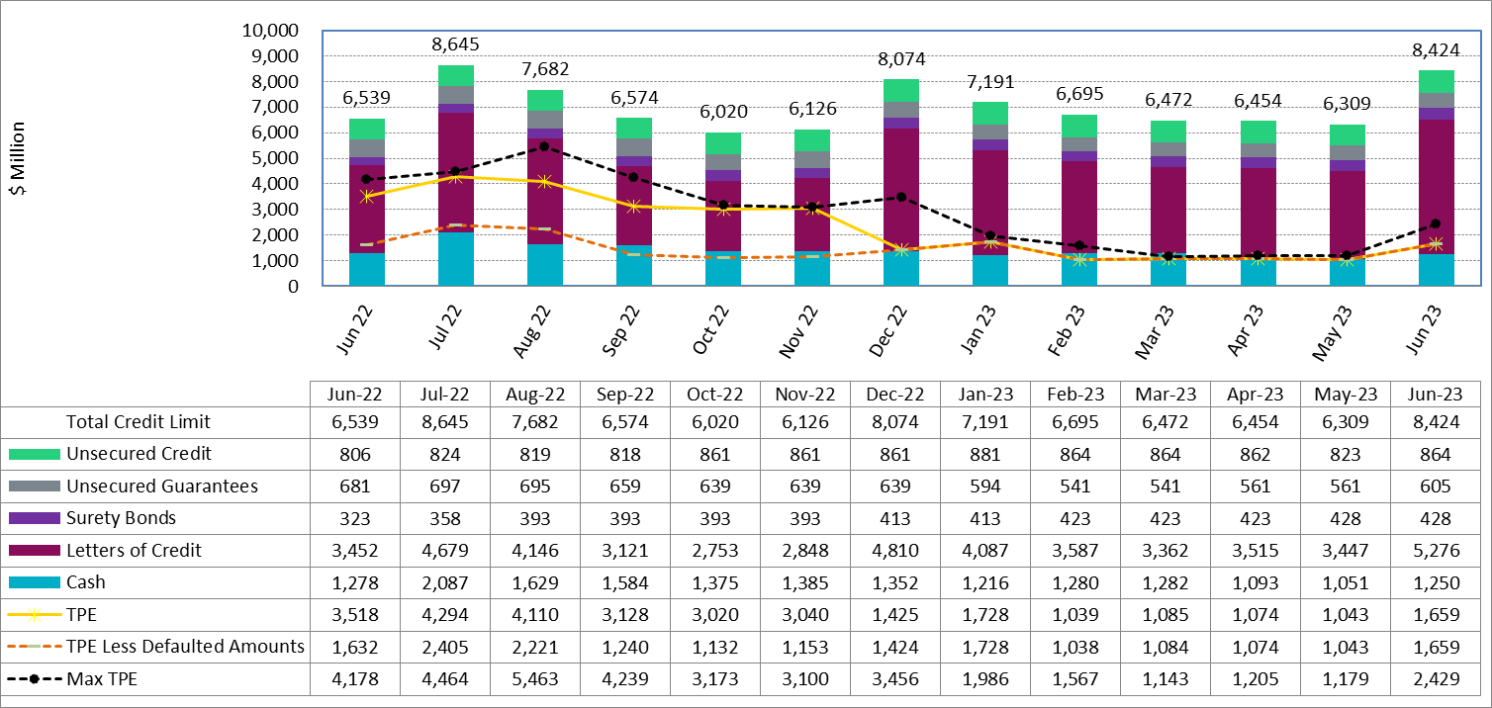
Available Credit by Type Compared to Total Potential Exposure (TPE) YTD June 2023

Slide 13
Discretionary Collateral YTD June 2023

Slide 14
Questions?

