Slide 1
Node Breaker Transition – NMMS Data Changes
NDWSG
Evan Mickelson
Network Model Administration
7/18/2023
evan.mickelson@ercot.com

Slide 2
Agenda
Why do we need to enter planning data?
New Data Fields
Validation Rules
Cleanup Effort
Templates

Slide 3
Why do we need to enter planning data?
NMMS seeds planning cases
NMMS contains ALL planning data*
*For operational equipment
NMMS (before 9/1/2023)
Planning Data
Operations Data
PSSE Bus-Branch Data
EMS Node-Breaker Data

Slide 4
Why do we need to enter planning data?
Upgrading planning cases to node-breaker
PSSE requires these PSSEIDs as the unique identifier
Like the rdfid in NMMS
NMMS (after 9/1/2023)
Planning Data
Operations Data
PSSE Bus-Branch Data
Needed September 1st and onwards
PSSE Node-Breaker Data
EMS Node-Breaker Data

Slide 5
Why do we need to enter planning data?
Almost all this already exists in NMMS!
Except for…
Needed September 1st and onwards
PSSE Node-Breaker Data

Slide 6
New Data Fields
cim:Substation
PSSEID: Integer between 1-999,999
cim:ConnectivityNode
PSSEID: Integer between 1-999

Slide 7
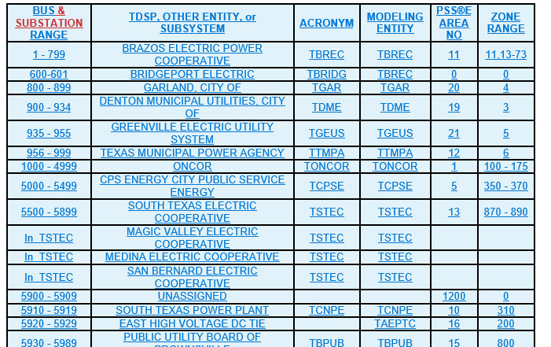
New Data Fields
cim:Substation
PSSEID: Integer between 1-999,999
See ranges below (same as ConnectivityNodeGroup)
Range is not enforced

Slide 8
Validation Rules
cim:Substation
PSSEID: Must be unique per the whole system
cim:ConnectivityNode
PSSEID: Must be unique per cim:Substation

Slide 9
Cleanup Effort
Currently soliciting PSSEIDs for cim:Substation instances from SSWG members
ConnectivityNode.PSSEID attributes will be assigned by ERCOT (60,000+)

Slide 10
Template Update
Substation and ConnectivtyNode templates will be updated to include the PSSEID attribute

Slide 11
Questions and Comments

