Slide 1
ERCOT Updates
NDSWG July 2023
ERCOT
7/18/2023

Slide 2
Topics
NPRR 1164 – group update
Manual Contingency Review
Project Updates
SSWG node/breaker

Slide 3
NPRR1164 review – New Definitions
NPRR1164 creates 4 new definitions in section 2.1

Slide 4
NPRR1164 – 3.14.2 Updates

Slide 5
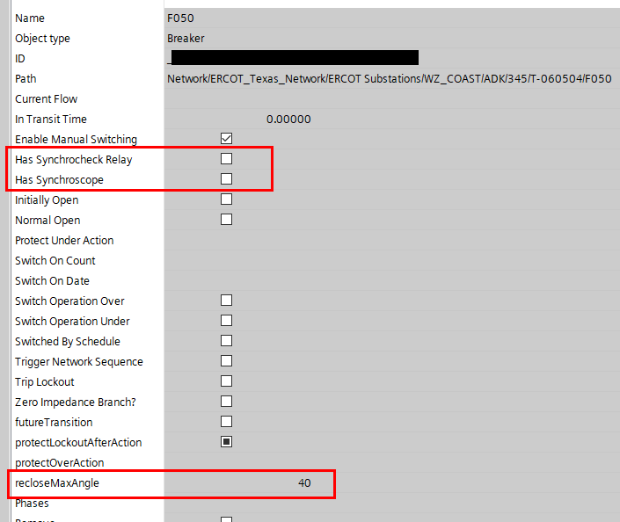
NPRR1164 – Updating in NMMS
Validation Rule:
If Synchrocheck Relay is checked, recloseMaxAngle should be between 0 to 90 degrees.
recloseMaxAngle:
Phase Angle Limit that is operator initiated, non-automated breaker control action.
Notes:
Note: anything over 60 should be evaluated and double checked. -90 is default.

Slide 6
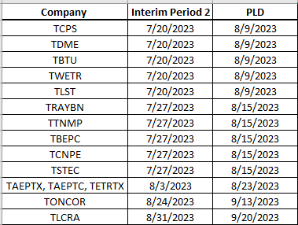
Manual Contingency Review
4/13 have been completed

Slide 7
Project Updates
NMMS Tech Health Upgrade
Officially closed.
Upgrade to NMMS RHEL Operating System
Project kickoff in June
Upgrades the OS of additional NMMS systems
Upgrade to CIM16
Project kickoff in July
Upgrades the NMMS database schema to meet the CIM16 standard
Updates the format of the XML models and incremental files

