Slide 1
Workshop to Discuss NPRR1186
Improvements Prior to the RTC+B Project for Better ESR State of Charge Awareness, Accounting, and Monitoring
ERCOT Staff
July 19, 2023

Slide 2
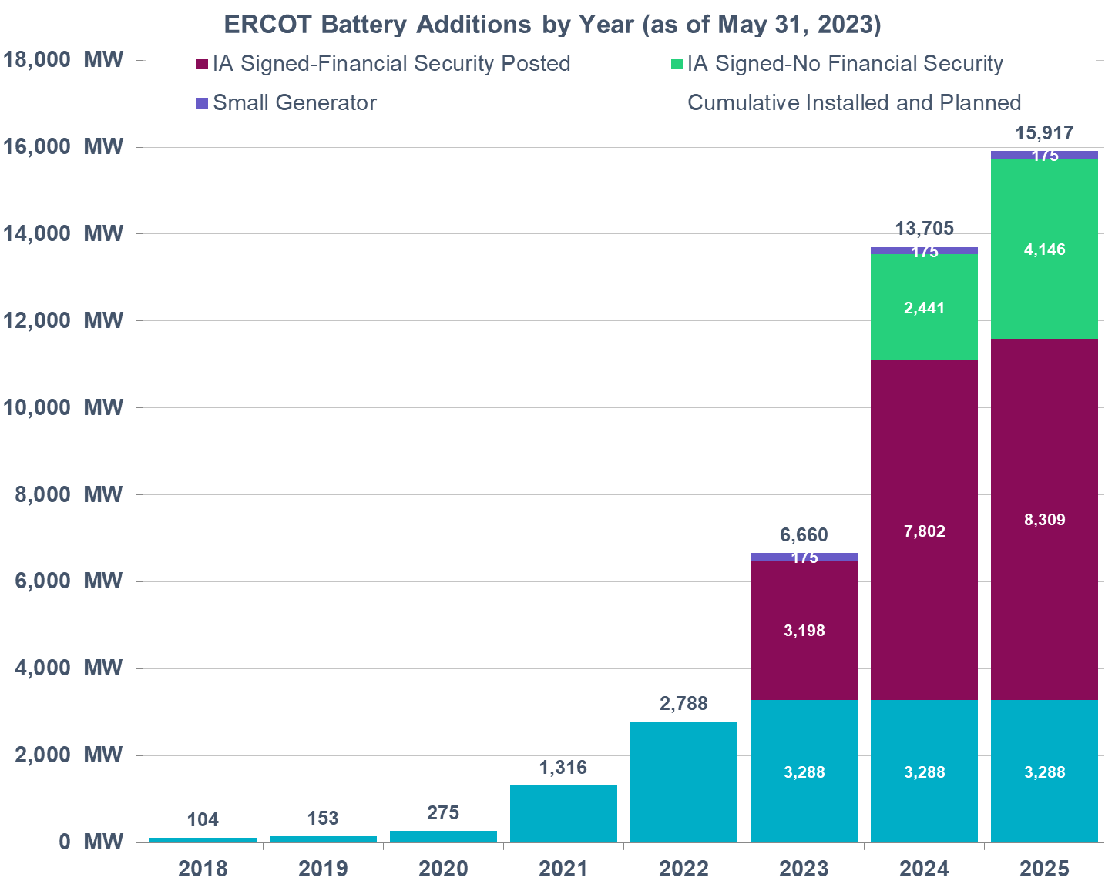
Background & NPRR 1186 Introduction
ERCOT has seen a steady growth in the capacity of interconnected battery Energy Storage Resources (ESRs). This rapid growth is expected to continue in the future as well.
  Most ESRs interconnected or planning to interconnect are less than 2 hours batteries.
  ESRs are already providing up to 60% of ERCOT’s Ancillary Services (AS).
ERCOT’s current systems and processes including DAM, RUC and SCED are not designed to account for capability i.e., State of Charge (SOC) of duration limited ESRs. Also, per the approved protocols, Real-Time Co-optimization (RTC) & Single-Model ESR (“RTC+B” effort) systems as planned today will model ESRs but do not model SOC changes.
Absent SOC modeling,
  RUC may incorrectly assume an ESR’s capacity will be available for dispatch in a future hour when it may not be (due to SOC depletion). This could result in ERCOT failing to commit sufficient generation through RUC.
  SCED may send Base Points that may deplete an ESR’s SOC that should be preserved for its remaining AS obligation. (ESRs have the ability to reduce HSL/MPC to preserve SOC for AS but that alone may not be sufficient.)
Updating current RUC and SCED to model ESRs and account for SOC are expected to be fairly intensive tasks. Hence the changes in NPRR1186 have been proposed with the aim to strategically improve SOC awareness in the current tools and studies with minimal system changes so that a complete suite of DAM, RUC and SCED improvements needed to fully model ESRs and account for their SOC can be designed and implemented with the RTC+B (with single ESR model) project.

Slide 3
Agenda
Discuss the proposed changes in NPRR1186
  review the posted NPRR1186 language,
  walk through the posted examples and
  answer any questions that may come up on these.
Review the proposed single model approach for telemetering AS responsibilities with examples.
  Discuss potential implementation timeline for this change.
Summary and Next Steps

Slide 4
NPRR 1186 Summary of Changes
At a high level with NPRR1186, ERCOT is proposing to,
  Alter Day-Ahead Market (DAM) process so that the Day-Ahead Ancillary Service (AS) awards respect the duration requirements for AS. Absent this change, in some cases DAM AS awards may not be operationally feasible.
  Add 3 new SOC related fields in COP (MaxSOC, MinSOC and Planned Hour Begin SOC) AND Modify the High Ancillary Service Limit (HASL) calculation that is used by Reliability Unit Commitment (RUC) studies such that RUC only counts on SOC that an ESR plans to have in excess of SOC required for AS it is providing in every hour as being available for dispatch. This change will alleviate some of the risks with RUC’s lack of visibility into ESRs.
    RUC treats ESRs as online or Out. RUC will not commit an ESR to come online. RUC can count on ESR being available to serve Load.
  Change the HASL calculation that is used by 5-min Security Constrained Economic Dispatch (SCED) to account for SOC required to support an ESR’s Ancillary Service Resource Responsibility. This change will ensure that SCED issues Base Point such that these preserve the SOC needed to cover an ESR’s remaining AS obligation within the Operating Hour.
With the projected growth in ESRs, the minimal changes in RUC and SCED that have been identified in NPRR1186 are essential for ERCOT to continue reliable grid operations

Slide 5
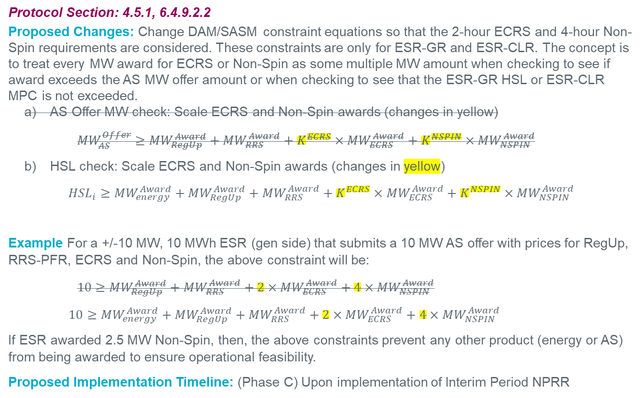
DAM/SASM ECRS & Non-Spin Duration Accounting, Contd.
Protocol Section: 4.5.1, 6.4.9.2.2
Proposed Changes: Change DAM/SASM constraint equations so that the 2-hour ECRS and 4-hour Non-Spin requirements are considered. These constraints are only for ESR-GR and ESR-CLR. The concept is to treat every MW award for ECRS or Non-Spin as some multiple MW amount when checking to see if award exceeds the AS MW offer amount or when checking to see that the ESR-GR HSL or ESR-CLR MPC is not exceeded.
  AS Offer MW check: Scale ECRS and Non-Spin awards (changes in yellow)
    $${MW}_{AS}^{Offer}≥{MW}_{RegUp}^{Award}+{MW}_{RRS}^{Award}+K^{ECRS}×{MW}_{ECRS}^{Award}+K^{NSPIN}×{MW}_{NSPIN}^{Award}$$
  HSL check: Scale ECRS and Non-Spin awards (changes in yellow)
    $${HSL}_{i}≥{MW}_{energy}^{Award}+{MW}_{RegUp}^{Award}+{MW}_{RRS}^{Award}+K^{ECRS}×{MW}_{ECRS}^{Award}+K^{NSPIN}×{MW}_{NSPIN}^{Award}$$
Example For a +/-10 MW, 10 MWh ESR (gen side) that submits a 10 MW AS offer with prices for RegUp, RRS-PFR, ECRS and Non-Spin, the above constraint will be:
    $$10≥{MW}_{RegUp}^{Award}+{MW}_{RRS}^{Award}+2×{MW}_{ECRS}^{Award}+4×{MW}_{NSPIN}^{Award}$$
    $$10≥{MW}_{energy}^{Award}+{MW}_{RegUp}^{Award}+{MW}_{RRS}^{Award}+2×{MW}_{ECRS}^{Award}+4×{MW}_{NSPIN}^{Award}$$
If ESR awarded 2.5 MW Non-Spin, then, the above constraints prevent any other product (energy or AS) from being awarded to ensure operational feasibility.
Proposed Implementation Timeline: (Phase C) Upon implementation of Interim Period NPRR

Slide 6
Current Operating Plan (COP) & Reliability Unit Commitment (RUC) Changes
Protocol Section: 3.9.1, 5.5.2
Today’s Issue: ERCOT’s lookahead studies such as Reliability Unit Commitment (RUC) treat an ESR-GR like any other Generation Resource. The HASL used in RUC study to meet Load Forecast is calculated from the ESR-GR’s COP HSL and COP AS responsibilities. If HASL > 0, then RUC study can dispatch the ESR-GR. There are scenarios where RUC study dispatches ESR-GR for energy when HASL>0 but the ESR may not have sufficient energy to discharge for energy as well as provide its AS responsibility.
Proposed Change:
For ESR-GR add the following three (3) new fields in COP
MinSOC: Minimum Operating SOC for given hour
MaxSOC: Maximum Operating SOC for given hour
PlannedSOC: Planned (target) SOC at the beginning of given hour
Add the following COP submission validations,
    MinSOC <= Planned SOC <= MaxSOC
    MinSOC must be greater than or equal to the registered nameplate MinSOC
    MaxSOC must be less than or equal to the registered nameplate MaxSOC
Changes to RUC in the Interim Period:
In RUC pre-processing, discount COP PlannedSOC by the energy required to support AS responsibilities in the COP
If there is any excess SOC remaining, then use that to calculate effective HASL for the ESR-GR, otherwise do not allow ESR-GR to be dispatched for energy in the RUC study.
Proposed Implementation Timeline: (Phase C) Upon implementation of Interim Period NPRR

Slide 7
High and Low Ancillary Service Limit Calculation and SOC Requirements
Protocol Section: 6.5.5.2, 6.5.7.2, 8.1
Today’s Issue: ERCOT’s SCED does not take into account the SOC that needs to be preserved to support an ESR’s AS Responsibility and hence is ignorant of the amount of SOC that is truly available for dispatch.
Proposed Change: Modify RLC to ensure HASL/LASL for ESR’s take into remaining SOC available for SCED base Point after discounting the SOC required to support the ESR’s AS Responsibilities.
Updated ESR-GR HASL
HASL = Max (LASL, Min ((HSLTELEM – (RRSTELEM + RUSTELEM + ECRSTELEM + NSRSTELEM +NFRCTELEM)), MaxBP))
MaxBP = (SOCTELEM – MINSOCTELEM – REQ_AS_SOC ) / TSCED
Updated ESR-CLR HASL
HASL = Max (LPCTELEM, Min ((MPCTELEM – RDSTELEM), MaxBP))
MaxBP = (MAXSOCTELEM – SOCTELEM – REQ_Headroom_AS_SOC) / TSCED
Proposed Implementation Timeline: (Phase C) Upon implementation of Interim Period NPRR

Slide 8
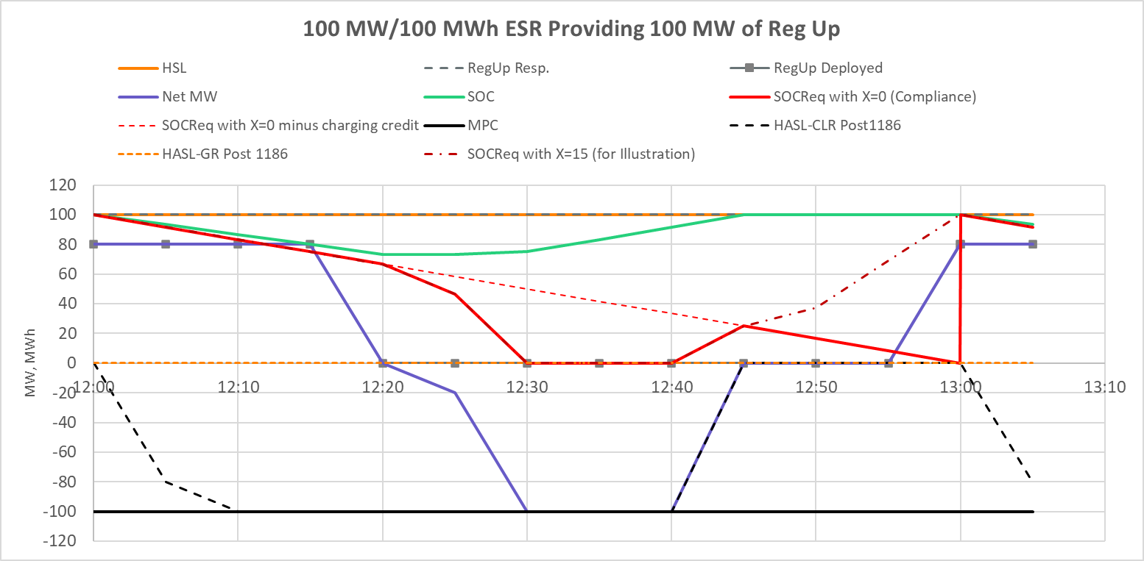
State of Charge Requirements for AS
NPRR1186 also proposes to update the SOC requirements for AS and a create a framework within ERCOT’s EMS to calculate SOC that is available for SCED dispatch by taking into account the following
    SOC that ESR is required to preserve for the AS obligation it is carrying in the current hour.
      SOC requirement for AS will diminish as the clock progresses such that at the end of the Operating Hour the SOC requirement for that an Ancillary Service will reduce by an amount that reflects the energy depleted if the Ancillary Service was fully deployed for one hour.
    X* minutes prior to end of current Operating Hour any additional SOC needed to support the ESR’s next hour AS obligation
    Discount SOC requirement to account for the ESR’s current withdrawal BP.
Example below demonstrates the SOC requirement over the course of on hour for a 100 MW/100MWh battery that is providing 100 MW of Regulation Up. In this example SOCReq with X=0 demonstrates the SOC requirement for compliance monitoring. HASL-GR and HASL-CLR have been computed using SOCReq with X=0. For illustrative purposes SOCReq with X=16 has been included to show how SOC requirements change if a ramp up based on next Hour’s AS obligation is included in the SCED that runs at 45 minutes past current hour.
*X is a parameter that can be altered based on discussions.

Slide 9
NPRR 1186 Examples
Jackson DuBro

Slide 10
Example Workbook Introduction
The posted workbook contains illustrative examples to demonstrate how the proposed State of Charge (SOC) requirements will be used for compliance and in computing High Ancillary Service Limit (HASL).
These examples are not exhaustive. For example, the posted workbook does not include examples to demonstrate how Reg Down Responsibility will impact on HASL-CLR or the maximum SOC requirement for compliance.
Each worksheet has been set up with an example. Each example assumes a 100 MW/100 MWh Energy Storage Resource (ESR) that is qualified to provide Reg Up, RRS-PFR, ECRS, and Non-Spin up to maximum capacity allowed per the associated AS duration requirement*. Each example demonstrates how SOC available for dispatch and SOC compliance requirements will be calculated over a 3 hour period (in steps of 5-minute granularity, 5-minute is used for simplicity).
*Regulation Up/Down = 1h, RRS-PFR = 1h, ECRS = 2h, Non-Spin = 4h

Slide 11
How to Use the Example Workbook
All cells have embedded formulas except those highlighted in yellow, which were manually entered for each example
All CLR values (including MPC, HASL, and BP) are entered in as negative values for graphical purposes
  These values will continue to be telemetered as positive post 1186
The number of minutes before the top of the hour that the SOC Requirement begins to ramp to support the ESR’s next hour AS obligation is found in cell L1 on each sheet
  This value is only used in the HASL Post 1186 calculation, not in the SOCReq-Compliance calculation
  The value is currently set to 0 on all sheets

Slide 12
Additional Information for the Examples
All values are measured at the beginning of the interval and are assumed to persist until a “step change” at the beginning of the next interval
  The graph in Excel automatically interpolates between two points, but values do not ramp between intervals (except telemetered SOC and SOC Req)
Expected generation deviation is assumed to be 0
  If Reg is deployed or the ESR receives a BP, Net MW output reflects the ESR following these instructions

Slide 13
ESR AS Telemetry Change
Luis Hinojosa

Slide 14
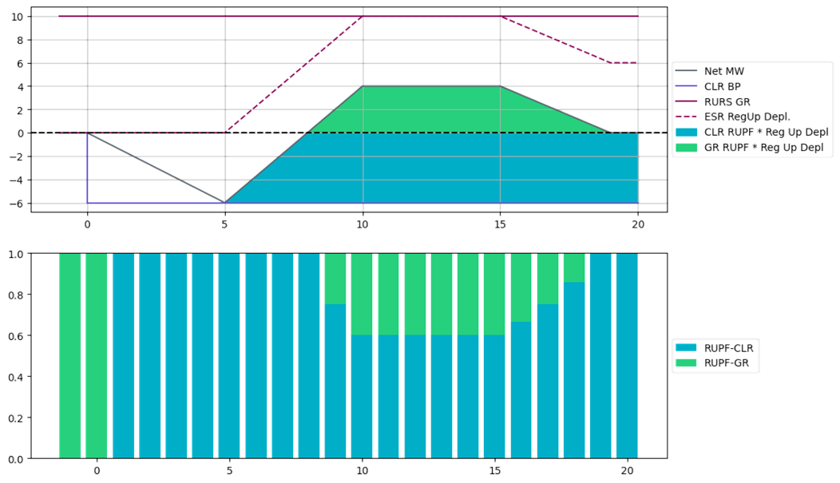
ESR AS Telemetry Change – Not tied to NPRR1186
The current combo model for ESR (combo of ESR-GR and ESR-CLR) has complicated the process of the QSE moving the AS responsibilities on an ESR between its modeled ESR-GR and ESR-CLR to self-manage SOC. In addition, under certain scenarios, an ESR-GR and/or ESR-CLR may incur compliance violations and Base Point Deviation charges even when the overall ESR performance meets expectations.
Proposed change in ESR AS telemetry
  All up AS Responsibilities be carried first on the ESR-GR side of the ESR up till HSL and any remaining up AS Responsibility then be carried on the ESR-CLR side. Similarly, all the Regulation Down Responsibility be carried first on the ESR-CLR side of the ESR up till MPC and any remaining Regulation Down Responsibility then be carried on the ESR-GR side.
  The telemetered Regulation Up and Regulation Down participation factors are expected to be updated based on Regulation deployment amounts for both ESR-GR and ESR-CLR so that ERCOT can compute expected Regulation deployment from both sides of the ESR.
This change will bring relief to the Base Point Deviation and GREDP/CLREDP issues associated with the AS transition requirements AND reduces the need to implement NPRR 963 prior to RTC+B project.
ERCOT systems are ready with this feature and will work with QSEs on a timeline to turn it on.
ERCOT has posted a draft ERCOT and QSE Operations Practices During The Operating Hour Business Practice Manual to provide more details on this.

Slide 15
Treat Dual Model Telemetry as Single Model ESR
With these changes the telemetry setup for ESRs will become closer to the telemetry setup expected with single model ESR implementation.
All up AS Responsibilities be carried first on the ESR-GR side of the ESR up till HSL and any remaining up AS Responsibility then be carried on the ESR-CLR side.
Similarly, all the Regulation Down Responsibility be carried first on the ESR-CLR side of the ESR up till MPC and any remaining Regulation Down Responsibility then be carried on the ESR-GR side.
With this change, there is no need to transition the AS Responsibilities to the charging side as the ESR starts charging in response to a charging Base Point.
  In case of Regulation, Regulation Up and Regulation Down participation factors can be used to indicate which side of the ESR is responding to the Regulation deployment.
ESR-HSL
ESR-Gen
Up AS
0
ESR-CLR
Down AS
ESR-LSL

Slide 16
Example 1 – 50 MW RegUp and 0 MW RegDown
In this example the ESR has enough room to carry the Regulation AS responsibility without any overflow. i.e., RegUp on Gen and RegDown on CLR.
GR-HSL = 100
GR-REGUP-Responsibility (RGURS) = 50 MW
CLR-REGUP-Responsibility (RGURS) = 0
CLR-MPC = 100
HSL =100
RGURS=50
HASL = 50
ESR-Gen
RGDRS=0
0
RGURS=0
ESR-CLR
RGDRS = 0
HASL = MPC =100

Slide 17
Example 2 – 50 MW RegUp and 50 MW RegDown
In this example the ESR has enough room to carry the Regulation AS responsibility without any overflow. i.e., RegUp on Gen and RegDown on CLR.
GR-HSL = 100
GR-REGUP-Responsibility (RGURS) = 50 MW
GR-REGDOWN-Responsibility (RGDRS) = 0
CLR-REGUP-Responsibility (RGURS) = 0
CLR-REGDOWN-Responsibility (RGDRS) = 50 MW
CLR-MPC = 100
HSL =100
RGURS=50
HASL = 50
ESR-Gen
RGDRS=0
0
RGURS=0
HASL = 50
ESR-CLR
RGDRS = 50
MPC =100

Slide 18
Example 2 – 125 MW RegUp and 50 MW RegDown
In this example the ESR can only carry 100 MW of RegUp on the ESR-GR. The remaining 25 MW will can be provided on the ESR-CLR. There is no change to the ESR-CLR for RegDown from the last example.
GR-HSL = 100
GR-REGUP-Responsibility (RGURS) = 100 MW
GR-REGDOWN-Responsibility (RGDRS) = 0
CLR-REGUP-Responsibility (RGURS) = 25 MW
CLR-REGDOWN-Responsibility (RGDRS) = 50 MW
CLR-MPC = 100
100
RGURS=100
ESR-Gen
RGDRS=0
HASL=LASL=0
RGURS=25
LASL=25
ESR-CLR
HASL=50
RGDRS = 50
100

Slide 19
Additional Example 1 Details
Following slides will show an example discussing the use of dynamic participation factors during a regulation Up Deployment while maintaining Regulation Up Responsibility on the ESR-GR.
ESR Details:
  ESR HSL/MPC = =/-100 MW
  ESR-Regulation Up Responsibility = 80 MW
  ESR-Regulation Down Responsibility = 22 MW
  ESR-GR HASL = 20 MW
  ESR-CLR HASL = -78MW
  ESR-GR LASL = ESR-CLR LASL = 0 MW
  ESR-GR BP = 0 MW
  ESR-CLR BP = 0 MW but then increases to -30 MW then to -78MW
  As the ESR-CLR UDBP begins to ramp to meet the new charging BPs the participation factors for the GR and CLR will adjust to represent the portion of regulation deployment being provided by each side.
  The Regulation Up Responsibility is not moved at any time.

Slide 20
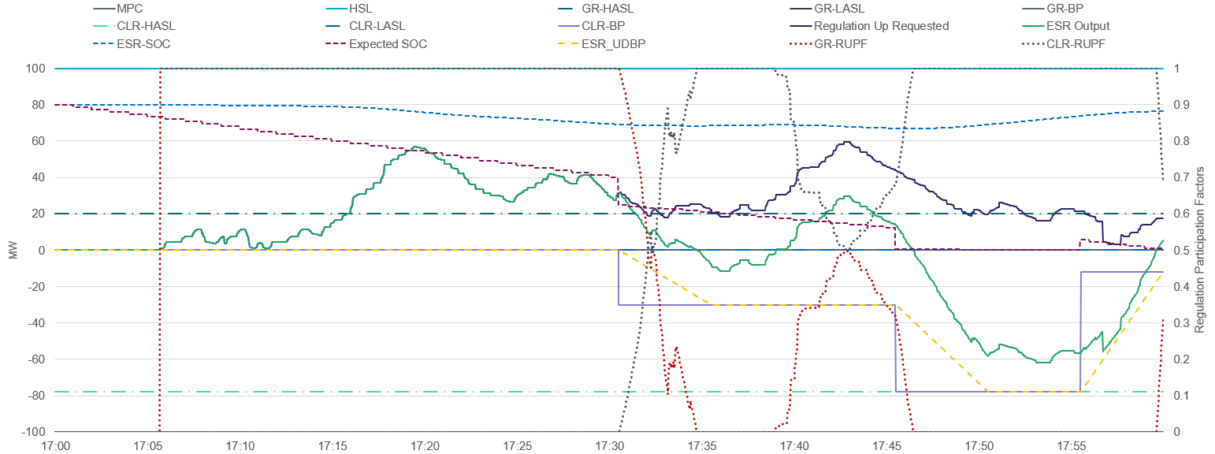
Additional Example 1
Notes:
Regulation Responsibility on GR = 80 MW
Regulation Down on CLR = 22 MW

Slide 21
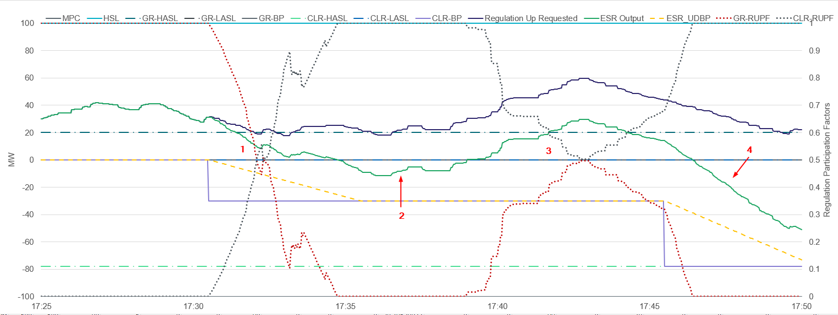
Additional Example 1 - Zoom
Notes:
Regulation Responsibility on GR = 80 MW
Regulation Down on CLR = 22 MW
CLR BP = 30
GR providing all regulation. Then CLR gets a BP and UDBP ramps
CLR covering regulation now that UDBP has ramped to BP and Regulation Requested reduced
Shared 50/50 RUPFs
CLR covers all regulation request as it ramps to BP

Slide 22
Additional Example 2 Details
Following slides will show an example discussing the use of dynamic participation factors during a regulation Up Deployment while maintaining Regulation Up Responsibility on the ESR-GR.
ESR Details:
  ESR HSL/MPC = =/-100 MW
  ESR-Regulation Up Responsibility = 80 MW
  ESR-Regulation Down Responsibility = 22 MW
  ESR-GR HASL = 20 MW
  ESR-CLR HASL = -78MW
  ESR-GR LASL = ESR-CLR LASL = 0 MW
  ESR-GR BP = 20 MW to start but then drops to 0 MW
  ESR-CLR BP = 0 MW to start but then changes to -20 MW then to -78MW
  As the ESR-CLR UDBP begins to ramp to meet the new charging BPs the participation factors for the GR and CLR will adjust to represent the portion of regulation being provided by each side.
  The Regulation Up Responsibility is not moved at any time.

Slide 23
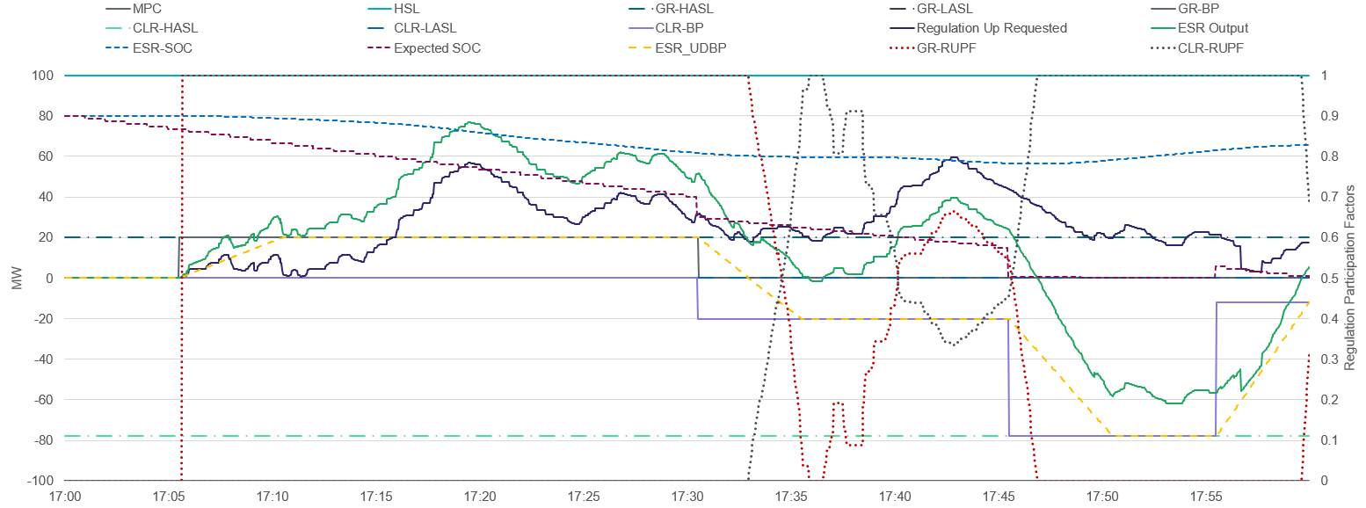
Additional Example 2
Notes:
Regulation Responsibility on GR = 80 MW
Regulation Down on CLR = 22 MW

Slide 24
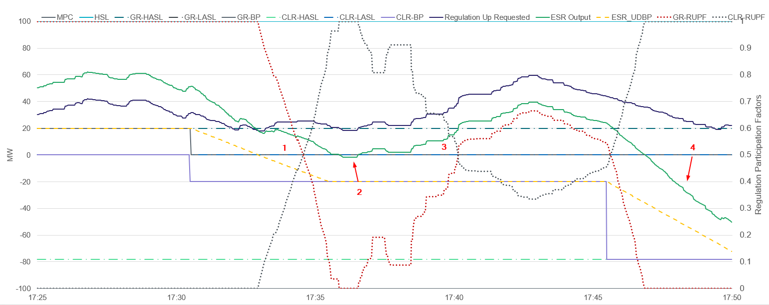
Additional Example 2-Zoom
Notes:
Regulation Responsibility on GR = 80 MW
Regulation Down on CLR = 22 MW
GR-BP =20 then to 0
CLR-BP 0 to -20MW then -78MW
1)Equal Participation Factors now that CLR-UDBP ~12 MW and GR-MW ~12 MW and Regulation Requested ~24MW
2)CLR covering all of the Reg Requested so CLR-RUPF = 1
3)Regulation increase and PFs are equal
4)CLR-UDBP ramping to BP and covers remaining Regulation CLr-RUFP=1

Slide 25
Additional Example 3 Details
Following slides will show an example showing a ESR carrying RRS while discharging followed by charging.
ESR Details:
  ESR HSL/MPC = =/-100 MW
  ESR-RRS Responsibility = 50 MW
  ESR-GR HASL = 50 MW
  ESR-CLR HASL = 100 MW
  ESR-GR LASL = ESR-CLR LASL = 0 MW
  ESR-GR BP = 50 MW to start but then drops to 0 MW
  ESR-CLR BP = 0 MW to start but then changes to -50 MW
  When we see the BPs change for the ESR as the unit starts charging there is an SOC discount applied for charging, but the RRS Responsibility is never moved and the HASL/LASL remain the same.

Slide 26
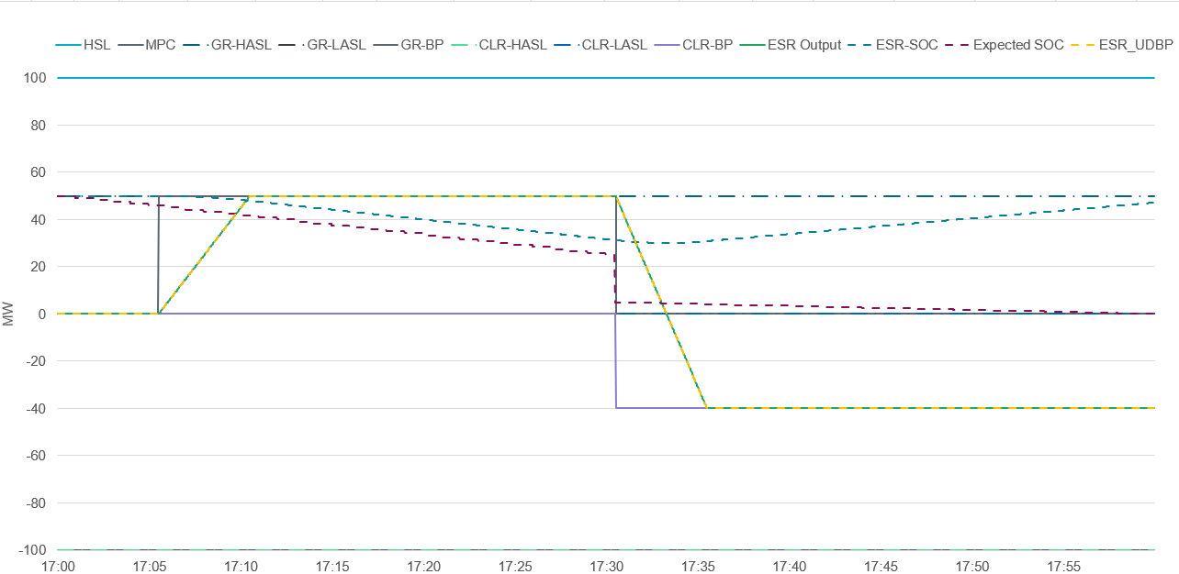
Additional Example 3
Notes:
No Regulation Responsibility
MW RRS on GR
SOC Discount for BP charging. RRS not moved so no LASL set for CLR

Slide 27
Summary
Nitika Mago and Kenneth Ragsdale

Slide 28
NPRR1186 Does and Does Not
NPRR1186 specifies changes that are applicable to today’s systems and studies to improve accounting of an ESR’s SOC in DAM, RUC and SCED. ERCOT is not seeking to manage an ESR’s SOC.
NPRR1186 changes DAM and SASM such that AS awards take AS duration into account. Ex. A 100 MW/100 MWh ESR can get awarded only 50MW of ECRS.
  Post NPRR1186 DAM will not stop an ESR be awarded a particular AS for consecutive hours.
NPRR1186 changes COP to include 3 new SOC related fields. These fields will be used to supplement the HASL used in RUC such that RUC only counts on SOC that an ESR plans to have in excess of SOC required for AS it is providing in every hour as being available for dispatch.
  Post NPRR1186, RUC will continue to treat ESRs as online or Out; RUC will not commit an ESR to come online; RUC will not model ESRs fully; RUC will only count on ESR being available to serve Load if it has SOC in excess of its AS obligation.
NPRR1186 changes Real Time HASL to include SOC requirement.
  An ESR’s Real Time injection HASL will be based on the SOC that the ESR actually has in excess of its SOC requirement. Similarly, an ESRs Real Time charging HASL will be based on the margin the ESR has to charge in excess of the SOC margin required to provide Regulation Down obligation (if any).
  Post NPRR1186, the HASL changes, will not force an ESR to charge to replenish SOC. The obligation of taking actions such that the ESR stays in compliance with the SOC requirements falls on the QSE.
  The SOC requirements will take current Operating Hour’s AS obligation the ESR is providing on the injection sides into account, the SOC requirement will reduce as time progresses within the hour and will also include a credit if the ESR has an active Base Point in excess of its LASL to charge.

Slide 29
Evolution of Battery Energy Storage Resources
D
C
RTC+B Period:
Starts when RTC+B project is implemented
B
Interim Period:
Starts when Interim Period NPRR is Implemented
A
Starting DD/MM/2023
“Quick –Simple Changes”
Today
June 2023
DD/MM/2023
Interim NPRR Go-Live Date
RTC+B Go-Live Date
Time
Not to Scale

Slide 30
Today: (June 2023)
Phase
Registration
(RARF or RIOO)
Siebel, NMMS, EMS, MMS, Settlements
A
GR
GR
ESR
ESR
CLR
CLR
Today
ESR
ESR
Note the telemetry points related to SOC specified in the fall of 2018. https://www.ercot.com/files/docs/2018/11/08/New_Telemetry_for_Storage_Resourcev2.docx
DAM clearing does not consider duration requirements for AS. Market Participants have the responsibility to limit AS offers so that DAM awards do not exceed the resource capability in any one hour.
ERCOT “SOC accounting-monitoring-expectations” specified in ERCOT and QSE Operations Practices During The Operating Hour Business Practice Manual.
NPRR 963 is not implemented. Base Point Deviation and CLREDP calculations do not “see” a “single resource”.
Telemetered SOC values not considered by SCED.
RUC does not consider SOC. (Assumes there is no limit to the duration of the batteries and there is a potential for overstating available capacity from batteries in future hours.]
Other issues/complexity because of the “Combo Model” imperfections such as the QSE managing AS transitions between injection & charging side of the ESR.

Slide 31
Changes Implemented Before the Interim Period
Phase
Registration
(RARF or RIOO)
Siebel, NMMS, EMS, MMS, Settlements
B
GR
GR
ESR
ESR
CLR
CLR
Starting DD/MM/2023
ESR
ESR
Changes that can be implemented without Protocol Changes
and without ERCOT Software Changes
QSEs in Real Time use “single model ESR” approach in assigning AS via telemetry to the ESR-GR and the ESR-CLR.
ERCOT “turns on” EMS improved calculation in determining AS Regulation Up/Down deployment requirement for ESR-GR and ESR-CLR as a single model ESR.
  Item 1 and 2 should bring some relief to Base Point Deviation charges and GREDP/CLREDP issues associated with the AS transition requirements AND reduces the need to implement NPRR 963 prior to RTC+B project.

Slide 32
Interim Period: Changes Implemented with NPRR1186
Phase
Registration
(RARF or RIOO)
Siebel, NMMS, EMS, MMS, Settlements
C
GR
GR
ESR
ESR
CLR
CLR
Interim Period:
Starts when Interim Period NPRR is Implemented
ESR
ESR
For ESRs in DAM, the equations will be modified to account for the 2-hour ECRS and 4-hour Non-Spin duration requirements.
For ESR-GRs and ESR-CLRs, a new telemetered value representing the next Operating Hour’s AS Responsibility will be required. (This will no longer be used after RTC+B goes live.)
Implement refinements to the ERCOT “SOC accounting-monitoring-expectations” approach. Provide clarity on how much SOC is required for each AS responsibility and how ERCOT will check to see if the SOC is adequate for the AS responsibilities.
For ESR-GRs, three new COP fields related to SOC will be added.
For ESR-GRs, the RUC studies will use the new COP fields related to SOC to determine ESR-GR capacity available to meet Load Forecast after satisfying ESR COP AS responsibilities.
For ESR-GRs and ESR-CLRs, Real Time HASL calculation is modified to account for SOC required to support AS responsibilities and Max/Min SOC Limits.
QSEs continue to use the single model ESR approach in assigning AS in Real Time to the ESR-GR and the ESR-CLR from phase B. ERCOT continues to use EMS improvement in determining AS Regulation Up/Down deployment requirements assignment to ESR-GR and ESR-CLR.

Slide 33
RTC+B Period: Changes in NPRRXX Implemented with the RTC+B project
Phase
Registration
(RARF or RIOO)
Siebel, NMMS, EMS, MMS, Settlements
D
Single
Resource
ESR_B1
Single
Resource
ESR_B1
RTC+B Period:
Starts when RTC+B project is implemented
Single Model approach will be implemented in all ERCOT systems. (No more Combo Model.)
RTC+B is implemented with SOC accounting in RUC and Real-Time SCED (additional RTC+B NPRR required).
RTC+B DAM: No SOC accounting. Keeps Interim Period changes for tracking AS duration requirements in DAM.
The 3 new COP fields introduced with the Interim Period NPRR will be applied to single ESR model.
RTC+B SCED: In addition to the existing set of constraints for an ESR, new constraints will be introduced to enable SOC accounting.
RTC+B RUC changes for SOC modeling/accounting include:
  In addition to the existing set of constraints for an ESR, new constraints will be introduced to enable SOC accounting.
  Deployment factors for each AS type (by hour) to simulate deployment of AS on ESRs.
  RUC Capacity Short Calculation to consider AS duration requirements and SOC when determining ESR capability.

Slide 34
Next Steps
NPRR1186 continues to be on a fairly tight review timeline with the target of Aug 2023 BoD Meeting.
  Jul 19, 2023 Workshop
  Aug 10, 2023 PRS
  Aug 22, 2023 TAC
  Aug 31, 2023 BoD
  Sep 14, 2023 PUC OM
Stakeholders are requested to review the NPRRs and reach out with questions/comments to ERCOT as soon as practicable. ERCOT will use the feedback received to file comments by EoD July 31, 2023.
  Please reach out to Nitika Mago (nmago@ercot.com), Kenneth Ragsdale (kragsdale@ercot.com), Sai Moorty (smoorty@ercot.com) or Pamela Shaw (pshaw@ercot.com).

Slide 35
Appendix – Relevant Slides from Jun 22, 2023 Workshop

Slide 36
Overview of Improvements for Current systems & processes
Nitika Mago

Slide 37
Real Time AS Telemetry
Today’s Issue with AS Transitions: The current combo model for ESR (combo of ESR-GR and ESR-CLR) has complicated the process of the QSE moving the AS responsibilities on an ESR between its modeled ESR-GR and ESR-CLR to self-manage SOC. In addition, under certain scenarios, an ESR-GR and/or ESR-CLR may incur compliance violations and Base Point Deviation charges even when the overall ESR performance meets expectations.
Proposed Changes:
All Up-AS Responsibilities will be carried first on the ESR-GR side of the ESR up till HSL and any remaining Up-AS Responsibility on the ESR will then be carried on the ESR-CLR side. Similarly, all the Regulation Down Responsibility will be carried first on the ESR-CLR side of the ESR up till MPC and any remaining Regulation Down Responsibility will then be carried on the ESR-GR side.
QSE will be required to ensure that the telemetered Regulation Up and Regulation Down participation factors are dynamically calculated for the ESR-GR and ESR-CLR so that ERCOT can compute expected Regulation deployment from both sides of the ESR.
Example: A +/-10 MW, 10 MWh ESR is qualified for 10 MW RegUp and charging with a -6 MW BP receives a 10 MW Reg Up deployment.
Proposed Implementation Timeline: (Phase B) ERCOT systems are ready with this feature and will work with QSEs on a timeline to turn it on.
ESR-GR Telemetry
  HSL = 10 MW
  REGUP Responsibility = 10 MW
  BP = 0
  RUPF = 0.4
  MW = BP + RegUp Deployment * RUPF = 0 + 10 * 0.4 = 4 MW
ESR-CLR Telemetry
  MPC = 10 MW
  REGUP Responsibility = 0 MW
  BP = 6
  RUPF = 0.6
  NPC = BP - RegUp Deployment * RUPF = 6 – (10 * 0.6) = 0 MW

Slide 38
DAM/SASM ECRS & Non-Spin Duration Accounting
Today’s Issue: QSE’s representing ESRs take on risk if they choose to offer into the ECRS and Non-Spin in the DAM/SASM. This is because the DAM/SASM clearing engine does not consider the 2-hour and 4-hour duration requirement for ECRS and Non-Spin respectively.
Example of operationally infeasible outcome: A +/-10 MW, 10 MWh ESR is qualified for 10 MW RegUp, 10 MW RRS and 2.5 MW for Non-Spin.
QSE representing ESR submits ESR-GR specific Offer of 10 MW with prices for RegUp, RRS-PFR and Non-Spin
If the submitted offer for RRS-PFR and Non-Spin are in the money, then DAM/SASM could award 2.5 MW Non-Spin, 7.5 MW of RRS-PFR
The above outcome is not operationally feasible for the ESR to provide in Real-Time as the energy required exceeds its 10 MWh capability.

Slide 39
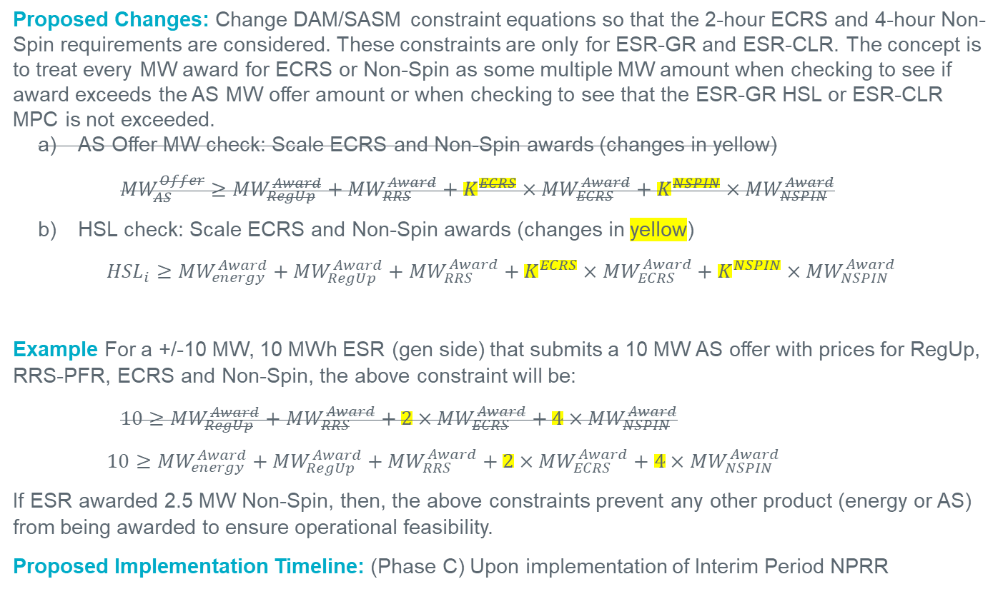
DAM/SASM ECRS & Non-Spin Duration Accounting, Contd.
Proposed Changes: Change DAM/SASM constraint equations so that the 2-hour ECRS and 4-hour Non-Spin requirements are considered. These constraints are only for ESR-GR and ESR-CLR. The concept is to treat every MW award for ECRS or Non-Spin as some multiple MW amount when checking to see if award exceeds the AS MW offer amount or when checking to see that the ESR-GR HSL or ESR-CLR MPC is not exceeded.
  AS Offer MW check: Scale ECRS and Non-Spin awards (changes in yellow)
    $${MW}_{AS}^{Offer}≥{MW}_{RegUp}^{Award}+{MW}_{RRS}^{Award}+K^{ECRS}×{MW}_{ECRS}^{Award}+K^{NSPIN}×{MW}_{NSPIN}^{Award}$$
  HSL check: Scale ECRS and Non-Spin awards (changes in yellow)
    $${HSL}_{i}≥{MW}_{energy}^{Award}+{MW}_{RegUp}^{Award}+{MW}_{RRS}^{Award}+K^{ECRS}×{MW}_{ECRS}^{Award}+K^{NSPIN}×{MW}_{NSPIN}^{Award}$$
Example For a +/-10 MW, 10 MWh ESR (gen side) that submits a 10 MW AS offer with prices for RegUp, RRS-PFR, ECRS and Non-Spin, the above constraint will be:
    $$10≥{MW}_{RegUp}^{Award}+{MW}_{RRS}^{Award}+2×{MW}_{ECRS}^{Award}+4×{MW}_{NSPIN}^{Award}$$
    $$10≥{MW}_{energy}^{Award}+{MW}_{RegUp}^{Award}+{MW}_{RRS}^{Award}+2×{MW}_{ECRS}^{Award}+4×{MW}_{NSPIN}^{Award}$$
If ESR awarded 2.5 MW Non-Spin, then, the above constraints prevent any other product (energy or AS) from being awarded to ensure operational feasibility.
Proposed Implementation Timeline: (Phase C) Upon implementation of Interim Period NPRR

Slide 40
High and Low Ancillary Service Limit Calculation
Today’s Issue: ERCOT’s SCED does not take into account the SOC that needs to be preserved to support an ESR’s AS Responsibility and hence is ignorant of the amount of SOC that is truly available for dispatch.
Proposed Change: Modify RLC to ensure HASL/LASL for ESR’s take into remaining SOC available for SCED base Point after discounting the SOC required to support the ESR’s AS Responsibilities.
Updated ESR-GR HASL
HASL = Max (LASL, Min ((HSLTELEM – (RRSTELEM + RUSTELEM + ECRSTELEM + NSRSTELEM +NFRCTELEM)), MaxBP))
MaxBP = (SOCTELEM – MINSOCTELEM – REQ_AS_SOC ) / TSCED
Updated ESR-CLR HASL
HASL = Max (LPCTELEM, Min ((MPCTELEM – RDSTELEM), MaxBP))
MaxBP = (MAXSOCTELEM – SOCTELEM – REQ_Headroom_AS_SOC) / TSCED
Proposed Implementation Timeline: (Phase C) Upon implementation of Interim Period NPRR

Slide 41
Current Operating Plan (COP) & Reliability Unit Commitment (RUC) Changes
Today’s Issue: ERCOT’s lookahead studies such as Reliability Unit Commitment (RUC) treat an ESR-GR like any other Generation Resource. The HASL used in RUC study to meet Load Forecast is calculated from the ESR-GR’s COP HSL and COP AS responsibilities. If HASL > 0, then RUC study can dispatch the ESR-GR. There are scenarios where RUC study dispatches ESR-GR for energy when HASL>0 but the ESR may not have sufficient energy to discharge for energy as well as provide its AS responsibility.
Proposed Change:
For ESR-GR add the following three (3) new fields in COP
MinSOC: Minimum Operating SOC for given hour
MaxSOC: Maximum Operating SOC for given hour
PlannedSOC: Planned (target) SOC at the beginning of given hour
Add the following COP submission validations,
    MinSOC <= Planned SOC <= MaxSOC
    MinSOC must be greater than or equal to the registered nameplate MinSOC
    MaxSOC must be less than or equal to the registered nameplate MaxSOC
Changes to RUC in the Interim Period:
In RUC pre-processing, discount COP PlannedSOC by the energy required to support AS responsibilities in the COP
If there is any excess SOC remaining, then use that to calculate effective HASL for the ESR-GR, otherwise do not allow ESR-GR to be dispatched for energy in the RUC study.
Proposed Implementation Timeline: (Phase C) Upon implementation of Interim Period NPRR

Slide 42
Individual ESR SOC Expectation for AS
Today’s Issue: Since late last year ERCOT has been monitoring SOC that is preserved for the amount of Up-AS responsibility that is provided on an ESR-GR. The methodology used for establishing ERCOT’s current SOC expectation for AS currently discounts SOC for any intra-hour AS deployments. These SOC discounts reset any time the AS responsibility is moved intra-hour forcing the QSE to preserve a lot more SOC for AS than their obligation.
Proposed Changes:
QSE to telemeter on an individual ESR basis the next hour AS responsibilities that the ESR is expected to carry.
Add validations in Resource Limit Calculator (RLC) to ensure minSOC <= currentSOC <= maxSOC.
Validate QSE level next hour telemetered AS Responsibilities with QSE level next hour COP AS Responsibilities.
Validate QSE level SOC requirements for supporting AS Responsibilities with the available SOC across the ESRs in its fleet.

Slide 43
Individual ESR SOC Expectation for AS, Cont.
Add two new calculation to monitor SOC for an ESR at a given instance of time:
SOC required for discharge without going below its minSOC
SOC headroom required for charging without going above its maxSOC
Proposed Implementation Timeline: (Phase C) Upon implementation of Interim Period NPRR
These new calculations will consider:
The elapsed time within the current Operating Hour (OH) to account for :
  the diminished SOC discharge requirement to support full deployment (discharge) for the remainder of the Operating Hour, or
  the diminished SOC headroom requirement to support full deployment (charge) for the remainder of the Operating Hour
The ramping of:
  SOC required to discharge at the tail end of the current Operating Hour to support the next hour’s AS responsibilities.
  SOC headroom required for charging at the tail end of the current Operating Hour to support the next hours AS responsibilities
The reduction in SOC required to discharge to support Up-AS Responsibility on the ESR-GR if the ESR-CLR Base Point>0
The reduction in SOC headroom required to charge to support RegDown Responsibility on the ESR-CLR if the ESR-GR Base Point>0

Slide 44
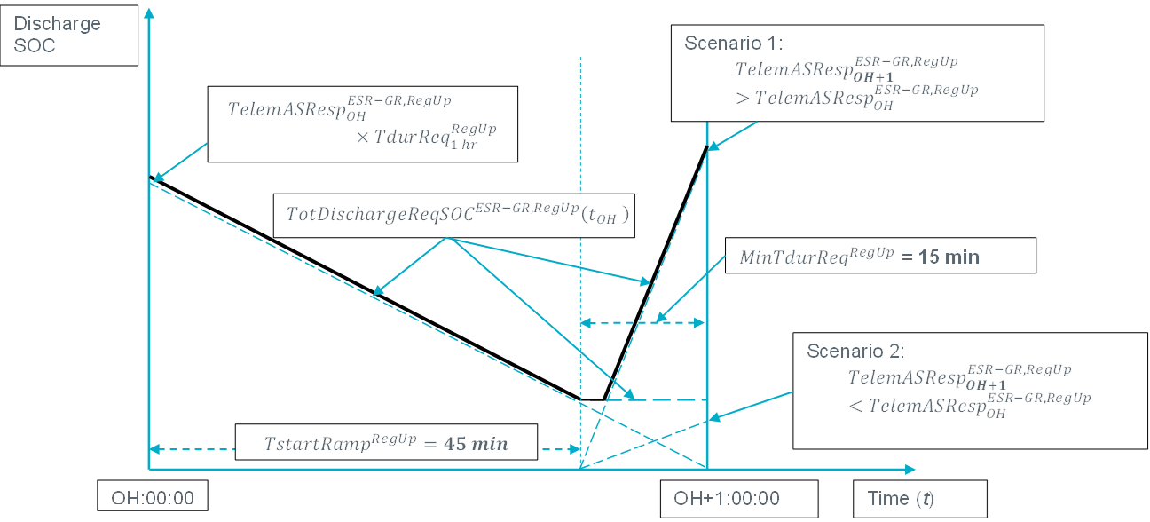
SOC Requirement Compliance vs Dispatch
ERCOT’s comments will include a description of the formulas that will be used to compute SOC requirements for compliance and 5-min dispatch.
RegUp example for SOC required to discharge if ESR-GR Base Point >0
#1 For Dispatch
#2 For Dispatch: Tune-able Parameter
Compliance and Enforcement

Slide 45
Overview of Improvement to be applied along with RTC+B (Single ESR Model)
Sai Moorty

Slide 46
RTC+B DAM
There are no changes proposed for the RTC+B version of DAM to perform ESR SOC accounting for the following reasons:
  Increases scope and risk for RTC+B project delivery with maybe limited benefits as DAM is a financial market rather than a physical market. Also, RTC+B version of DAM introduces virtual AS Offers
  DAM performance concerns.
If required, modifying RTC+B version of DAM to do ESR SOC accounting can be addressed after RTC+B project goes live.

Slide 47
RTC+B: Changes to COP
Following three (3) SOC fields for single ESR model COP:
    MinSOC: Minimum Operating SOC for given hour
    MaxSOC: Maximum Operating SOC for given hour
    PlannedSOC: Planned (target) SOC at the beginning of given hour
COP Submission Validations:
    MinSOC <= Planned SOC <= MaxSOC
    MinSOC must be greater than or equal to the registered nameplate MinSOC
    MaxSOC must be less than or equal to the registered nameplate MaxSOC

Slide 48
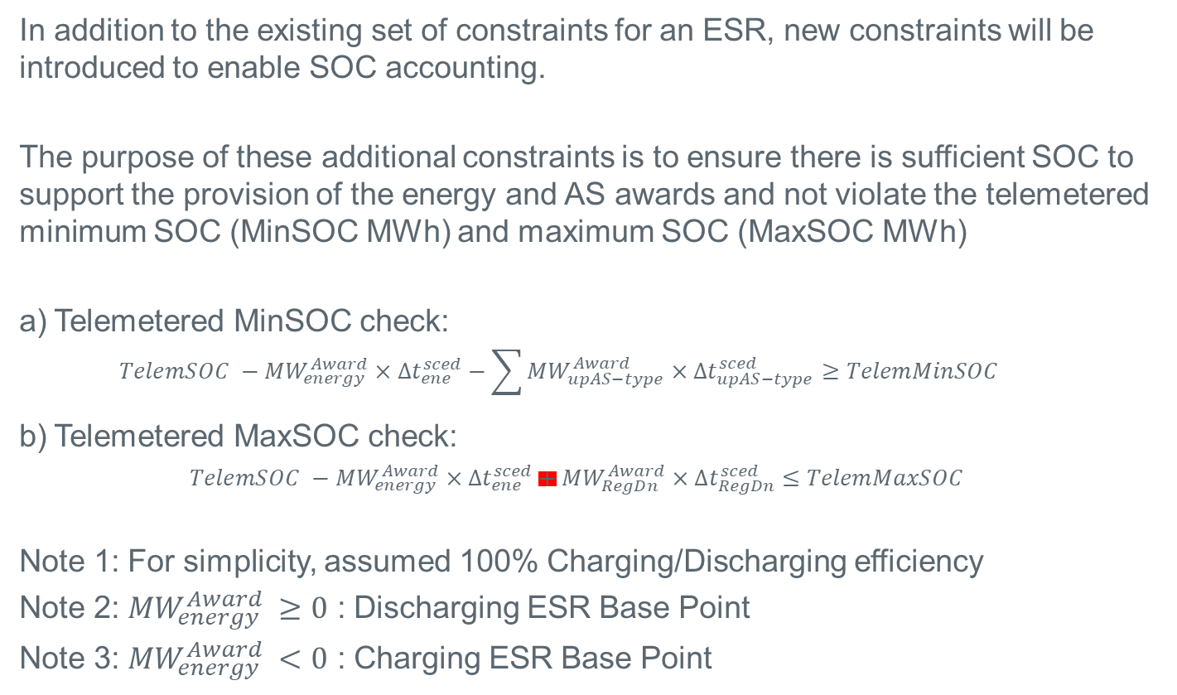
RTC+B SCED: ESR SOC Accounting
In addition to the existing set of constraints for an ESR, new constraints will be introduced to enable SOC accounting.
The purpose of these additional constraints is to ensure there is sufficient SOC to support the provision of the energy and AS awards and not violate the telemetered minimum SOC (MinSOC MWh) and maximum SOC (MaxSOC MWh)
Telemetered MinSOC check:
  $$TelemSOC −{MW}_{energy}^{Award}×∆t_{ene}^{sced}−\sum{{MW}_{upAS−type}^{Award}×∆t_{upAS−type}^{sced}≥TelemMinSOC}$$
Telemetered MaxSOC check:
      $TelemSOC −{MW}_{energy}^{Award}×∆t_{ene}^{sced}+{MW}_{RegDn}^{Award}×∆t_{RegDn}^{sced}$ $≤TelemMaxSOC$
Note 1: For simplicity, assumed 100% Charging/Discharging efficiency
Note 2: ${MW}_{energy}^{Award} ≥0$ : Discharging ESR Base Point
Note 3: ${MW}_{energy}^{Award} <0$ : Charging ESR Base Point

Slide 49
RTC+B RUC: ESR SOC Accounting
RTC-RUC study will co-optimize energy dispatch and AS from On-Line ESRs such that, the combination of energy from the dispatch MW, AS MW and PlannedSOC for one hour will match the next hour’s PlannedSOC subject to penalty costs for violating this tracking of Planned SOC from one hour to the next.
  Due to the “tracking” of PlannedSOC from one hour to the next, RUC studies will not consider ESR energy dispatch costs (charging/discharging) and AS costs
MaxSOC
PlannedSOC
MinSOC
RUC study : Energy for dispatch, AS and PlannedSOC_{h} in one hour will drive ESR SOC to change and be equal to next hour PlannedSOC_{h+1}
Hour x
Hour x+1
Hour x+2

Slide 50
RTC+B RUC: ESR SOC Accounting
As proposed for RTC-SCED, in addition to the existing set of constraints for an ESR, new constraints will be introduced to enable SOC accounting in RTC+B RUC studies.
The additional constraints in RTC+B RUC study for ESRs is to:
  Guide the RUC study clearing to move from one hour’s COP value of PlannedSOC_{h} to the next hour’s COP value of PlannedSOC_{h+1},
  Deployment factors for each AS type (by hour) are used to simulate deployment of AS. The deployment factors (especially for ECRS and Non-Spin) can be updated by ERCOT Operator if recent forecasted Net Load indicates higher likelihood of ECRS and Non-Spin deployment
  Ensure there is sufficient SOC to support the provision of the energy and AS awards and not violate the COP minimum SOC (MinSOC MWh) and COP SOC (MaxSOC MWh).

Slide 51
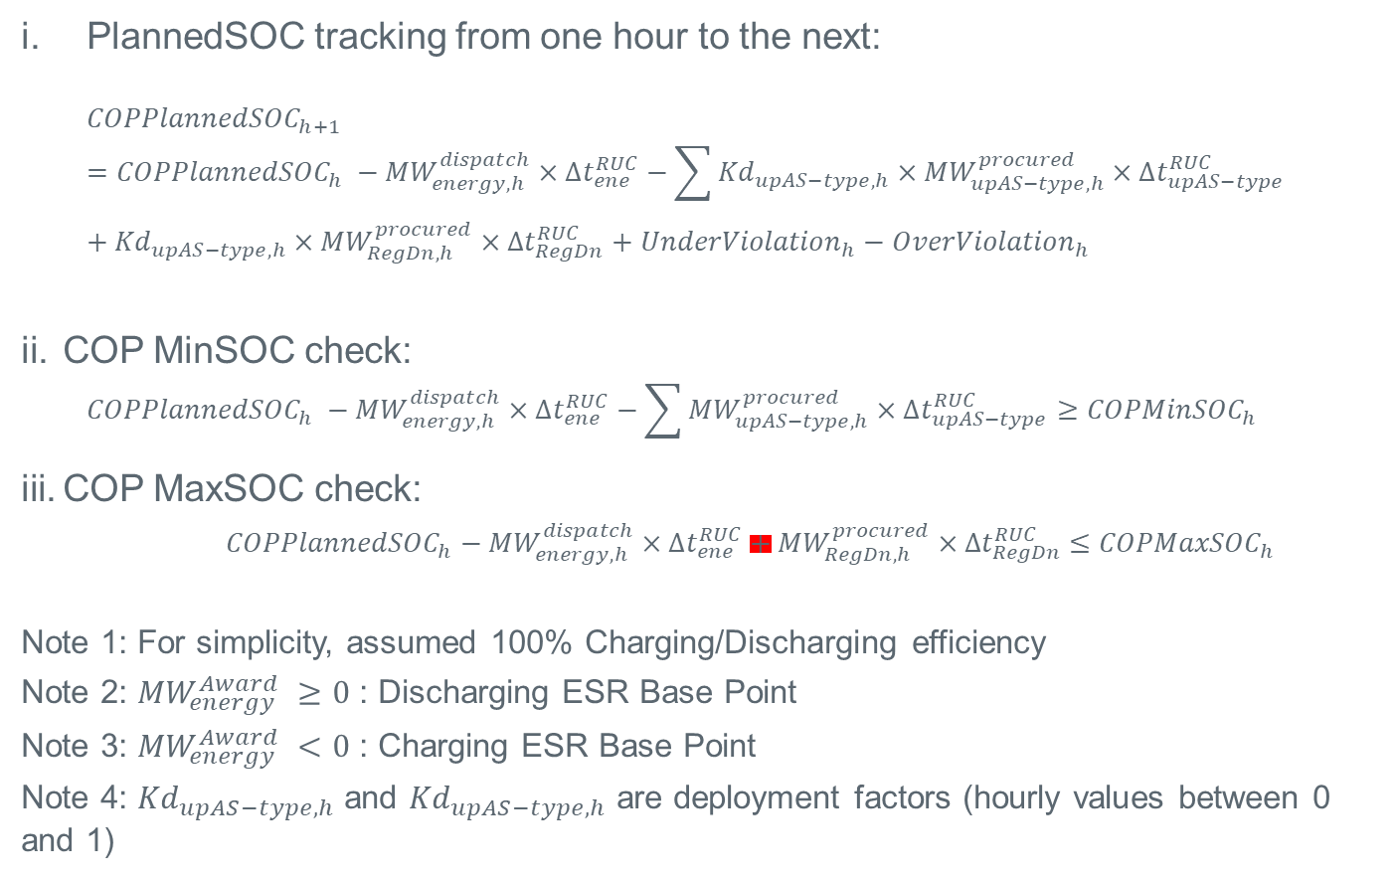
RTC+B RUC: ESR SOC Accounting
PlannedSOC tracking from one hour to the next:
  $${COPPlannedSOC}_{h+1}={COPPlannedSOC}_{h} −{MW}_{energy,h}^{dispatch}×∆t_{ene}^{RUC}−\sum{{{Kd}_{upAS−type,h}×MW}_{upAS−type,h}^{procured}×∆t_{upAS−type}^{RUC}}+{{Kd}_{upAS−type,h}×MW}_{RegDn,h}^{procured}×∆t_{RegDn}^{RUC}+{UnderViolation}_{h}−{OverViolation}_{h}$$
COP MinSOC check:
  $${COPPlannedSOC}_{h} −{MW}_{energy,h}^{dispatch}×∆t_{ene}^{RUC}−\sum{{MW}_{upAS−type,h}^{procured}×∆t_{upAS−type}^{RUC}≥{COPMinSOC}_{h}}$$
COP MaxSOC check:
      ${COPPlannedSOC}_{h}−{MW}_{energy,h}^{dispatch}×∆t_{ene}^{RUC}+{MW}_{RegDn,h}^{procured}×∆t_{RegDn}^{RUC}$ $≤{COPMaxSOC}_{h}$
Note 1: For simplicity, assumed 100% Charging/Discharging efficiency
Note 2: ${MW}_{energy}^{Award} ≥0$ : Discharging ESR Base Point
Note 3: ${MW}_{energy}^{Award} <0$ : Charging ESR Base Point
Note 4: ${Kd}_{upAS−type,h}$ and ${Kd}_{upAS−type,h}$ are deployment factors (hourly values between 0 and 1)

Slide 52
RTC+B RUC: ESR SOC Accounting
RUC Capacity Short Calculation
  The current RTC+B RUC Short calculation will be modified for ESRs such that energy and AS (by type) duration requirements will be factored into calculating the ESR MW capability instead of just using the ESR’s HSL

Slide 53
ESR AS Telemetry Change

Slide 54
Additional Example Details
Following slides will show an example discussing the use of dynamic participation factors during a regulation Up Deployment while maintaining Regulation Up Responsibility on the ESR-GR.
ESR Details:
  ESR HSL/MPC = =/-100 MW
  ESR-Regulation Up Responsibility = 125 MW
  ESR-Regulation Down Responsibility = 22 MW
  ESR-GR HASL = 0 MW
  ESR-CLR HASL = -78MW
  ESR-GR LASL = 0 MW
  ESR-CLR LASL = -25 MW
  ESR-GR BP = 0 MW
  ESR-CLR BP = -25 MW satisfying LASL requirements and changes charging to -30MW followed by -78 MW
  As the ESR-CLR UDBP begins to ramp to meet the new charging BPs the participation factors for the GR and CLR adjust to represent the portion of regulation being provided from each side.
  The Regulation Up Responsibility is not moved at any time.

Slide 55
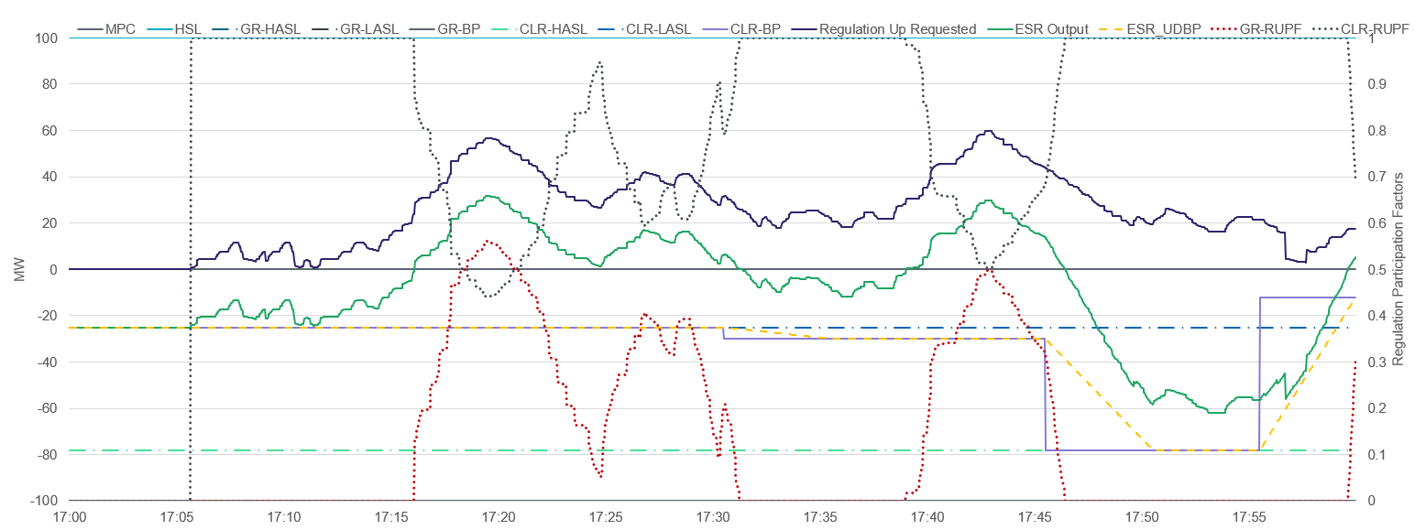
Additional Example Image
Notes:
Regulation Up Responsibility of 125 MW
100 on GR and 25 on CLR
Regulation Down on CLR of 22 MW

