Slide 1
Credit Exposure Update
Credit Finance Sub Group
ERCOT Public
July 2023

Slide 2
Monthly Highlights May 2023 – June 2023
Market-wide average Total Potential Exposure (TPE) slightly increased from $1.10 billion in May 2023
to $1.46 billion in June 2023
TPEA increased due to higher forward adjustment factors and Real-Time and Day-Ahead Settlement Point prices
Discretionary Collateral is defined as Secured Collateral in excess of TPE,CRR Locked ACL and DAM Exposure
Average Discretionary Collateral increased from $3.10 billion in May 2023 to $3.66 billion in June 2023
No unusual collateral call activity

Slide 3
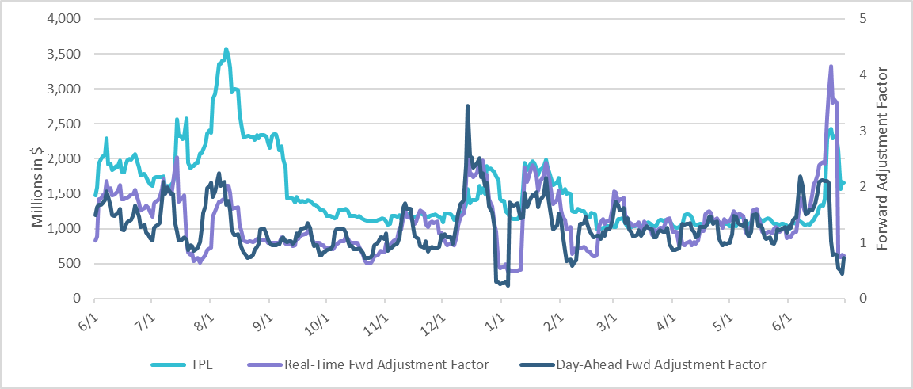
TPE and Forward Adjustment Factors Jun 2022 - Jun 2023
*TPE adjusted to exclude short pay entities eliminating data skew

Slide 4
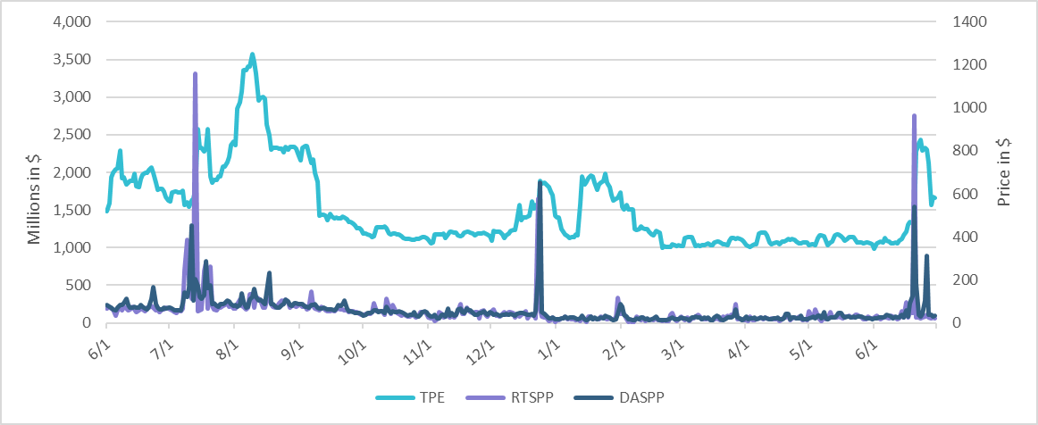
TPE/Real-Time & Day-Ahead Daily Average Settlement Point Prices for HB_NORTH Jun 2022 - Jun 2023
* TPE adjusted to exclude short pay entities eliminating data skew

Slide 5
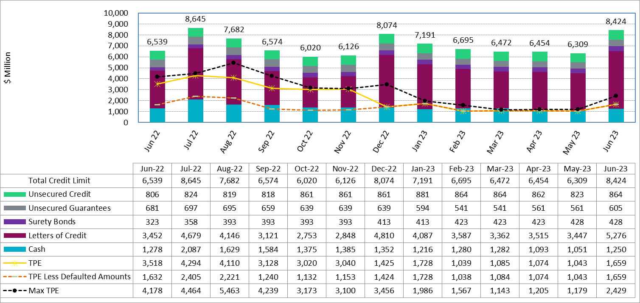
Available Credit by Type Compared to Total Potential Exposure (TPE) Jun 2022- Jun 2023
Numbers are as of month-end except for Max TPE
Max TPE is the highest TPE for the corresponding month
TPE less Defaulted Amounts: TPE – Short-Paid Invoices

Slide 6
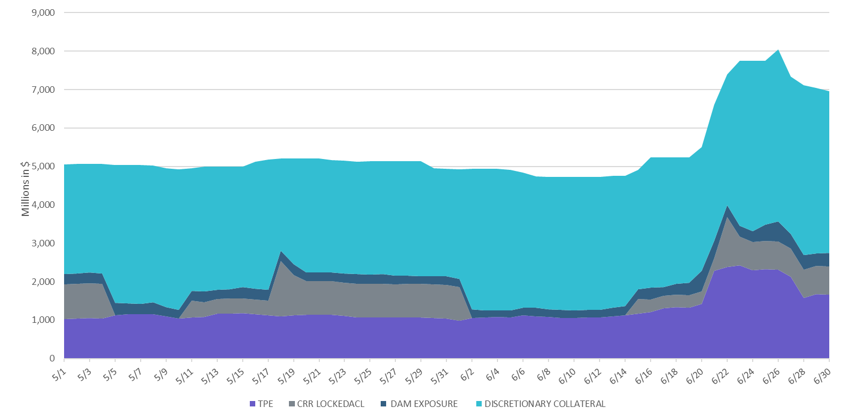
Discretionary Collateral May 2023 - June 2023
* Discretionary Collateral adjusted to exclude short pay amounts eliminating data skew

Slide 7
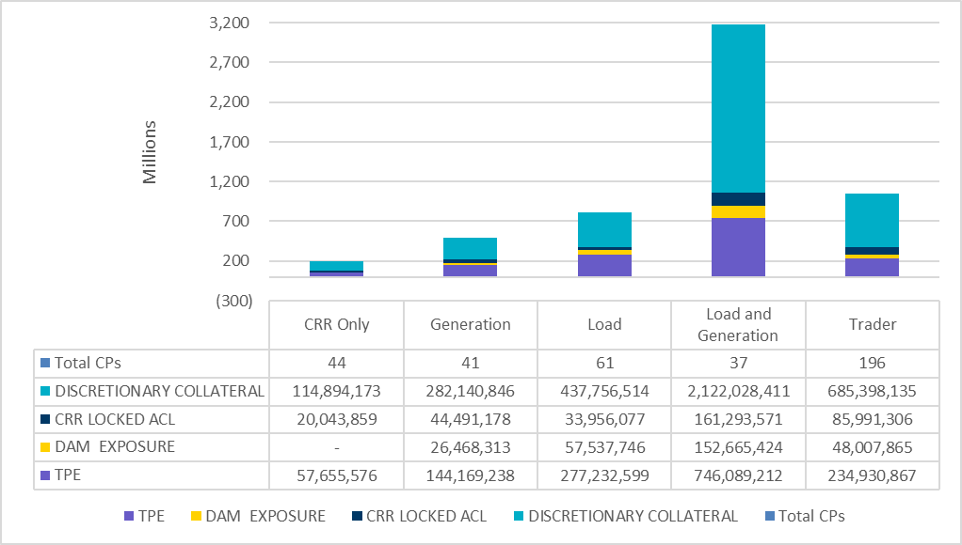
TPE and Discretionary Collateral by Market Segment - Jun 2023*
Load and Generation entities accounted for the largest portion of discretionary collateral
*Discretionary collateral doesn’t include Unsecured Credit Limit or parent guarantees

Slide 8
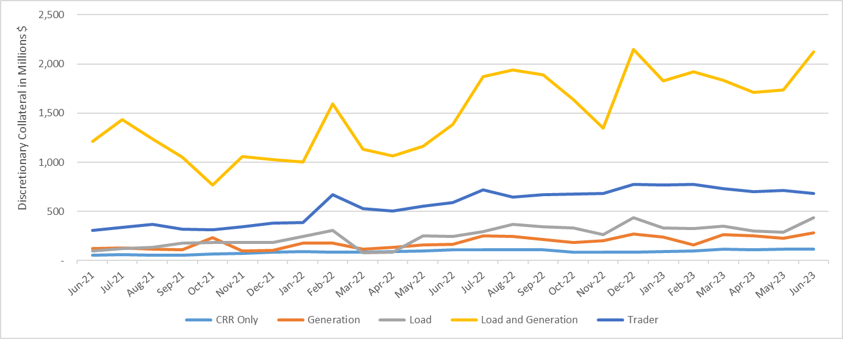
Discretionary Collateral by Market Segment Jun 2021 - Jun 2023
* Discretionary Collateral adjusted to exclude short pay amounts eliminating data skew

Slide 9
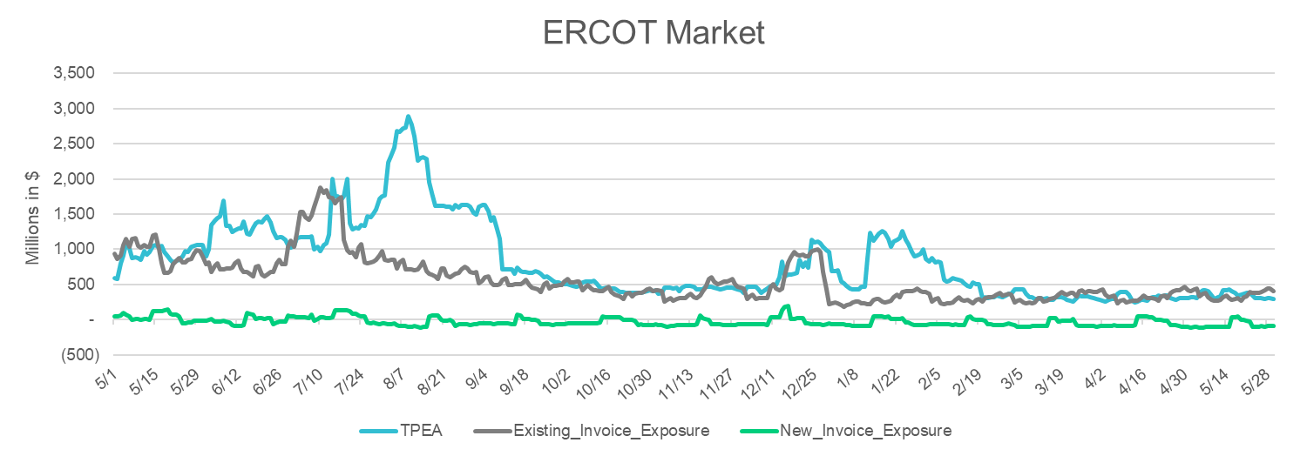
TPEA Coverage of Settlements May 2022 - May 2023
Invoice Exposure | Historical | Future
Existing Invoice Exposure | RTLCNS + UDAA | M1 Days (including current day) Forward Charge Invoice Amounts
New Invoice Exposure | 7 Days Back Net Invoice Amounts (Charges & Credits) | M1 Days (including current day) Forward Net Invoice Amounts (Charges & Credits); Excluding: 1) Securitization Invoices; 2) CRR Auction Invoices; and 3) Subchapter N Funds Distribution Invoice
TPEA closely approximates actual/invoice exposure
TPEA adjusted to exclude short pay entities eliminating data skew

Slide 10
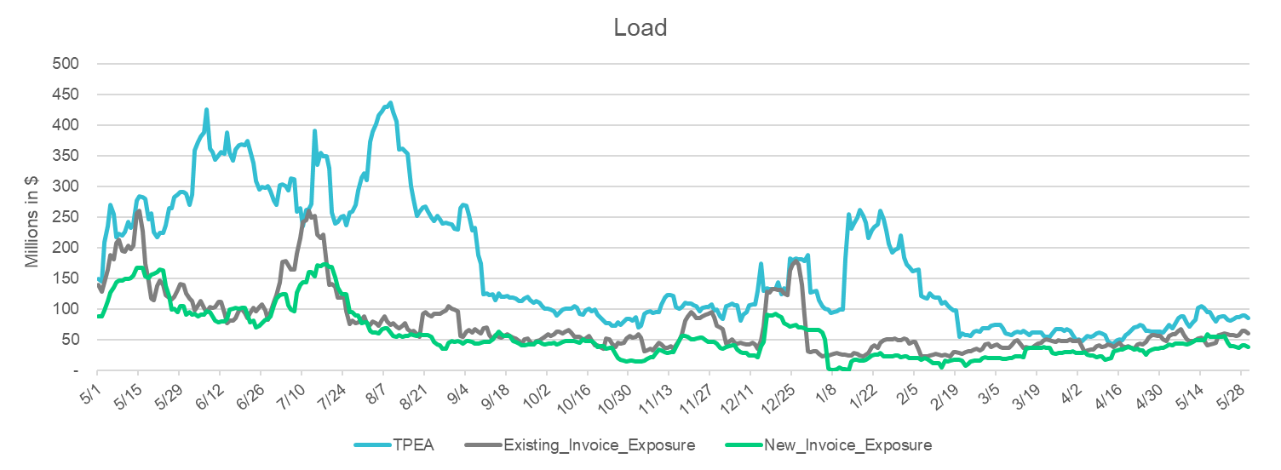
TPEA Coverage of Settlements May 2022 - May 2023
Invoice Exposure | Historical | Future
Existing Invoice Exposure | RTLCNS + UDAA | M1 Days (including current day) Forward Charge Invoice Amounts
New Invoice Exposure | 7 Days Back Net Invoice Amounts (Charges & Credits) | M1 Days (including current day) Forward Net Invoice Amounts (Charges & Credits); Excluding: 1) Securitization Invoices; 2) CRR Auction Invoices; 3) Subchapter N Funds Distribution Invoice
*TPEA exceeds invoice exposure
*TPEA adjusted to exclude short pay entities eliminating data skew

Slide 11
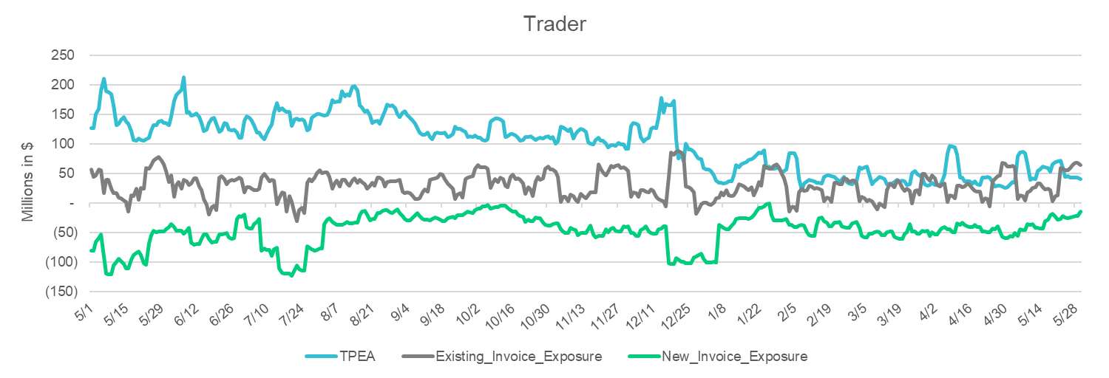
TPEA Coverage of Settlements May 2022 - May 2023
Invoice Exposure | Historical | Future
Existing Invoice Exposure | RTLCNS + UDAA | M1 Days (including current day) Forward Charge Invoice Amounts
New Invoice Exposure | 7 Days Back Net Invoice Amounts (Charges & Credits) | M1 Days (including current day) Forward Net Invoice Amounts (Charges & Credits); Excluding: 1) Securitization Invoices; 2) CRR Auction Invoices; 3) Subchapter N Funds Distribution Invoice
*TPEA generally exceeds invoice exposure

Slide 12
TPEA Coverage of Settlements May 2022 - May 2023
Invoice Exposure | Historical | Future
Existing Invoice Exposure | RTLCNS + UDAA | M1 Days (including current day) Forward Charge Invoice Amounts
New Invoice Exposure | 7 Days Back Net Invoice Amounts (Charges & Credits) | M1 Days (including current day) Forward Net Invoice Amounts (Charges & Credits); Excluding: 1) Securitization Invoices; 2) CRR Auction Invoices; 3) Subchapter N Funds Distribution Invoice
Invoice exposure generally exceeds TPEA
TPEA adjusted to exclude short pay entities eliminating data skew

Slide 13
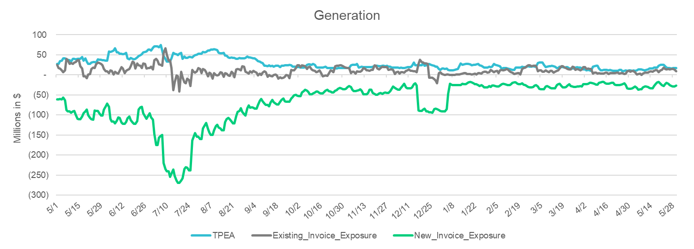
TPEA Coverage of Settlements May 2022 - May 2023
Invoice Exposure | Historical | Future
Existing Invoice Exposure | RTLCNS + UDAA | M1 Days (including current day) Forward Charge Invoice Amounts
New Invoice Exposure | 7 Days Back Net Invoice Amounts (Charges & Credits) | M1 Days (including current day) Forward Net Invoice Amounts (Charges & Credits); Excluding: 1) Securitization Invoices; 2) CRR Auction Invoices; 3) Subchapter N Funds Distribution Invoice
* TPEA generally exceeds Invoice exposure

Slide 14
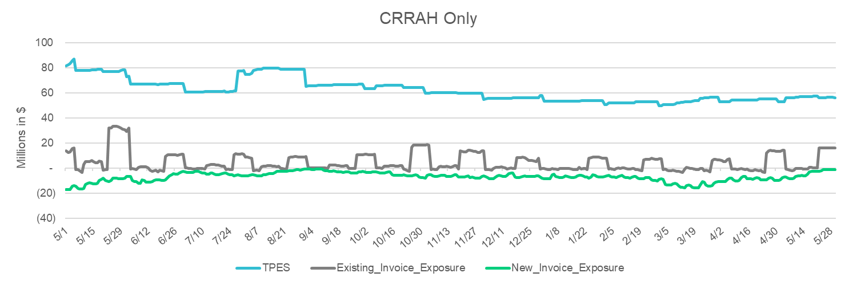
TPES Coverage of Settlements May 2022 - May 2023
Invoice Exposure | Historical | Future
Existing Invoice Exposure | RTLCNS + UDAA | M1 Days (including current day) Forward Charge Invoice Amounts
New Invoice Exposure | 7 Days Back Net Invoice Amounts (Charges & Credits) | M1 Days (including current day) Forward Net Invoice Amounts (Charges & Credits); Excluding: 1) Securitization Invoices; 2) CRR Auction Invoices; 3) Subchapter N Funds Distribution Invoice
*TPES exceeds actual/invoice exposure

Slide 15
Questions

