Slide 1
Overview of NPRR1186
Improvements Prior to the RTC+B Project for Better ESR State of Charge Awareness, Accounting, and Monitoring
Nitika Mago
July 12, 2023
WMS

Slide 2
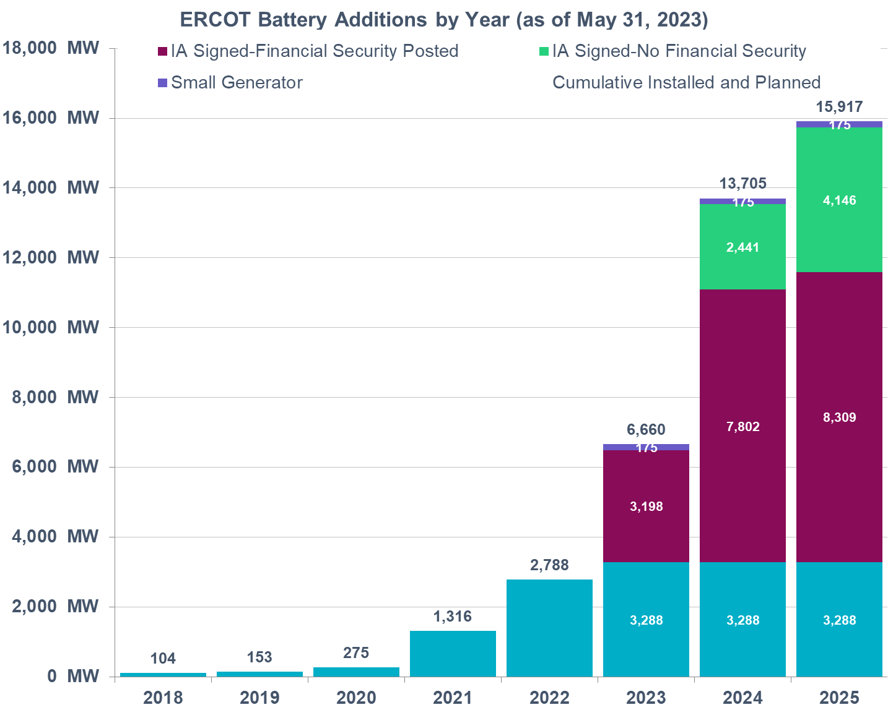
Background & NPRR 1186 Introduction
ERCOT has seen a steady growth in the capacity of interconnected battery Energy Storage Resources (ESRs). This rapid growth is expected to continue in the future as well.
Most ESRs interconnected or planning to interconnect are less than 2 hours batteries.
ESRs are already providing up to 60% of ERCOT’s Ancillary Services (AS).
ERCOT’s current systems and processes including DAM, RUC and SCED are not designed to account for capability i.e., State of Charge (SOC) of duration limited ESRs. Also, per the approved protocols, Real-Time Co-optimization (RTC) & Single-Model ESR (“RTC+B” effort) systems as planned today will model ESRs but do not model SOC changes.
Absent SOC modeling,
RUC may incorrectly assume an ESR’s capacity will be available for dispatch in a future hour when it may not be (due to SOC depletion). This could result in ERCOT failing to commit sufficient generation through RUC.
SCED may send Base Points that may deplete an ESR’s SOC that should be preserved for its remaining AS obligation. (ESRs have the ability to reduce HSL/MPC to preserve SOC for AS but that alone may not be sufficient.)
Updating current RUC and SCED to model ESRs and account for SOC are expected to be fairly intensive tasks. Hence the changes in NPRR1186 have been proposed with the aim to strategically improve SOC awareness in the current tools and studies with minimal system changes so that a complete suite of DAM, RUC and SCED improvements needed to fully model ESRs and account for their SOC can be designed and implemented with the RTC+B (with single ESR model) project.

Slide 3
NPRR 1186 Summary of Changes
At a high level with NPRR1186, ERCOT is proposing to,
Alter Day-Ahead Market (DAM) process so that the Day-Ahead Ancillary Service (AS) awards respect the duration requirements for AS. Absent this change, in some cases DAM AS awards may not be operationally feasible.
Add 3 new SOC related fields in COP (MaxSOC, MinSOC and Planned Hour Begin SOC) AND Modify the High Ancillary Service Limit (HASL) calculation that is used by Reliability Unit Commitment (RUC) studies such that RUC only counts on SOC that an ESR plans to have in excess of SOC required for AS it is providing in every hour as being available for dispatch. This change will alleviate some of the risks with RUC’s lack of visibility into ESRs.
RUC treats ESRs as online or Out. RUC will not commit an ESR to come online. RUC can count on ESR being available to serve Load.
Change the HASL calculation that is used by 5-min Security Constrained Economic Dispatch (SCED) to account for SOC required to support an ESR’s Ancillary Service Resource Responsibility. This change will ensure that SCED issues Base Point such that these preserve the SOC needed to cover an ESR’s remaining AS obligation within the Operating Hour.
With the projected growth in ESRs, the minimal changes in RUC and SCED that have been identified in NPRR1186 are essential for ERCOT to continue reliable grid operations. Urgent status is necessary so that these essential system changes associated can be implemented immediately in the narrow window before development work on the “RTC+B” project begins, and this essential effort does not delay/impact RTC+B implementation timeline.

Slide 4
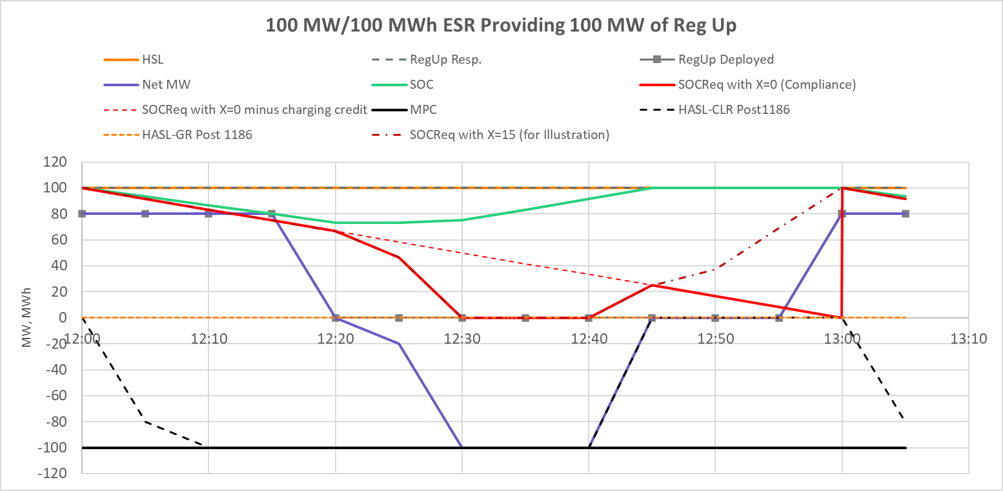
State of Charge Requirements for AS
NPRR1186 also proposes to update the SOC requirements for AS and a create a framework within ERCOT’s EMS to calculate SOC that is available for SCED dispatch by taking into account the following
SOC that ESR is required to preserve for the AS obligation it is carrying in the current hour.
SOC requirement for AS will diminish as the clock progresses such that at the end of the Operating Hour the SOC requirement for that an Ancillary Service will reduce by an amount that reflects the energy depleted if the Ancillary Service was fully deployed for one hour.
X* minutes prior to end of current Operating Hour any additional SOC needed to support the ESR’s next hour AS obligation
Discount SOC requirement to account for the ESR’s current withdrawal BP.
Example below demonstrates the SOC requirement over the course of on hour for a 100 MW/100MWh battery that is providing 100 MW of Regulation Up. In this example SOCReq with X=0 demonstrates the SOC requirement for compliance monitoring. HASL-GR and HASL-CLR have been computed using SOCReq with X=0. For illustrative purposes SOCReq with X=16 has been included to show how SOC requirements change if a ramp up based on next Hour’s AS obligation is included in the SCED that runs at 45 minutes past current hour.
*X is a parameter that can be altered based on discussions.

Slide 5
Summary
NPRR1186 focuses on specific improvements that are needed for today’s systems and processes. This NPRR aims to strategically improve SOC awareness, accounting and monitoring with minimal changes so that the improvements can be in place while the RTC+B project is completed.
NPRR1186 also proposes to create a new framework for SOC requirements for AS. ERCOT will work with stakeholders to establish values of each parameter in the new framework such that these mitigate the performance risks that ERCOT sees while allowing optimal use of the ESRs during an Operating Hour.
ERCOT plans to file comments to NPRR1186 that will incorporate the proposed SOC requirement framework within the protocols. ERCOT is targeting to file these NPRR Comments before July 13 PRS.
Also as requested, before July 13 PRS, ERCOT will also post examples to demonstrate how the proposed changes will impact SCED HASL for an ESR and a DRAFT of ERCOT and QSE Operations Practices During The Operating Hour Business Practice Manual for NPRR1186 related changes.
ERCOT will host a workshop on July 19, 2023 to discuss NPRR1186 and associated potential improvements prior to RTC+B further. Interested WMS members are requested to participate in this Workshop.

Slide 6
Appendix – Relevant Slides from Jul 22 Workshop & Jul 6 ROS

Slide 7
DAM/SASM ECRS & Non-Spin Duration Accounting, Contd.
Proposed Changes: Change DAM/SASM constraint equations so that the 2-hour ECRS and 4-hour Non-Spin requirements are considered. These constraints are only for ESR-GR and ESR-CLR. The concept is to treat every MW award for ECRS or Non-Spin as some multiple MW amount when checking to see if award exceeds the AS MW offer amount or when checking to see that the ESR-GR HSL or ESR-CLR MPC is not exceeded.
AS Offer MW check: Scale ECRS and Non-Spin awards (changes in yellow)
$${MW}_{AS}^{Offer}≥{MW}_{RegUp}^{Award}+{MW}_{RRS}^{Award}+K^{ECRS}×{MW}_{ECRS}^{Award}+K^{NSPIN}×{MW}_{NSPIN}^{Award}$$
HSL check: Scale ECRS and Non-Spin awards (changes in yellow)
$${HSL}_{i}≥{MW}_{energy}^{Award}+{MW}_{RegUp}^{Award}+{MW}_{RRS}^{Award}+K^{ECRS}×{MW}_{ECRS}^{Award}+K^{NSPIN}×{MW}_{NSPIN}^{Award}$$
Example For a +/-10 MW, 10 MWh ESR (gen side) that submits a 10 MW AS offer with prices for RegUp, RRS-PFR, ECRS and Non-Spin, the above constraint will be:
$$10≥{MW}_{RegUp}^{Award}+{MW}_{RRS}^{Award}+2×{MW}_{ECRS}^{Award}+4×{MW}_{NSPIN}^{Award}$$
$$10≥{MW}_{energy}^{Award}+{MW}_{RegUp}^{Award}+{MW}_{RRS}^{Award}+2×{MW}_{ECRS}^{Award}+4×{MW}_{NSPIN}^{Award}$$
If ESR awarded 2.5 MW Non-Spin, then, the above constraints prevent any other product (energy or AS) from being awarded to ensure operational feasibility.
Proposed Implementation Timeline: (Phase C) Upon implementation of Interim Period NPRR

Slide 8
High and Low Ancillary Service Limit Calculation
Today’s Issue: ERCOT’s SCED does not take into account the SOC that needs to be preserved to support an ESR’s AS Responsibility and hence is ignorant of the amount of SOC that is truly available for dispatch.
Proposed Change: Modify RLC to ensure HASL/LASL for ESR’s take into remaining SOC available for SCED base Point after discounting the SOC required to support the ESR’s AS Responsibilities.
Updated ESR-GR HASL
HASL = Max (LASL, Min ((HSLTELEM – (RRSTELEM + RUSTELEM + ECRSTELEM + NSRSTELEM +NFRCTELEM)), MaxBP))
MaxBP = (SOCTELEM – MINSOCTELEM – REQ_AS_SOC ) / TSCED
Updated ESR-CLR HASL
HASL = Max (LPCTELEM, Min ((MPCTELEM – RDSTELEM), MaxBP))
MaxBP = (MAXSOCTELEM – SOCTELEM – REQ_Headroom_AS_SOC) / TSCED
Proposed Implementation Timeline: (Phase C) Upon implementation of Interim Period NPRR

Slide 9
Current Operating Plan (COP) & Reliability Unit Commitment (RUC) Changes
Today’s Issue: ERCOT’s lookahead studies such as Reliability Unit Commitment (RUC) treat an ESR-GR like any other Generation Resource. The HASL used in RUC study to meet Load Forecast is calculated from the ESR-GR’s COP HSL and COP AS responsibilities. If HASL > 0, then RUC study can dispatch the ESR-GR. There are scenarios where RUC study dispatches ESR-GR for energy when HASL>0 but the ESR may not have sufficient energy to discharge for energy as well as provide its AS responsibility.
Proposed Change:
For ESR-GR add the following three (3) new fields in COP
MinSOC: Minimum Operating SOC for given hour
MaxSOC: Maximum Operating SOC for given hour
PlannedSOC: Planned (target) SOC at the beginning of given hour
Add the following COP submission validations,
MinSOC <= Planned SOC <= MaxSOC
MinSOC must be greater than or equal to the registered nameplate MinSOC
MaxSOC must be less than or equal to the registered nameplate MaxSOC
Changes to RUC in the Interim Period:
In RUC pre-processing, discount COP PlannedSOC by the energy required to support AS responsibilities in the COP
If there is any excess SOC remaining, then use that to calculate effective HASL for the ESR-GR, otherwise do not allow ESR-GR to be dispatched for energy in the RUC study.
Proposed Implementation Timeline: (Phase C) Upon implementation of Interim Period NPRR

Slide 10
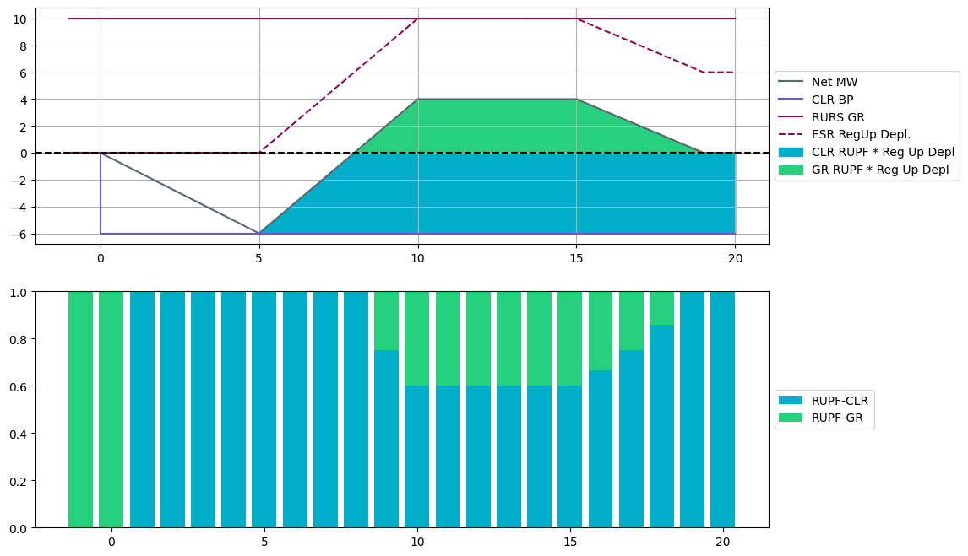
Appendix Real Time AS Telemetry – Example
5
3
2
1
4
At t = 0: ESR-CLR receives a BP of 6 MW at t=0 and ramps down to charge at 6 MW by t=5
At t = 5: Reg Up is deployed. RUPF-CLR is equal to 1, so the full deployment occurs on the ESR-CLR and ESR-CLR’s net MW ramps back up in response to Reg Up deployment.
When the Reg Up deployment becomes greater than the ESR-CLR’s BP (6 MW), RUPF-GR becomes non-zero and the ESR-GR starts responding to the Reg Up deployment.
Note that at all times, the RUPF-GR and RUPF-CLR add up to the same total value of 1.0. The ESR-CLR RUPF is expected to be set dynamically such that the RUPF*Reg Up Deployed is never greater than the BP-CLR
Reg Up Responsibility remains on the GR for the entire interval

Slide 11
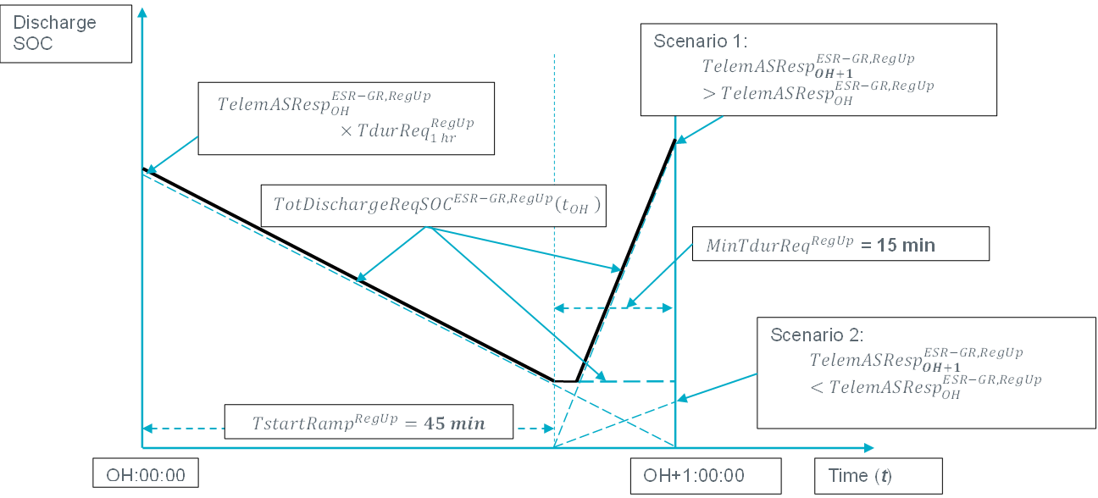
SOC Requirement Compliance vs Dispatch
ERCOT’s comments will include a description of the formulas that will be used to compute SOC requirements for compliance and 5-min dispatch.
RegUp example for SOC required to discharge if ESR-GR Base Point >0
#1 For Dispatch
#2 For Dispatch: Tune-able Parameter
Compliance and Enforcement

