Slide 1
ECRS Update
Alfredo Moreno
Manager, Forward Markets
July 12, 2023

Slide 2
Agenda
Summary of what was shared at TAC
Follow-up from TAC
Can ERCOT provide more data?
Was there a change in Non-Spin resource mix awards?
Questions
Appendix

Slide 3
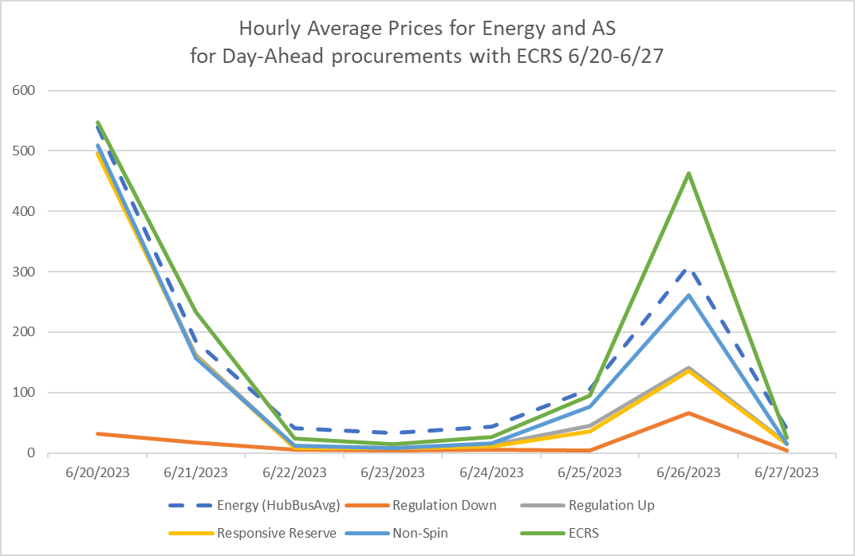
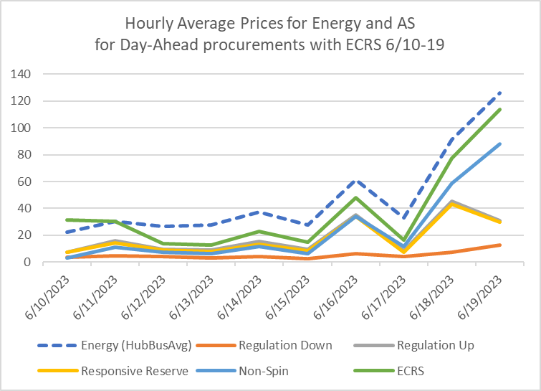
Day-Ahead Market ECRS June 10-27, 2023 (from TAC)
ECRS daily procurement
2,073 average procured MW/hour

Slide 4
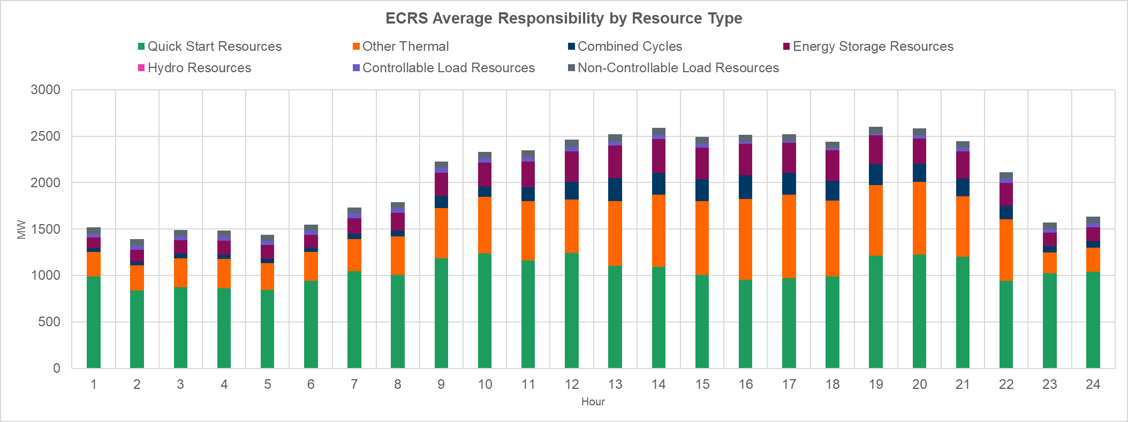
ECRS Deployments (from TAC)
For the period of Jun 10-18, 2023, Quick Start Resources (~50%), Thermal Resources (~33%) and Energy Storage Resources (~12%) provided majority of the ECRS in Real Time. There were 3 events that resulted in deployment of SCED dispatchable ECRS.
Date and Time Released to SCED | Date and Time Recalled | Duration of Event | Maximum MWs Released | Reason
6/14/2023 19:20 | 6/14/2023 19:33 | 12:28 | 600 | Insufficient capability for forecasted 10min Ahead Net Load
6/18/2023 19:20 | 6/18/2023 19:46 | 25:25 | 200 | 10min out Net Load Forecast
6/16/2023 18:31 | 6/16/2023 18:36 | 04:40 | 430 | Frequency below 59.91Hz
Key Takeaway: ECRS performed well in all deployments and helped recover from the events that triggered deployment.

Slide 5
Deployments (from TAC)
6/14/2023 at 19:20 (manual)
SCED Dispatchable MW Released: 600 MW
Deployment Duration: 12 minutes and 28 seconds
Min HDL – GEN: 1467.2
Max System Lambda: 136.9
Reason: Insufficient capability for forecasted 10min Ahead Net Load.
6/16/2023 at 18:31 (frequency trigger)
SCED Dispatchable MW Released: 430 MW
Duration: 4 minutes and 40 seconds
Reason: Frequency below 59.91Hz due to unit trip (~632 MW instantaneous, 1235 MW total)
6/18/23 at 19:20 (manual)
SCED Dispatchable MW Released: 200 MW
Duration: 25 minutes and 25 seconds
Min HDL – GEN: 1515.7
Max System Lambda: 873.8
Reason: Insufficient capability for forecasted 10min Ahead Net Load.
6/20/23 at 16:21 (manual)
ERCOT deployed up to 1900 MW of ECRS in steps as dispatchable headroom reduced during the period of 16:21 and 21:01 (4 hours and 40 minutes)

Slide 6
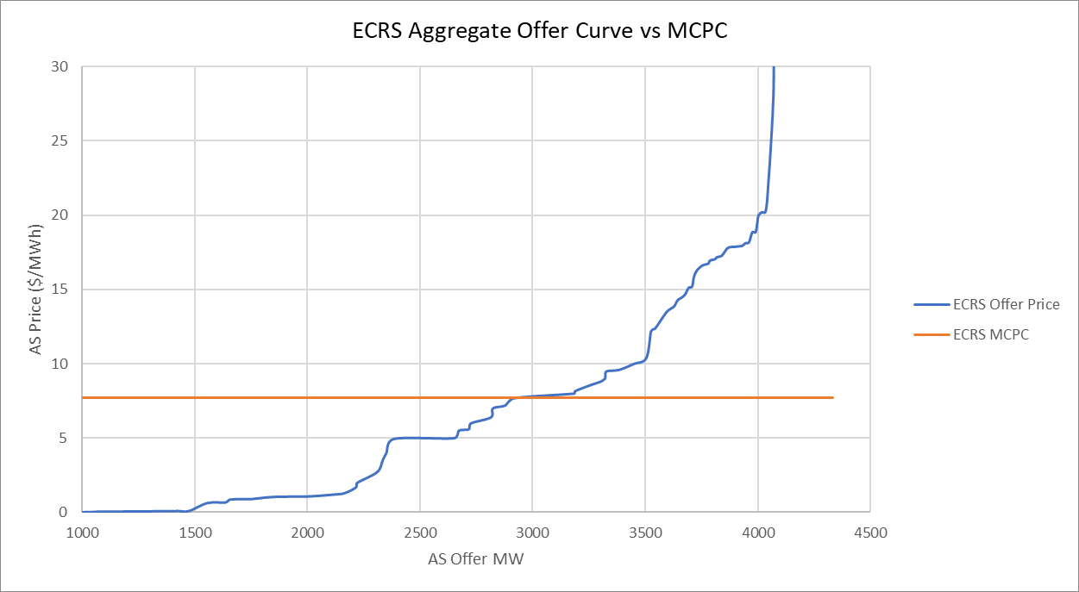
Follow-up from TAC to WMS
Can ERCOT provide more data?
ERCOT offers the following links for MPs to consider for data
Aggregate AS offer curves/Cleared AS/Self-Arranged AS (2-Day)
Ability to see MW amounts for each AS type at each offered price point
Ability to see cleared and self-arranged MW amounts
Highest price offer selected (3-Day)
Ability to see highest offer price selected, although published MCPC price may be higher due to co-optimization opportunity costs
Total AS offers (Daily)
Ability to see daily total MW AS offers for each hour

Slide 7
Follow-up from TAC to WMS
Was there a change in Non-Spin resource mix after ECRS go-live?
Below ERCOT provides a before/after ECRS go-live to show change (if any) in resource mix for non-spin awards. Graphic below is compressed but intended to reflect:
Average Non-Spin amount procured per Operating Hour week before ECRS (first and brightest bar graphic) and week after ECRS (second and lighter)
Observations:
NSPIN requirement was decreased after ECRS go-live
Proportionally less NSPIN from ESR, CLR, NCLR and more NSPIN from CC and other thermal
QSGR (proportionally increased during peak hours, decreased in off-peak)

Slide 8
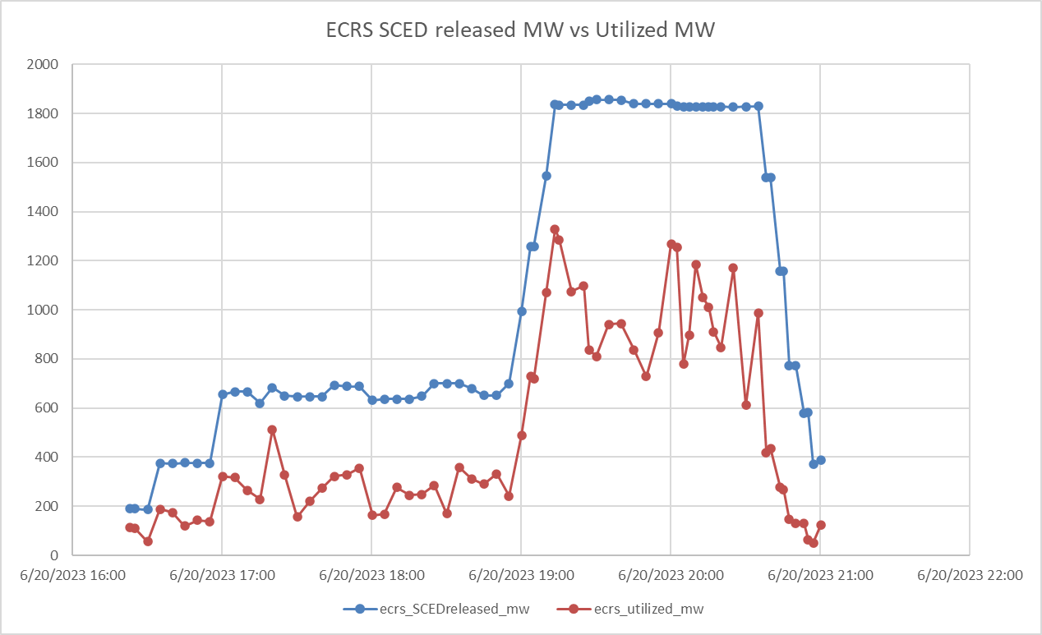
ECRS deployment SCED released MW vs Utilized MW

Slide 9
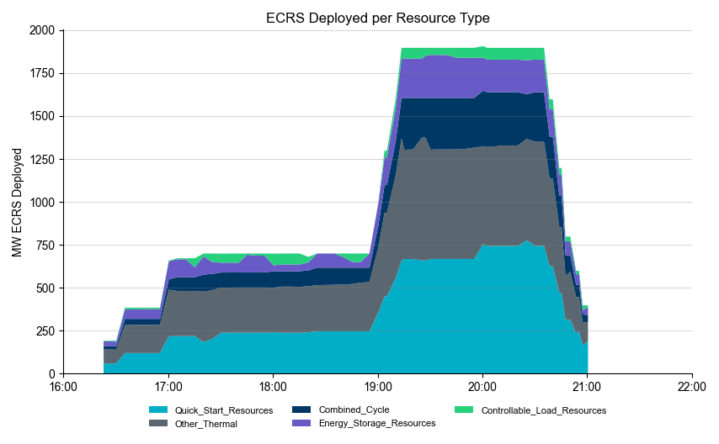
ECRS deployment SCED released MW by Resource Type

Slide 10
Wrap-Up and Question
ERCOT is prepared to help support future discussion and analysis of ECRS during the early weeks/months of the new AS.
ERCOT can support questions at WMS or a designated WMS working group, while also recognizing certain analysis needs to be at ROS/PDCWG.
Questions?

Slide 11
Appendix

Slide 12
Average NSPIN Awards Resource Mix

