Slide 1
DSWG Meeting
July 14, 2023
ERCOT staff

Slide 2
Review issues from the JunSep23 Procurement process
ERS Procurement Summary for JunSep23
ERS Historical Procurement Information
Reinstating ERS suspensions
Review OBDRR-Revision to ERS Procurement Methodology regarding Unused Funds from Previous SCTs
Presentation on historical proration for RRS
Update on Load Resource Participation in Non-Spin and ECRS

Slide 3
Review issues from the JunSep23 Procurement process
No abnormal issues processing the Non-Weather Sensitive ERS ERIDs during the JunSep23 Procurement.
Issues with Weather Sensitive ERS ERIDs
Large aggregation of WS (20,000+)
Problem: Data is being pulled from a database for ERS is routinely being used by other ERCOT departments and therefore system issues are not uncommon. During times of high usage of the database, there has been a slow down in acquiring and processing data for the ERID process.
Solution: Code is being enhanced to better mange large pulls of data and is currently being tested.
(Error) High Consumption of Zeros
Problem: Current procedures will not allow WS ERIDs to be processed if there are errors.
Solution: Going forward SAS code will convert High Consumption of Zero errors to warning which will allow the code to continue processing the ERID rather than stopping. Code is being written and tested. Moving forward ERCOT will no longer work through iterations with the QSEs on the High Consumption of Zero errors and so the QSE will be responsible for determining if these sites should be offered into the upcoming SCT.
Duplicates Sites found during the offer process (All ERS Service types)
Problem: During the offer analysis process, the ERS team routinely identifies Duplicate sites in offers.
Solution: Notify both QSEs with duplicates and ask them to resolve the issues. If the QSEs cannot agree to a resolution within the specified time communicated by ERCOT then ERCOT will remove the duplicates from both offers prior to procurement. It also should be noted that multiple technologies within a premise represented by more than one QSE are considered duplicates.

Slide 4
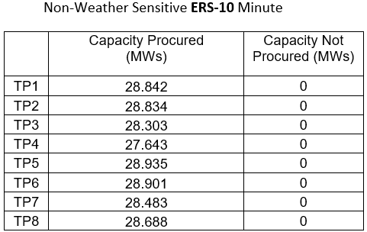
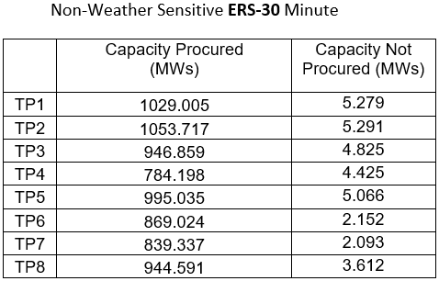
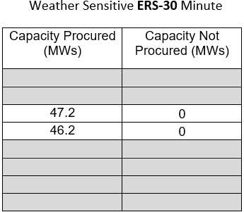
ERS Procurement Summary (JunSep2023)

Slide 5
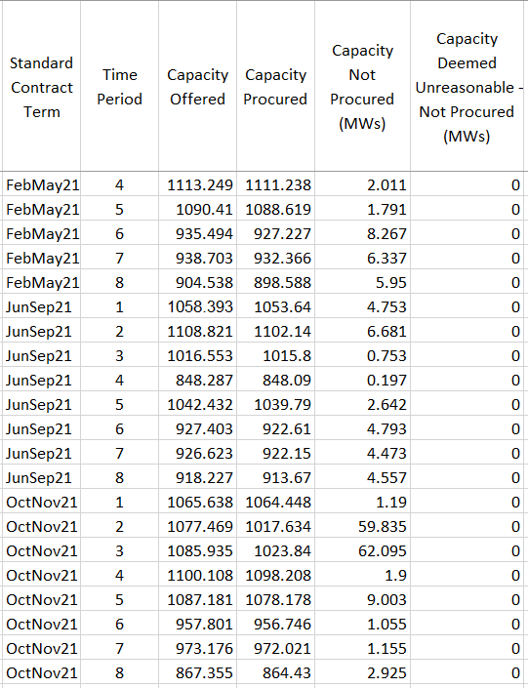
ERS Historical Procurement Information

Slide 6
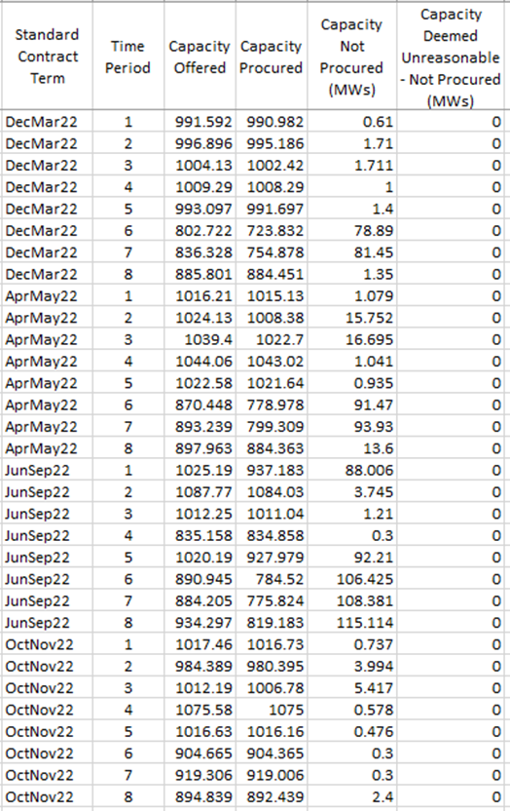
ERS Historical Procurement Information

Slide 7
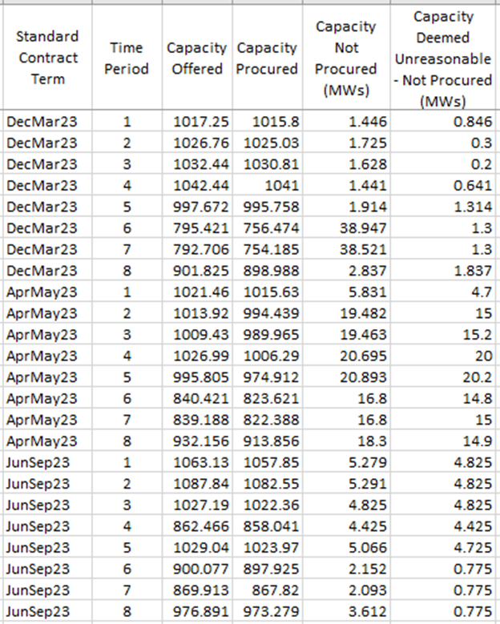
ERS Historical Procurement Information

Slide 8
Reinstating ERS Suspensions (high level overview)
ERCOT will apply Test Failures, Availability Failures and Event Performance Failures independently (i.e., a QSE or ERS Resource that fails a particular criterion is subject to suspension regardless of language in a separate criterion).
Failing multiple criteria will not lead to compounding suspension periods.
This suspension policy will begin on December 1, 2023.
Detailed document titled Non-Weather-Sensitive (NWS) Emergency Response Service (ERS) Suspension Details can be found on the Emergency Response Service webpage under Key Documents.
Reinstatement Process included in the detailed document.

Slide 9
Reinstating ERS Suspensions (high level overview)
Test Failures
ERCOT will deem a test successful if the ERS Resource achieves a test performance factor of ≥ 0.95 and an ERS Interval Performance Factor (EIPF) for the full first interval of the test of ≥ 0.95
If an ERS Resource has four consecutive unsuccessful tests within a rolling 365-day period, ERCOT may suspend the ERS Resource from participating in ERS
Consecutive test failures prior to the start of the Dec 2023 – Mar 2024 Standard Contract Term (SCT) will apply toward counting consecutive test failures.
If an ERS Resource successfully deploys during an ERS event, ERCOT will reset the failed test count to zero even if the ERS Resource had reached four consecutive test failures earlier in the SCT.
Any suspension begins the day following the expiration of the current or most recent ERS obligation.
Test-related suspensions of ERS Resources will last for one SCT
ERCOT may reinstate an ERS Resource’s eligibility to offer into ERS once the ERS Resource satisfactorily completes the reinstatement process.
QSEs may begin the reinstatement process once the suspension is complete.

Slide 10
Reinstating ERS Suspensions (high level overview)
Availability Failures
If a QSE fails to meet its portfolio-level availability requirements, ERCOT may suspend the QSE from participation in ERS.
When considering whether to suspend a QSE, ERCOT may take into account any mitigating factors (e.g., Force Majeure events).
If a QSE fails its portfolio-level availability requirement, the following apply:
If an ERS Resource achieves an availability factor of ≥ 0.85, the ERS Resource is not subject to suspension.
If an ERS Resource achieves an availability factor < 0.85, the ERS Resource is suspended from participation in ERS; however, ERCOT may consider not suspending an ERS Resource if the reduced availability or event performance factor was the QSE's fault or the result of at least one mitigating factor (such as equipment failures or Force Majeure events).
Suspensions will last one SCT
ERCOT will reject offers that include ≥ one suspended ERS Resources
Suspensions begin the day following the expiration of the current or most recent ERS obligation.

Slide 11
Reinstating ERS Suspensions (high level overview)
Event Performance Failures
If a QSE fails to meet its portfolio-level event performance requirements ERCOT may suspend the QSE from ERS participation; however, ERCOT may consider mitigating factors (e.g., equipment failures or Force Majeure events) in determining whether to suspend the QSE.
If a QSE fails its portfolio-level event performance requirements, the following apply:
If an ERS Resource in the QSE’s portfolio met its event performance requirements, ERCOT will not suspend the ERS Resource.
If an ERS Resource in the QSE’s portfolio has its event performance factor reduced, ERCOT may suspend the ERS Resource from ERS; however, ERCOT may choose to not suspend an ERS Resource if the reduced event performance factor was the QSE’s fault or due to one or more mitigating factors (such as equipment failures or Force Majeure events).
ERS Resource suspensions apply to individual ERS Resources and to all sites in an aggregated ERS Resource.
Suspensions of a QSE providing ERS shall last for one SCT and begin the day following the expiration of the current or most recent ERS obligation.
If a QSE is suspended then so are all failing resources in the portfolio.

Slide 12
OBDRR 047, Revision to ERS Procurement Methodology regarding Unused Funds from Previous Terms
Proposed changes to the Emergency Response Service Procurement Methodology OBD
Prior to issuing an RFP for an upcoming ERS Standard Contract Term, ERCOT will update the ERS Time Period Expenditure Limits for each remaining ERS Time Period in the ERS program year to reflect updated forecasts and any expected remaining funds from ERS Expenditure Limits for the remaining ERS Standard Contract Terms within the same ERS program year. Any unused funds from previous ERS Standard Contract Terms in the ERS program year may be reallocated among ERS Contract Periods, including ERS contract renewals, during the same program year at ERCOT’s sole discretion. Unless the offer submission deadline for the upcoming ERS Standard Contract Term has passed, ERCOT may update the ERS Time Period Expenditure Limits and issue a revised RFP if funds originally allocated to the upcoming ERS Standard Contract Term must be reallocated to fund an ERS renewal Contract Period in the current ERS Standard Contract Term. ERCOT may revise and reissue the RFP for other reasons if the offer submission date has not yet passed. Any funds remaining at the end of an ERS program year will not be carried forward
into a new ERS program year.
For each ERS Time Period, the expenditure limit is calculated as follows:
Expenditure LimitTP=Annual Expenditure Limit Remaining ERS Funds Determined for AllocationProgram Year×Expenditure Limit Allocation FactorTP

Slide 13
Historical Proration of RRS
Participation in RRS continues at a similar level to 2022
Proration Levels remain high
Jan 23 – 60.9% of RRS offers were awarded
Jun 23 – 60.2% of RRS offers were awarded
No deployment of RRS thru 6/30
Participation in NSRS has been increasing month over month (see monthly table)
No proration of Non-Spin Awards similar to RRS
Deployments have been averaging about 3 per month
See next slide on Issues with Non-Spin
Participation in ECRS has primarily come from one QSE
No Proration of Awards to date

Slide 14
Update on LR participation in Non-Spin
Most significant issue to date has been understanding how deployed MW value is calculated
First 30 minutes calculated off of real-time telemetry
Second half of the hour calculated using the next hour’s COP
Can get deployment instruction with a ramp completion time in the next hour (even if currently showing no responsibility and Net Power Consumption of 0 MW)
Need to look at how we should calculate baselines
Deployed and recalled using XML only – no verbal instructions
Need to remain deployed until recalled

Slide 15
ECRS Implementation Update (from 7/1/23)
ECRS Technical Specs – Sept 29, 2022 Technology Working Group (TWG) meeting
Market Readiness and Qualification Workshop (Monday April 3, 2023)
Friday April 14, 2023 – Deadline for QSE Declaration of Resources
Thursday, April 20, 2023 – MOTE deployed for QSEs to test
Tuesday, April 23, 2023 – Begin Weekly Market Readiness WebEx meetings
June 10, 2023 – Go-Live success
Monthly reporting nearing completion
QSE Report is Secure
Resource Specific Report is Certified
July 14, 2023 DSWG Meeting

Slide 16
Qualification and Telemetry for ECRS
Two QSEs and about 35 NCLRs plus 2 CLRs have participated to date
No NCLR deployments in June; CLRs have been deployed with GRs and ESRs via automated EMS deployments
New ECRS qualification test procedure for NCLRs has been posted to the ERCOT Website: https://www.ercot.com/services/programs/load/laar
New Resources submit requests for Provisional Qualifications using forms on the same web location
Most ICCP telemetry is in place, but the new values for ECRS are not populated with values unless the QSE has initiated the mapping of their telemetry to ERCOT
Follow normal process for requesting new ICCP Service Request
July 14, 2023 DSWG Meeting

