Slide 1
Supply Analysis Working Group Update July 2023 Update to WMS
July 12, 2023
Kevin Hanson (National Grid) Chair
Pete Warnken (ERCOT) Co-Vice Chair

Slide 2
Overview
Preliminary Reliability Standard Study Results
Pete Warnken presented the slide deck which was previously presented to PUC and ERCOT BOD
CDR NPRR and Monthly Outlook for Resource Adequacy (MORA) Status (Pete Warnken)
The NPRRs are coming!
New MORA tabs with mockups included
SAWG Vice Chair
Nobody stepped up for the Vice Chair position

Slide 3
Preliminary Reliability Standard Study Results
Slide 19 from the presentation presented a good example of an event

Slide 4
Preliminary Reliability Standard Study Results
Risk is higher in winter events compared to summer events
For winter event modeling, a probabilistic relationship between declining temperature and historical weather/fuel-related thermal outages is used; excludes Winter Storm Uri thermal outages since those don’t reflect the impact of recent weatherization initiatives

Slide 5
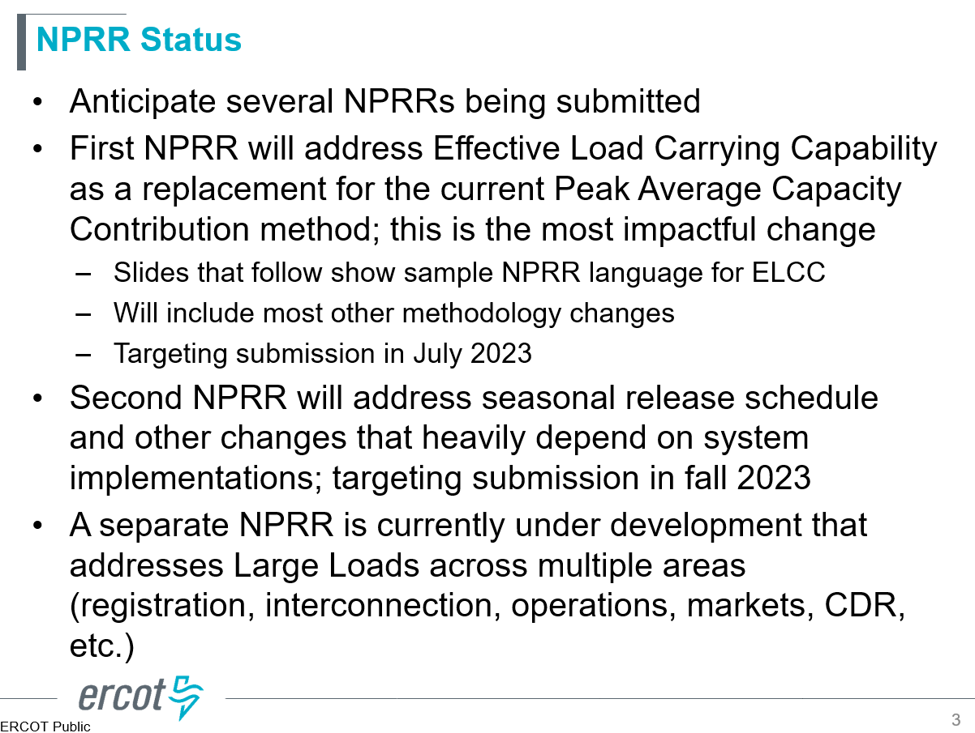
CDR NPRR and Monthly Outlook for Resource Adequacy (MORA) Status
First NPRR (July 2023 subsmission): ELCC calculation revision
Second NPRR (fall 2023 submission): addresses seasonal release schedule
Third NPRR (TBD submission): Addresses Large Loads

Slide 6
CDR NPRR and Monthly Outlook for Resource Adequacy (MORA) Status
Multiple mocked up Summary tabs were presented

