Slide 1
NOGRR245 Update
Stephen Solis
Principal, System Operations Improvement
IBRTF Meeting
July 7, 2023

Slide 2
Updated NOGRR 245 comments
ERCOT comments that align with the alternative framework proposal presented during the May IBRTF meeting were posted on June 22, 2023.
Responsive to stakeholder comments.
Balance ride-through failure risk against resource adequacy risk (if retroactive application drives IBR retirements).
Additional implementation period reliability risk is offset by clear authority (and discretion) for ERCOT to immediately apply restrictions for new ride –through performance failures as well as clear requirements that entities maximize their ride-through capability when making protection system, controls, and other adjustments.
No permanent exemptions from ride-through requirements. Acceptable ride-through performance for normal system disturbances is essential to reliability.
All existing IBR must comply with the current ride-through curves.
IBRs with SGIA (or modified IBRs with GIM initiated) on or after June 1, 2023, must meet the new ride-through curves.
DME requirements relocated into NOGRR 255.

Slide 3
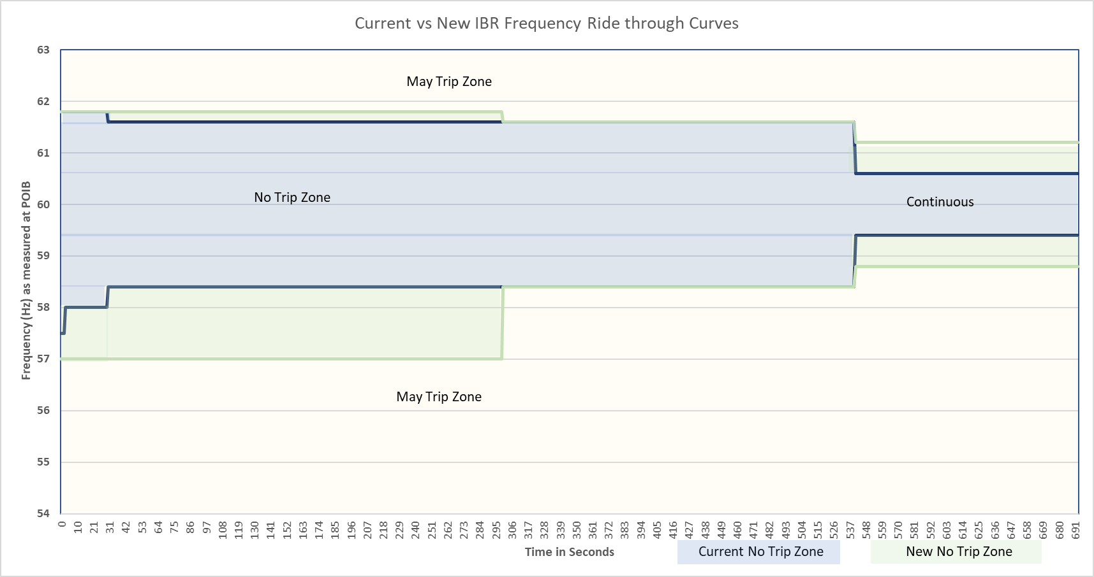
IBR - Frequency-ride through (FRT) requirements
All existing IBRs must meet new FRT requirements by 12/31/25.
No substantial change from initial proposal, but clarifying and structural edits throughout.

Slide 4
IBR – Voltage ride-through (VRT) requirements
Voltage ride-through requirements have additional structural changes:
  2.9.1 new paragraph (1) that directs new IBR requirements to Section 2.9.1.1 and legacy IBR requirements to Section 2.9.1.2 which are similar except for curves.
  Section 2.9.1.1 very similar to initial language in NOGRR 245
    Adds new table that aligns with IEEE 2800 Table 12 (VRT curves for solar and ESR IBR)
    Maintains table that aligns with IEEE 2800 Table 11 (VRT curves for wind IBR)
    Maintains requirement for IEEE 2800 Table 14 (sub-cycle voltage ride-through)
    Clarifying edits allowing additional ERCOT discretion in applying restrictions
  Section 2.9.1.2 very similar to initial language in NOGRR 245
    New Table A represents existing VRT curves in table format
    Requirement to report by 3/1/24: ride-through capabilities and plan for compliance
    Requirement to maximize capability and meet current curve be 12/31/25
    If unable to meet current curve, must meet new requirements by 12/31/27
    Clarifying edits allowing additional ERCOT discretion in applying restrictions
  2.9.1 new paragraph (2) requires new IBRs to comply with IEEE 2800 Sections 5 (Q-V control), 7 (abnormal conditions), and 9 (protection) by reference.

Slide 5
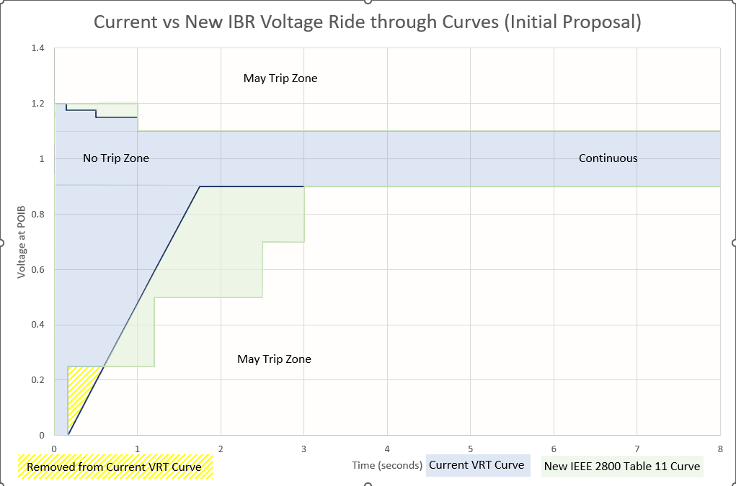
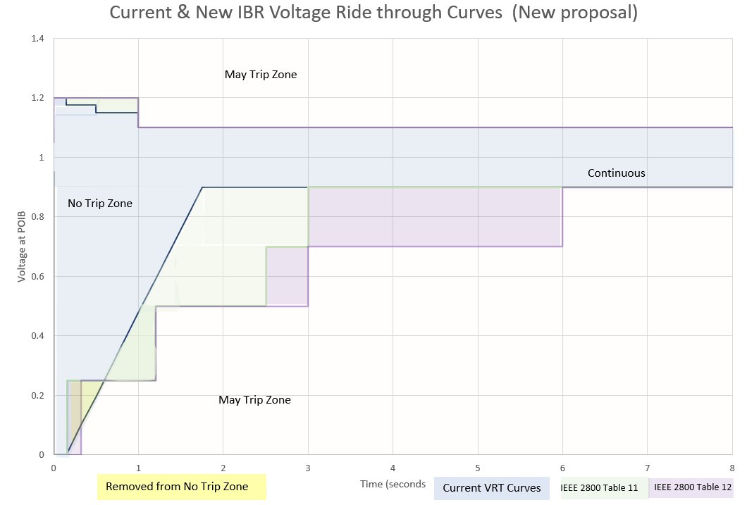
Initial vs New Proposal for VRT curves
New Proposal:
Requires existing IBRs to maximize VRT capability and meet the current VRT curves within ~2 years
Requires existing IBRs that are unable to meet the current VRT curves to meet the IEEE 2800 VRT curves within ~4 years
Requires new and retrofitted Wind IBRs to meet IEEE 2800 Table 11 curves
Requires new and retrofitted Solar and ESR IBRs to meet IEEE 2800 Table 12 curves
Initial Proposal:
Required all existing IBRs to meet IEEE 2800 Table 11 VRT curves within ~2 years
Required all new IBRs to meet IEEE 2800 Table 11 VRT curves

Slide 6
Type 1 and Type 2 WGRs
ERCOT has considered the proposed rules for all IBRs to comply with existing VRT requirements to apply to Type 1 and Type 2 WGRs.
Type 1 and Type 2 WGRs are not considered IBRs in IEEE 2800-2022. ERCOT is considering comments to clarify in NOGRR 245 that requirements in Section 2.9.1.2 would apply to Type 1 and Type 2 WGRs.
There are approximately 1395 MW of Type 1 WGR capacity and 625 MW of Type 2 WGR capacity in ERCOT today. Some repower projects may have altered these values as well as some capacity being co-located with load.
The average Net MW output for all Type 1 and Type 2 WGRs for the last 365 days was 343 MW (17% of max capacity).
ERCOT proposes that all WGRs, regardless of type, must ride-through normal system disturbances within the ride-through curves. Every failure compounds the magnitude of the system impacts and may introduce more units that enter an HVRT or LVRT mode.

Slide 7
WGR ride-through failures
While the two Odessa event ride-through performance failures were primarily PVGR units, multiple events over the last 5 years continue to involve WGR ride through failures.
The following statistics between 2018 and 2023 show that WGRs with some type of current exemption from ride-through requirements have and continue to demonstrate ride-through performance failures.
  22% (17 out of 77 WGRs) with an SGIA before 11/1/2008 experienced one or more ride-through failures
  34% (23 of 67 WGRs) with an SGIA after 11/1/2008 and before 1/16/14 experienced one or more ride-through failures
  24% (51 of 211 WGRs) with an SGIA after 1/16/14 experienced one or more ride-through failures
Some events may have had a significantly greater MW loss if wind speed was higher at the time of the failures.

Slide 8
New and replaced IBR requirements
IBRs with SGIA (or modified IBRs with GIM initiated) on or after June 1, 2023, must meet the new ride-through curves.
Since curves from IEEE 2800-2022 Table 11 are no longer being retroactively required, ERCOT is proposing to further align with IEEE-2800-2022 by requiring WGRs to meet Table 11 and all PVGR and ESRs to meet Table 12 (Tables A and B respectively in Section 2.9.1.1).
ERCOT is additionally proposing to fully adopt IEEE 2800 Sections 5 (Q-V control), 7 (abnormal conditions), and 9 (protection) by reference along with any cross references in other sections for these IBRs unless otherwise otherwise clarified, modified, or exempted in the ERCOT Protocols, Operating Guides, or Planning Guides.
ERCOT is also proposing the clarification that IBR plant requirements and all IBR unit requirements described in the IEEE 2800-2022 standard are to be applied at the Point of Interconnection Bus (POIB) and the individual Inverter-Based unit terminal respectively unless otherwise clarified, modified, or exempted in the ERCOT Protocols, Operating Guides, or Planning Guides.

Slide 9
NOGRR 245 path forward
ERCOT will continue to consider submitted public comments to adjust the latest ERCOT submitted comments (6/22/23) for NOGRR 245.
Any suggested revisions should demonstrate how the reliability risk of ride-through failures are still addressed with the suggested revision
It is unlikely that any implementation dates would be further delayed due to the reliability risk that ride-through failures are presenting to the ERCOT system.
ERCOT is looking for ROS to consider approval of NOGRR 245 in August to make it to the October BOD.

Slide 10

Questions
?

