Slide 1
Overview of NPRR1186
Improvements Prior to the RTC+B Project for Better ESR State of Charge Awareness, Accounting, and Monitoring
Nitika Mago
July 6, 2023
ROS

Slide 2
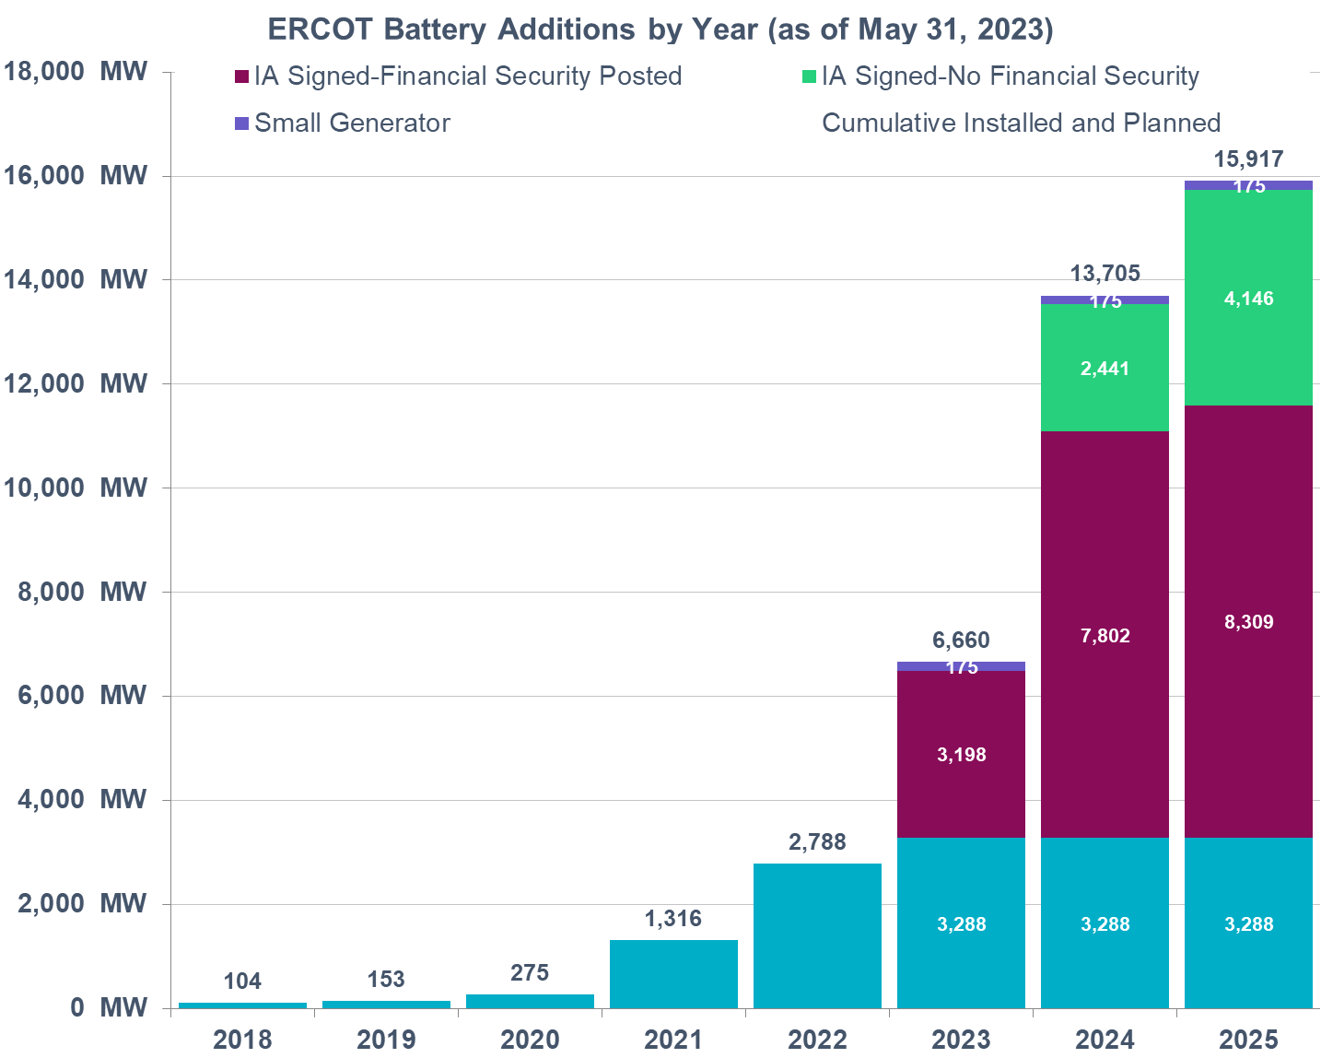
Background
ERCOT has seen a steady growth in the capacity of interconnected battery Energy Storage Resources (ESRs). This rapid growth is expected to continue in the future as well.
Most ESRs interconnected or planning to interconnect are less than 2 hours batteries.
ESRs are already providing up to 60% of ERCOT’s Ancillary Services (AS).
ERCOT’s current systems and post RTC+B (with single ESR model) systems (as per approved protocol language) are not designed to account for capability i.e., State of Charge (SOC) of duration limited ESRs.
ERCOT has undertaken a holistic review of its systems and process and has identified improvements in the awareness, accounting and monitoring of SOC of an ESR that are needed (a) today and (b) along with RTC+B project (with Single-Model ESR implementation).
As a part of this effort ERCOT has interviewed other ISO/RTOs that have ESRs in their footprint.
The penetration of (relatively short duration) ESRs in ERCOT markets is already much larger than most ISOs/RTOs. With the projected ESR penetration levels, while ERCOT does not see a need to manage the SOC for an ESR, ERCOT does find it essential to make changes that will allow ERCOT to appropriately “model/account” for SOC of an ESR in ERCOT processes.
Jun 22, 2023 Workshop discussed the specific changes ERCOT has identified.

Slide 3
NPRR 1186 Introduction
NPRR1186 focuses on specific improvements that are needed for today’s systems and processes. This NPRR aims to strategically improve SOC awareness, accounting and monitoring with minimal changes so that the improvements can be in place while the RTC+B project is completed.
Urgent status is necessary so that the system changes associated with this NPRR1186 can be implemented in the narrow window before development work on the Real-Time Co-optimization (RTC) & Single-Model ESR (“RTC+B”) project begins.
At a high level with NPRR1186, ERCOT is proposing to,
Alter Day-Ahead Market (DAM) process so that the Day-Ahead Ancillary Service (AS) awards respect the duration requirements for AS. Absent this change, in some cases DAM AS awards may not be operationally feasible.
Modify the High Ancillary Service Limit (HASL) calculation that is used by Reliability Unit Commitment (RUC) studies such that RUC only counts on SOC that an ESR plans to have in excess of SOC required for AS it is providing in every hour as being available for dispatch.
RUC treats ESRs as online or Out. RUC will not commit an ESR to come online. RUC can count on ESR being available to serve Load.
Change the HASL calculation that is used by 5-min Security Constrained Economic Dispatch (SCED) to account for SOC required to support an ESR’s Ancillary Service Resource Responsibility.

Slide 4
State of Charge Requirements for AS
Through NPRR1186, ERCOT is also proposing to alter the SOC requirements for the Ancillary Service Responsibilities to better align these with how SOC is expected to be accounted for post RTC+B.
Since late last year ERCOT has been monitoring SOC that is preserved for the amount of AS responsibility that is provided on an ESR. There are some drawbacks in the method that is currently used to establish SOC requirements for AS.
NPRR1186 proposes update the SOC requirements for AS and a create a new framework within ERCOT’s EMS that allows the SOC requirements for AS to be computed such that these will consider
Elapsed time within the current Operating Hour to diminish the SOC discharge and headroom requirements as the clock progresses. This means that that the SOC requirement will reduce as a function of time such that at the end of the Operating Hour the SOC requirement for that an up Ancillary Service will reduce by an amount that reflects the energy depleted if the up Ancillary Service was fully deployed for one hour.
Potentially increase of SOC requirement at the tail end to support the ESR’s next hour AS obligation and
Discount SOC requirement to account for the ESR’s current BP.
ERCOT intends to implement each of the above facets for the SOC requirement as a parameter that can be altered. This approach will allow ERCOT to work with stakeholders in establishing values of each parameter such that these mitigate the performance risks that ERCOT sees while allowing optimal use of the ESRs during an Operating Hour.
To this end, ERCOT plans to file comments to NPRR1186 that will better incorporate the SOC requirement framework within the protocols. ERCOT is targeting to file this NPRR before July 13 PRS.

Slide 5
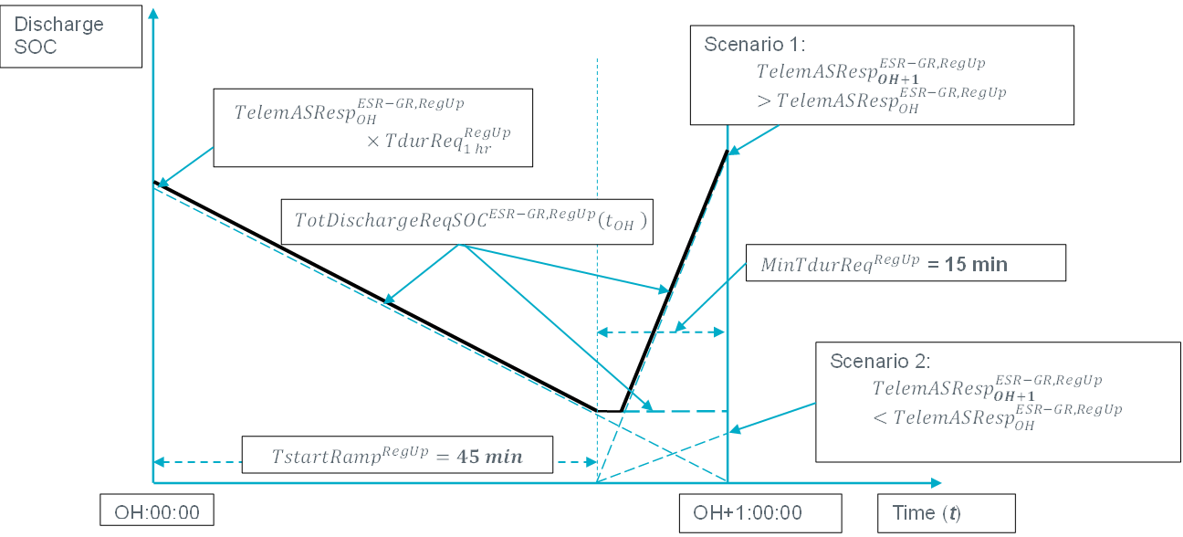
SOC Requirement Compliance vs Dispatch
ERCOT’s comments will include a description of the formulas that will be used to compute SOC requirements for compliance and 5-min dispatch.
RegUp example for SOC required to discharge if ESR-GR Base Point >0
#1 For Dispatch
#2 For Dispatch: Tune-able Parameter
Compliance and Enforcement

Slide 6
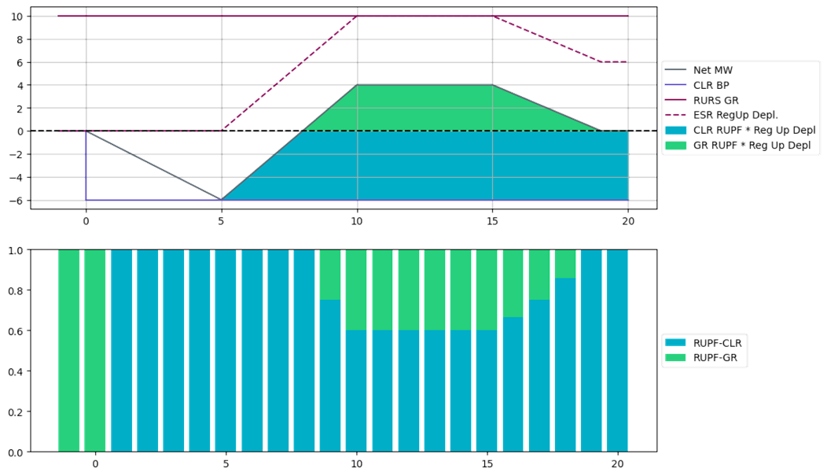
ESR AS Telemetry Change – Not tied to NPRR1186
The current combo model for ESR (combo of ESR-GR and ESR-CLR) has complicated the process of the QSE moving the AS responsibilities on an ESR between its modeled ESR-GR and ESR-CLR to self-manage SOC. In addition, under certain scenarios, an ESR-GR and/or ESR-CLR may incur compliance violations and Base Point Deviation charges even when the overall ESR performance meets expectations.
Proposed change in ESR AS telemetry
All up AS Responsibilities be carried first on the ESR-GR side of the ESR up till HSL and any remaining up AS Responsibility then be carried on the ESR-CLR side. Similarly, all the Regulation Down Responsibility be carried first on the ESR-CLR side of the ESR up till MPC and any remaining Regulation Down Responsibility then be carried on the ESR-GR side.
The telemetered Regulation Up and Regulation Down participation factors are expected to be updated based on Regulation deployment amounts for both ESR-GR and ESR-CLR so that ERCOT can compute expected Regulation deployment from both sides of the ESR.
This change will bring some relief to the Base Point Deviation charges and GREDP/CLREDP issues associated with the AS transition requirements AND reduces the need to implement NPRR 963 prior to RTC+B project.
ERCOT systems are ready with this feature and will work with QSEs on a timeline to turn it on.
ERCOT plans to post updates to the ERCOT and QSE Operations Practices During The Operating Hour Business Practice Manual to provide more details before the July 13 PRS.

Slide 7
Summary
ERCOT has seen and is expecting a steady growth in the capacity of interconnected battery Energy Storage Resources (ESRs). ERCOT’s current and post RTC+B (with single model) systems (as per approved protocol language) are not designed to account for capability i.e., State of Charge (SOC) of duration limited ERSs.
ERCOT has undertaken a holistic review of its systems and process and has identified improvements in the awareness, accounting and monitoring of SOC of an ESR that are needed (a) today and (b) along with RTC+B project (with Single-Model ESR implementation).
NPRR1186 focuses on specific improvements that are needed for today’s systems and processes. This NPRR aims to strategically improve SOC awareness, accounting and monitoring with minimal changes so that the improvements can be in place while the RTC+B project is completed.
NPRR1186 also proposes to create a new framework for SOC requirements for AS. ERCOT will work with stakeholders to establish values of each parameter in the new framework such that these mitigate the performance risks that ERCOT sees while allowing optimal use of the ESRs during an Operating Hour.
ERCOT has identified a narrow window for implementing these strategic improvements and hence is targeting a tighter timeline so that the associated system changes can be implemented before development work on RTC+B has to begin.
Proposed Review Timeline
Jul 13, 2023 PRS (Language + IA)
Jul 25, 2023 TAC
Aug 31, 2023 BoD
Sep 14, 2023 PUC OM

Slide 8
Appendix – Relevant Slides from Jul 22 Workshop

Slide 9
DAM/SASM ECRS & Non-Spin Duration Accounting, Contd.
Proposed Changes: Change DAM/SASM constraint equations so that the 2-hour ECRS and 4-hour Non-Spin requirements are considered. These constraints are only for ESR-GR and ESR-CLR. The concept is to treat every MW award for ECRS or Non-Spin as some multiple MW amount when checking to see if award exceeds the AS MW offer amount or when checking to see that the ESR-GR HSL or ESR-CLR MPC is not exceeded.
AS Offer MW check: Scale ECRS and Non-Spin awards (changes in yellow)
$${MW}_{AS}^{Offer}≥{MW}_{RegUp}^{Award}+{MW}_{RRS}^{Award}+K^{ECRS}×{MW}_{ECRS}^{Award}+K^{NSPIN}×{MW}_{NSPIN}^{Award}$$
HSL check: Scale ECRS and Non-Spin awards (changes in yellow)
$${HSL}_{i}≥{MW}_{energy}^{Award}+{MW}_{RegUp}^{Award}+{MW}_{RRS}^{Award}+K^{ECRS}×{MW}_{ECRS}^{Award}+K^{NSPIN}×{MW}_{NSPIN}^{Award}$$
Example For a +/-10 MW, 10 MWh ESR (gen side) that submits a 10 MW AS offer with prices for RegUp, RRS-PFR, ECRS and Non-Spin, the above constraint will be:
$$10≥{MW}_{RegUp}^{Award}+{MW}_{RRS}^{Award}+2×{MW}_{ECRS}^{Award}+4×{MW}_{NSPIN}^{Award}$$
$$10≥{MW}_{energy}^{Award}+{MW}_{RegUp}^{Award}+{MW}_{RRS}^{Award}+2×{MW}_{ECRS}^{Award}+4×{MW}_{NSPIN}^{Award}$$
If ESR awarded 2.5 MW Non-Spin, then, the above constraints prevent any other product (energy or AS) from being awarded to ensure operational feasibility.
Proposed Implementation Timeline: (Phase C) Upon implementation of Interim Period NPRR

Slide 10
High and Low Ancillary Service Limit Calculation
Today’s Issue: ERCOT’s SCED does not take into account the SOC that needs to be preserved to support an ESR’s AS Responsibility and hence is ignorant of the amount of SOC that is truly available for dispatch.
Proposed Change: Modify RLC to ensure HASL/LASL for ESR’s take into remaining SOC available for SCED base Point after discounting the SOC required to support the ESR’s AS Responsibilities.
Updated ESR-GR HASL
HASL = Max (LASL, Min ((HSLTELEM – (RRSTELEM + RUSTELEM + ECRSTELEM + NSRSTELEM +NFRCTELEM)), MaxBP))
MaxBP = (SOCTELEM – MINSOCTELEM – REQ_AS_SOC ) / TSCED
Updated ESR-CLR HASL
HASL = Max (LPCTELEM, Min ((MPCTELEM – RDSTELEM), MaxBP))
MaxBP = (MAXSOCTELEM – SOCTELEM – REQ_Headroom_AS_SOC) / TSCED
Proposed Implementation Timeline: (Phase C) Upon implementation of Interim Period NPRR

Slide 11
Current Operating Plan (COP) & Reliability Unit Commitment (RUC) Changes
Today’s Issue: ERCOT’s lookahead studies such as Reliability Unit Commitment (RUC) treat an ESR-GR like any other Generation Resource. The HASL used in RUC study to meet Load Forecast is calculated from the ESR-GR’s COP HSL and COP AS responsibilities. If HASL > 0, then RUC study can dispatch the ESR-GR. There are scenarios where RUC study dispatches ESR-GR for energy when HASL>0 but the ESR may not have sufficient energy to discharge for energy as well as provide its AS responsibility.
Proposed Change:
For ESR-GR add the following three (3) new fields in COP
MinSOC: Minimum Operating SOC for given hour
MaxSOC: Maximum Operating SOC for given hour
PlannedSOC: Planned (target) SOC at the beginning of given hour
Add the following COP submission validations,
MinSOC <= Planned SOC <= MaxSOC
MinSOC must be greater than or equal to the registered nameplate MinSOC
MaxSOC must be less than or equal to the registered nameplate MaxSOC
Changes to RUC in the Interim Period:
In RUC pre-processing, discount COP PlannedSOC by the energy required to support AS responsibilities in the COP
If there is any excess SOC remaining, then use that to calculate effective HASL for the ESR-GR, otherwise do not allow ESR-GR to be dispatched for energy in the RUC study.
Proposed Implementation Timeline: (Phase C) Upon implementation of Interim Period NPRR

Slide 12
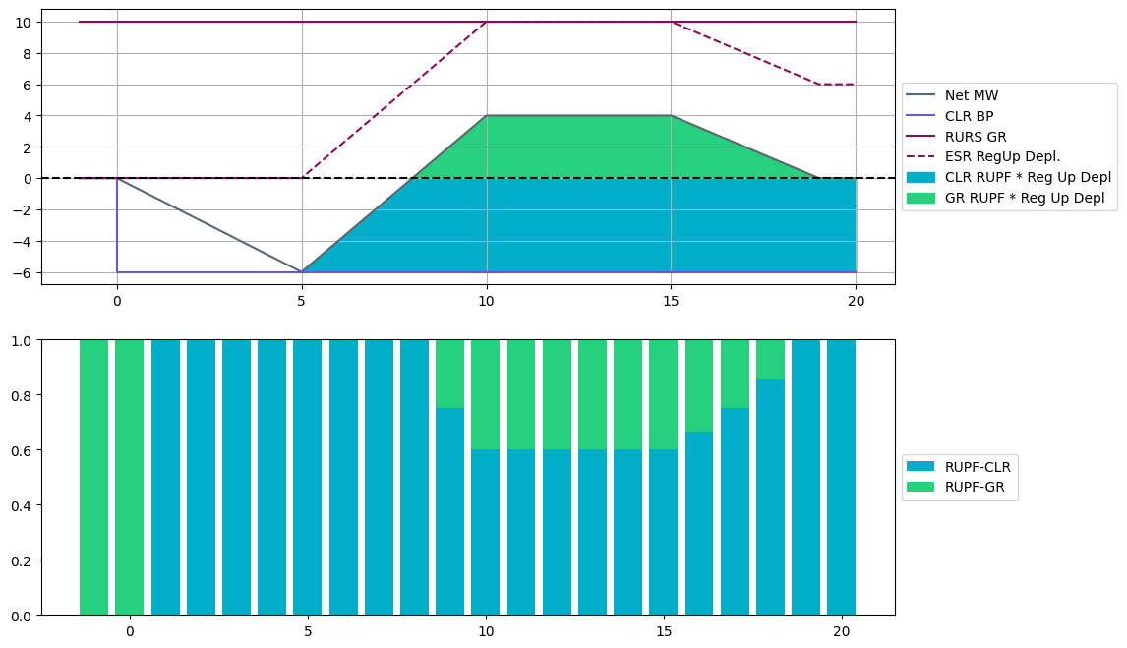
Appendix Real Time AS Telemetry – Example
5
3
2
1
4
At t = 0: ESR-CLR receives a BP of 6 MW at t=0 and ramps down to charge at 6 MW by t=5
At t = 5: Reg Up is deployed. RUPF-CLR is equal to 1, so the full deployment occurs on the ESR-CLR and ESR-CLR’s net MW ramps back up in response to Reg Up deployment.
When the Reg Up deployment becomes greater than the ESR-CLR’s BP (6 MW), RUPF-GR becomes non-zero and the ESR-GR starts responding to the Reg Up deployment.
Note that at all times, the RUPF-GR and RUPF-CLR add up to the same total value of 1.0. The ESR-CLR RUPF is expected to be set dynamically such that the RUPF*Reg Up Deployed is never greater than the BP-CLR
Reg Up Responsibility remains on the GR for the entire interval

