Slide 1
Update On ERCOT Contingency Reserve Service
Nitika Mago
July 6, 2023

Slide 2
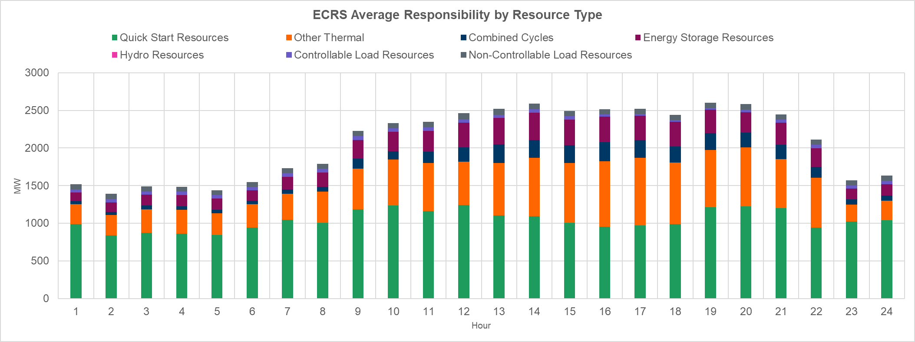
Introduction
Summary of ERCOT’s ECRS software migration Timeline
Software changes related to ECRS were migrated on June 8 by 5pm.
Day-Ahead Market (DAM) activities on June 9 for Operating Day (OD) June 10 included ECRS. And after DAM, QSE submitted COP updates OD June 10 to include ECRS, and Day-Ahead Reliability Unit Commitment (DRUC) executed.
June 10 was the First OD with ECRS. Starting at 12:01am, telemetry that ERCOT received included ECRS values
Hourly ECRS quantities provided in from June 10 to Jun 30 ranged between 1,509 MW and 2,601 MW (average ~2,073 MW).
During the period of June 10-18, Thermal Resources, including Quick Start Generation Resources provided approximately 83% and Energy Storage Resources provided approximately ~12% of the total ECRS quantities in Real Time.

Slide 3
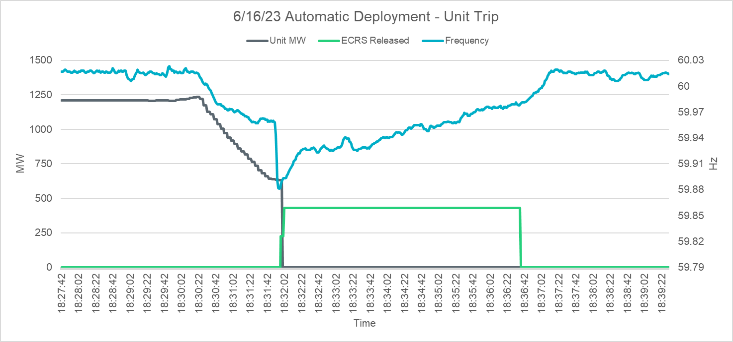
ECRS Deployments
On 6/14/2023 at 19:20, ~600 MW of SCED dispatchable ECRS were released for 12 minutes and 28 seconds
Reason: Insufficient capability for forecasted 10min Ahead Net Load
Min dispatchable headroom (HDL – Gen): ~1,467 MW
On 6/16/2023 at 18:31, ~430 MW of SCED dispatchable
ECRS were released for 4 minutes and 40 seconds.
Reason: Frequency below 59.91Hz due to unit trip
(~632 MW instantaneous, 1235 MW total)
On 6/18/23 at 19:20, ~200 MW of SCED dispatchable
ECRS were released for 25 minutes and 25 seconds
Reason: Insufficient capability for forecasted 10min Ahead Net Load.
Min dispatchable headroom (HDL – Gen): ~1,515 MW
On 6/20/23 starting 16:21, over the course of 4 hours and 40 minutes up to 1,900 MW of SCED dispatchable ECRS was deployed in steps as dispatchable headroom reduced during the period of 16:21 and 21:01.

Slide 4
Follow Up Questions from TAC for ROS
Are volumes of ECRS Requirements appropriate considering deployments
This will be evaluated as a part of the 2024 AS Methodology process.
Any concerns with the longer duration ECRS deployments that warrant Protocol changes.
It may be too early to gauge the need for additional ECRS related Protocol changes for this issue. At a high level during the four deployments, ERCOT and QSE systems mostly functioned as designed/expected. ERCOT is in the process of conducting detailed performance evaluations of Resources that were providing ECRS during the four deployments. Any performance concerns are being discussed with appropriate Qualified Scheduling Entities. ERCOT will continue to monitor how both individual Resources and ERCOT system performance evolves in future and if additional Protocols changes are needed.
Can the posted Operations Message include a Reason for ECRS Deployment.
This is not a straightforward request given that ECRS deployments can occur for more than one reasons and ERCOT Operations prefers to setup a solution that can be consistently implemented. ERCOT is still in the process of evaluating what system changes can be made to support this request and will bring a proposed solution to the July PDCWG.

Slide 5
Wrap-Up and Question
ERCOT is prepared to help support future discussion and analysis of ECRS during the early weeks/months of this new AS product at ROS (recognize some analysis would be at WMS)
Open to questions at today’s meeting.

