Slide 1
Market Coordination Team Update
RMS: July 11, 2023

Slide 2
June 21st
Reviewed Texas SET 5.0 Swimlanes
Inadvertent Changes
CSA
Reviewed feedback on Texas SET Guide Redlines 814_20 to 814_29
Participants should review Texas SET Guide Redlines 650s, 810s, 820s, 824, 867s, 997, T series
Once the above are reviewed, draft redlines, and draft SEF Files will be posted
Questions regarding SCR817

Slide 3
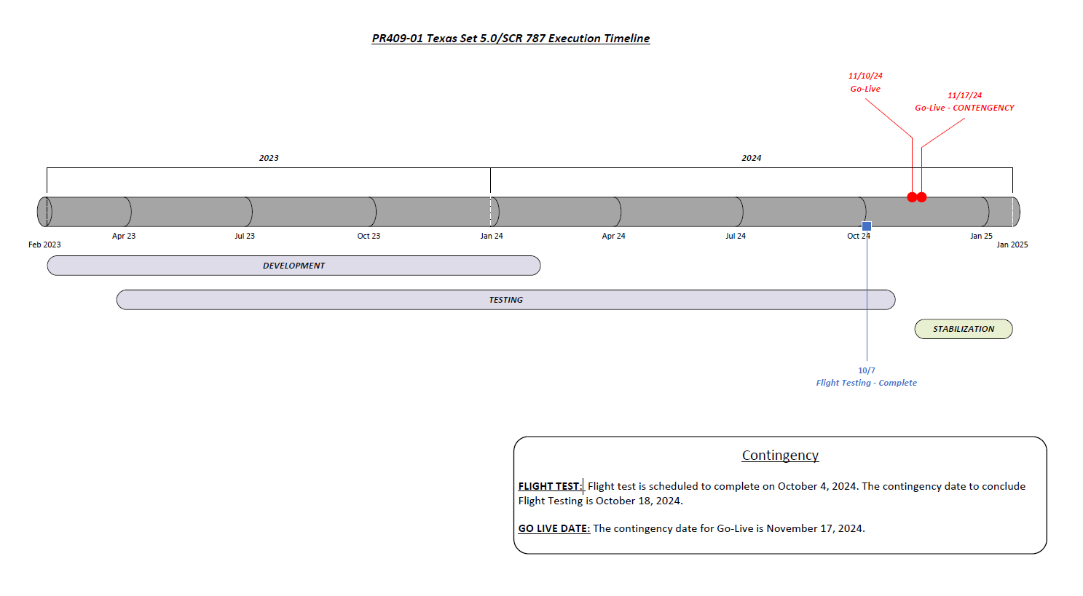

Slide 4
Future Meetings
July 19th
August 16th
September 20th

