Slide 1
PDCWG Report to ROS
Chair: Jimmy Jackson, CPS
Vice Chair: Vacant
ROS
July 6th, 2023

Slide 2
Report Overview & Notes
Report Overview
Meeting Minutes
BAL-001-TRE-2 FMEs and IMFR
1 FME in the month of May
Frequency Control Report

Slide 3
Meeting Minutes
PDCWG Meeting 6/21/2023
RRS Limit Study : Q&A Responses
ECRS Implementation and Summary of 6/14 manual deployment
PSRR cap changes in the GTBD
Review of ROS assignments to PDCWG
ERCOT Reports
TRE Report

Slide 4
Frequency Measurable Events Performance

Slide 5
Frequency Measurable Events
There was 1 FME in May
5/1/2023 13:32:02
Loss of 851 MW of Generation
Interconnection Frequency Response: 999 MW/0.1 Hz
81 Resources were evaluated. These includes,
26 Generation Resources
1 Controllable Load Resources
54 Energy Storage Resources
9 of 81 Evaluated Resources had less than 75% of their expected Initial Primary Frequency Response.
9 of 91 Evaluated Resources had less than 75% of their expected Sustained Primary Frequency Response.

Slide 6
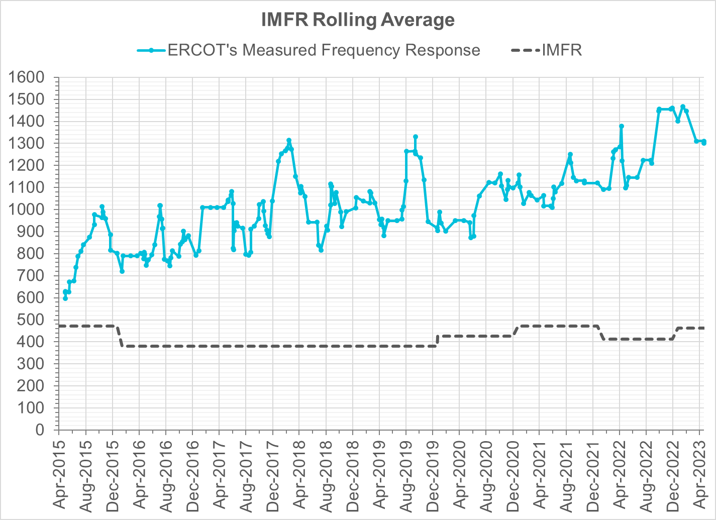
Interconnection Minimum Frequency Response (IMFR) Performance
IMFR Performance currently
1301.17 MW/0.1HZ
Frequency Response Obligation (FRO): 463 MW/0.1 Hz

Slide 7
Questions?

Slide 8
Frequency Control Report
May 2023

Slide 9
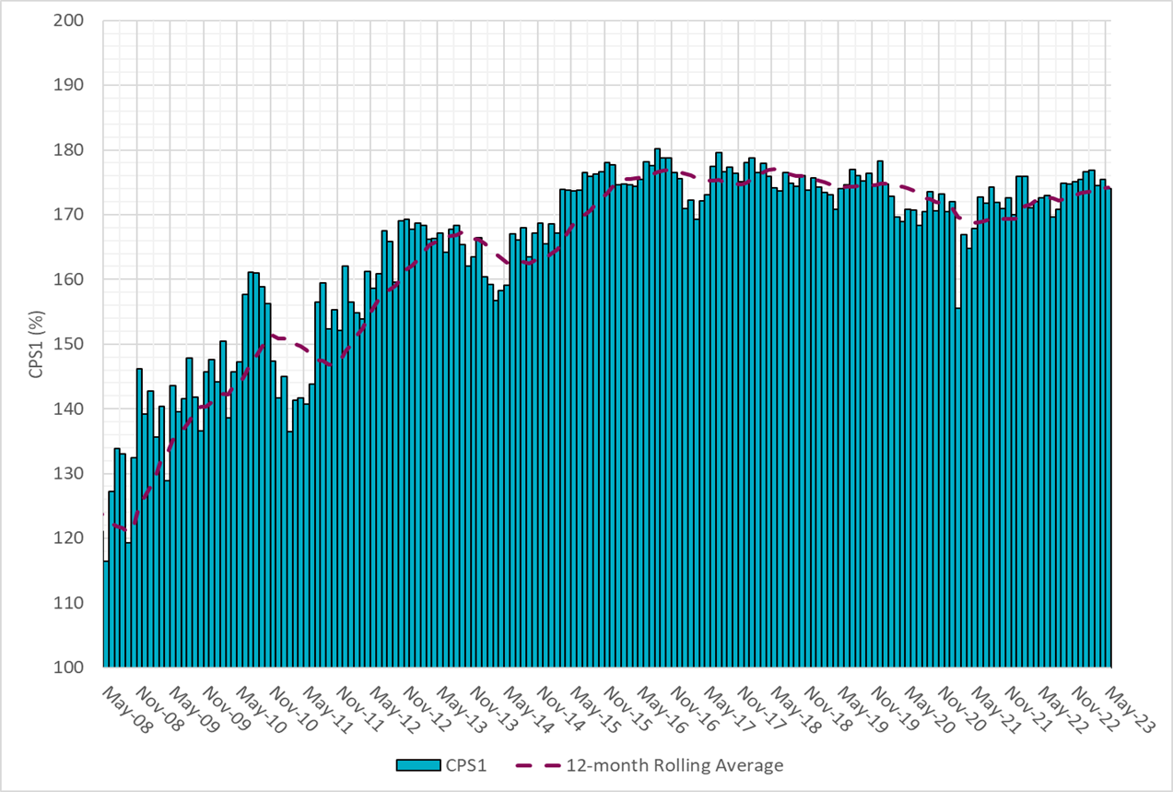
CPS1 Performance

Slide 10
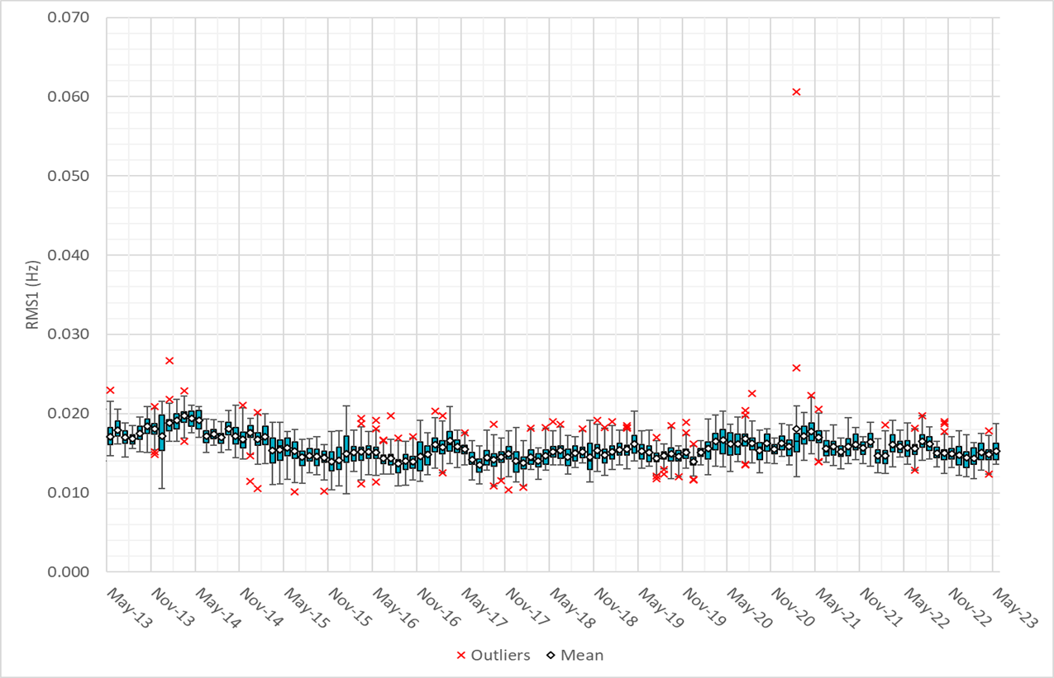
RMS1 Performance of ERCOT Frequency
Notes:
15.28 Mhz on avg for May 2023

Slide 11
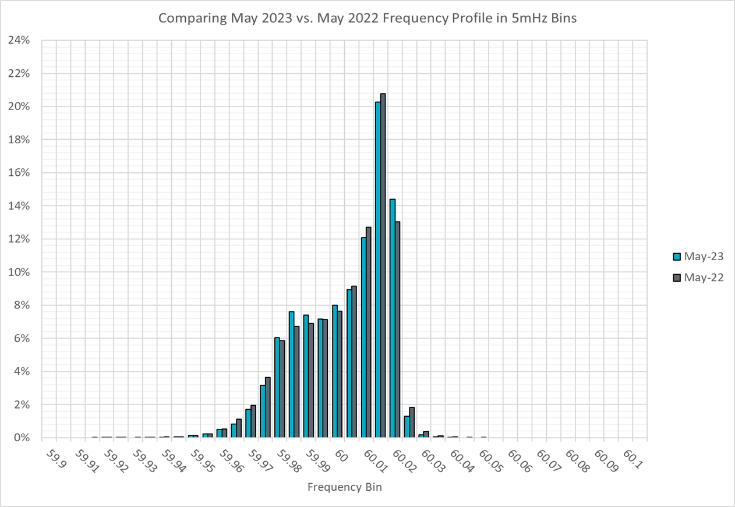
Frequency Profile Analysis

Slide 12
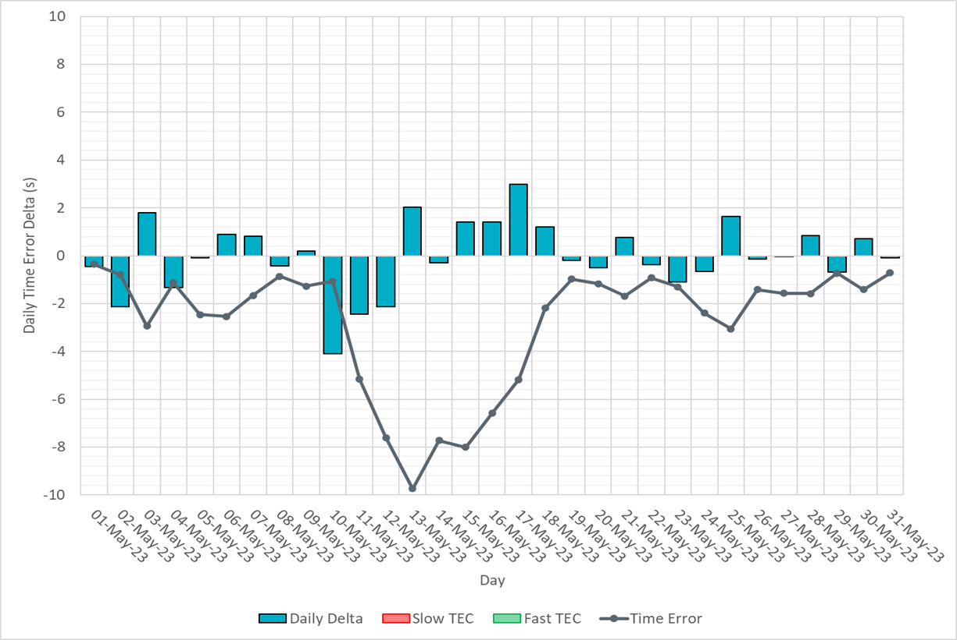
Time Error Corrections

Slide 13
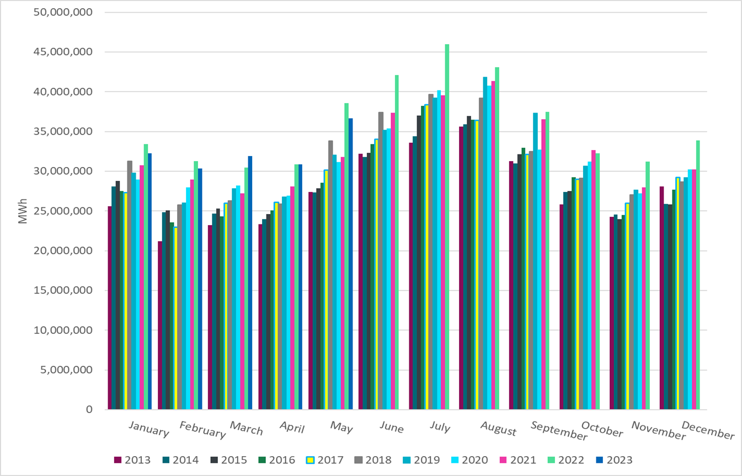
ERCOT Total Energy
Notes:
366,369,87 MWh

Slide 14
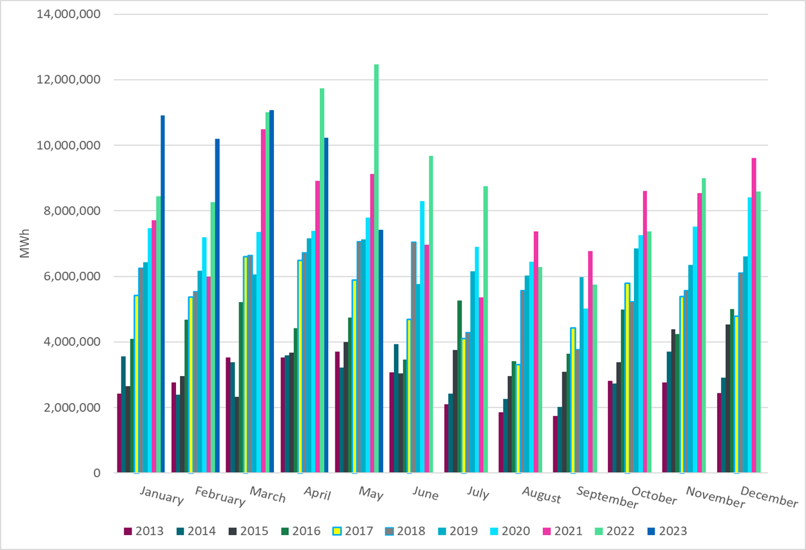
ERCOT Total Energy from Wind Generation
Notes:
7,430,115 MWH

Slide 15
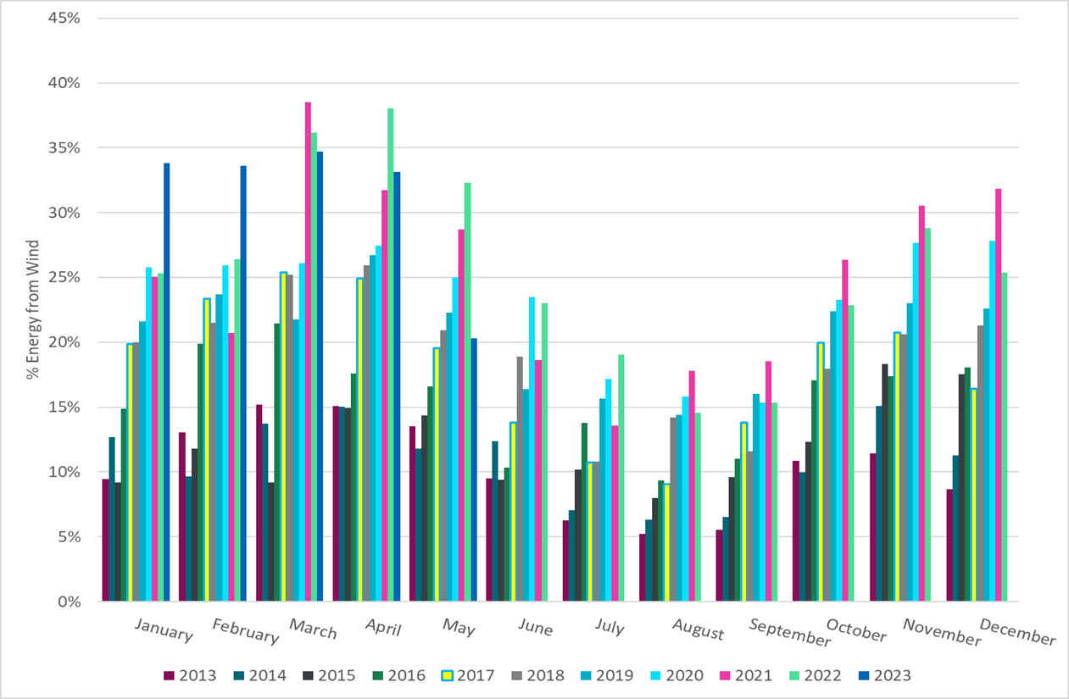
ERCOT % Energy from Wind Generation
Notes:
20.28% of total energy was provided by wind generation

Slide 16
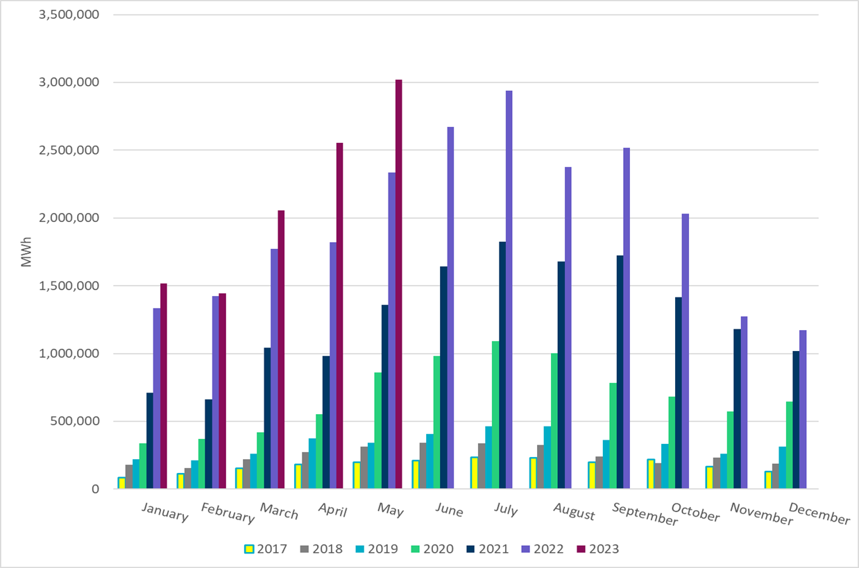
ERCOT Total Energy from Solar Generation
Notes:
3,019,271 MWh

Slide 17
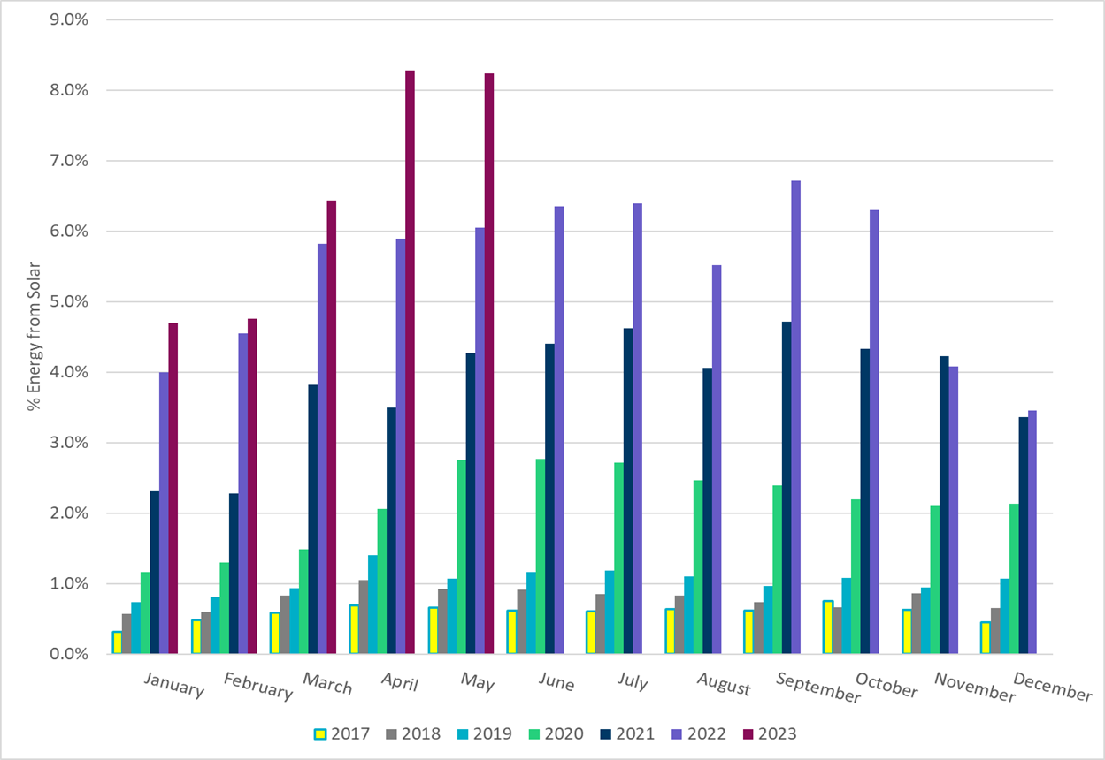
ERCOT % Energy from Solar Generation
Notes:
8.24%

Slide 18
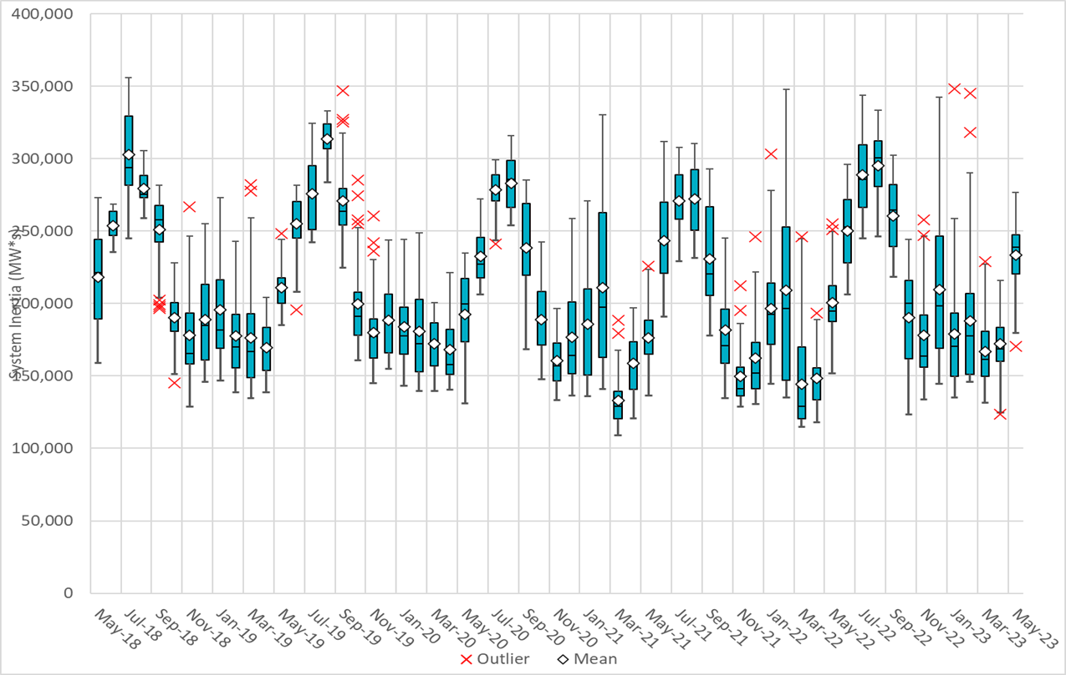
ERCOT Daily Minimum System Inertia
Notes:
Minimum Inertia =170,359 MW*s on 5/1/2023
Previous Minimum was 109,029 MW*s on 3/22/2021
Data:
Mean: 233,598 MW*s
Max: 276,88 MW*s on May 16th
Min: 170,359 MW*s on May 1st

Slide 19
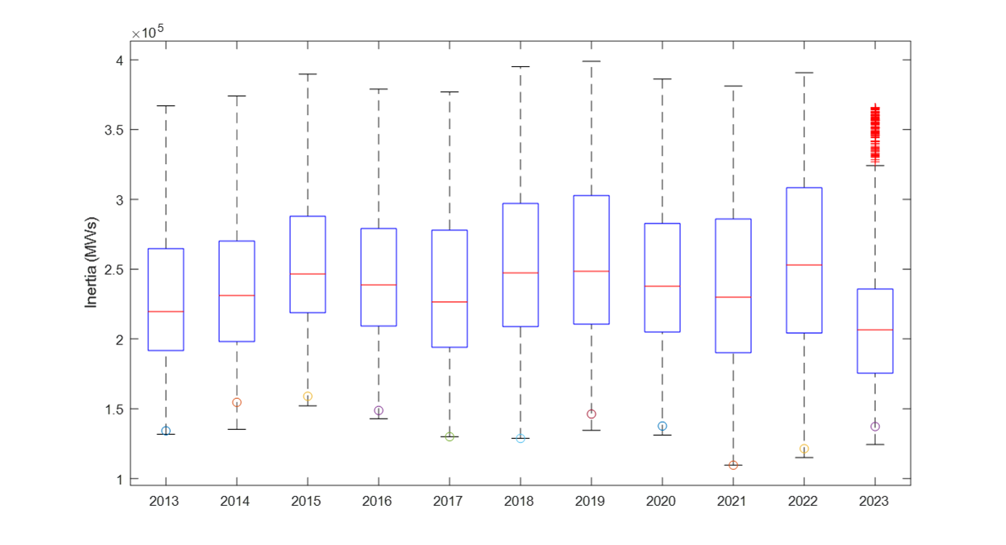
ERCOT Inertia Trend
Notes:
For each box, the central mark (red line) is the median, the edges of the box (in blue) are the 25th and 75th percentiles, the whiskers correspond to +/- 2.7 sigma (i.e., represent 99.3% coverage, assuming the data are normally distributed. The corresponding lowest inertia in each year is given in the table.
The circle on each boxplot is showing inertia during time when highest portion of load was served by wind/solar generation in that year.

