Slide 1
ADER OFFSET and MPC/LPC Information
(For Discussion Purposes)
6/26/2023

Slide 2
How the Resource would look with no Offset (+/- 5 MW of batteries)
-6
-5
-4
-2
0
2
4
5
6
10.0 MW = Response Capability
All batteries in the ADER at max withdrawal level
All batteries in the ADER at max injection level
(5.0)
(5.0)
The “net power flow” is a negative number when a withdrawal and a positive number when an injection
The ERCOT software system needs the ADER to always be seen as a Load.
The next slides describe how the Offset Approach is applied.
The basic formula to determine the telemetry to send to ERCOT is:
“ADER Net Power Flow with Offset” = ABS (“net power flow” – “Offset Quantity”)

Slide 3
How the ADER would look with 10 MW Offset (+/- 5 MW of batteries)
16
15
14
12
10
8
6
5
4
Always seen as a Load and MPC and LPC are positive numbers
10.0 MW = Response Capability
All batteries in the ADER at max withdrawal level
All batteries in the ADER at max injection level
(5.0)
(5.0)
The “net power flow” is a negative number when a withdrawal and a positive number when an injection
MPC = 15.0
LPC = 5.0
“ADER Net Power Flow with Offset” = ABS (“ net power flow” – “Offset Quantity”)
The Range of Response = 15.0 – 5.0 = 10.0 MW
When the “net power flow” is “0”; the “ADER Net Power Flow with Offset” = 10 MW (the Offset Quantity)

Slide 4
Example #1
A DotA with 1000 sites
Each site has a +/- 5 kW battery (10kW response capability)
Total for the DotA; 10 MW response capability
Each site has native load and PV solar
Registration:
Total for ADER before offset application = +/- 5 MW
Assume Offset = 10 MW (Note the offset quantity is determined and provided by ERCOT based on the size of the ADER)
ADER Registration MPC = 15 MW
ADER Registration LPC = 5 MW
NPF should be between MPC and LPC
Take “information” at the terminal of the batteries and add offset
When the “net power flow” (sum of what is happening at the terminals of the batteries) is “0”;
the “ADER Net Power Flow with Offset” = 10 MW (the Offset Quantity)

Slide 5
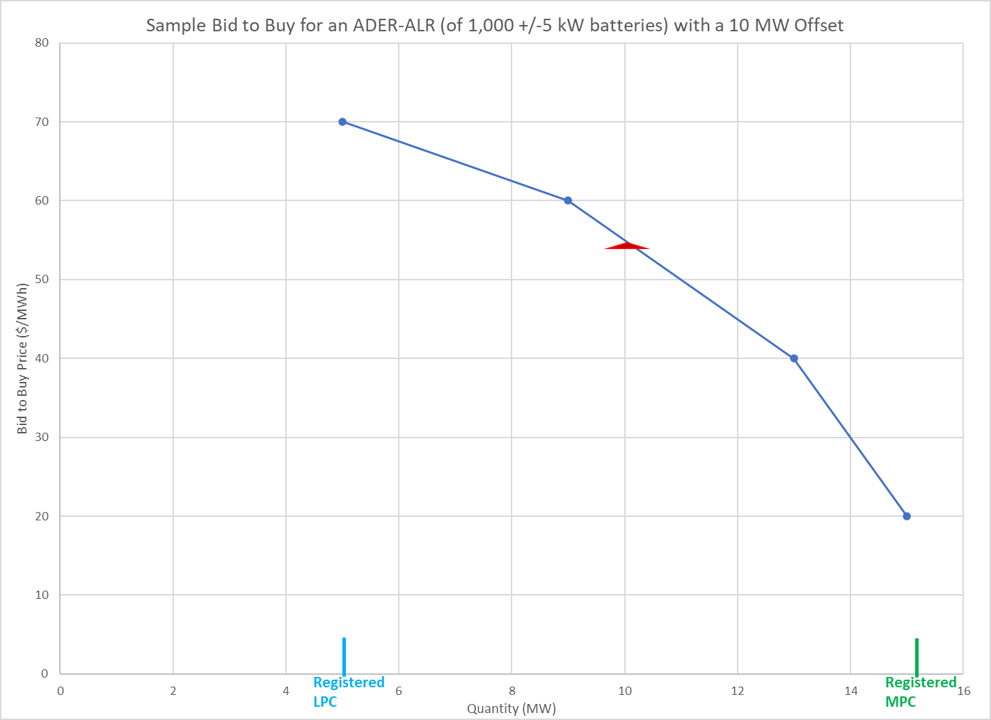
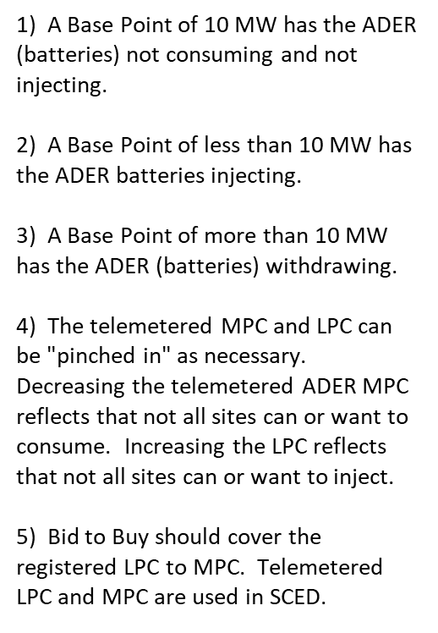
Example Bid to Buy for an ADER-ALR
Bid (MW) | Bid Price ($/MWh)
5 | 70
9 | 60
13 | 40
15 | 20
Real Time Energy Price | Base Point sent to Resource
$250/MWh | 0 MW
$70/MWh | 5 MW
$65/MWh | 7 MW
$40/MWh | 13 MW
$20/MWh | 15 MW
-$50/MWh | 15 MW

Slide 6
Example Information for the ADER
Site # | Device | Registered Response Capability | PV Output | Native Load | Information at terminals of batteries Net Power Flow (NPF)
1 | +/- 5 kW | 10 kW |  |  | Injecting 3 kW
2 | +/- 5 kW | 10 kW |  |  | Injecting 3 kW
3 | +/- 5 kW | 10 kW |  |  | Injecting 3 kW
4 | +/- 5 kW | 10 kW |  |  | Injecting 3 kW
. | . | . |  |  | .
. | . | . |  |  | .
. | . | . |  |  | .
1000 | +/- 5 kW | 10 kW |  |  | Injecting 3 kW
Total | +/- 5 MW | 10 MW |  |  | Injecting 3 MW With Offset: NPF = 7 MW

