Slide 1
LFLTF Update
Bill Blevins
June 27, 2023 TAC Meeting

Slide 2
What’s in it?
Terms (LFLTF NPRR)
Registration (LFLTF RRGRR) RIOO & NMMS
Interconnection Process (LFLTF PGRR) RIOO
Operations (LFLTF NPRR and NOGRR) Siebel* and MMS
Ramp Limits
Ride-through
PFR for CLR change*
Operations-Markets (CLR NPRR) MMS
CLRs requirements for SCED
Change to Nodal Settlements for CLRs
EEA- Manual Loadshed (LFLTF NPRR, LFLTF NOGRR)
Visibility EMS, MMS, PI, Grid GEO
Manual Load Interruption prior to EEA (Deployment via Ancillary Service deployment manager) MMS

Slide 3
Terms and Associated NPRR for CLR Nodal settlement
Large Load
Large Load Interconnection Study (LLIS)
Registered Curtailable Load (RCL)
Interconnecting Large Load Entity
SSR terms addressing some new Feroresonance interactions.
Interruptible load types
FIRM
RCL
NCLR
CLR
NEW
Implement Nodal Dispatch and Energy Settlement for Controllable Load Resources
Addresses CLR must have an offer curve in and must not use OUTL when consuming power.
The green types of Loads already exists
By level of sophistication

Slide 4
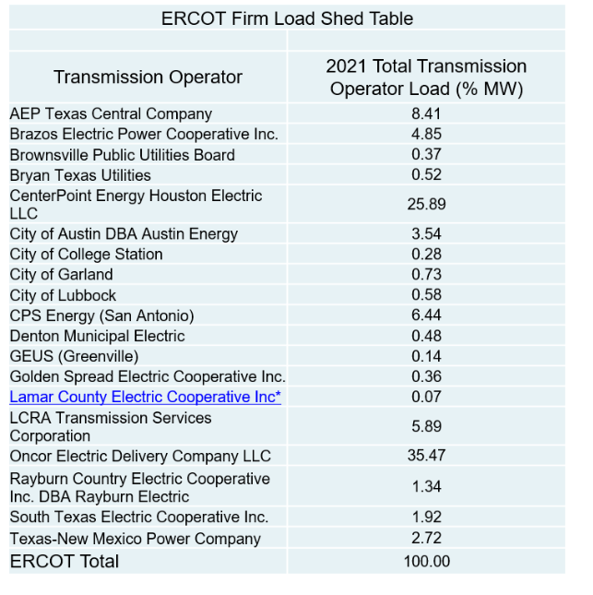
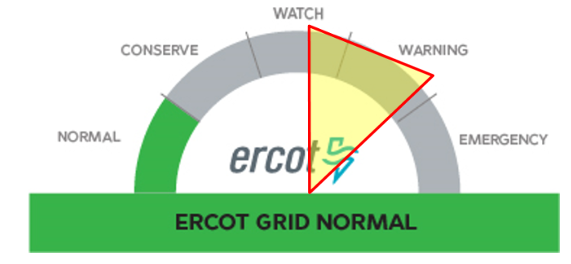
Manual curtailment of RCLs prior to EEA

Slide 5
Timeline
Complete Impact Analysis
Get internal approvals
Post NPRR, PGRR, RRGRR, NOGRR July
Meet and discuss LFLTF in July
Issues not yet addressed
Large Loads UFLS
Load 5 minute settlement
This item was discussed and was decided the item should be addressed outside LFLTF
Addresses the behavior of Loads that respond to price during the 15 minute settlements intervals
Credit impacts for Flexible Loads
Expected to be discussed in July Meeting

