Slide 1
CDR NPRR and MORA Status
Pete Warnken
Resource Adequacy
Supply Analysis Working Group
June 23, 2023

Slide 2
Status of NOPRs for the Capacity, Demand and Reserves Report

Slide 3
NPRR Status
Anticipate several NPRRs being submitted
First NPRR will address Effective Load Carrying Capability as a replacement for the current Peak Average Capacity Contribution method; this is the most impactful change
  Slides that follow show sample NPRR language for ELCC
  Will include most other methodology changes
  Targeting submission in July 2023
Second NPRR will address seasonal release schedule and other changes that heavily depend on system implementations; targeting submission in fall 2023
A separate NPRR is currently under development that addresses Large Loads across multiple areas (registration, interconnection, operations, markets, CDR, etc.)

Slide 4
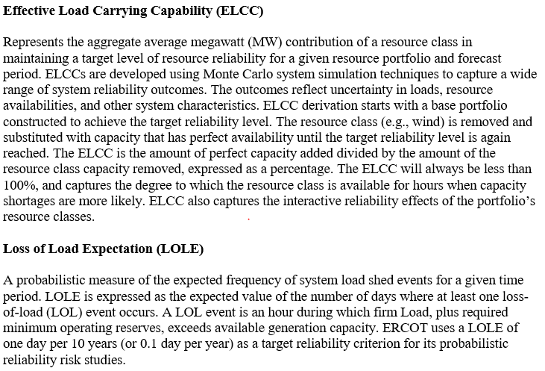
New ELCC Defined Terms: ELCC and LOLE

Slide 5
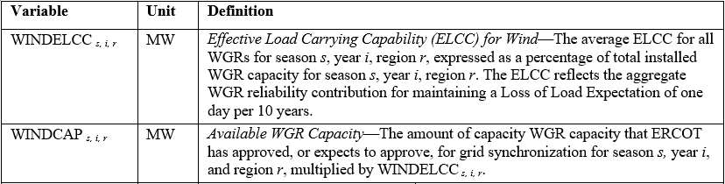
ELCC Study Requirement and Sample ELCC variables
3.2.6.2 Effective Load Carrying Capability Studies
Language on the ELCC study scope, frequency, stakeholder review process, and posting on ercot.com.

Slide 6
Monthly Outlook on Resource Adequacy
Mock-up

Slide 7
MORA Tabs
Summary
Detailed Resource Breakdown
Risk Assessment
Historical trends
  Month-to-month resource capacity growth
  Year-to-year monthly comparison
  Previous month’s actual vs forecasted demand and resources
Background
  Purpose
  Definitions
  Probabilistic Reserve Risk Model description
  Monthly release schedule
  Mock-up sections being shown today are preliminary, and some are not shown as they are still under construction

Slide 8
Mock-up: Summary Tab, Section 1

Slide 9
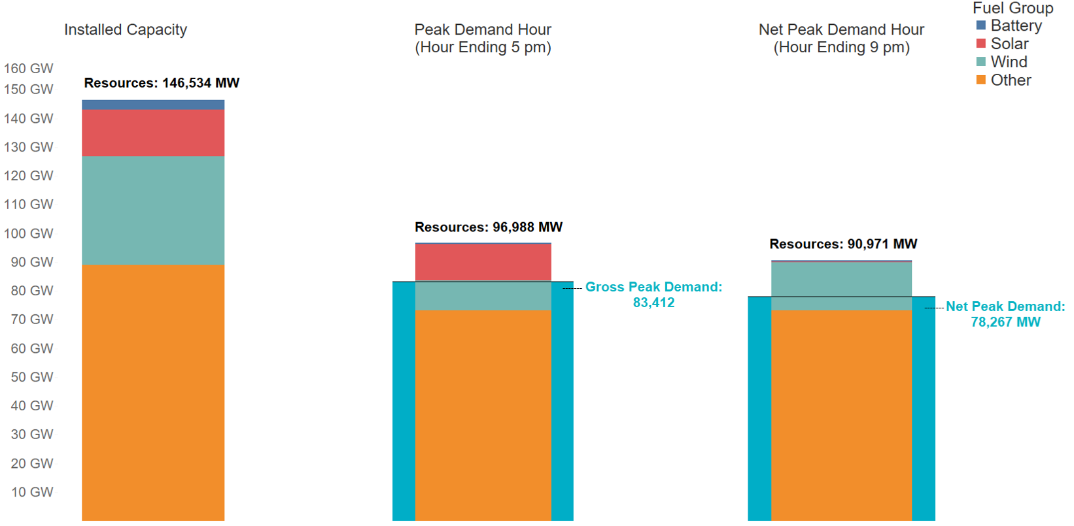
Mock-up: Summary Tab, Section 2
Demand & Resource Availability Summary for [Month] [Year]

Slide 10
Mock-up: Detailed Resource Breakdown Tab
Resource categories generally align with those listed in the Generator Interconnection Status (GIS) reports

Slide 11
Mock-up: CAFOR Ranges and Probabilities, Section 1

Slide 12
Mock-up: EEA Hourly Risk Profile, Section 2

Slide 13
Mock-up: Historical Trends Tab, Section 1

