Slide 1
ECRS Analysis and Deployment Review
Balancing Operations Planning Staff
June 2023
PDCWG

Slide 2
Overview
On April 3, 2023, ERCOT hosted an ECRS Market Readiness Workshop
Slides posted on workshop page cover detailed background on ECRS. These details the deployment of ECRS
Reminder ECRS can be deployed automatically for frequency deviation or manually for Net Load Ramps
On June 8th ERCOT cutover ECRS changes
On June 10th ECRS was carried in real-time for the first time
These slides will cover the 3 ECRS deployments that have occurred over the period of June10th – June 19th
Manual Deployments
6/14/2023 at 19:20
6/18/23 at 19:20
Auto Deployment
6/16/2023 at 18:31

Slide 3
Manual Deployments
6/14/2023 at 19:20
SCED Dispatchable MW Released: 600 MW
Deployment Duration: 12 minutes and 28 seconds
Min HDL – GEN: 1467.2
Max System Lambda: 136.9
Reason: Insufficient capability for forecasted 10min Ahead Net Load.
6/18/23 at 19:20
SCED Dispatchable MW Released: 200 MW
Duration: 25 minutes and 25 seconds
Min HDL – GEN: 1515.7
Max System Lambda: 873.8
Reason: Insufficient capability for forecasted 10min Ahead Net Load.
ERCOT is reviewing ECRS deployment periods to determine accuracy of forecasted net load and ramping capability calculations.

Slide 4
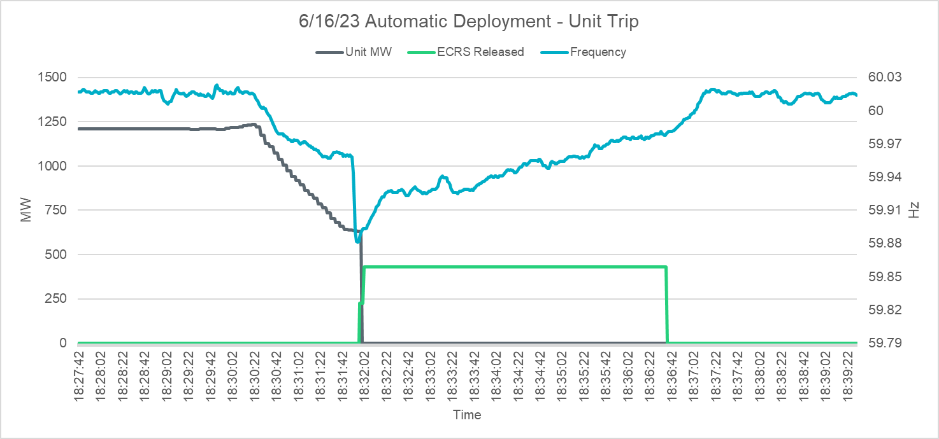
Automatic Deployment
6/16/2023 at 18:31
SCED Dispatchable MW Released: 430 MW
Duration: 4 minutes and 40 seconds
Reason: Frequency below 59.91Hz due to unit trip (~632 MW instantaneous, 1235 MW total)

Slide 5
ECRS QSE Performance
We are monitoring performance for:
QSE ECRS Schedule release
Expected Generation during ECRS deployment
ECRS Responsibility switching between Resources during and around deployment conditions
Overall performance for these 3 events looks good from the system perspective, but there are a few outliers that will require some follow up.
We will continue to review performance as more events occur and provide guidance to QSE as needed.

Slide 6
Questions?

