Slide 1
ERCOT Frequency Control Report
May 2023
ERCOT
Operations Planning
PDCWG | June 21st, 2023

Slide 2
Summary of May 2023
CPS1: 173.97%
Current CPS1 12-Month Rolling Average: 174.24%
0 BAAL Exceedance(s)
4 hourly CPS1 score below 100%
BAAL-003 Events have updated through 2022
2022 BAAL-003 FRM Performance: -1060.40
2023 RMS1 Statistics
  Mean: 14.82 mHz
  Min: 11.76 mHz
  Max 18.7mHz
Energy Statistics
  Total Energy: 36,636,987 MWh
  Wind Energy: 7,430,115 MWH
  Percent Energy from Wind: 20.28%
  Solar Energy: 3,019,271 MWh
  Percent Energy from Solar: 8.24%
Minimum System Inertia
  Mean: 233,598 MW*s
  Max: 276,88 MW*s on May 16th
  Min: 170,359 MW*s on May 1st

Slide 3
Frequency Control
CPS1, BAAL, & RMS1

Slide 4
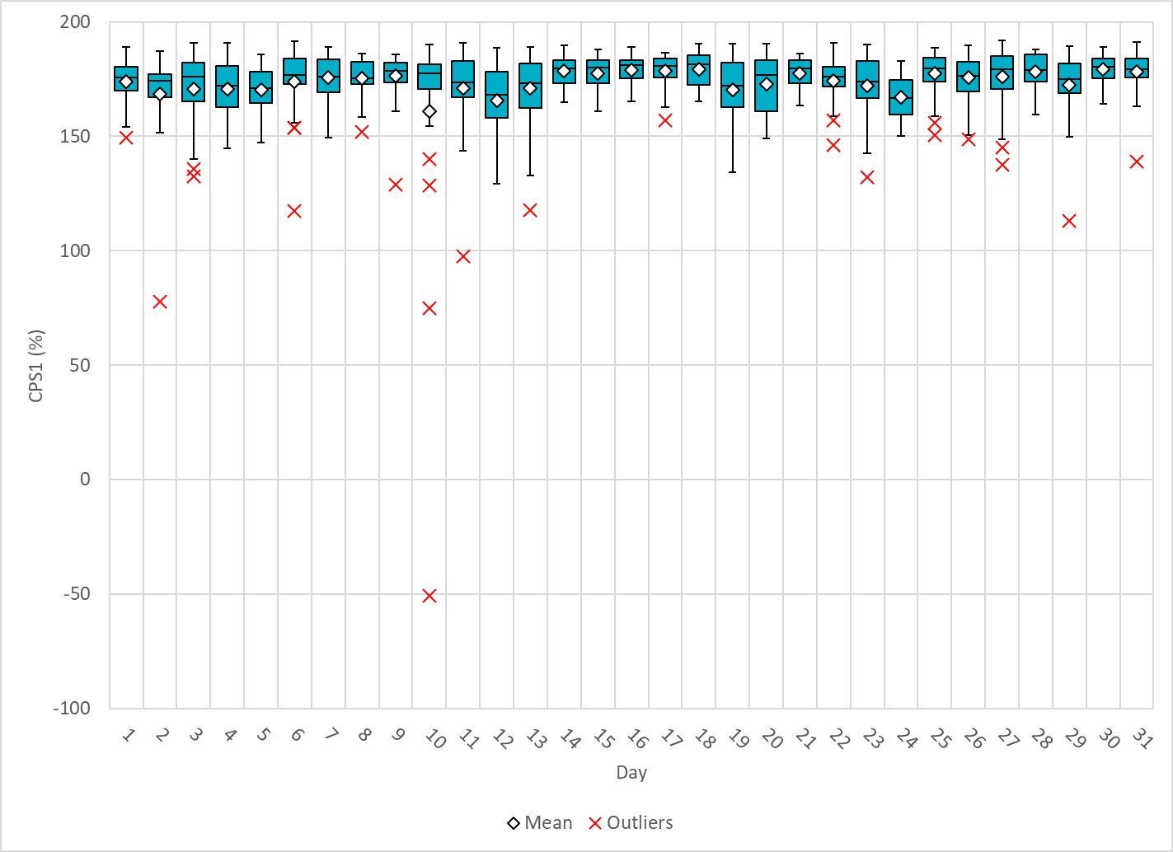
Hourly CPS1 by Day
May-23 CPS1 (%): 173.97
Notes:
77.75 @ 5/2/2023 HE:24
Expected Generation Deviation: Expected generation deviation remained negative throughout this period, The largest expected generation deviation was -1700 MW @11:56 PM with significant contribution wind generation.
IRR Ramps
Between 23:00 and 24:00,. Wind generation ramped down by ~5213MW
Regulation: A total of 149 MW of Regulation Up was deployed and exhausted during this period.
OTHER: SCED was run multiple times and several SCED offsets were applied with highest offset being 400 MW.
2. 75.03 @ 5/10/2023 HE 3:00 and -50.65%@ 5/10/2023 HE 4:00
Expected Generation Deviation: Expected generation deviation remained negative throughout this period, The largest expected generation deviation was -3450 MW @3:32 AM with significant contribution wind generation.
IRR Ramps
Between 2:00 AM and 4:00 AM. Wind generation ramped down by ~6850 MW
Regulation: A total of 216 MW of Regulation Up was deployed and exhausted during this period.
OTHER: SCED was run multiple times and several SCED offsets were applied with highest offset being 500 MW.
3. 97.68 @5/11/2023 HE 20
Expected Generation Deviation: Expected generation deviation remained negative throughout this period, The largest expected generation deviation was -2500 MW @7:22 PM PM with significant contribution solar and wind generation.
IRR Ramps
Between 7:00 PM and 8:00 PM, Solar generation ramped down by ~5700 MW and at the same time, Wind generation ramped down by ~2576 MW
Regulation: A total of 476 MW of Regulation Up was deployed and exhausted during this period.
OTHER: SCED was run multiple times and manual offset of 300 MW was applied.

Slide 5
BAAL Exceedances & Violations
There were 0 BAAL exceedance(s) in May.

Slide 6
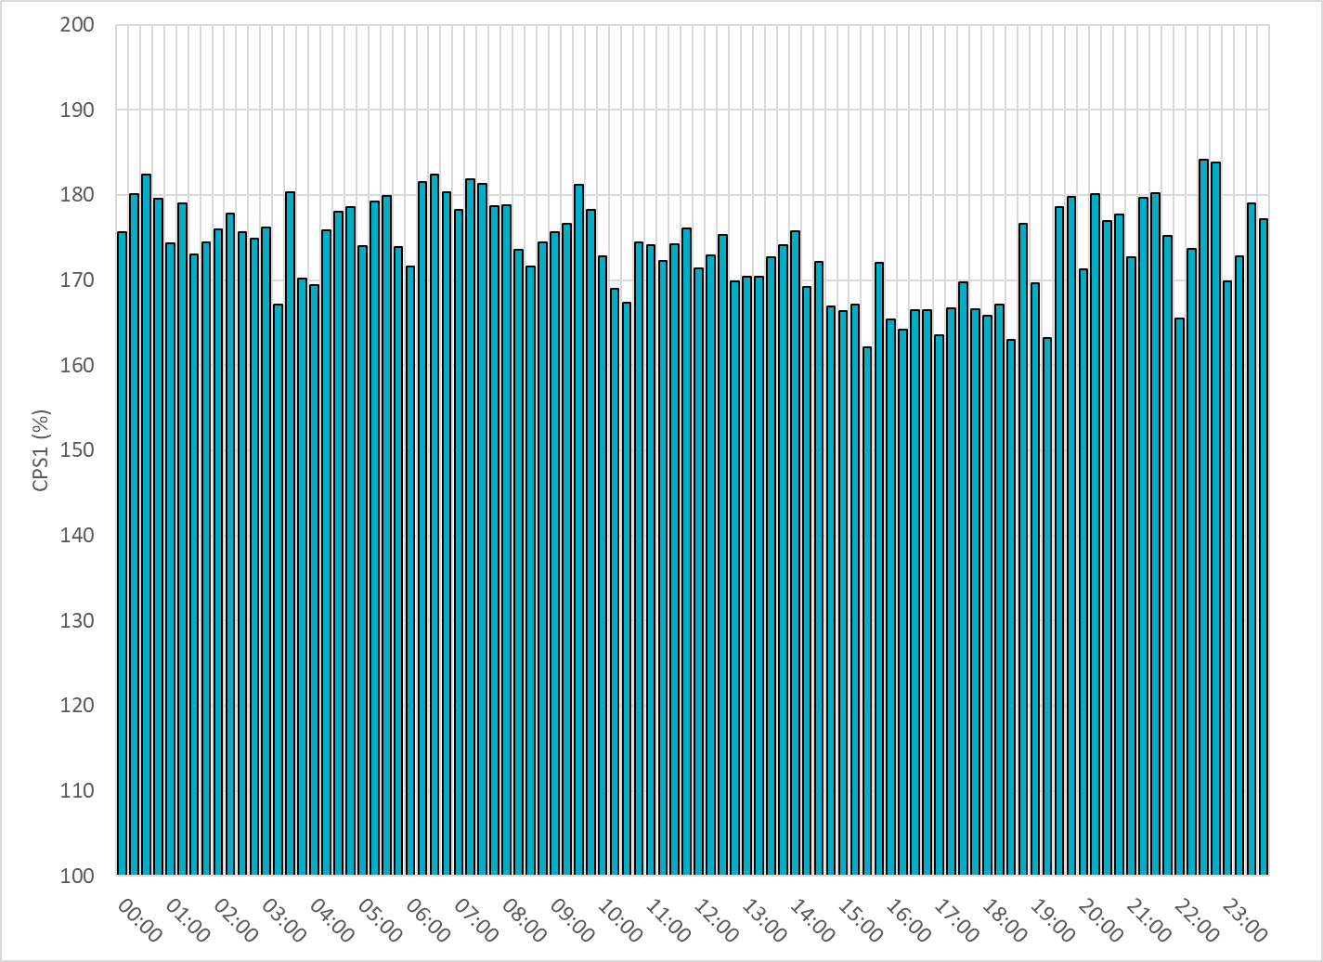
15-Minute Average CPS1%
May-23 CPS1 (%): 173.97
Notes:
Overall the 15 min CPS1 score is consistently above 160

Slide 7
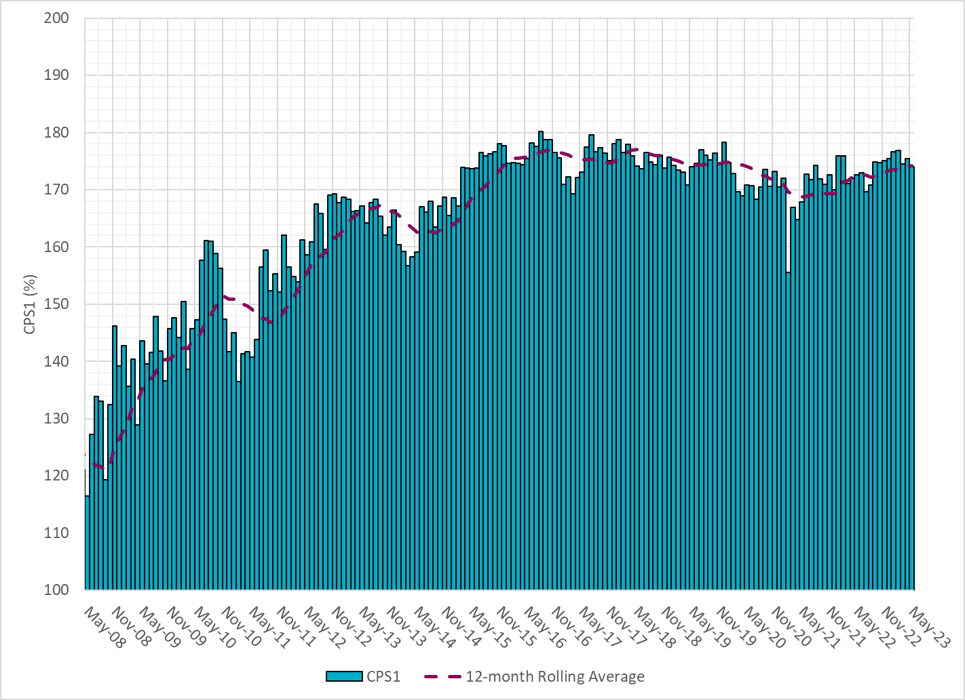
12-Month Rolling Average CPS1
Current 12-Month Rolling Average: 174.24%
Notes:
12 month rolling average CPS1 score is 173.48, which is in line with expectations, and the CPS1 score for Jan is slightly higher than the last month.

Slide 8
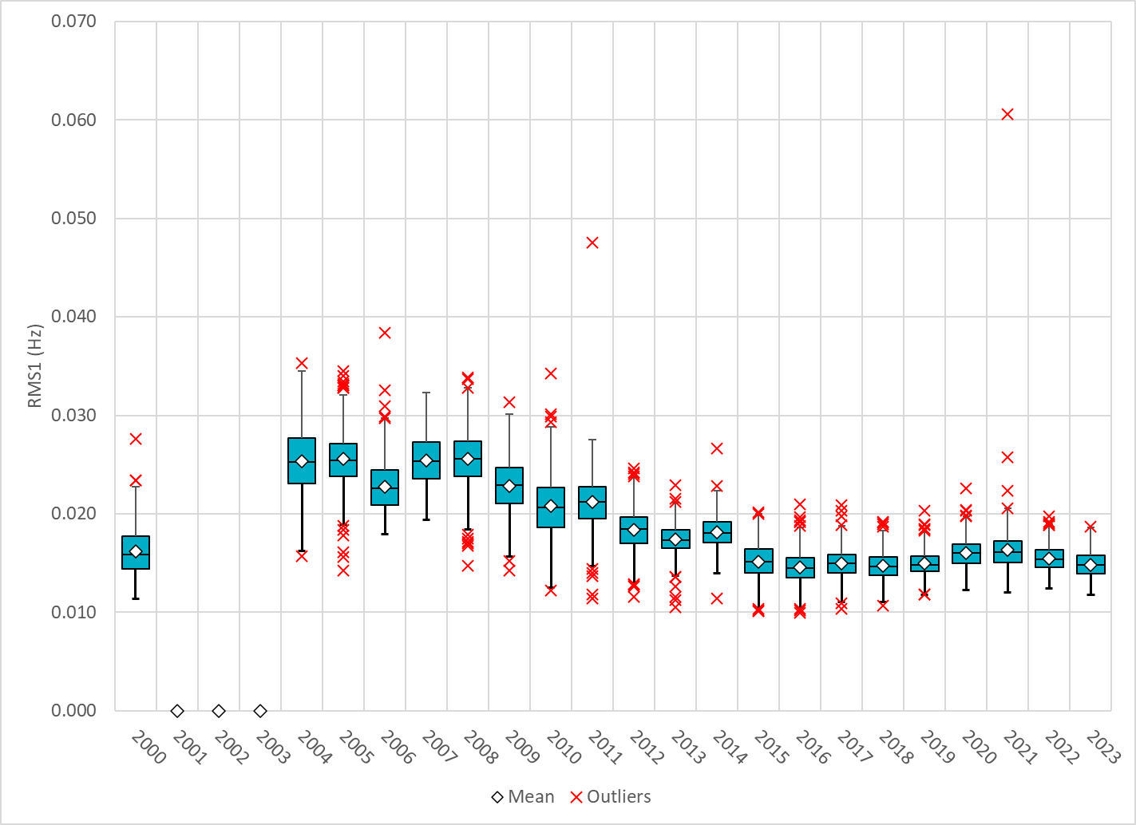
Daily RMS1 of ERCOT Frequency by Year
Notes:
Daily RMS1 frequency by year is so far slightly smaller overall compared with 2022.
Mean: 14.82 mHz
Min: 11.76 mHz
Max 18.7mHz

Slide 9
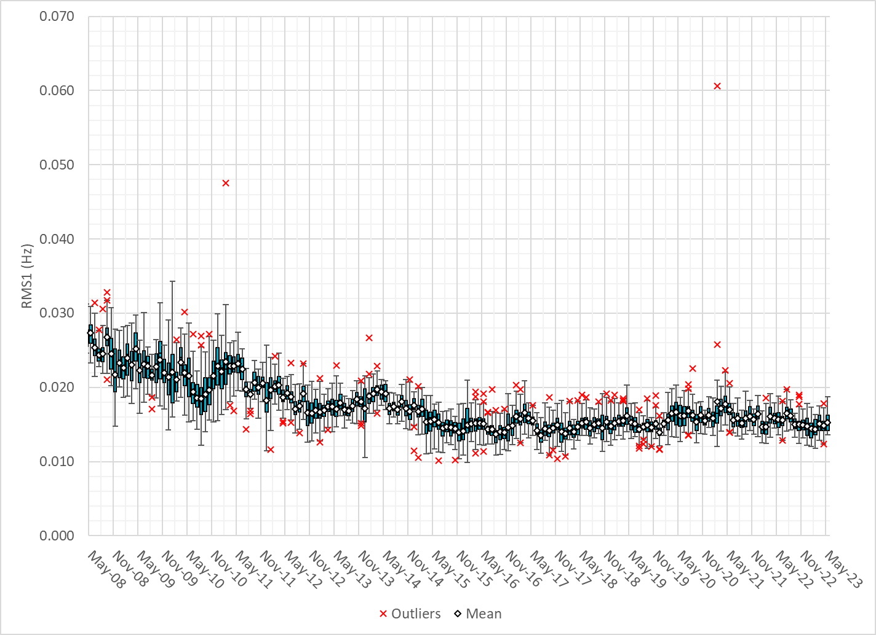
Daily RMS1 of ERCOT Frequency by Month
Notes:
A More granular look at last 15 years of RMS1 by month
15.28 mHz on avg for May 2023

Slide 10
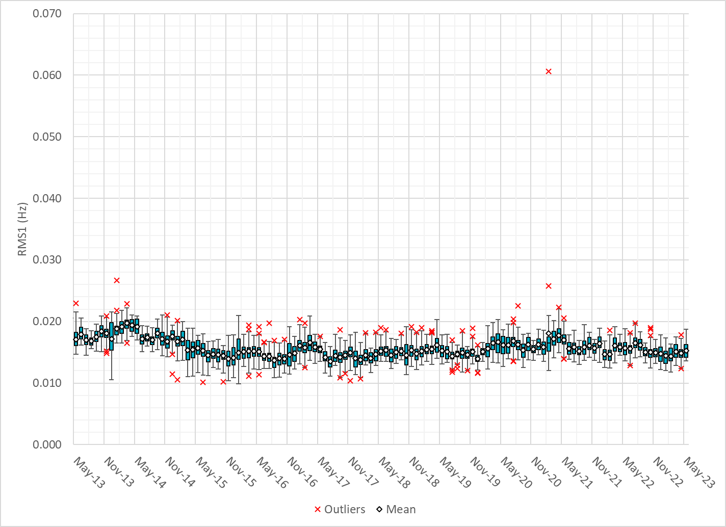
Daily RMS1 of ERCOT Frequency by Month
Notes:
Same data with 10 years shown instead of 15

Slide 11
Frequency Profile Comparison

Slide 12
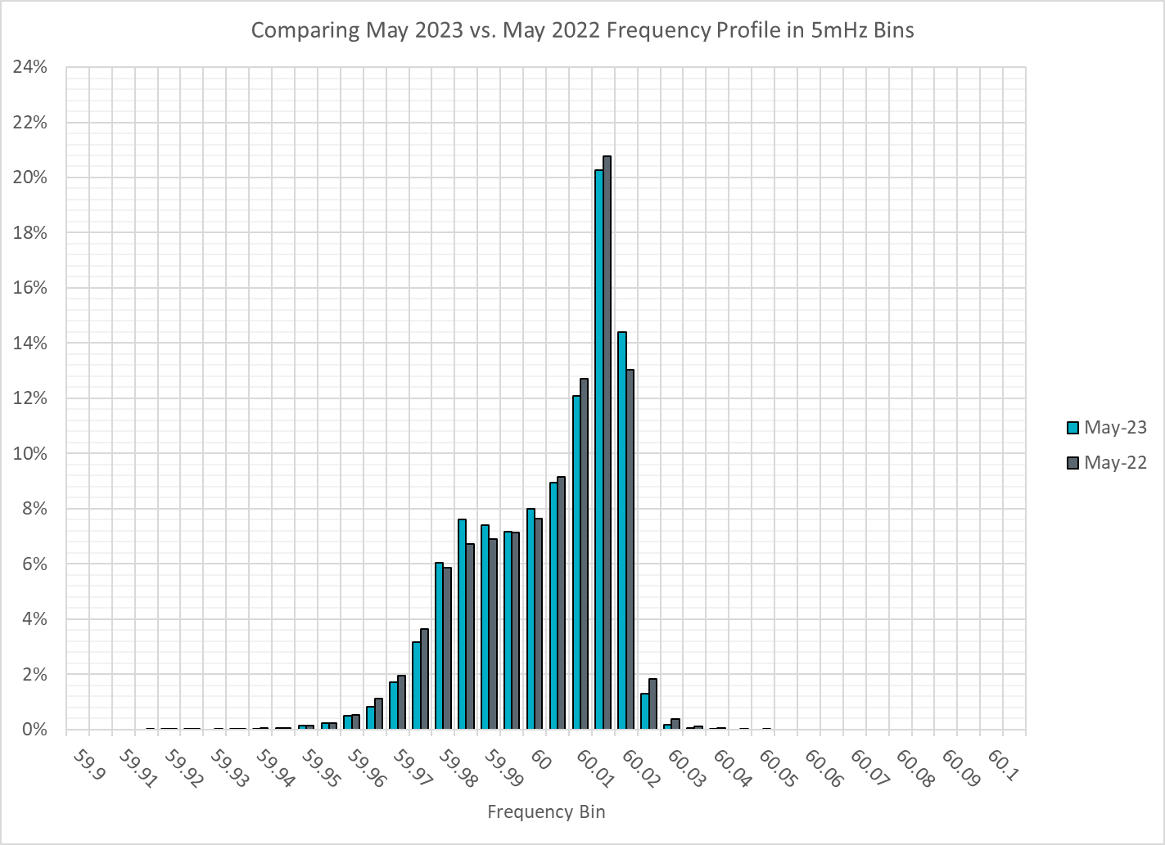
Frequency Profile Comparison
Notes:
Comparison of frequency profile between March 2022 and Mar 2023, we see fewer instances of frequency hovering at or below the lower deadband in March 2023.

Slide 13

Frequency Profile Comparison
Notes:
Comparison of frequency profile between Mar 2021 and Mar 2023, we see fewer instances of frequency hovering well below the lower deadband in Marc 2023, and significantly fewer instances of frequency crossing the higher deadband in March 2023.

Slide 14
Time Error Correction

Slide 15
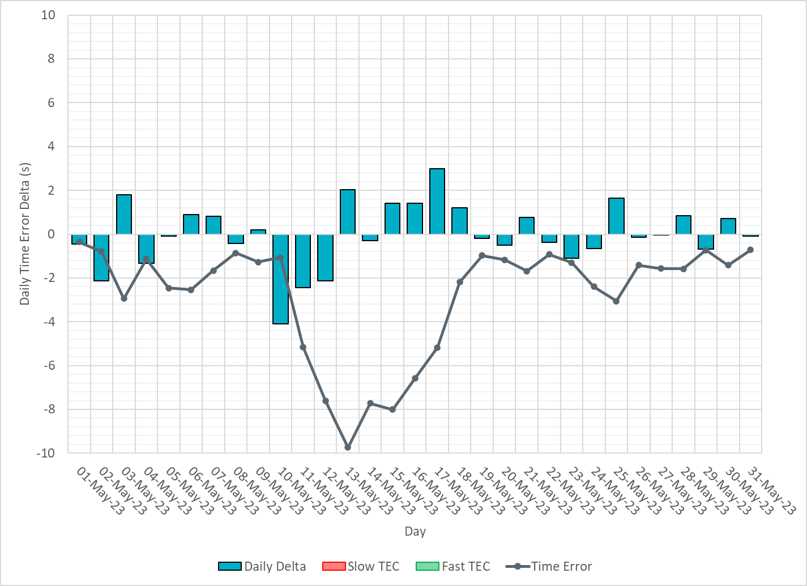
ERCOT Daily Time Error
Notes:
The time error remained negative in May. We see time error accumulation from 5/10/23 due to the steep wind down ramp on 5/10 HE1 – HE4. We have also noticed Wind down ramps on 5/11-5/13 which lead to time error.

Slide 16
Time Error Corrections Log Summary
There have been no time error corrections since December 2016

Slide 17
BAL-003 Performance

Slide 18
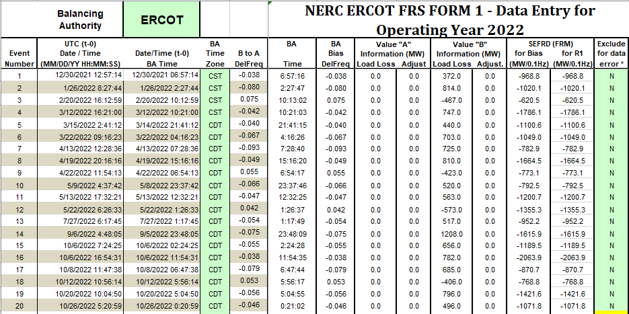
Op. Year 2022 BAL-003 Selected Events – Update
Notes:
BAL-003

Slide 19
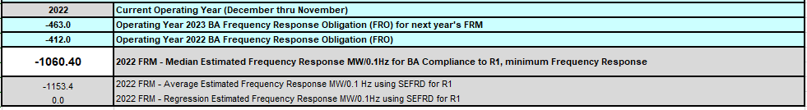
Op. Year 2022 BAL-003 FRM Performance - Update
Notes:
OP2018: FRO = -381.0, FRM_median = -843.17, FRM_average = -959.7
OP2019: FRO = -381.0, FRM_median = -811.14, FRM_average = -892.5
OP2020: FRO = -425.0, FRM median = -789.34, FRM average = -879.0
OP2021: FRO = -471.0, FRM median = -913.56, FRM average = -992.
OP2022: FRO = -463.0, FRM median = -1060.40, FRM average = -1153.4

Slide 20
ERCOT Energy Statistics

Slide 21
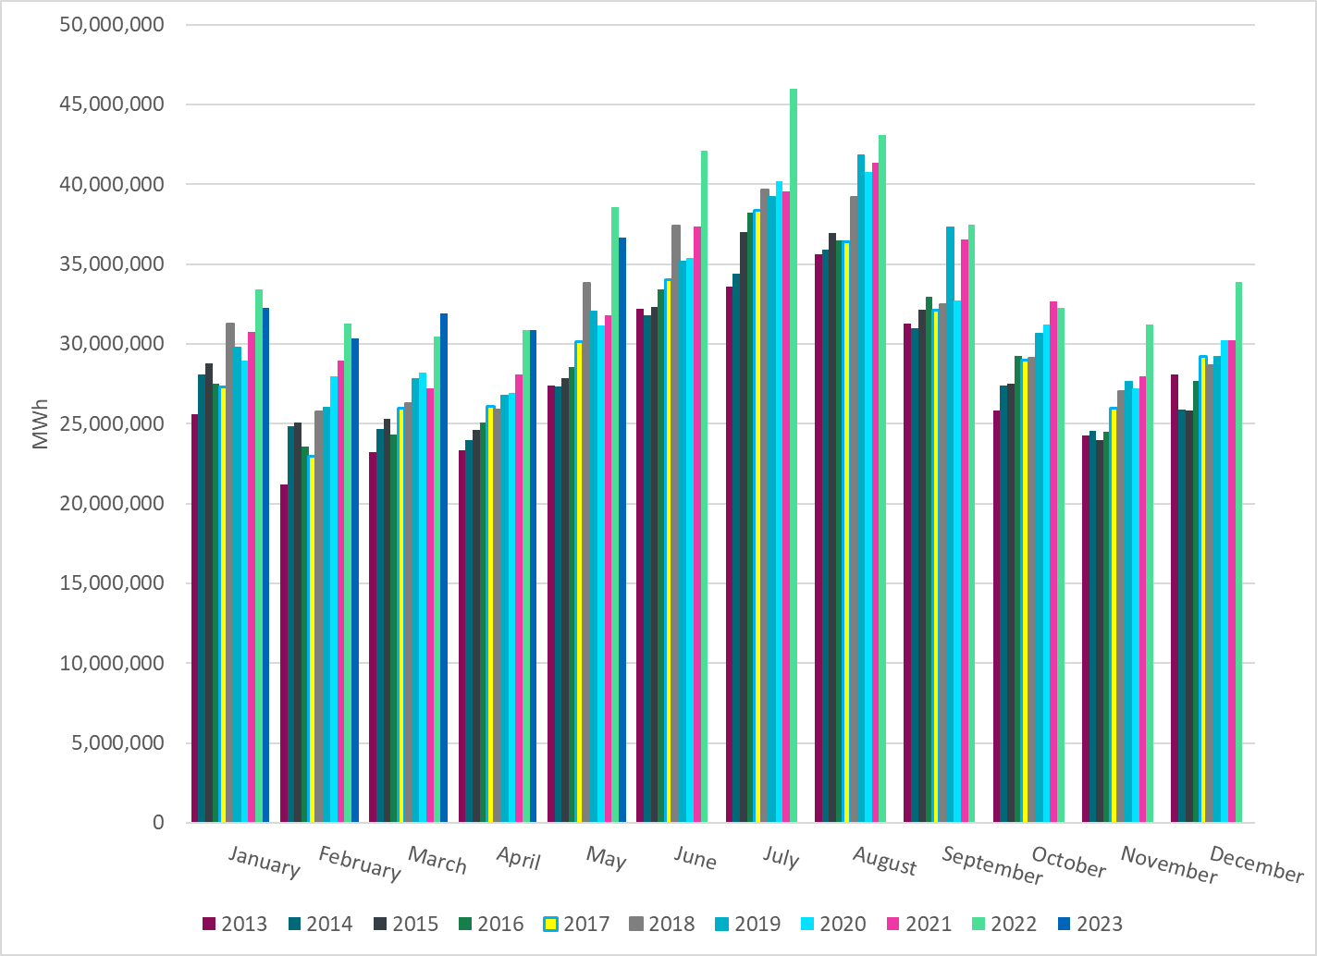
Total Energy
Notes:
366,369,87 MWh

Slide 22
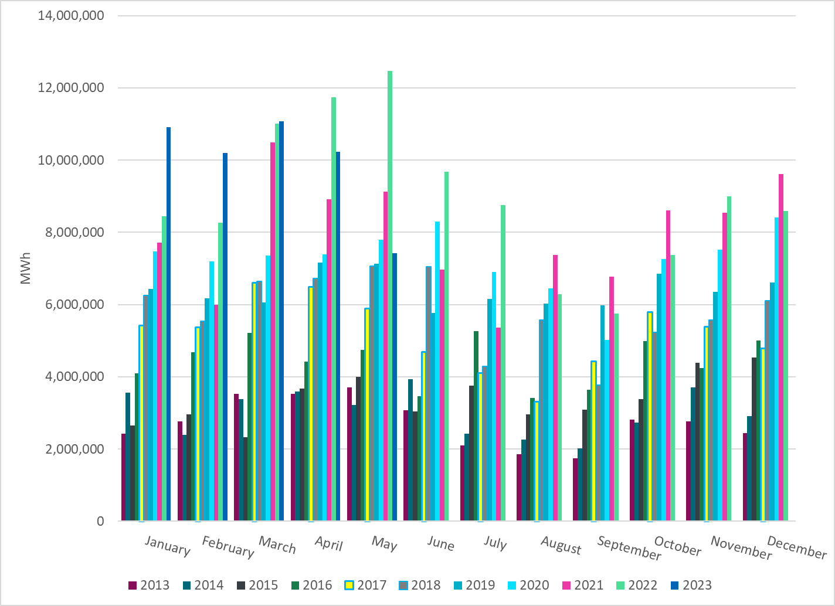
Total Energy from Wind Generation
Notes:
743,011,5 MWH

Slide 23
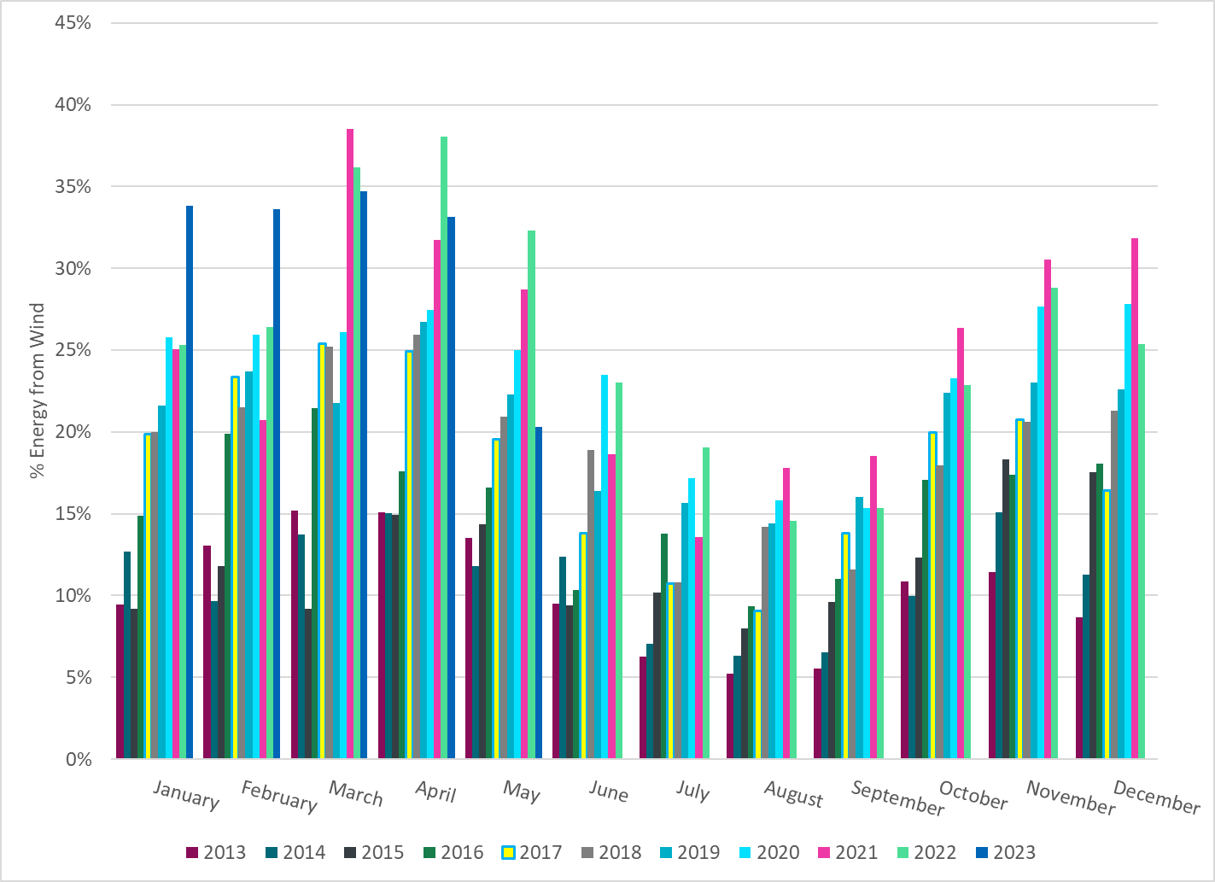
% Energy from Wind Generation
Notes:
20.28%
of total energy was provided by wind generation

Slide 24
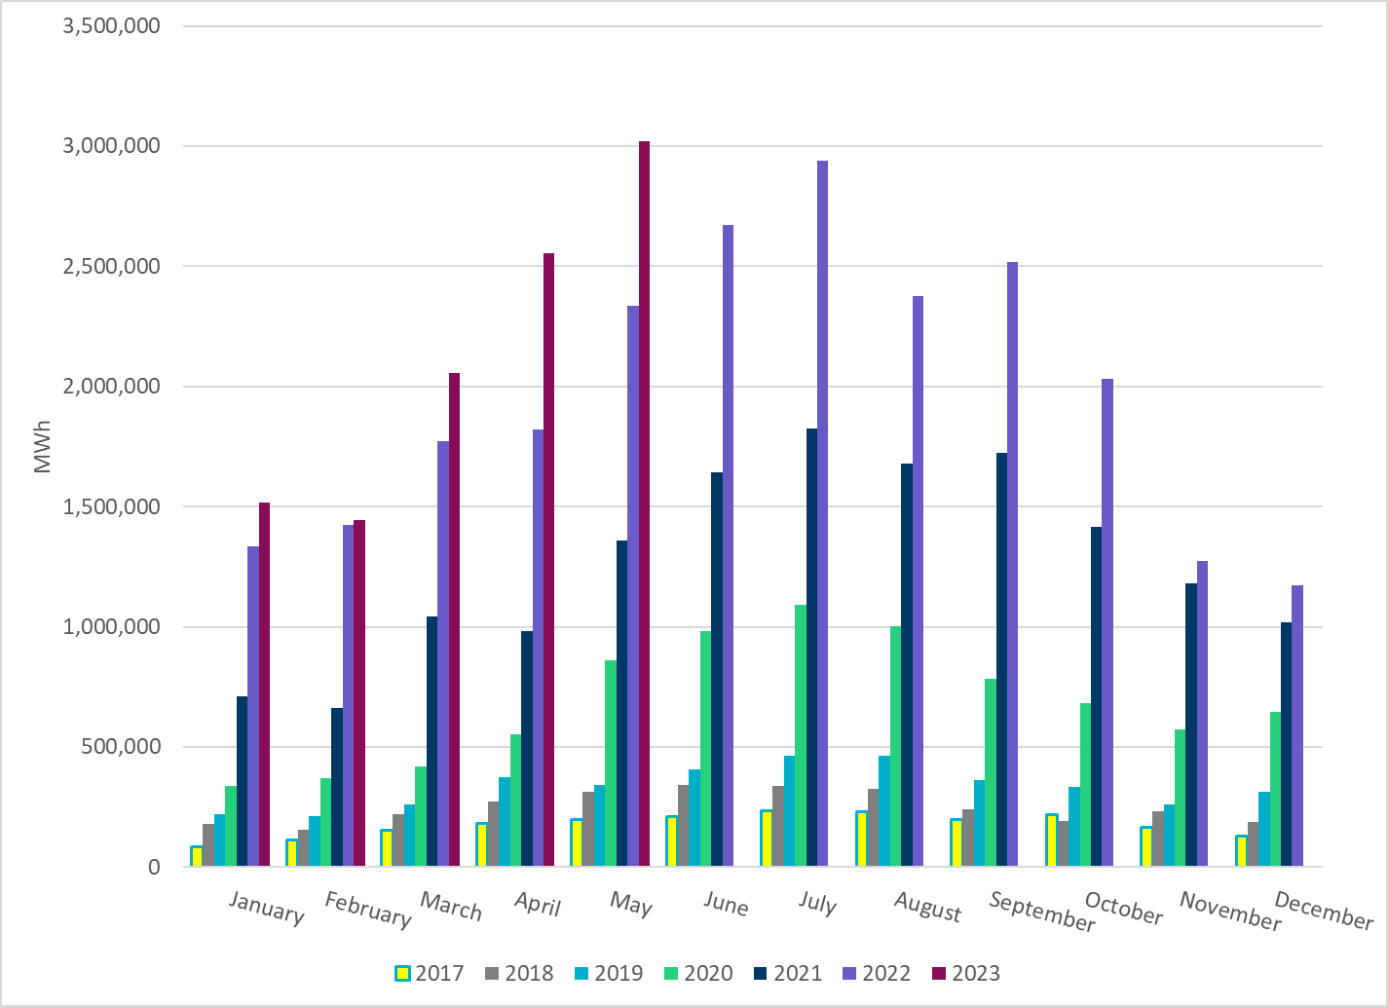
Total Energy From Solar Generation
Notes:
301,927,1 MWh

Slide 25
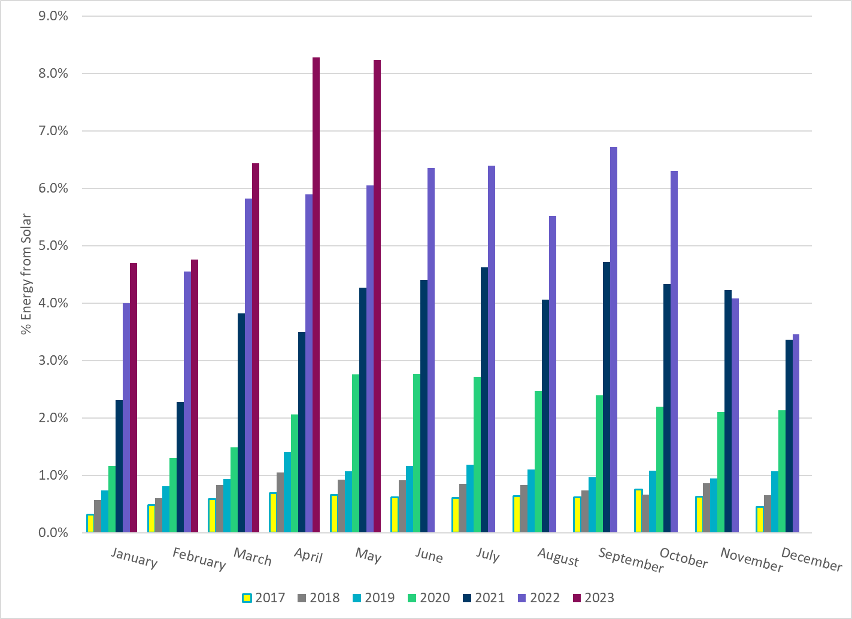
% Energy from Solar Generation
Notes:
8.24% of total
energy was provided by solar generation, which is highest solar penetration level so far.

Slide 26
ERCOT System Inertia

Slide 27
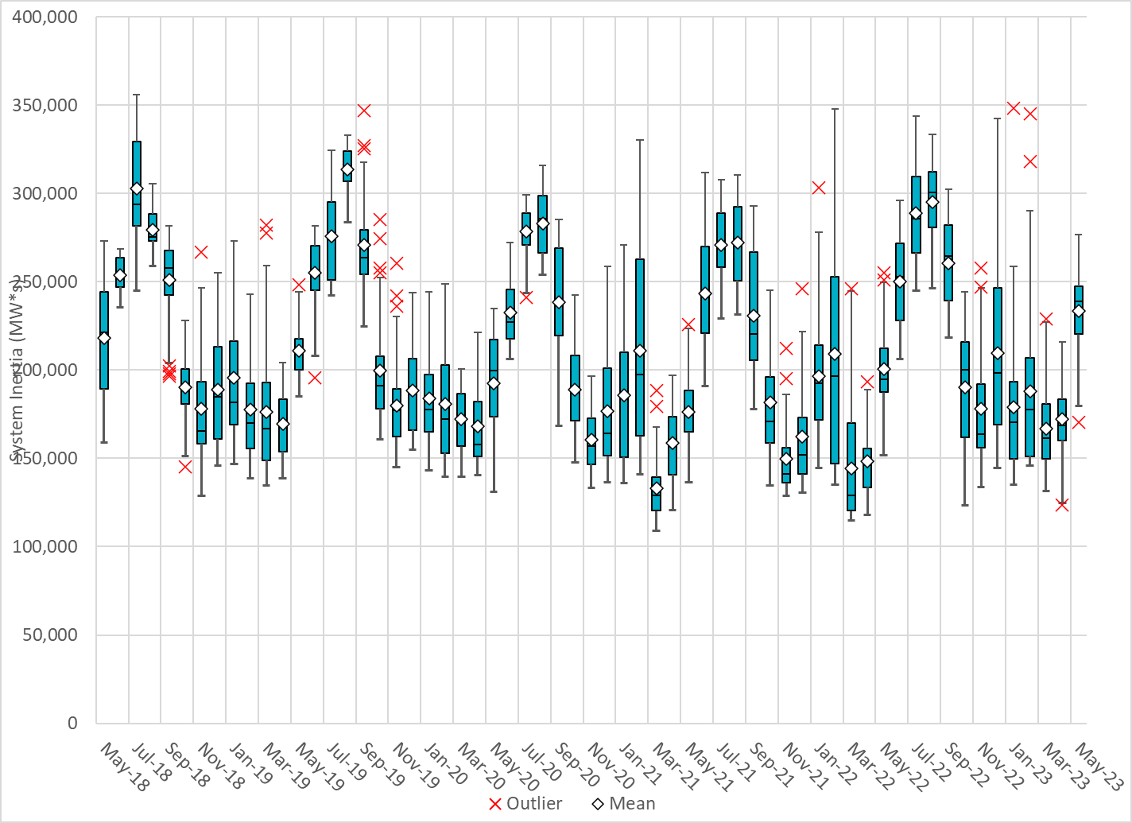
Daily Minimum System Inertia
Notes:
Minimum Inertia =170,359 MW*s on 5/1/2023
Previous Minimum was 109,029 MW*s on 3/22/2021
Data:
Mean: 233,598 MW*s
Max: 276,88 MW*s on May 16th
Min: 170,359 MW*s on May 1st

Slide 28
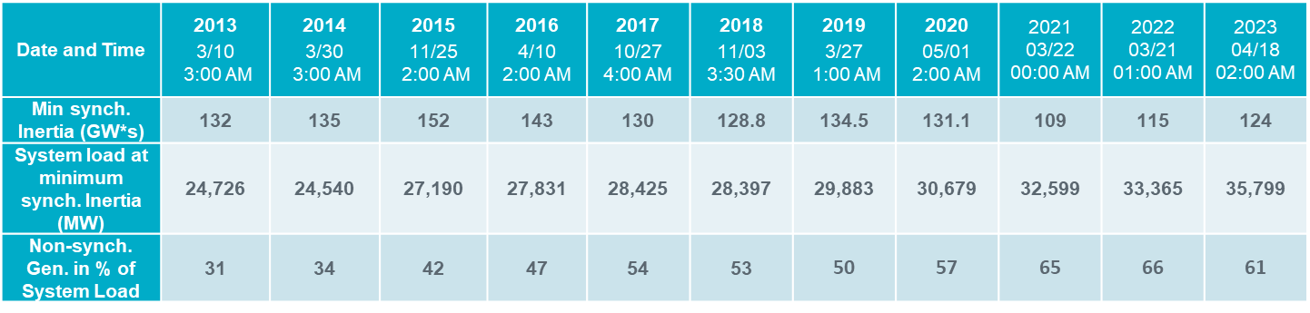
ERCOT Inertia 2013-2023
Notes:
For each box, the central mark (red line) is the median, the edges of the box (in blue) are the 25th and 75th percentiles, the whiskers correspond to +/- 2.7 sigma (i.e., represent 99.3% coverage, assuming the data are normally distributed. The corresponding lowest inertia in each year is given in the table.
The circle on each boxplot is showing inertia during time when highest portion of load was served by wind/solar generation in that year.

Slide 29
Questions?
Thank you!

