Slide 1
ERCOT Frequency Events
May 2023
ERCOT
Operations Planning
PDCWG |June 21st, 2023

Slide 2
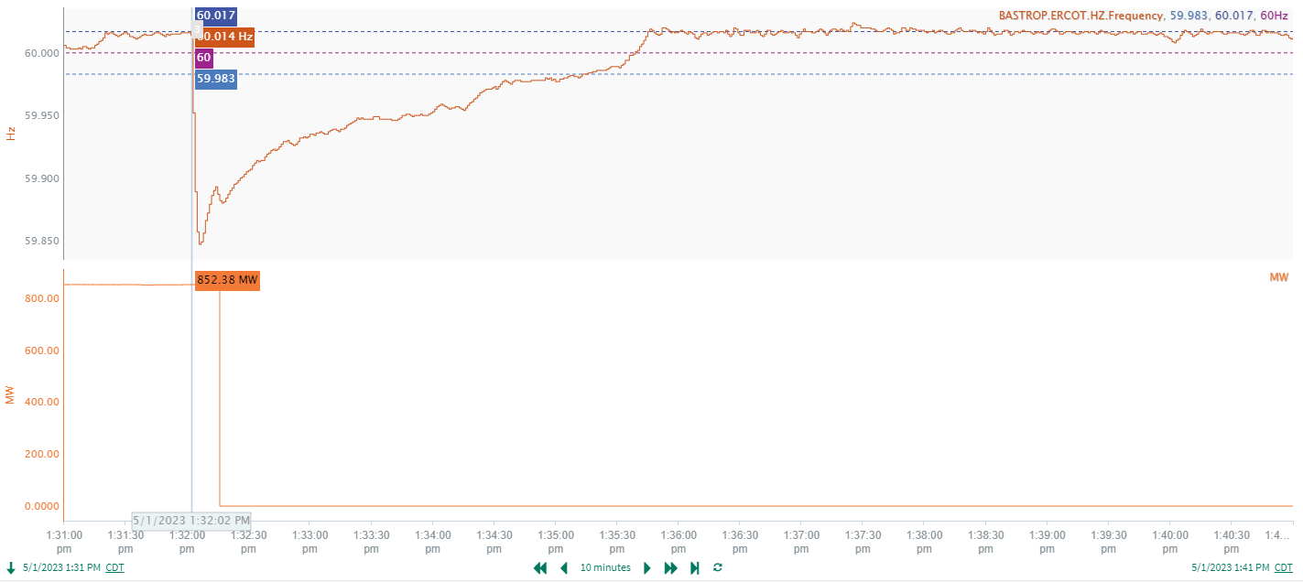
5/1/2023 13:32:02 (FME)
Notes:
A unit tripped offline while carrying approximately 852MW gen
Starting Frequency: 60.014Hz
Minimum Frequency: 59.9847 Hz
A-C Time : 4 seconds
Recovery Time(back to deadband): 3 minutes 11 seconds
RRS Released: 664 MW
Trip Reason: Unknown.
Contextual Information: A total of 332 MW of regulation Up was deployed during the event. Two manual SCED runs.

Slide 3
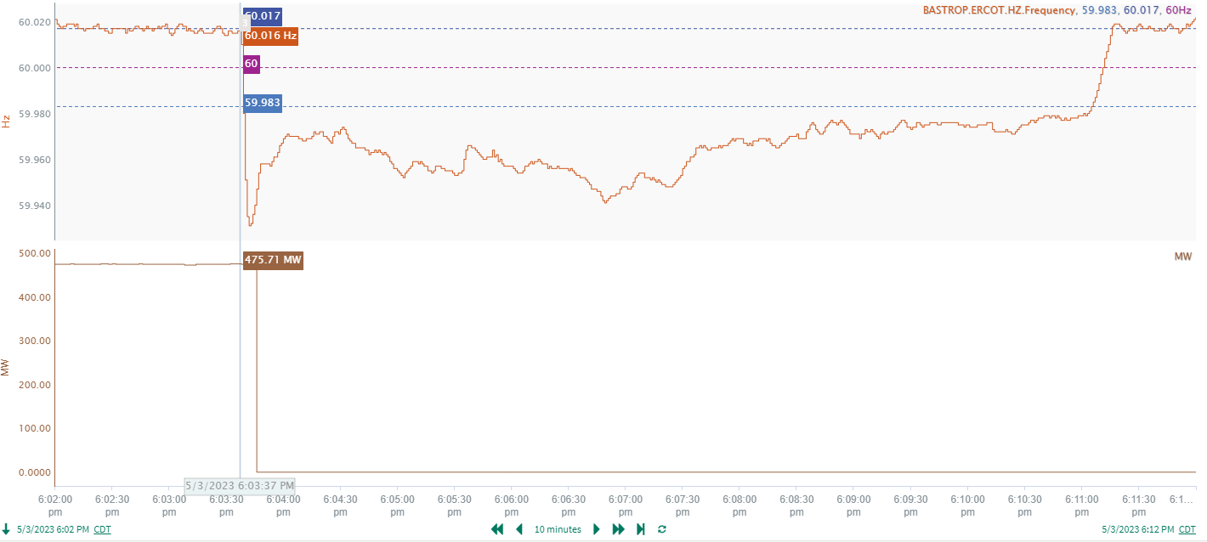
5/3/2023 18:03:37 (Non-FME)
Notes:
A unit tripped offline while carrying approximately 476MW gen
Starting Frequency: 60.016Hz
Minimum Frequency: 59.931 Hz
A-C Time : 5 seconds
Recovery Time(back to deadband): 7 minutes 28 seconds
RRS Released: 0 MW
Trip Reason: Primary air fan dampers failed
Contextual Information: A total of 476 MW of regulation Up was deployed during the event.

Slide 4
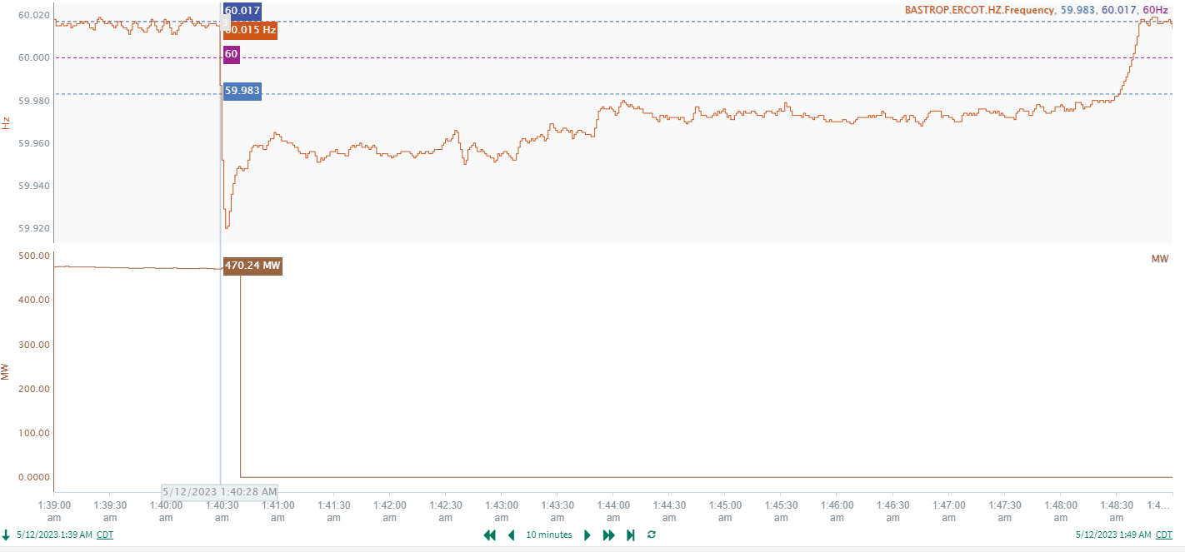
5/12/2023 1:40:28 (Non-FME)
Notes:
A unit tripped offline while carrying approximately 470MW gen
Starting Frequency: 60.015Hz
Minimum Frequency: 59.92 Hz
A-C Time : 4 seconds
Recovery Time(back to deadband): 8 minutes 3 seconds
RRS Released: 0 MW
Trip Reason: Unknown
Contextual Information: A total of 176 MW of regulation Up was deployed during the event.

Slide 5
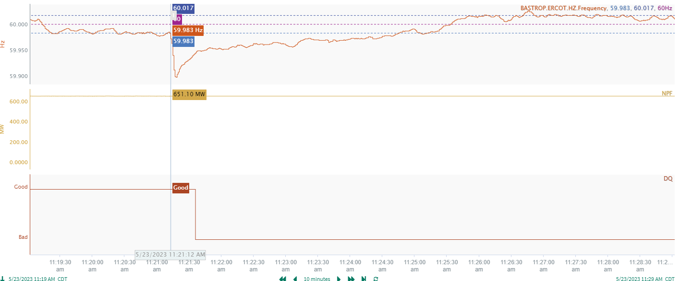
5/23/2023 11:21:12 (Non-FME)
Notes:
A unit tripped offline while carrying approximately 651MW gen
Starting Frequency: 59.983Hz
Minimum Frequency: 59.898 Hz
A-C Time : 6 seconds
Recovery Time(back to deadband): 3 minutes 33 seconds
RRS Released: 263 MW
Trip Reason: Unknown
Contextual Information: A total of 562 MW of regulation Up was deployed during the event
A 200 MW SCED offset was applied as well.

Slide 6
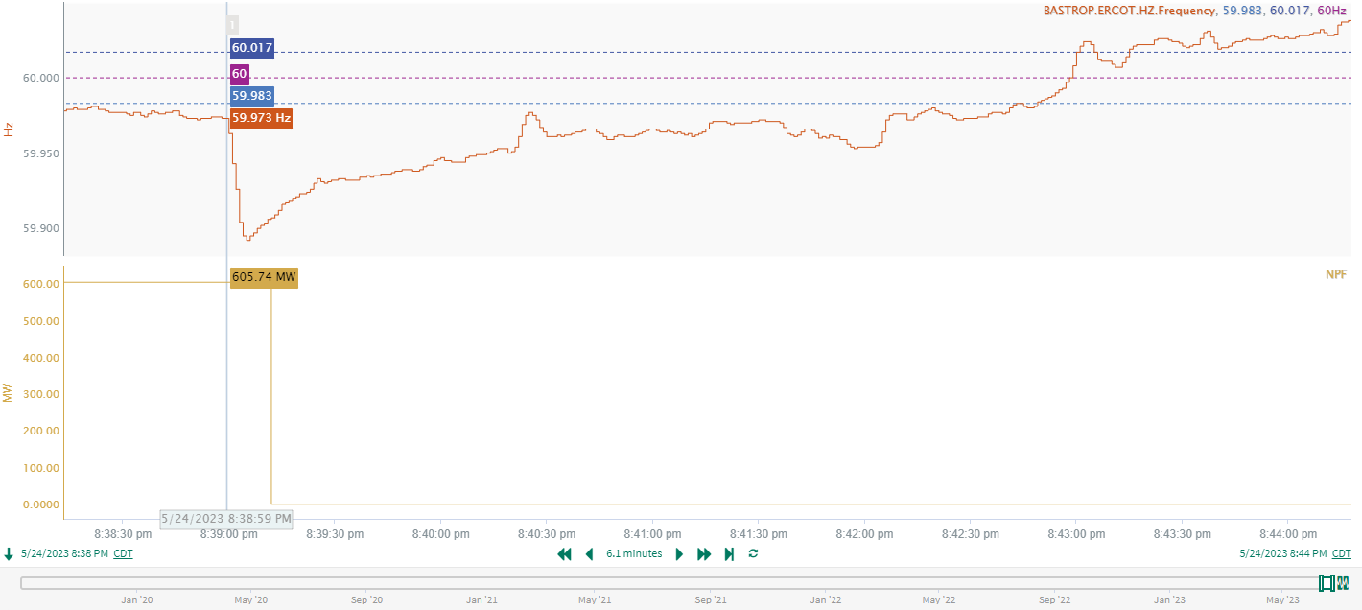
5/24/2023 20:38:59 (Non-FME)
Notes:
A unit tripped offline while carrying approximately 605MW gen
Starting Frequency: 59.973Hz
Minimum Frequency: 59.892 Hz
A-C Time : 6 seconds
Recovery Time(back to deadband): 3 minutes 44 seconds
RRS Released: 455MW
Trip Reason: Unknown.
Contextual Information: A total of 339 MW of regulation Up was deployed during the event
A 200 MW SCED offset was applied as well.

Slide 7
Questions?
Thank you!

