Slide 1
Dynamic Predicted Solar Ramp Rate in GTBD Calculation
ERCOT
Operations Planning
PDCWG | June 21st, 2023

Slide 2
Overview – Static Threshold of Predicated Solar Ramp Rate (PSRR) in GTBD
ERCOT added PSRR in GTBD calculation with a threshold of 10MW/min on 6/1/2021 .
Over the last 2 years, ERCOT has increased this threshold to 40MW/min.

Slide 3
Actual Solar Ramp Rate (4/1/2023-6/1/2023)
Sunrise
Sunset

Slide 4
Overview – Dynamic PSRR Threshold in GTBD
ERCOT started to apply a dynamic PSRR threshold in GTBD calculation on 6/12/2023
PSRR thresholds change with 4 pre-defined day periods - Night, Sunrise, Sunset and Other
ERCOT started with a threshold of 80MW/min for Sunrise and Sunset periods on 6/12 and subsequently increased it to 100MW/min on 6/15
ERCOT plans to update the thresholds and the definition of day periods seasonally* (4 times a year)
Night
* Seasons will be defined by shift in solar ramping patterns

Slide 5
% Intervals* Benefitted from Increased Threshold
*Intervals benefited :
Intervals with | PSRR | > 40 MW/min, when | actual solar ramp | >40MW/min

Slide 6
Appendix

Slide 7
Seasonal Update
Spring
Summer
Fall
Winter
Winter
Each season has its own definition of 4 different periods of a day (Update if needed)
Four different caps per season
  Night : 0 MW/min
  Sunrise: Updated seasonally based on Installed Capacity Change
  Other: 40MW/min (current Cap)
  Sunset :Updated seasonally based on Installed Capacity
Mock-Up Table
 | Winter | Spring | Summer | Fall
Night | 0 | 0 | 0 | 0
Sunrise | 60 | 70 | 74 | 62
Other | 40 | 40 | 40 | 40
Sunset | 68 | 80 | 84 | 72
Night | 0
Sunrise | 1
Other | 3
Sunset | 2
Winter: Nov (Post DST) - Feb
Spring: Mar (Pre DST)
Summer: Mar (Post DST) - Aug
Fall: Sep - Nov(Pre DST)

Slide 8
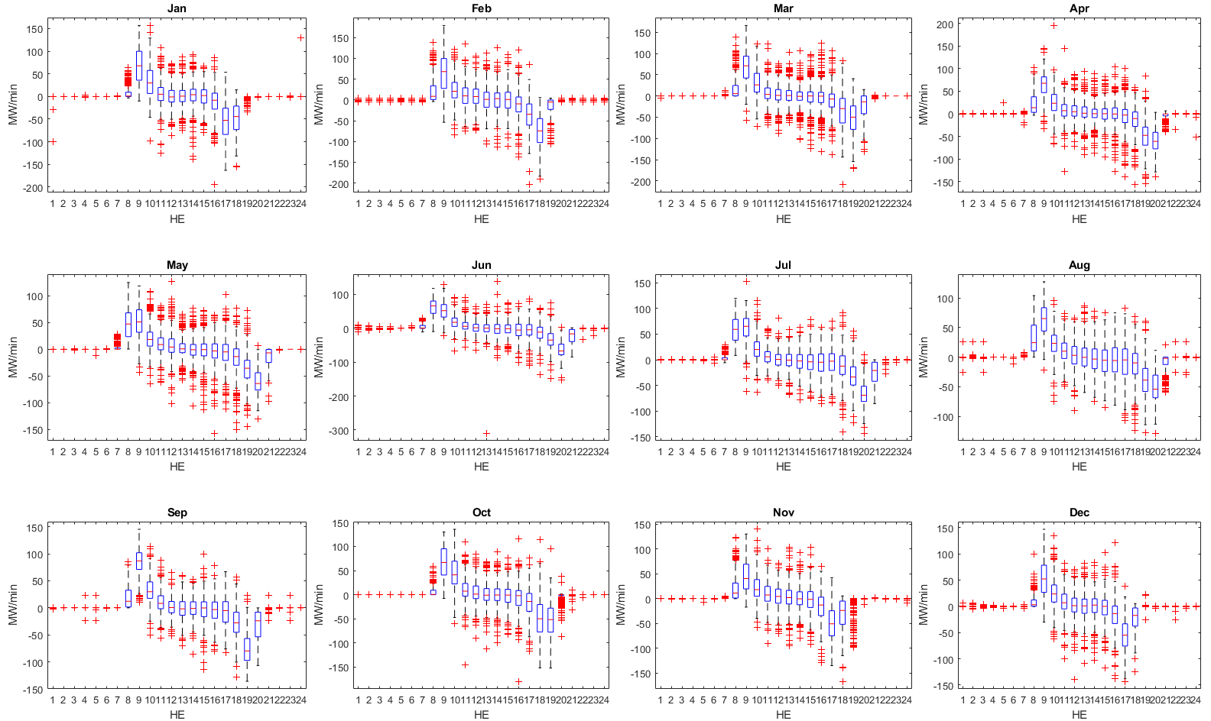
Actual Solar Ramp Boxplot (March 2022-March 2023)

