Slide 1
ERCOT Updates
NDSWG June 2023
ERCOT
6/20/2023

Slide 2
Topics
Project Updates
Manual Contingency Review Kickoff
Training
Supplemental Slides
  Planning node/breaker changes
  NPRR1164 background

Slide 3
Project Overview
Active/Upcoming Projects
  NMMS Tech Health Upgrade
    Officially closed this month
  SCR789 Node/Breaker Modeling for SSWG
    Will require coordination between Operations modelers and Planners
    Deadline for TDSP-provided data updates is 9/1
  Upgrade to NMMS RHEL Operating System
    Scheduled to start this month
    Upgrades the OS of additional NMMS systems
  Upgrade to CIM16
    Scheduled to start in July
    Upgrades the NMMS database schema to meet the CIM16 standard
    Updates the format of the XML models and incremental files

Slide 4
CIM16 Project – Upgrading from CIM10 to CIM16
ERCOT produces Network Models following CIM standards and in an XML format
  Since 2010, the Network Model Management System (NMMS) produces models using the CIM10 schema (with customizations)
  In 2021, a process was developed a post-process to translate a CIM10 models into CIM16 allowing for downstream systems to upgrade their importers
ERCOT is formalizing a project to enhance NMMS to natively produce CIM16 model files
  Reduce the need for ERCOT-specific legacy code in vendor applications
  Currently collecting vendor estimates and determining resource loading
  Tentatively scheduled to start in first half of 2023
  Project duration is estimated at 18-24 months
ERCOT will no longer produce CIM10 models after project completion

Slide 5
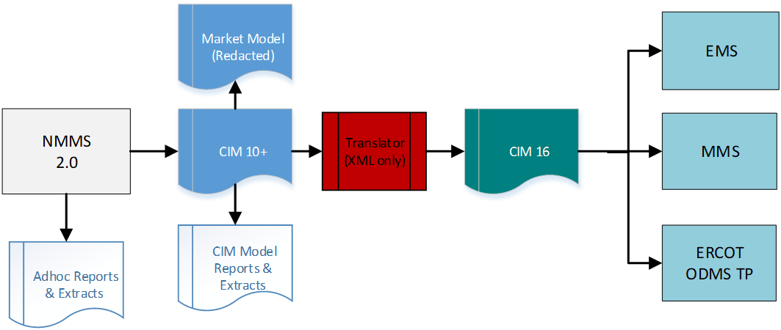
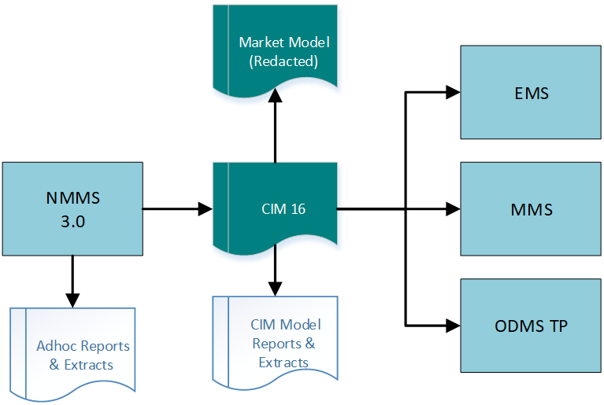
Goal - Removing the CIM10 to CIM16 Translator
After
Before

Slide 6
CIM-Related Inputs/Outputs of NMMS

Slide 7
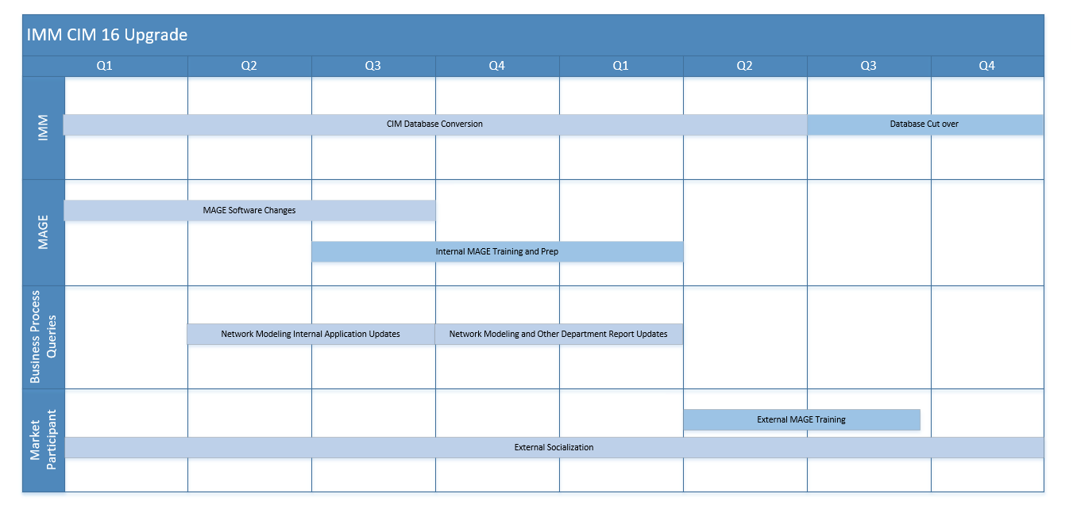
Estimated Timeline - Two Year Duration
Sample full CIM16 file already posted to Citrix folder
Incremental files will not be available until later in the timeline

Slide 8
Who/What is Affected?
Any processes utilizing files directly-created from NMMS will need to prepare for an updated schema.
Files include:
  MIS Secure:
    Redacted CIM Network Model - EMIL ID: NP3-450-SG
  MIS Certified:
    TSP Version of the CIM Network Model XMLs (via Citrix)
    Incremental CIM Change Requests XMLs (via Citrix/NMMS)

Slide 9
Example Schema Change
CIM10
Equipment
Power Transformer
Conducting Equipment
Terminal
Transformer Winding
In CIM16 attributes associated to a TransformerWinding are moved to a new class called TransformerEnd
CIM16
Power Transformer
Conducting Equipment
Terminal
Transformer End

Slide 10
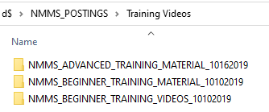
Existing ERCOT Training Content
Training content is available in the NMMS_Postings folder via Citrix
Training was developed with help from ERCOT’s training team and covers detailed modeling in MAGE
Training was originally held in 2019 but no major changes are needed

Slide 11
Existing ERCOT Training Content - Continued
There are numerous presentations and accompanying videos
  MAGE :
    Equipment modeling
    Debugging validation errors
    Good Practices
  Advanced training material:
    DPC process
    How are contingencies created
    Future and current modeling
    When is a manual needed
  SGEM:
    Overview
    Time based modeling
    Timelines
    SGEM screens
    History and messaging
    Validations and one-line requirements
    Interim update restrictions

Slide 12
Supplemental Slides

Slide 13
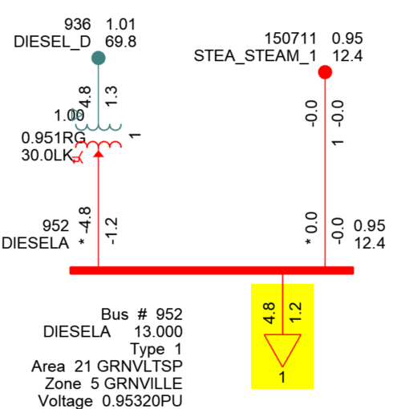
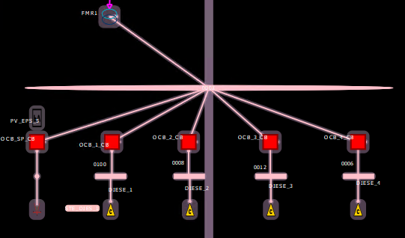
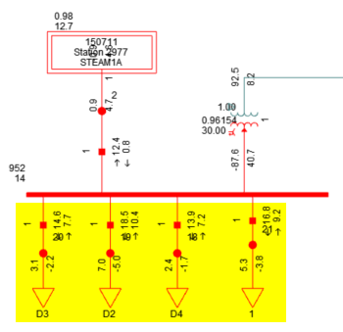
SSWG NOMCR Example: Deconsolidating Shunt Devices
Bus-Branch
The PSSE ID of many shunt devices must be updated to avoid consolidation during topology processing
Topology Processing
Loads are consolidated if their PSSE IDs are the same
Node-Breaker
Example: The operations model has 4 loads connected to the same Connectivity Node Group
Loads remain unaggregated if their PSSE IDs are different

Slide 14
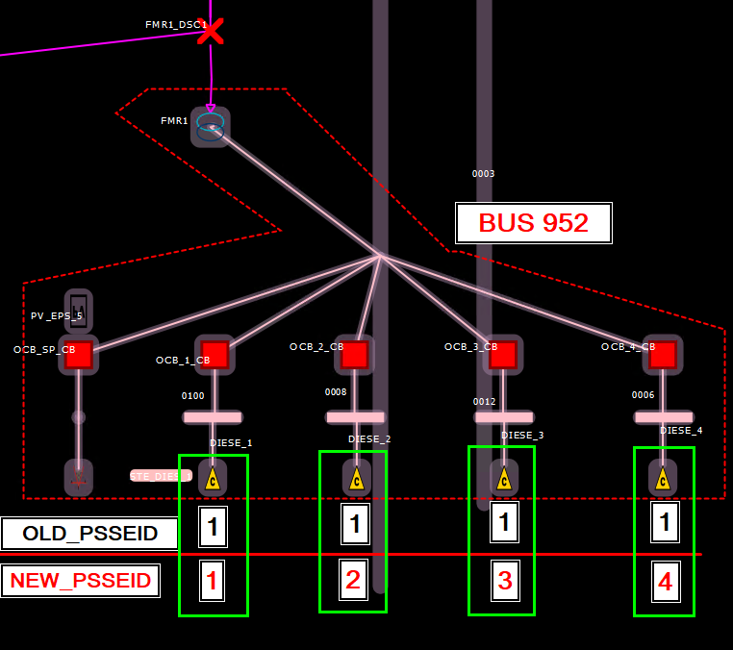
SSWG NOMCR Example: Deconsolidating Shunt Devices
Ongoing submissions must consider collisions with pre-existing PSSE IDs at the same ConnectivityNodeGroup

Slide 15
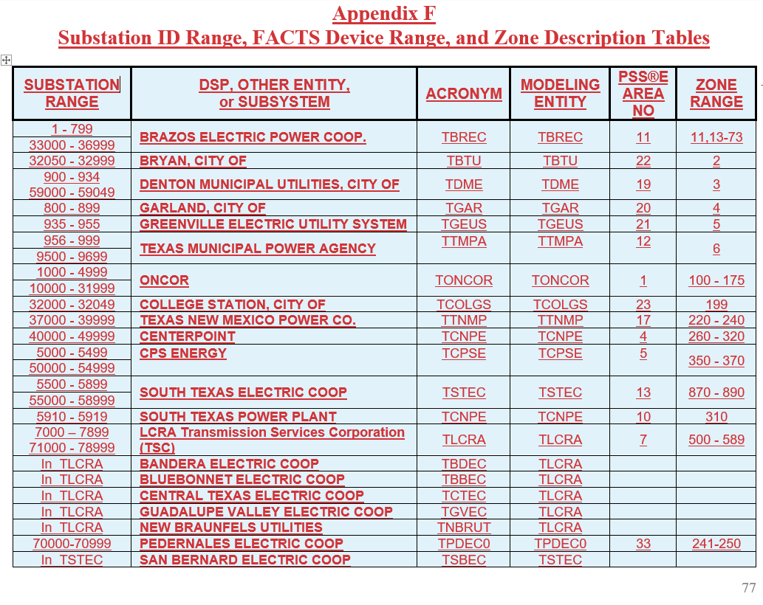
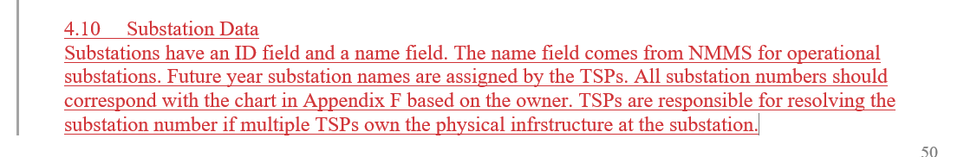
SSWG NOMCR Example: Substation Numbering
The Topology Processor will use the PSSE ID of Substation instances when creating node/breaker Planning models.

Slide 16
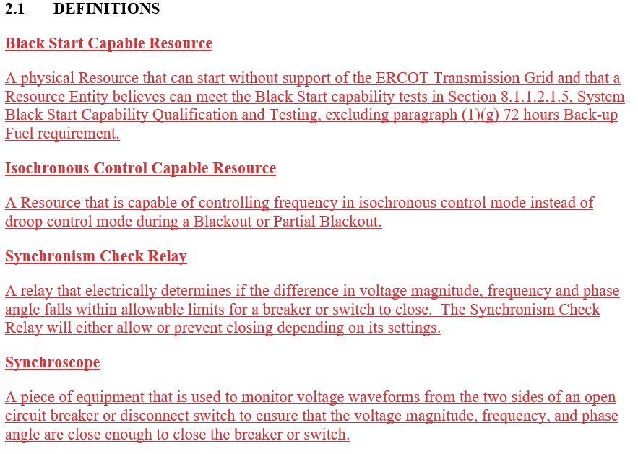
NPRR1164 – New Definitions
NPRR1164 creates 4 new definitions in section 2.1

Slide 17
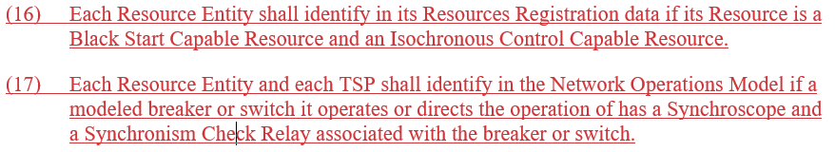
NPRR1164 – 3.14.2 Updates

Slide 18
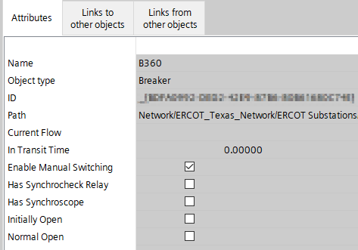
NPRR1164 – Updating in NMMS
Metrics from Network Operations Model:
  Circuit Breakers (18,670)
    Synchronism Check Relay: 286
    Synchroscope: 1,341
    Both: 158
  Disconnectors (45,850)
    Synchronism Check Relay: 0
    Synchroscope: 0
    Both: 0
Breaker and Disconnector instances already have attributes to hold this information

