Slide 1
Discussion on LC's and Bonds
Sanchir Dashnyam
ERCOT Market Credit Manager
ERCOT Public
June 21, 2023

Slide 2
Section 16.11.3 : Alternative Means of Satisfying ERCOT Creditworthiness Requirements
Background
Credit Suisse take over by UBS
Regional banking crisis in US
Potential ongoing banking concerns
Review of current practices at ERCOT, compare & contrast against the practices at other RTO/ISO’s and recommend actions to address potential shortcomings.
Section 16
Section 16.11.3. (1) (b) (ii) states “Letters of credit must be issued by a bank or other financial institution that is acceptable to ERCOT, with a minimum rating of A- with S&P or Fitch or A3 with Moody’s”.
“Issuing entity has Long term or Issuer Rating”
Current ERCOT practices
As long as one of the rating agencies provides a rating of A-/A3, ERCOT accepts LC’s issued from a bank even if it is rated in BBB range by one or two rating agencies.
If there is a split rating amongst the agencies, ERCOT takes the average for capacity purposes.
Rating is internally interpreted as “Long term rating, issuer rating or long term bank deposit rating (domestic).
ERCOT does not require US Branch of a foreign bank to be rated on its own.

Slide 3
LC Issuing bank criteria comparison amongst different ISO/RTO’s

Slide 4
ERCOT proposals to consider at CFSG and potential impact on MP’s
The above practices go against the principle of conservatism and ERCOT appears to be an outlier comparing against other ISO/RTO’s.
ERCOT recommends the following changes:
(1) Establish minimum rating threshold of A-/A3 rating from all available rating agencies (instead of at least one)
(2) Use the “lower of” rule to different ratings within the same rating agency and amongst rating agencies
(3) Define the bank ratings as follows (if available): Long term issuer rating, long term senior unsecured or Long Term Counterparty Risk Assessment (for Moody’s).
(4) Require US Branch/office to have an acceptable rating on its own by at least one of the rating agencies. Use US Branch rating as the issuing bank rating, if the ratings are available.
Bank | LC_AMOUNT
BBVA(FI) | 250,000,000
Deutsche Bank AG(FI) | 150,000,000
Deutsche Bank AG(FI) | 20,000,000
Unicredit Bank AG (FI) | 57,000,000

Slide 5
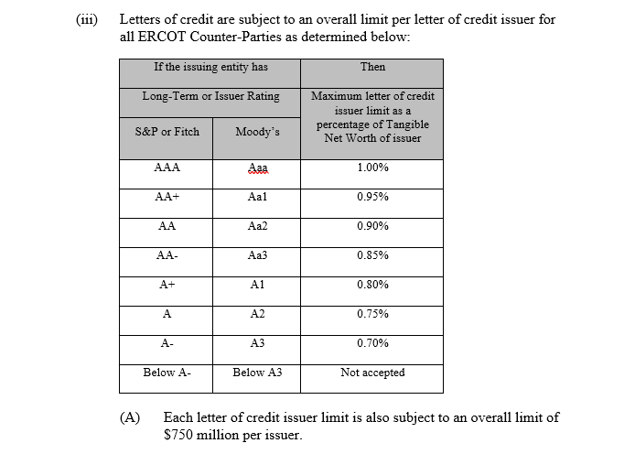
Overall limit per letter of credit issuer
Should we re-visit the limit of $750MM and the respective % for each rating category?

Slide 6
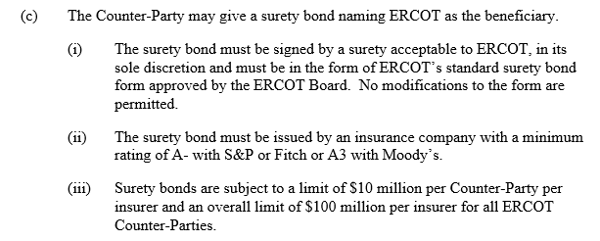
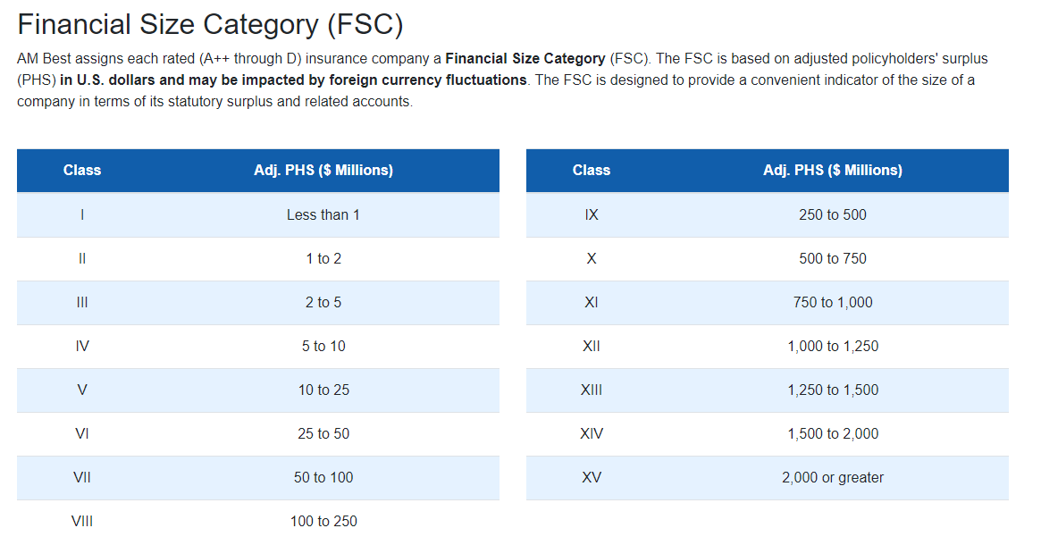
Surety bonds
Should we put minimum size qualifications for the surety bond/insurance companies?
Clarification to definition of a cap to include aggregate amounts of bonds issued by the companies belonging to the same corporate family.

