Slide 1
Unregistered Distributed Generation Workshop - Forecasting
Jeff Billo
June 15, 2023

Slide 2

Historical Operational Forecasting
Day of Week/ Holiday/ Season
Weather
Do we have enough generation committed?
How much ancillary services do we need?
What is the load forecast? What are the risks it could be different?
Operator
Forecaster

Slide 3
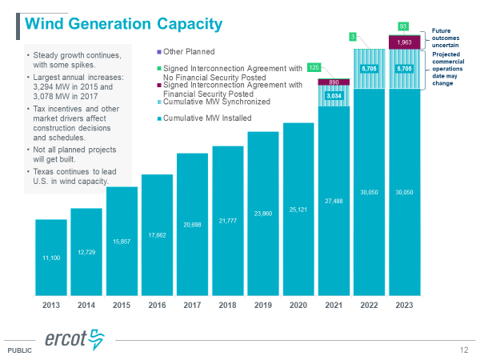
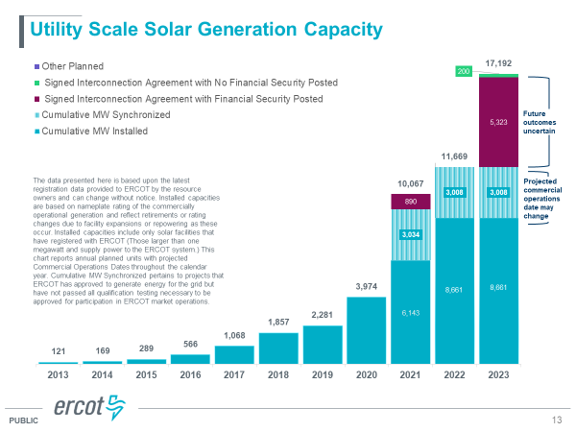
Changes…
More Net Load Variability

Slide 4
Current Operational Forecasting
Day of Week/ Holiday/ Season
Wind Forecast
Weather
Do we have enough generation committed?
How much ancillary services do we need?
What are the net load and ramp forecasts? What are the risks they could be different?
Solar Forecast
Operator
Forecaster

Slide 5
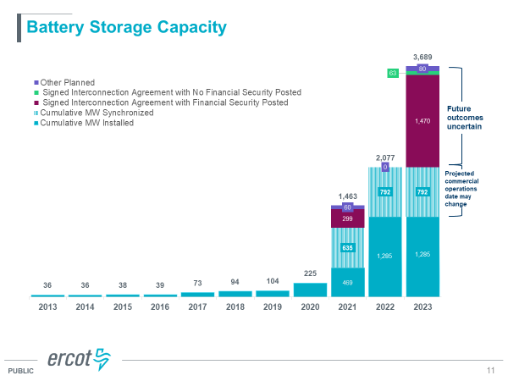
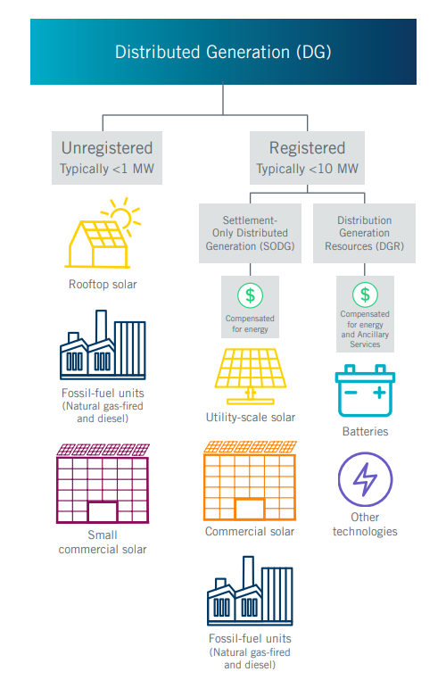
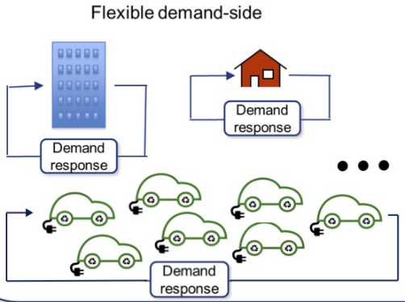
More Changes

Slide 6
Future Operational Forecasting
Day of Week/ Holiday/ Season
Wind Forecast
Weather
Do we have enough generation committed?
How much ancillary services do we need?
What are the net load and ramp forecasts? What are the risks they could be different?
Solar Forecast
Rooftop PV Forecast
Price Responsive Demand
Forecast
DGR/ SODG Forecast
ESR/ DESR Forecast
4CP
Forecast
Operator
Forecaster
For illustration purposes only

Slide 7
Forecast Direction
Current
Future
DGR
SODG
UDG
DGR
SODG
UDG
LOAD
SODG
UDG
LOAD
Gen
Load
Gen
Load
Load Forecast
UDG Forecast
SODG Forecast
Load Forecast

Slide 8
Questions?

