Slide 1
ERCOT Data Requirements
Slides for Unregistered DG Workshop 2
June 15, 2023

Slide 2
Background
Appropriate representation of DER in planning assessments is required by NERC to understand their impacts and maintain reliability
  For Background Information refer to first Unregistered DG Workshop https://www.ercot.com/calendar/03302021-Unregistered-DG-Workshop-I
  https://www.nerc.com/comm/RSTC_Reliability_Guidelines/Reliability_Guideline%20_DER_Model_Verification_of_Aggregate_DER_Models_used_in_Planning_Studies.pdf
Planning and Forecasting decisions are being made for 5-6 years in the future with limited visibility of what is connected to the system today

Slide 3
Original Goals from 2021 UDG Workshop
Step 1: Consistent representation of DGR/DESR, SODG, and “Unregistered DG” in planning cases
  https://www.ercot.com/files/docs/2021/09/22/096PGRR-01_Achieve_Consistent_Representation_of_Distributed_Generation_in_Steady-State_Models_092221.doc
  Implemented June 2022
Step 2: Represent DGR/DESR, SODG, and Unregistered DG as separate aggregations by CIM Load using generator models

Slide 4
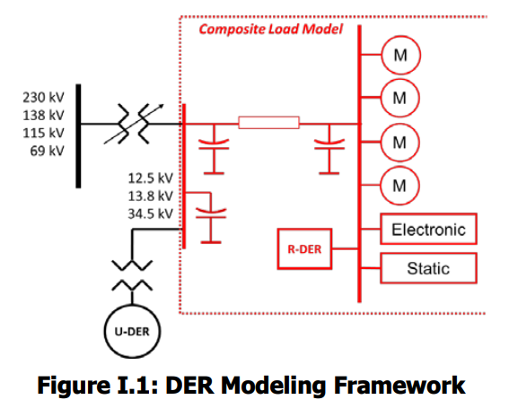
Step 2: NERC DER Modeling Guideline
NERC SPIDERWG
Although the NERC guideline includes significant model elements of the distribution system, ERCOT does not want to model the distribution system and prefers to simply include aggregations at each CIM Load.
Model representation modified based on feedback received by ERCOT after the first Unregistered DG workshop

Slide 5
Step 2: Conceptual One-Line representation of actual system
Transmission Line 1
Substation X
Transmission Line 2
HV Bus/PSSE Bus
Switch Y
C
~
~
~
C
TSF1
~
TSF2
Substation XFMR (CIM Load-TYP)
Feeder 1
Feeder 2
Feeder 3
Feeder 4
Feeder 5
MV Bus
Aggregated
Resources
~
ESID Meter#
w/ BES
SODG-G
~
ESID Meter#
ESID Meter#
ESID Meter#
SODG-PV
~
Distribution system
~
DGR-G
ESID Meter
w/ Rooftop PV
SODG-G
ESID Meter
w/ Rooftop PV
ESID Meter
w/ Rooftop PV
CIM Load 1
CIM Load 2

Slide 6
Step 2: NMMS Operations Model
Transmission Line 1
Transmission Line 2
Indicates SODG mapped to this CIM Load
Substation X
Node
Switch Y
N.C>
~
DGR 1
ADER 1
Information from TSPs
CIM Load 1 - Mapping
Total Aggregated Load
Aggregated rooftop solar
with fractional ride-through
Aggregated BES
With fractional ride-through
Individual SODG
CIM Load 2 - Mapping
Total Aggregated Load
Aggregated rooftop solar
with fractional ride-through
Aggregated BES
with fractional ride-through
Individual SODG
ADER information (new!)
Individual DGR (Modeled)
DGR/SODG/ADER Owner submittal into RIOO
RIOO

Slide 7
Step 2: Generic Planning Model
See next slide for data requirements
Node**
DGR
SODG
UDG
Battery
Solar
Nat Gas
Battery
Solar
Nat Gas
Solar
Battery
Nat Gas
ADER
Individually Modeled Resources
Mapped* Aggregations
Mapped* Aggregations
Modeled Aggregation (TBD)
*SODG, and Unregistered DG will be represented as separate aggregations or units by Transmission level CIM Load using generator models per Modeling guidelines. (SSWG, etc)
**Resource Node if DGR
LOAD

Slide 8
Example: UDG Data Requirements at CIM Load
Substation ID
CIM Load (typically Substation transformer)
Aggregate nameplate capacity—inverters or generators (MW)
Energy Capacity for storage only (MWh)
Fuel type / technology (Solar, Storage, Nat Gas, etc)
Reactive capability--- assume unity power factor, unless noted
Ride Through characteristics
  Aggregate by in-service date
  i.e. pre and post adoption of IEEE1547 ride-though (PUC 54233)
Data submissions required from TSPs at each CIM Load to be put into ERCOT model 1x per year.

Slide 9
Changes required
Revise section 3.2.5.1 language
  Pending outcome of PUC 54233, potentially add requirements for DSP DG registration process
  Require DSPs to provide data to TSPs by Mar 1 of each year (current timeline for NOIE DG Reporting)
  Require TSPs to submit data to ERCOT by Mar 15 of each year

Slide 10
Appendix I
Modeling Details under Current Process

Slide 11
DGR/DESR and SODG
DGR/DESR
  ERCOT will continue modeling using current practices
  Committed and dispatched using current SSWG methodology
  TSPs will not embed in load forecasts nor represent with a negative load
SODG
  ERCOT will represent as generators using simple models per SSWG manual
  TSPs will not embed in load forecasts nor represent with a negative load
  Individually Represented

Slide 12
DWG Cases per DWG Manual
DGR/DESR and SODG
  Use RE-provided dynamic models, if available
  Use DER_A for IBRs if RE does not provide a dynamic model or dynamic model is insufficient
  Use generic dynamic models for synchronous DGR if RE does not provide a dynamic model or dynamic model is insufficient
  GNET some SODG
UDG
  Dynamic models will not be explicitly represented
  DWG will not modify representation from SSWG cases

Slide 13
DG Parameterization Documentation
DWG Procedure Manual
  Summarizes how DWG will represent DGRs and SODGs
Parameterization Guideline
  DWG-approved guideline for developing default parameterization assumptions for DER
DWG will need to revise these documents to address UDG

Slide 14
Appendix II
Proposed Model Details

Slide 15
Step 2: DGR/DESR
ERCOT will represent in NMMS using generator models based on data in RIOO (aggregated for multiple units/inverters)
Unit IDs used to identify fuel type and technical specifications
Generator bus names are “DGR_” + transmission-level POI identifier
Not embedded in ERCOT load forecasts
  Resource telemetry provided
Added to planning cases once individual DGR meets milestone for inclusion

Slide 16
Step 2: SODG
ERCOT will represent in NMMS as mapped to CIM Load based on data in RIOO
Unit IDs used to identify fuel type and technical specifications
Generator bus names are “SODG_” + transmission-level POI identifier
Not embedded in ERCOT load forecasts
  Resource telemetry for units that export > 10 MWh/yr will be provided
No ERCOT SODG forecast
Added to planning cases once individual SODG meets milestone for inclusion

Slide 17
Step 2: Unregistered DG
Represented in models at each CIM Load using aggregate generator models by capacity for a given fuel type and technical specification
  Ride through characteristics defined as a percentage derived from install date
    prior to 1/1/24 to be IEEE1547-2003
    After 1/1/24 to be IEEE1547-2018
Unit IDs used to identify fuel type and technical specifications
Generator bus names are “UDG_” + transmission-level POI identifier
Embedded in ERCOT load forecasts
  No telemetry available
ERCOT will forecast rooftop solar growth

