Slide 1
Project Update
June 14, 2023
Troy Anderson
ERCOT Portfolio Management

Slide 2
Project Update Agenda
Recent / Upcoming Project Highlights
2023 Release Targets
Additional Project Status Information
Priority/Rank Options for Revision Requests with Impacts
PGRR103 – Establish Time Limit for Generator Commissioning Following Approval to Synchronize
Technology Working Group (TWG)
Next meeting date is TBD
Location of Revision Request Project Information: http://www.ercot.com/services/projects

Slide 3
Recent / Upcoming Project Highlights
2023 June Release – R3 – 6/6/2023 - 6/8/2023 Implemented / In Stabilization
NPRR863 – Creation of ERCOT Contingency Reserve Service (ECRS) and Revisions to Responsive Reserve
NPRR903 – Day-Ahead Market Timing Deviations
NPRR992 – Updated Day-Ahead Liability for NPRR863
NPRR1015 – Clarification of DAM implementation of NPRR863 Phase 2
NPRR1085 – Ensuring Continuous Validity of PRC and Dispatch through Timely Changes to Resource Telemetry and COPs
NPRR1096(b) – Require Sustained Two-Hour Capability for ECRS
NPRR1148 – Language Cleanup Related to ERCOT Contingency Reserve Service (ECRS)
NOGRR186 – Alignment Changes for March 1, 2019, Nodal Operating Guide – NPRR863
NOGRR187 – Related to NPRR863, Creation of ECRS and Revisions to Responsive Reserve
OBDRR043 – Related to NPRR1148, Language Cleanup Related to ECRS
OBDRR044 – Related to NPRR1085, Ensuring Continuous Validity of PRC and Dispatch through Timely Changes to Resource Telemetry and COPs
2023 July Off-Cycle Release – 7/14/2023 In Flight
SCR789 Phase 2 – Update NMMS Topology Processor to PSS/E 35
2023 July Release – R4 – 7/25/2023-7/27/2023 In Flight
Securitization Phase 2A – Maine Invoice and Credit Exposure
Note: Projected Go-Live dates are subject to change. Please watch for market notices as the effective dates approach.

Slide 4
2023 Release Targets – Approved NPRRs / SCRs / xGRRs
R1
R3
R5
February 1/31 – 2/2 | March 3/28 – 3/30 | June 6/6 – 6/8 | July 7/25 – 7/27 | October 10/3 – 10/5 | December 12/5 – 12/7
NPRR1020(a) | None | ECRS (NPRR863) NPRR903 NPRR992 NPRR1015 NPRR1085 NPRR1096(b) NPRR1148 NOGRR186 NOGRR187 OBDRR043/44 | Securitization Phase 2A – Maine Invoice and Credit Exposure SCR789 Ph2 NPRR1112 | NPRR945 NPRR962 NPRR1040 NPRR1090 NPRR1112 NPRR1121 NPRR1154 | NPRR1092(b) SCR807 SCR816 EMS Upgrade
R2
R4
R6
ü
E
E
E
E
E
E
E
E
E
E
E
E
E
NS
NS
E
NS
NS
P
NS
E
E
7/14
11/15
10/1
EMS Upgrade Freeze – May 2023 – Jan. 2024
TBD | NPRRs: 484,825(b),826,829,841,857,879,885,904,918,930,936,941,963,965,975,987,995,1004,1006,1007,1019,1023,1026,1030,1032,1034,1057, 1077,1105, 1111,1128,1131,1136 SCRs: 799,805,810,813,818,819,822 PGRRs: 066,076,088,091,094,099 Other: OBDRR009,OBDRR017,RRGRR028
Go-live dates can differ from Protocol effective dates – Please refer to market notices for more details
APPENDIX
Red Text: New additions and target release changes
Strike-Through Text: Previous target release
(a), (b), etc.: Multiple phase release
Project Status Codes
NS = Not Started
I = Initiation
P = Planning
E = Execution
H = On Hold
NPRR1020(a) – EPS Metering portion
NPRR1092(b) – Limit RUC Opt-Out Provision
NPRR1096(b) – ECRS portion
Release targets are subject to change

Slide 5
Additional Project Status Information
Page 1 of 2
Revision Request | Description | Project Phase | Additional Detail
NPRR1095 SCR817 SCR823 | Texas SET V5.0 Changes MarkeTrak Validation Revisions Aligning w/TX SET 5.0 ERCOT Mass System “County Name” File Updates | Execution | Expected completion in late 2024
SCR820 | Operator Real-Time Messaging During Emergency | Planning | Go-Live target is TBD
NPRR1149 | Implementation of Systematic Ancillary Service Failed Quantity Charges | Initiation | Approved for June 2023 start Late 2023 / early 2024 go-live target
NPRR1004 | Load Distribution Factor Process Update | Not Started | Mid-2023 start candidate
NPRR1006 | Update RT On-Line Reliability Deployment Price Adder Inputs to Match Actual Data | On Hold | Assessing restart date options
NPRR1026 | BESTF-7 Self-Limiting Facilities | Not Started | Reviewing options for Q3 2023 start
NPRR1128 | Allow FFR Procurement up to FFR Limit Without Proration | Not Started | Assessing start date options 2023 candidate
NPRR1131 | Controllable Load Resource Participation in Non-Spin | Not Started | Assessing start date options 2023 candidate
NPRR1136 | Updates to Language Regarding a QSE Moving Ancillary Service Responsibility Between Resources | Not Started | ERCOT staff is sponsoring an NPRR that will make remaining NPRR1136 language obsolete
SCR819 NPRR1111 | Improving IRR Control to Manage GTC Stability Limits | Not Started | Targeting Q4 2023 start
SCR822 | Create Daily Energy Storage Integration Report and Dashboard | Not Started | Approved for July 2023 start 2024-R1 go-live target
Red Text: New additions and updates

Slide 6
Additional Project Status Information
Page 2 of 2
Revision Request | Description | Project Phase | Additional Detail
NPRR1007 NPRR1014 | SCED Postings Gray-boxed in Section 3.2.5(4) Publication of Resource and Load Information | Not Started | Potential implementation of the gray box in this section, specifically the increasing of granularity for SCED disclosure reporting Evaluating a 2023 start
NPRR1002 RRGRR023 | BESTF-5 ESR Single Model Registration and Charging Restrictions in Emergency Conditions | Not Started | Q2 2023 start candidate for next bundle of RIOO enhancements
NPRR1164 RRGRR033 | Black Start and Isochronous Control Capable Identification | Not Started | Q2 2023 start candidate for next bundle of RIOO enhancements Still in stakeholder process (ROS)
RRGRR032 | Communicate Operating Limitations during Cold and Hot Weather Conditions | Not Started | Q2 2023 start candidate for next bundle of RIOO enhancements
NPRR1153 | ERCOT Fee Schedule Changes | Not Started | Q2 2023 start candidate for next bundle of RIOO enhancements
PGRR103 | Establish Time Limit for Generator Commissioning Following Approval to Synchronize | Not Started | Q2 2023 start candidate for next bundle of RIOO enhancements Still in stakeholder process (TAC)
Red Text: New additions and updates

Slide 7
Priority / Rank Options for Revision Requests with Impacts
Options for…
Revision Request | Description | Priority | Rank | Comments
PGRR013 | Establish Time Limit for Generator Commissioning Following Approval to Synchronize | 2024 | 4020 | $40k-$60k, 4-6 months Impacted Systems: RIOO, data mgmt Manual approach will allow language to be effective upon PUCT approval
PPL Rank Information
Next available 2023 Rank in Business Strategy = 3800
Next available Rank in Regulatory = 360

Slide 8
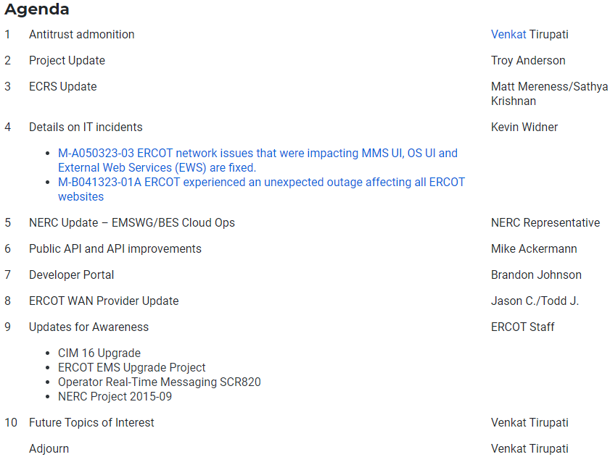
Technology Working Group (TWG)
5/18/2023 TWG meeting topics
Next TWG meeting date is TBD

