Slide 1
NOGRR245 Update
IBRTF
June 9th, 2023
John Schmall, Power System Engineer Principal

Slide 2
Update
ERCOT has drafted language for ERCOT comments that aligns with the alternative framework proposal presented by ERCOT during the May IBRTF meeting.
Language is undergoing additional ERCOT review
ERCOT plans to submit language in next two weeks

Slide 3
Draft structural approach to new revision
Frequency ride-through requirements in Section 2.6.2 and 2.6.2.1 are structurally similar to existing comments.
Primarily clarifying edits throughout.
Updating effective dates recognizing implementation window up to 12/31/25.
Clarifying edits allowing additional ERCOT discretion in applying restrictions
Gray box language to replace paragraph 6 after implementation on 1/1/26.
New section 2.6.2.1.1 that maintains current requirements during implementation window to be deleted on 1/1/26.
Voltage ride-through requirements have additional structural changes
2.9.1 new paragraph (1) that directs new IBR requirements to Section 2.9.1.1 and legacy IBR requirements to Section 2.9.1.2 which are similar except for curves.
Section 2.9.1.1 very similar to current language in NOGRR 245
Adds new table that aligns with IEEE 2800 Table 12 (VRT curves for solar and ESR IBR)
Maintains requirement for IEEE 2800 Table 13 (instantaneous voltage ride-through)
Removes paragraph (8) as no longer needed since is for new IBRs
Clarifying edits allowing additional ERCOT discretion in applying restrictions
Section 2.9.1.2 very similar to current language in NOGRR 245
New Table A represents existing VRT curves in table format
Updating effective dates recognizing implementation window up to 12/31/25.
Clarifying edits allowing additional ERCOT discretion in applying restrictions

Slide 4
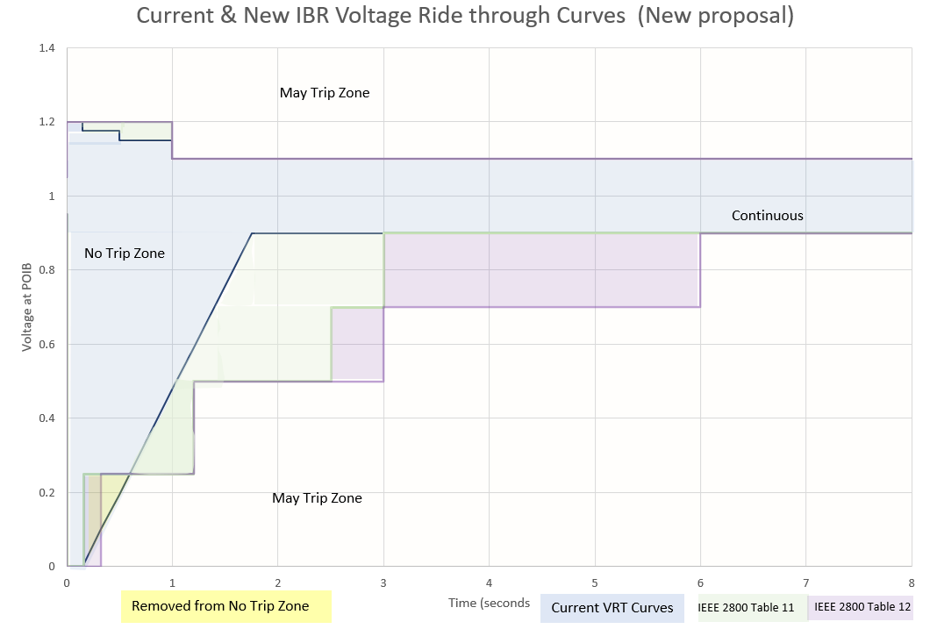
Initial vs New proposal for VRT curves
New Proposal:
Requires existing IBRs to maximize VRT capability and meet the current VRT curves within ~2 years
Requires existing IBRs that are unable to meet the current VRT curves to meet the IEEE 2800 VRT curves within ~4 years
Requires new and retrofitted Wind IBRs to meet IEEE 2800 Table 11 curves
Requires new and retrofitted Solar and ESR IBRs to meet IEEE 2800 Table 12 curves
Initial Proposal:
Required all existing IBRs to meet IEEE 2800 Table 11 VRT curves within ~2 years
Required all new IBRs to meet IEEE 2800 Table 11 VRT curves

Slide 5
Questions?

