Slide 1
ERCOT IBRTF: NERC and Other Industry Updates
Julia Matevosyan
Chief Engineer
ESIG
06/09/2023

Slide 2
Agenda
AEMO: Voluntary Specification for Grid-forming Inverters
FERC Order Approving NERC’s Registration Plan
NERC Webinar Series: Inverter Based Resources
ESIG Webinar: EMT Model Intake and Quality Assurance

Slide 3
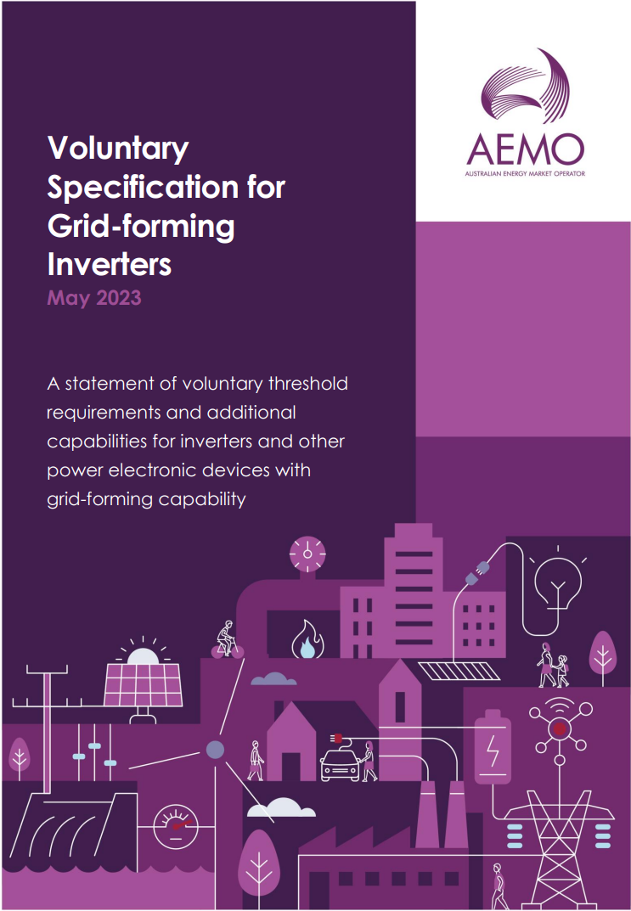
AEMO: Voluntary Specification for Grid-forming
Inverters, May 2023
A preliminary document to provide guidance to stakeholders while the regulatory environment around GFM technology develops.
Specifies the ‘core’ and ‘additional’ technical capabilities and expected performance that power electronic devices should have to be categorized as GFM.
Considers all technology forms, not just GFM batteries
Inform future regulatory changes on technical requirements/standards, service specifications, and procurement processes
https://aemo.com.au/-/media/files/initiatives/primary-frequency-response/2023/gfm-voluntary-spec.pdf?la=en&hash=F8D999025BBC565E86F3B0E19E40A08E
Notes:
All technology forms: also includes wind and solar inverters, STATCOMS and HVDC converter stations and loads interfaced to the power system with controllable converters.

Slide 4
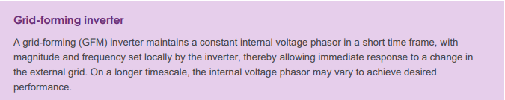
GFM Definition
‘Core’ capabilities of GFM inverters can be delivered with software and control changes.
To achieve ‘core’ capabilities GFM device is expected to have a small energy buffer by design or operation.
‘Additional’ capabilities require hardware or operational practices changes to provide larger energy buffer and overcurrent capability and are considered optional extensions to the ‘core’ capabilities.
Not all GFM inverters need to provide ‘additional’ capabilities, but these capabilities are valuable for secure operation of a power system with high share of IBRs.
https://aemo.com.au/-/media/files/initiatives/primary-frequency-response/2023/gfm-voluntary-spec.pdf?la=en&hash=F8D999025BBC565E86F3B0E19E40A08E
Notes:
.

Slide 5
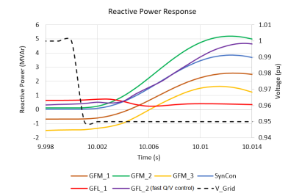
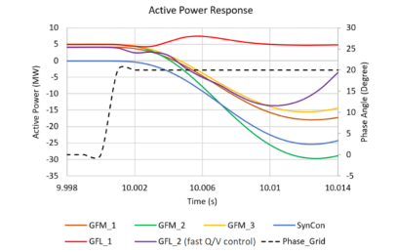
Response to Voltage Magnitude and Phase Angle Change
Nearly-instantaneous (< 5 ms) reactive response to an external voltage magnitude step, to oppose the change in voltage.
Nearly-instantaneous active power response to a voltage phase angle step, by injecting or absorbing power to oppose the change in phase angle.
The response when the inverter is at a limit, and in transition to and from a limit condition, must be smooth and stable.
The behavior at a limit should not be detrimental to stability and to harmonic performance (for example, clipping of current waveforms).
The conditions for these simulations have been chosen so that the devices do not encounter current limits. 5% voltage step top, 20 deg phase jump bottom
https://aemo.com.au/-/media/files/initiatives/primary-frequency-response/2023/gfm-voluntary-spec.pdf?la=en&hash=F8D999025BBC565E86F3B0E19E40A08E

Slide 6
Inertial Response
Inertial response from GFM inverters should be inherent (no calculation of frequency), providing a near-instantaneous active power response to a grid disturbance (e.g. load or generation trip)
If the inertia is configurable, it needs to be tuned based on network conditions and requirements (high inertia constant may increase power oscillations, particularly in strong systems).
https://aemo.com.au/-/media/files/initiatives/primary-frequency-response/2023/gfm-voluntary-spec.pdf?la=en&hash=F8D999025BBC565E86F3B0E19E40A08E
Notes:
AEMO has chosen to define ability to provide inertial response as a core capability without specifying the need to provide this capability across the inverter’s full operating range. In conjunction with this, the additional capability to maintain headroom or an energy buffer could be utilized to ensure a synthetic inertial response can be delivered across the desired operating range. This differs from some other international specifications, and not all GFM implementations currently have this capability. This capability is a function of the implementation algorithm, not requiring substantial modification, and therefore can be classed as core capability. However, it is recognized that for inverters to provide meaningful amounts of inertial response in both directions they would likely require a suitable energy buffer or adequate headroom

Slide 7
Other ‘Core’ Capability Requirements
Surviving Loss of Last Synchronous Machine (SM): operate stably in a grid without any other GFM inverters or SMs; remain stable for a transition from a grid with SMs to one without (and back); provide frequency and reactive support, unaffected by these transitions. All of that, provided the resultant state of the system is within the operating envelope of the GFM inverter.
Operate stably under a very low short circuit ratio, as defined by the system operator; provide system strength support to nearby GFL inverters during and after disturbances.
Provide positive damping for oscillations: following a disturbance GFM inverter output should be adequately damped; add damping to the system for the oscillatory phenomena:
SSCI (either between GFL inverters or GFL inverter and grid)
Rotor angle modes of oscillation inter-area modes of oscillation
Oscillations at harmonic frequencies which result from interactions of electrical and control resonances.
https://aemo.com.au/-/media/files/initiatives/primary-frequency-response/2023/gfm-voluntary-spec.pdf?la=en&hash=F8D999025BBC565E86F3B0E19E40A08E
Notes:
Rotor angle modes of oscillation damping: through the provision of damping power akin to that provided by synchronous machine damper windings. Where relevant, this should include damping for

Slide 8
‘Additional’ Capabilities
Larger headroom and energy buffer
Current capability above continuous rating
Black start capability
Power quality improvement
https://aemo.com.au/-/media/files/initiatives/primary-frequency-response/2023/gfm-voluntary-spec.pdf?la=en&hash=F8D999025BBC565E86F3B0E19E40A08E

Slide 9
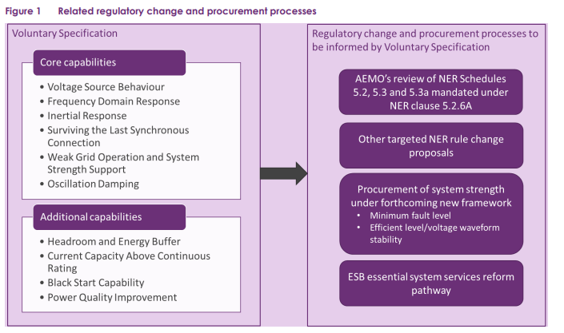
Related Regulatory Change and Procurement Process
Next Steps:
Develop a test plan and metrics for each of the qualitative capabilities to quantify requirements and to demonstrate that a device meets the specs (started, to be published in 2024)
Develop methodology to account for contributions from GFM devices in planning studies (some contributions are dependent on the operating point)
https://aemo.com.au/-/media/files/initiatives/primary-frequency-response/2023/gfm-voluntary-spec.pdf?la=en&hash=F8D999025BBC565E86F3B0E19E40A08E

Slide 10
FERC Order Approving NERC’s Registration Plan
On 05/18/2023 FERC issued an Order approving the NERC’s work plan to identify and register relevant IBRs that fall outside the BES definition, but individually or in the aggregate impact the reliability of BPS.
The work plan includes a 3-phased approach (the timelines are relative to FERC’s approval date):
Revise its Rules of Procedure to include generator owner-IBR (GO-IBR) with nameplate capacity of ≤ 75 MVA and ≥ 20 MVA (at ≥ 100 kV) as a new registered entity function within 12 months
Identify candidates for GO-IBR registration within 24 months
Register GO-IBRs within 36 months
NERC includes in its filing a communication plan outlining how NERC will coordinate with key stakeholders
NERC work plan is intended to work concurrently with efforts to update the Reliability Standards to address IBR data sharing, model validation, planning and operational studies, and performance requirements (during month 1-12)
https://www.ferc.gov/media/e-1-rd22-4-001
Notes:
In Nov. 2022, FERC Order E-1 directing NERC to submit (within 90 days) a plan for identification and registration of owners and operators of BPS-connected IBRs that are currently not required to register but, in the aggregate, have a material impact on the reliability of the BPS
NERC states that it will consider during the first year of its work plan applyinga sub-set list of Reliability Standards to GO-IBRs.28F29NERC explains that it will also consider whether to add the new GO-IBR function to the applicability section of the Reliability Standards or use some other means to identify the Standards with which GO-IBRs will need to comply

Slide 11
Reminder! Webinar Series: Inverter Based Resources
NERC webinar series discussing BPS-connected IBR and NERC’s risk mitigation strategy in this area. The series will provide a complete overview of IBRs – from a fundamental understanding of IBR technology to tackling the more complex and emerging risk issues. - June 6 – July 13, 2023 | 4:00 – 5:00 pm Eastern Time
Introduction to Inverter-Based Resources
NERC Disturbance Reports and Lessons Learned
Inverter-Based Resource Performance Issues
Establishing and Enhancing Interconnection Requirements
Modeling Part 1 – Modeling Requirements, Model Creation, Model Usability
Modeling Part 2 – Model Quality, Model Benchmarking
Studies – EMT, Special Studies, Interconnection Studies
Interconnection Process
Commissioning
IBR Registration and Reliability Standards Enhancements
Overview of IBR Risk Mitigations and Next Steps
Register Here: : https://www.nerc.com/comm/RSTC/Documents/IBR_Webinar_Series_Fyler.pdf

Slide 12
ESIG Webinar: EMT Model Intake and Quality Assurance, May 2013
Featured Speaker: Andrew Isaacs, Vice President, Electranix
About the Webinar: Continued industry need for EMT analysis has prompted NERC to recommend that planning groups require EMT models for all generators going forward. The webinar covered:
Background on the drivers for these recommendations
The basic components of what these requirements should look like
A practical discussion of what is involved in ensuring submitted models are appropriate and useful
A practical discussion of the challenges involved in implementing such requirements, including schedule impacts, human resource constraints, and acquisition of new skills.
Recording, Slides and Q&A available here: https://www.esig.energy/event/webinar-emt-model-intake-and-quality-assurance/

Slide 13
Julia Matevosyan
julia@esig.energy

