Slide 1
Lubbock
Retail Integration Task Force – LRITF
June 6th, 2023
Chris Rowley Michael Winegeart Sheri Wiegand

Slide 2

LRITF Meetings
4/4/23
4/13/23
5/2/23
5/25/23
The Task Force continues to discuss major implementation items that must be resolved prior to LP&L entering competition:
Pro-Forma Retail Access Tariff – Project# 54212 was approved on consent at the 3/23 PUC Open Meeting. LP&L currently working on Chapter 5 of tariffs and Customer Protection Rules.
CSA & Mass Transition Transaction Workflows –NPRR1159 and RMGRR171 have been approved by PUCT.
Customer Data Issue / Customer Choice Billing – HB2664/HB2663 have been signed by the Governor.
FERC Approval – required to transition remaining load from SPS to ERCOT; FERC settlement conference 5/25 and next is scheduled 7/6 for Docket: ER23-1144-000
Approved
Major Implementation Items

Slide 3
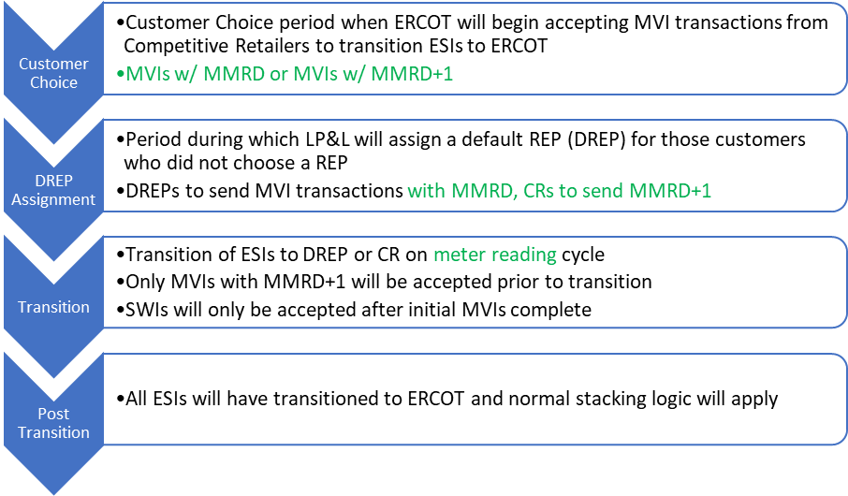
Solution to Transition stacking
Customer Choice
DREP Assignment
Transition
Post Transition
Four Phases of Transition
Swim-lanes and scenarios available on 6/6/23 meeting page.

Slide 4
Proposed rates/ structure summary
Delivery Charge Component | YES | NO | Notes
Power Factor Adjustments |  | x | Customers expected to maintain at least 85% lagging power factor; must install corrective equipment
Street Lighting | x |  | Only City of Lubbock and TXDOT have accounts; 1 ESI ID per lamp & wattage type
Security Lighting |  | x | Lighting will be phased out prior to transition to competition; HOA is considered security lighting
Demand Ratchets |  | x | 15 min demands, yet load factor will not be <3% - kWh/21 hours
4CP Demands |  | x | 4CP demands will not apply
Transition Charges | x |  | Transition charges represent stranded costs with debt service over 20 years; will be a separate line item on the 810 invoice
Rates have been approved by EUB & City Council
Finalized discretionary and non-discretionary rates will be included in Chapter 5
Below is a summary of the approved non-discretionary rates (streetlighting rates not included):

Slide 5
Completed Action Items
Q&A
Transition to Competition
Q: When will LP&L accept EDI transactions for transition to competition? A: Transactions will be accepted August 2nd, which corresponds to 90 days prior to LP&L’s last meter read cycle in October. “LP&L anticipate that the FERC order will result in a delay of both the integration of the remaining load and LP&L’s transition to retail competition but are currently unable to provide a definitive estimate of the magnitude of the delay due to the uncertainty surrounding the timing of the settlement and hearing procedures at FERC.” Q: Does Lubbock have any requirements/regulations pertaining to door-to-door solicitations? A: Below is a summary of the Peddler’s License requirements for any solicitations within the City of Lubbock. The Lubbock Police Department administers the licensing. All D2D solicitors will be required to register with the city. D2D registration licenses will remain active for six months (as opposed to the original 30 days) No registration is required if the REP makes an appointment with the customer. Town hall meetings will not require D2D registration as will be hosted by the City Pop-up sales sites at existing businesses will require registration as well as a letter from the business. REPs can contact the city to register at: 806-775-2803 806-775-2809

Slide 6
Completed Action Items
Q&A
Customer Education & PUCT Requirements & ERCOT Market Requirements
Q: Will Lubbock zip codes be integrated into PUCT’s Power to Choose website for customer shopping? A: Lubbock zip codes have been entered into PUCT’s PTC website and is ready for REP offer postings. Q: Will Energy Assistance be available for Lubbock customers during the transition to competition? A: At the time of transition, customers should appear on Solix list as REPs submit their scheduled monthly list of ESIs and Solix results will be received prior to Lubbock customers receiving their first bill from their REP. Q: In order to exchange banking information between LP&L and registered REPs, will the existing EFT Authorization be acceptable? If so, where should the form be submitted to complete the penny testing? A: Yes, ERCOT’s existing EFT Authorization form is acceptable and should be submitted to LP&L at marketops@mylubbock.us Q: Will LP&L submit LSE files to Smart Meter Texas for customer and REP access? A: LP&L is working with Smart Meter Texas to reach an agreement for utilization of the AMS data repository. It is expected LP&L will not integrate LSE files until Q2 of 2024 when SMT has planned a version update (v3.0). As a workaround, REPs may utilize ERCOT’s AMS Settlement extract to obtain daily interval data files (which is available at OD+4)

Slide 7
Completed Action Items
Q&A
ERCOT Market Requirements & TDSP Requirements
Q: Which SAC04 Codes do Lubbock plan to utilize for 810_02 invoices to REPs? A: LP&L will use the following existing SAC04 codes to represent the cost recovery components of their delivery charges: DIS001 – Delivery Service Charge (volumetric) MSC029 – Transition Charge (volumetric) DAS003 – Monthly DG Charge (fixed) Q: Will LP&L utilize a similar safety net process as TDSPs? A: Yes, safety nets will be accepted by LP&L. Existing approved spreadsheets will need to be submitted via an SFTP site which will be monitored and processed automatically. SFTP site URL will be available to approved REPs once registration is complete. Q: What are is the approximate number of solar customers in the Lubbock territory? How will these customers be billed for delivery charges? Will net metering continue for these customers? A: LP&L currently has ~1200 solar (PV) customers and growing. Current LP&L solar customers receive true net metering where energy costs reflect consumption – generation values. Upon transition, LP&L will adopt current TDSP practices of non-bypassable consumption charges. Any generation “credits” may be received from a customer’s REP of choice depending upon their product. LP&L delivery charges will include a monthly fixed charge. REPs may request a list of existing solar customers/ESIs with the MCL and ESI list.

Slide 8
Completed Action Items
Q&A
TDSP Activities
Q: Will L&L service street lighting? If so, what operational practices will be adopted? A: Yes, LP&L currently serve City of Lubbock and TXDOT for street lighting. 1 ESI ID will be created for each like wattage and lamp (same fixed costs and set kWh values). HOAs will not be considered street lighting accounts thus will be phased out by LP&L prior to transition. Q: What are LP&L’s tampering practices when tampering is discovered at a premise? A: LP&L’s tampering practices are and will be as follows: Disconnects are only performed if unsafe/hazardous conditions exist Once service order is complete and tampering is discovered: DAY 1 - $200 tampering fee will be assessed on ESI and sent to ROR via 810_02; 814_20 to set tampering switch hold will be sent DAY 3 – after investigation, any additional fees and cancel/rebilling will be sent to ROR via 810_02 (867_03s for cancel/rebills) DAY 5 – evidence will be sent to ROR via email Customer will be advised of tampering via door hanger left at the premise Q: Will daily switch hold files be provided by Lubbock? Where will a REP access the files? A: Yes, LP&L will provide daily switch hold files and will be available via an SFTP site. Format will be the same as TDSPs use today. SFTP site URL will be available to approved REPs once registration is complete. Q: Will historical usage information be available for transitioning customers? Will an LOA process be available and when? A: Monthly summary historical usage information will be available via the Mass Customer List (MCL) for entering REPs. Historical interval data will be available for REPs by emailing marketops@mylubbock.us with a signed copy of the approved LOA which is posted on the LP&L website. Brokers may also request monthly and interval data via the LOA process noted above. The LOA process may commence at the time the MCL is available for distribution (late April/early May). LOAs are required to be notarized. Out of state LOAs are accepted with a valid Commission ID. Modifications to the LOA will not be accepted.

Slide 9
Activities timeline
Posted to LRITF meeting page
A big thank you to Melenda w/ Oncor for developing timeline!

Slide 10
TIMELINE of Actions
Pro Forma Tariff
Access Agreement
POLR Process
Safety Net Process
Q4 2022
ERCOT Activities: SAC04s, Load Profiles
TSDP Activities: Critical Care, DLFs, Solar/DG, Switch Hold Files, BUSIDDRQ, Call Center, OGFLT, Weather Moratoriums, Proration
LP&L Rates
Customer Enrollment Process – Detailed Timeline
PUCT Complaint Process / Application of PUCT Rules
Transaction Timelines / TXSET Timelines
CSA Process
Q1 2023
Q2 2023
ESI IDs in TDSP Extract
RMG Chapter 8 Revisions
Historical Usage Requests
TDSP AMS Data Practices
Mass Customer Lists
Power to Choose website
Customer Forums/Town Halls
Flight Testing / Bank Testing
Q3 2023
CBCI files
Default REP Selection Process
DNP Blackout Period
Market Operations Group Established
Tampering Information Process
Smart Meter Texas
Q4 2023
GO LIVE – Transition to Competition
Delayed

Slide 11
Lritf meeting
Held after RMS @ 1:00 PM
June 6th, 2023
AGENDA:
FERC Status
Flight Testing Update
Solution to Stacking Update
  Force Out Scenario – True MVIs
Critical Care Clarification
RMGRR174 – Language Review
Chapter 5 tariffs – update
Customer Protection Rules update
Transition Activities Review
Open Discussion

