Slide 1
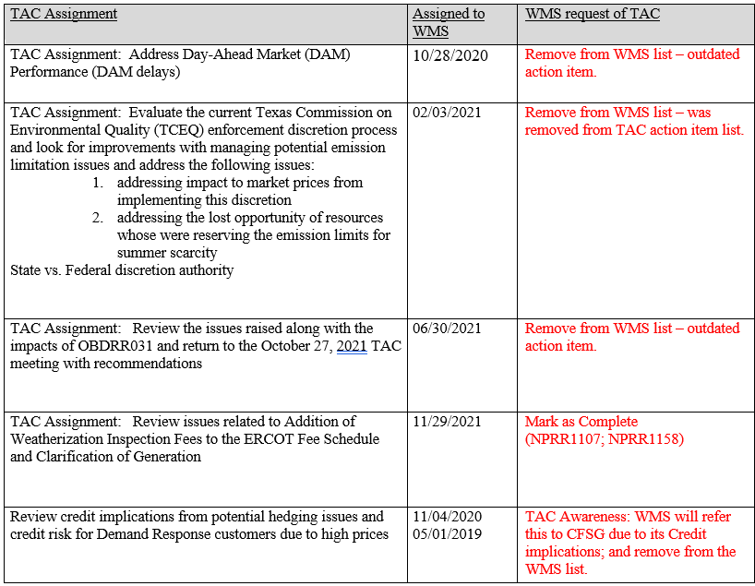
Open Action Item Updates

