Slide 1
Supply Analysis Working Group Update June 2023 Update to WMS
June 7, 2023
Kevin Hanson (National Grid) Chair
Pete Warnken (ERCOT) Co-Vice Chair
Ian Haley (Vistra) Co-Vice Chair

Slide 2
Overview
Vice Chair has resigned due to employment change.
Mid-Term Load Forecast during Winter Storm Elliott (Calvin Opheim)
Annual DG Report Follow-up (Clayton Stice)
CDR and Summer SARA Review (Pete Warnken)
Summer 2023 Reserve Risk Model Results (Pete Warnken)
Status of CDR NPRR (Pete Warnken)
Reliability Standard Modeling/VOLL RFP Update (Pete Warnken)
VOLL study will be awarded by June 12

Slide 3
Mid-Term Load Forecast during Winter Storm Elliott
Load forecast error during Winter Storm Elliott occurred by a combination of:
software upgrades not adequately tested, and
some of the forecasts were unusable

Slide 4
Mid-Term Load Forecast during Winter Storm Elliott
Corrective actions currently planned:
Reduce forecast errors from alternative load forecasting source (currently the GE models A3, A6)
Develop an innovative process for developing extreme cold weather forecasts
Reduce weather forecast error
Improve Itron software upgrade testing process
Actual peak load on 12/23/2022 was 73,910 MW at 0900 (highest ERCOT forecast two days prior was 67,574 MW)
If we would have had Uri type weather, load forecast would have been closer to 81 GWs

Slide 5
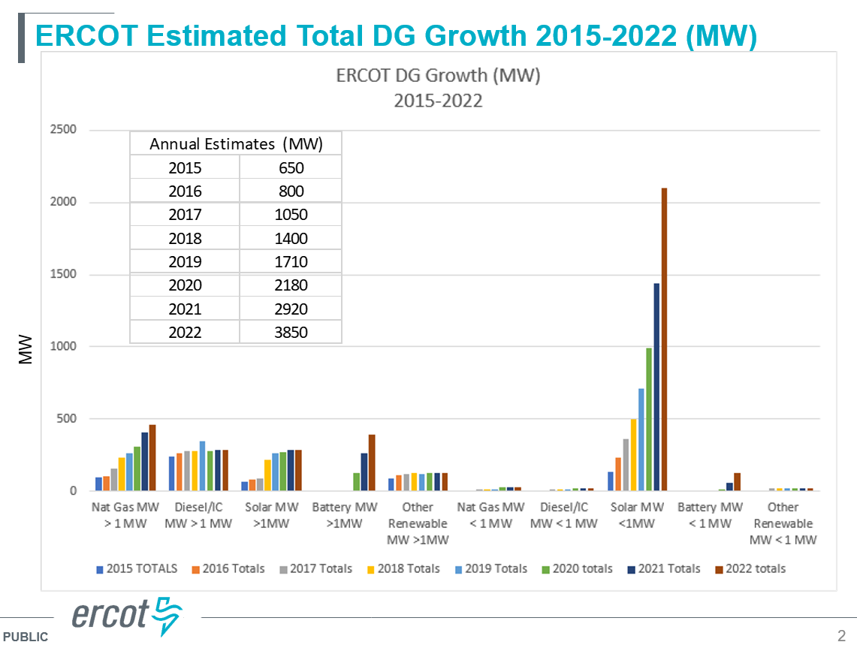
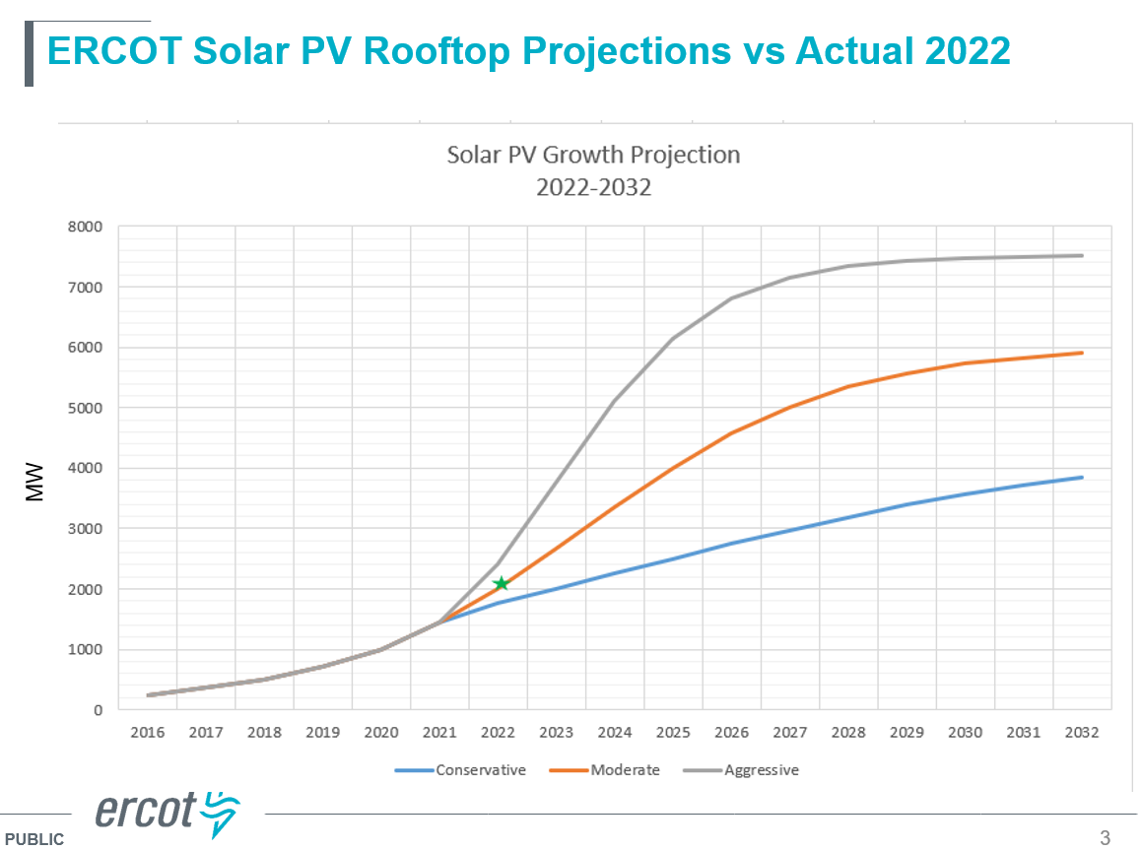
Annual DG Report Follow-up
Currently 3,850 MWs of DG
Solar PV DG is currently >2 GWs (forecasted to increase to 6 GWs by 2032)

Slide 6
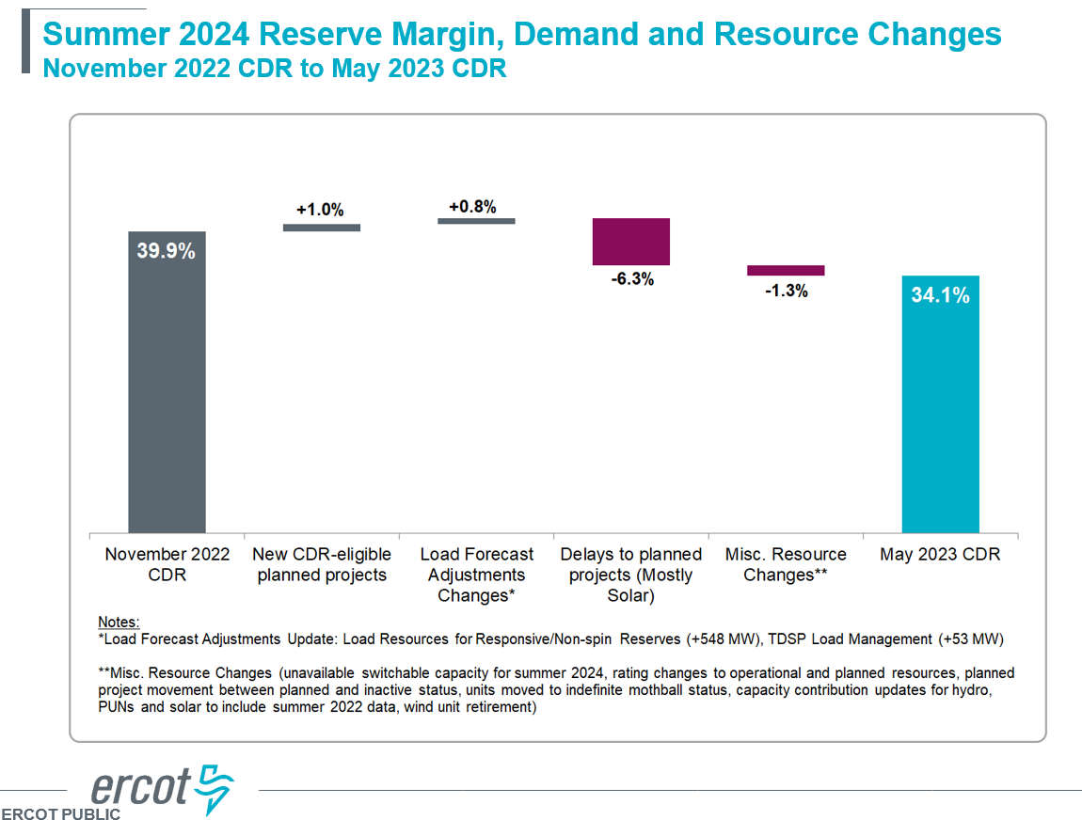
CDR and Summer SARA Review
Summer 2024 Reserve Margin came down 5.8% from November 2022 to May 2023 mainly due to delayed Solar projects
It is assumed that Large Flexible Loads does not consume power during peak load hours
U.S. EPA pending/proposed regs that may impact the availability of fossil-fueled generation units

Slide 7
CDR and Summer SARA Review
Most extreme summer SARA scenario shows a nearly 9 GW shortage
In this scenario, peak load is ~86.8 GWs, thermal outages are ~11.2 GWs, wind is ~0 MWs, and solar is ~12.6 GWs

Slide 8
CDR and Summer SARA Review
Large Flexible Loads
For the peak demand forecast, 220 MW is the amount of stand alone LFLs that are expected to be curtailed for the summer peak demand hour
220 MW = (1,500 MW + 700 MW growth by Summer 2023) x 10%
Due to more recent information regarding LFL interconnections and behavior, ERCOT decided to update both the stand-alone and co-located using the same interim methodology for consistency

Slide 9
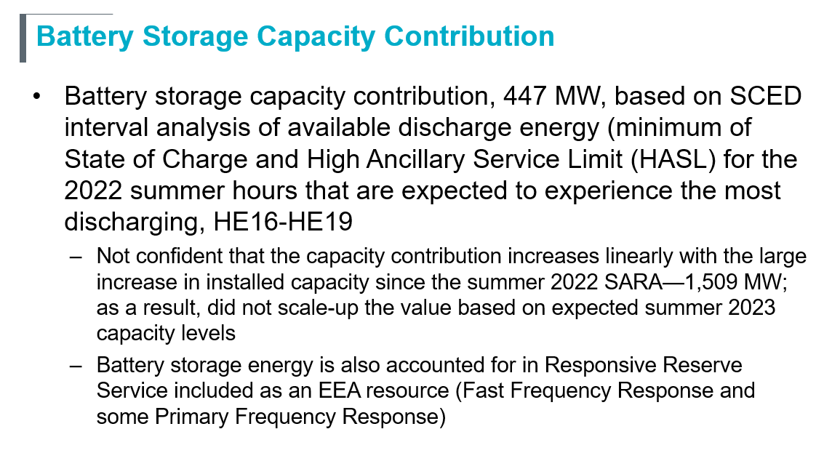
CDR and Summer SARA Review

Slide 10
Summer 2023 Reserve Risk Model Results
Pete Warnken presented the enhanced Reserve Risk Model Results
Hour 9 PM is now the hour with the most capacity scarcity risk due to more installed solar
Inclusion of Prices Responsive Demand is a major difference between the model and the SARA report, and helps explain why the SARA high/extreme scenario outcomes are more severe than the modeled Capacity Available for Operating Reserves (CAFOR) outcomes
The model uses a static amount of battery storage energy availability for all hours; an analysis is needed to determine how to best represent hourly State of Charge available for energy in the model

