Slide 1
PDCWG Report to ROS
Chair: Jimmy Jackson, CPS
Vice Chair: Vacant
ROS
June 8th, 2023

Slide 2
Report Overview & Notes
Report Overview
Meeting Minutes
BAL-001-TRE-2 FMEs and IMFR
0 FMEs in the month of April
Frequency Control Report

Slide 3
Meeting Minutes
PDCWG Meeting 5/17/2023
Overview of NPRR1176, NPRR1178, NGRR253
Follow-up Discussion on GE Study
BAL-001-TRE-SAR Update
ERCOT Reports
TRE Report

Slide 4
Frequency Measurable Events Performance

Slide 5
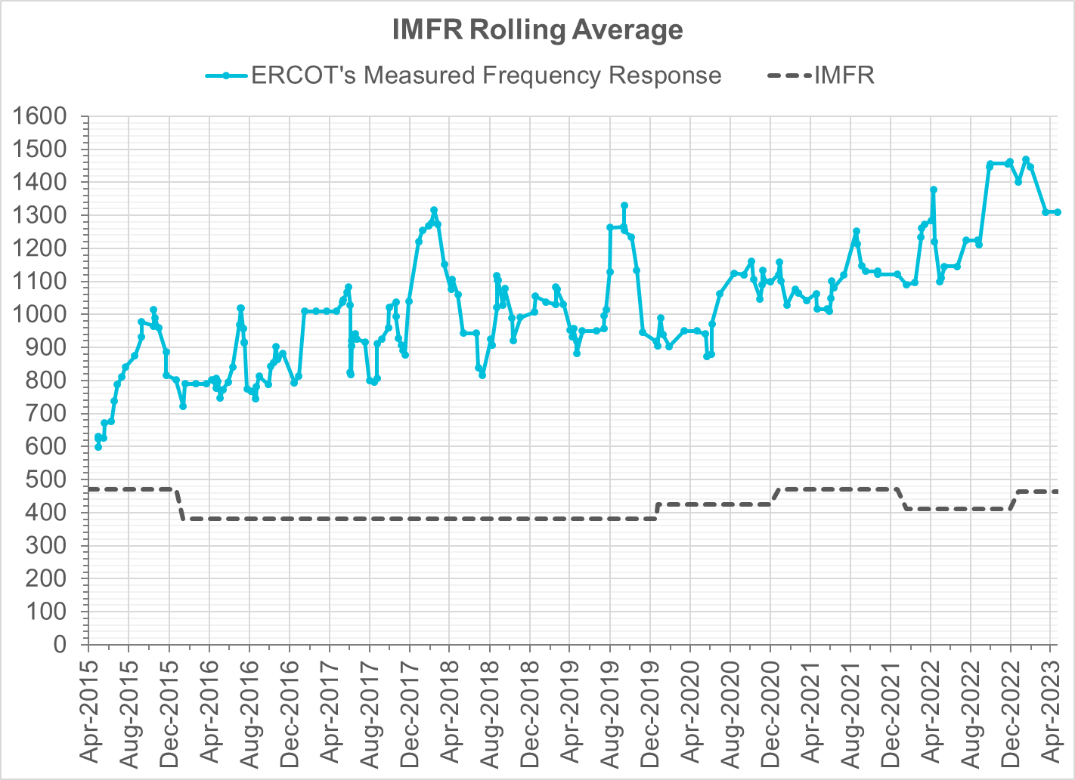
Interconnection Minimum Frequency Response (IMFR) Performance
IMFR Performance currently
1310.33 MW/0.1HZ
Frequency Response Obligation (FRO): 463 MW/0.1 Hz

Slide 6
Questions?

Slide 7
Frequency Control Report
April 2023

Slide 8
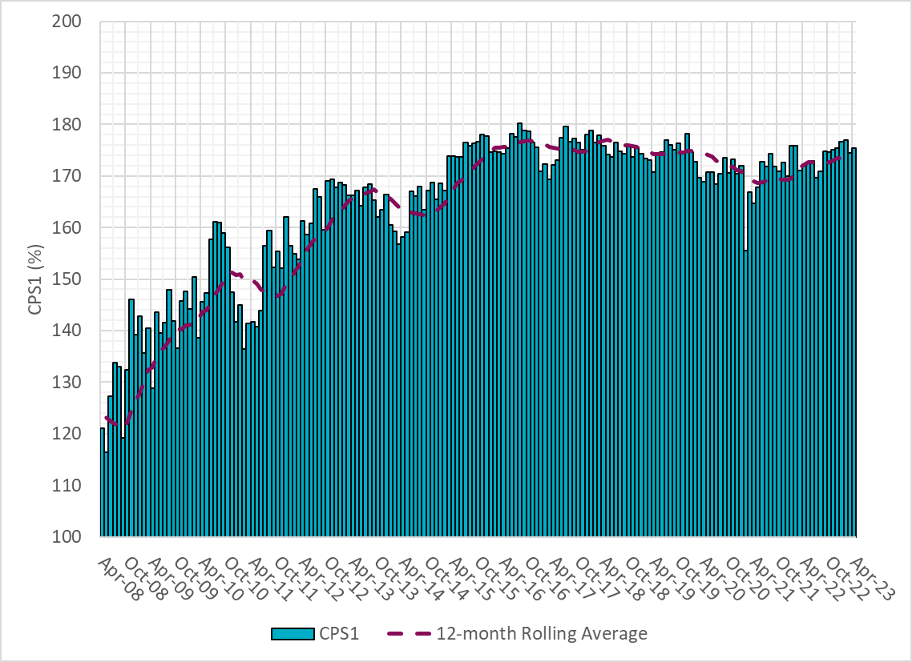
CPS1 Performance

Slide 9
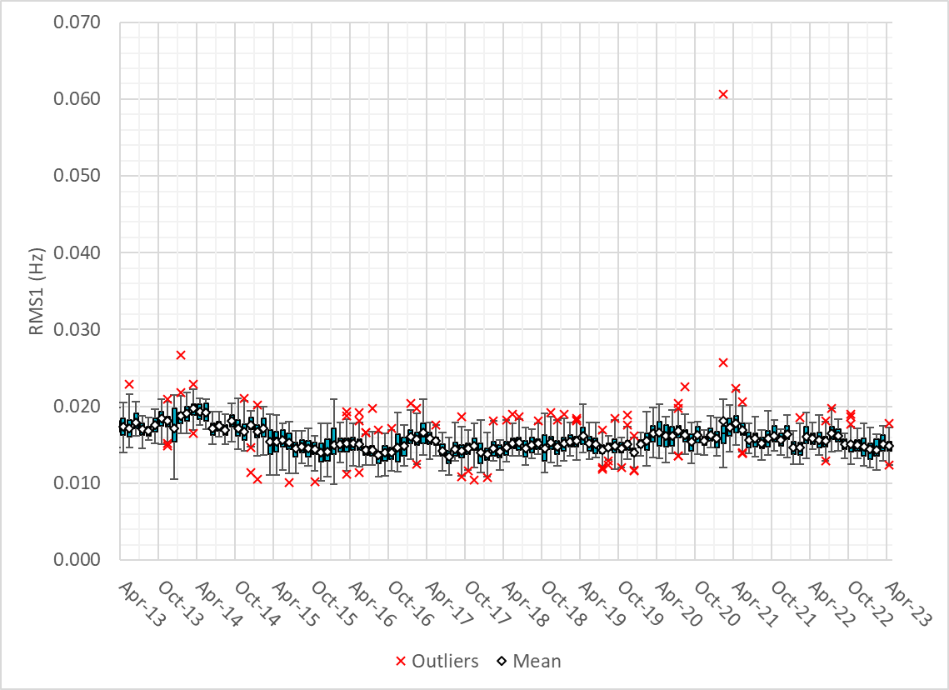
RMS1 Performance of ERCOT Frequency
Notes:
15.13 Mhz on avg for Mar 2023

Slide 10
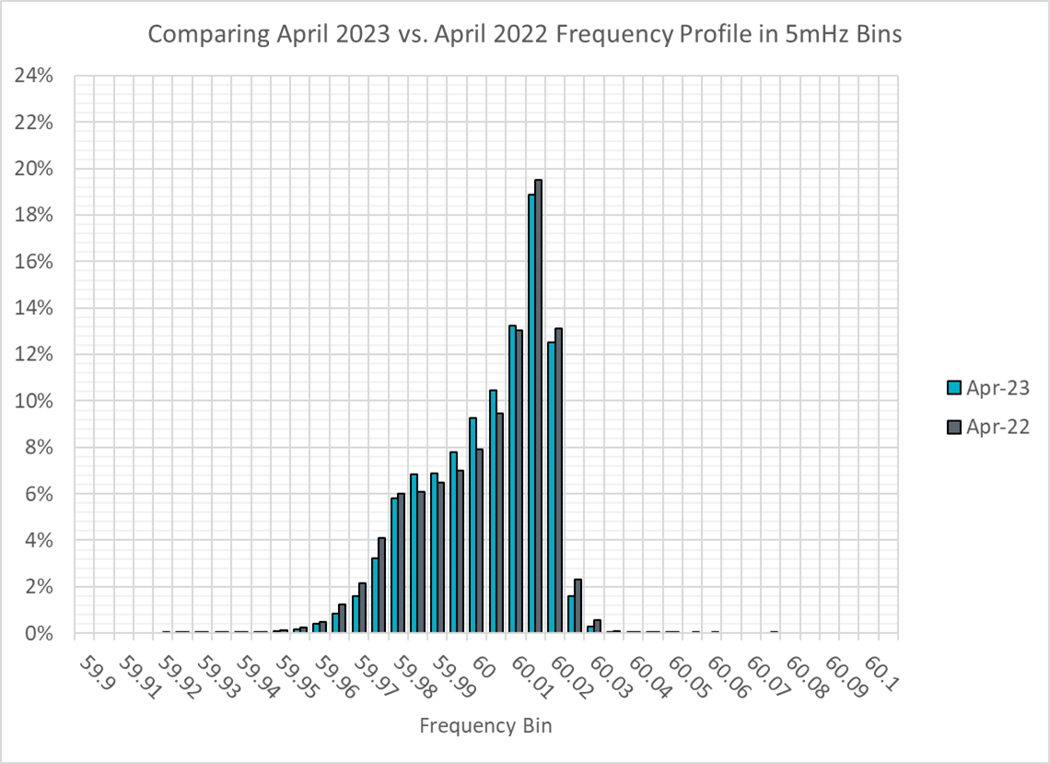
Frequency Profile Analysis

Slide 11
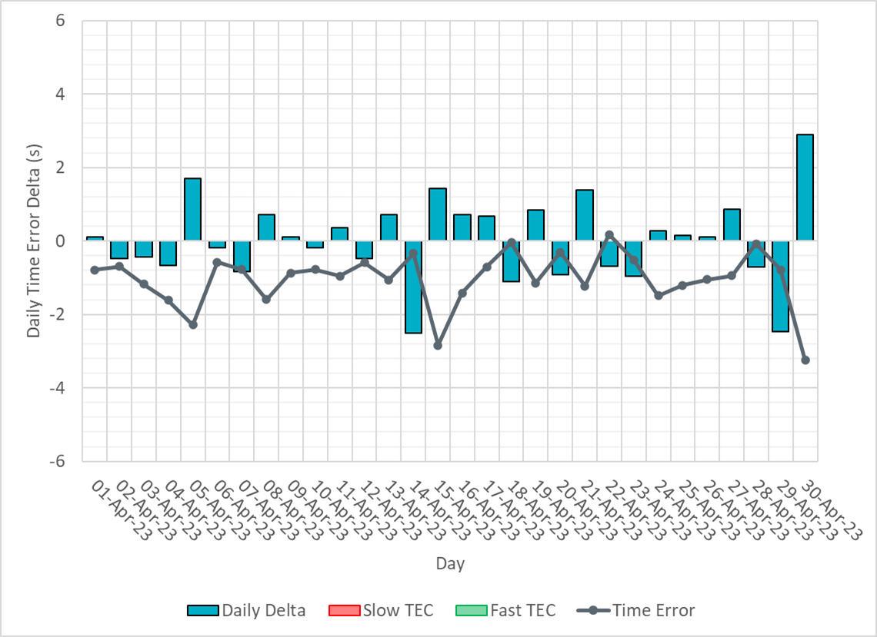
Time Error Corrections

Slide 12
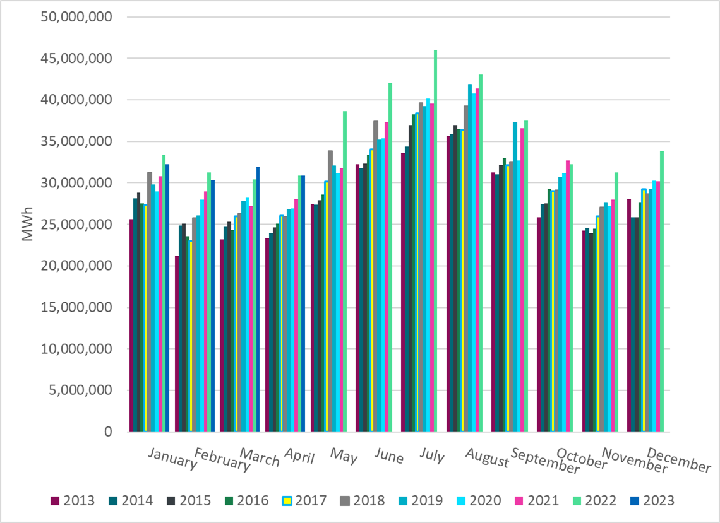
ERCOT Total Energy
Notes:
30,868,163 MWh

Slide 13
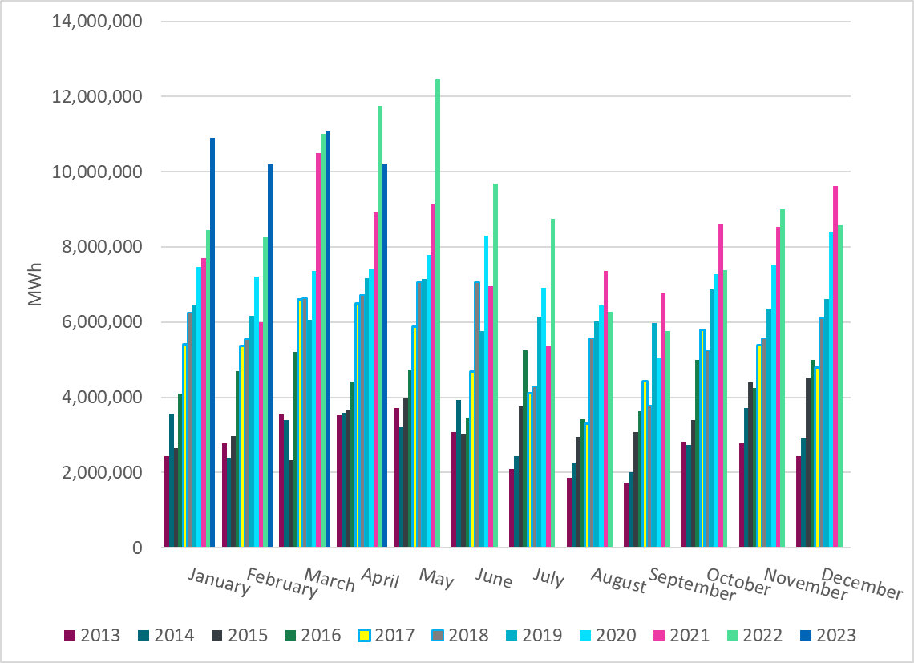
ERCOT Total Energy from Wind Generation
Notes:
10,225,756 MWH

Slide 14
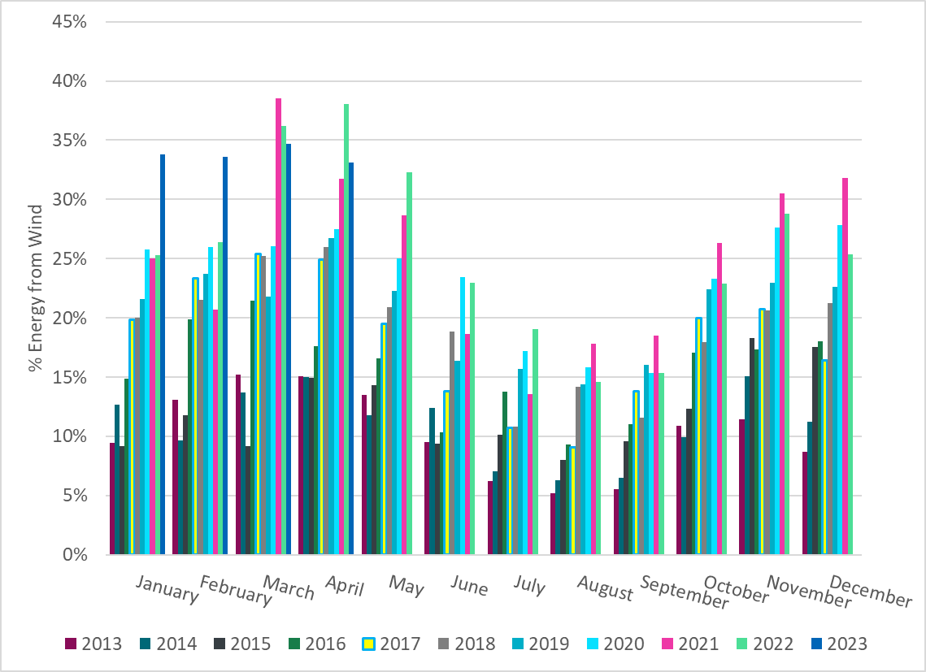
ERCOT % Energy from Wind Generation
Notes:
33.13% of total energy was provided by wind generation

Slide 15
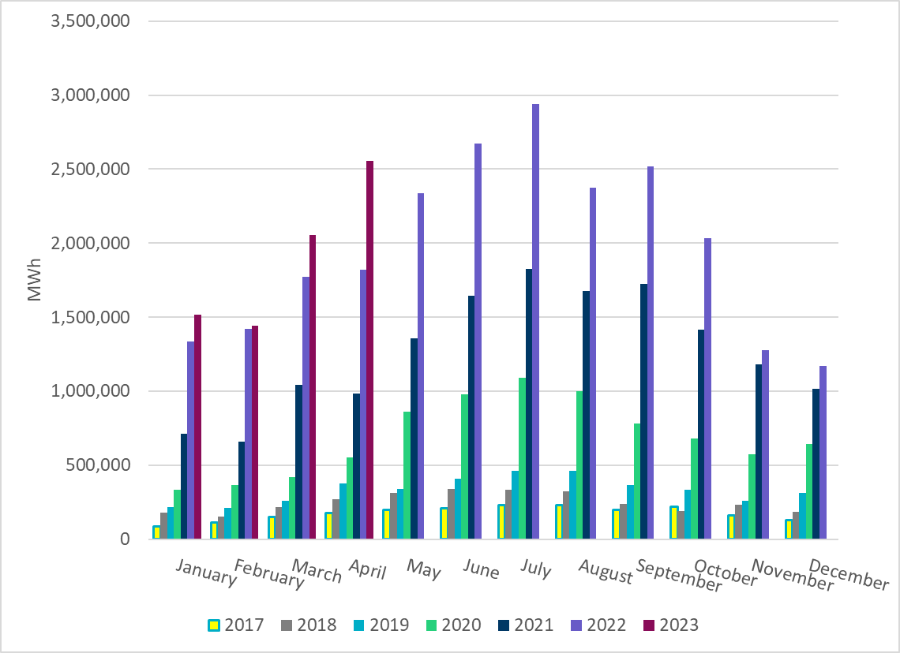
ERCOT Total Energy from Solar Generation
Notes:
2,555,621 MWh

Slide 16
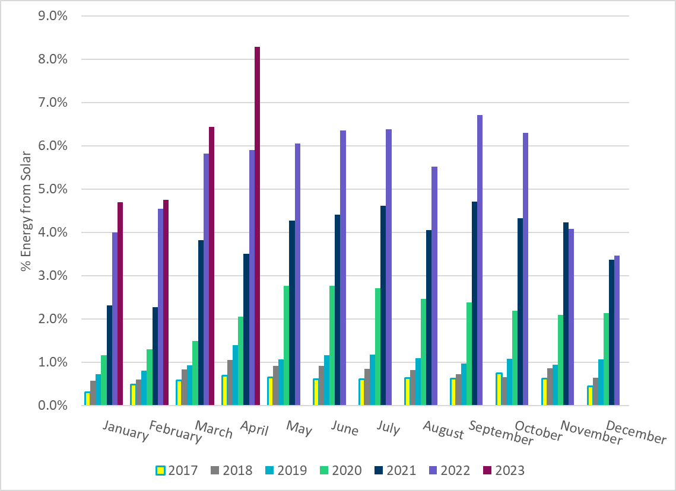
ERCOT % Energy from Solar Generation
Notes:
8.28%

Slide 17
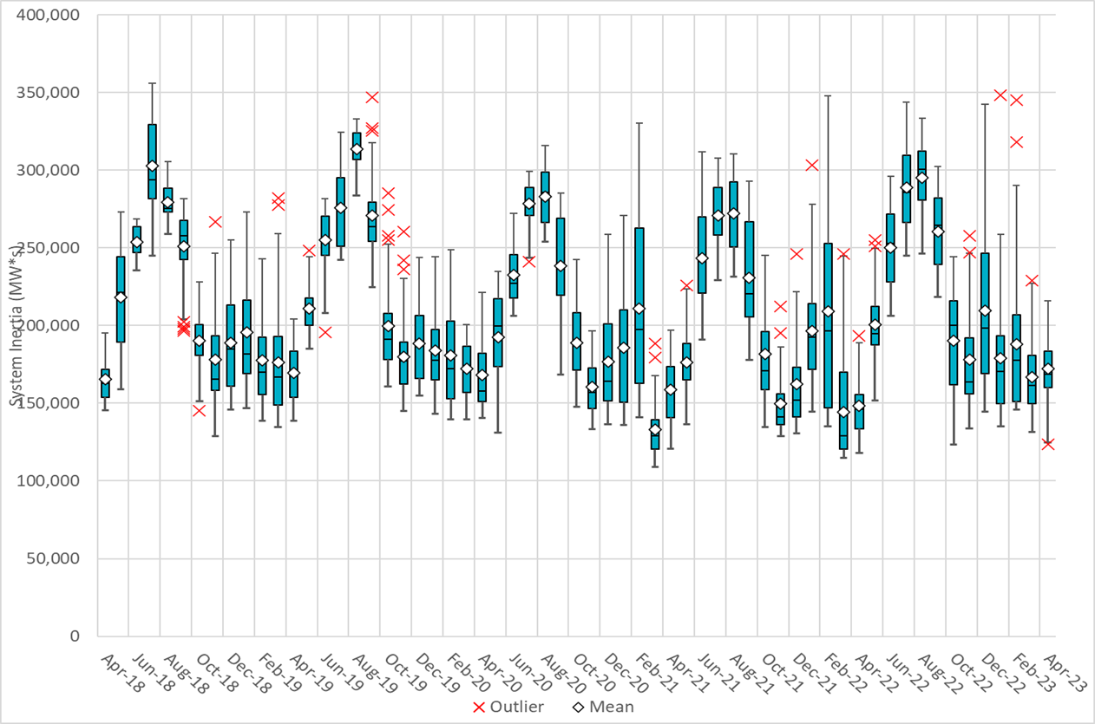
ERCOT Daily Minimum System Inertia
Notes:
Minimum Inertia =123,674 MW*s on 4/18/2023
Previous Minimum was 109,029 MW*s on 3/22/2021
Data:
Mean: 172,489 MW*s
Max: 216,099 MW*s on Apr 10th
Min: 123,674 MW*s on Apr 18th

Slide 18
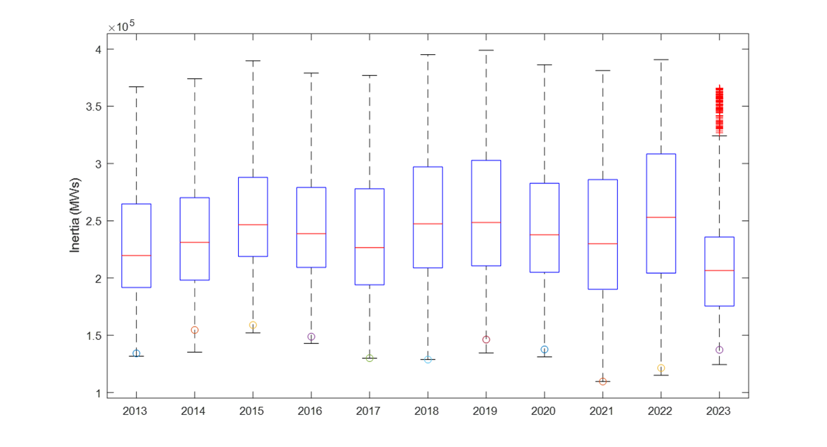
ERCOT Inertia Trend
Notes:
For each box, the central mark (red line) is the median, the edges of the box (in blue) are the 25th and 75th percentiles, the whiskers correspond to +/- 2.7 sigma (i.e., represent 99.3% coverage, assuming the data are normally distributed. The corresponding lowest inertia in each year is given in the table.
The circle on each boxplot is showing inertia during time when highest portion of load was served by wind/solar generation in that year.

