Slide 1
Analysis of Residential PV Performance in Competitive Area of ERCOT
Carl L Raish
Principal Load Profiling and Modeling
Retail Market Subcommittee – June 5, 2023

Slide 2
Residential PV – Analysis Methodology
(same as last year)
Find matching non-pv ESIIDs
  Same Weather Zone, Profile Type
  Stationcode, Zip Code
  Similar usage prior to PV installation
  Closest 5 with greater use and closest 5 with lower use
Baseline load for each PV ESIID is average of the load for the ten matching ESIIDs
Baseline load for non-match Esiids profiled based on average baseline of matched PV ESIIDs in same Weather Zone
PV output = Export + Load Offset (Baseline – Actual Load)
  Export and Actual metered interval data
  Baseline from matching ESIIDs

Slide 3
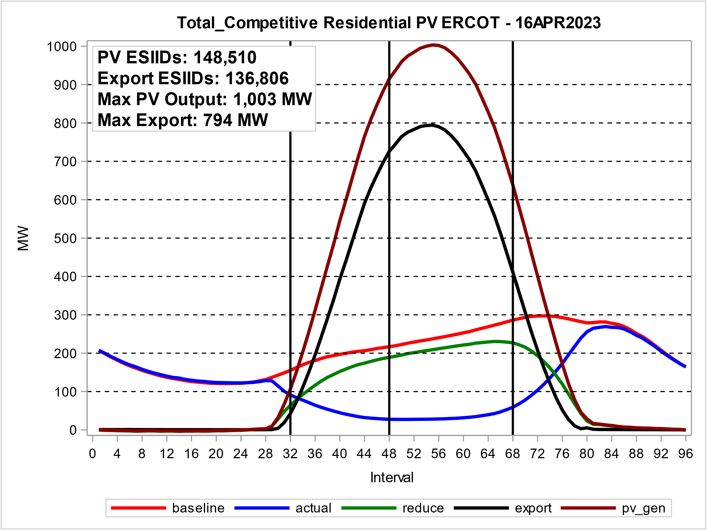
Residential PV – High 2023 PV Output Day
51.6 KWH of PV output per ESIID
33.7 Base KWH per ESIID
6.8 KW of PV output per ESIID

Slide 4
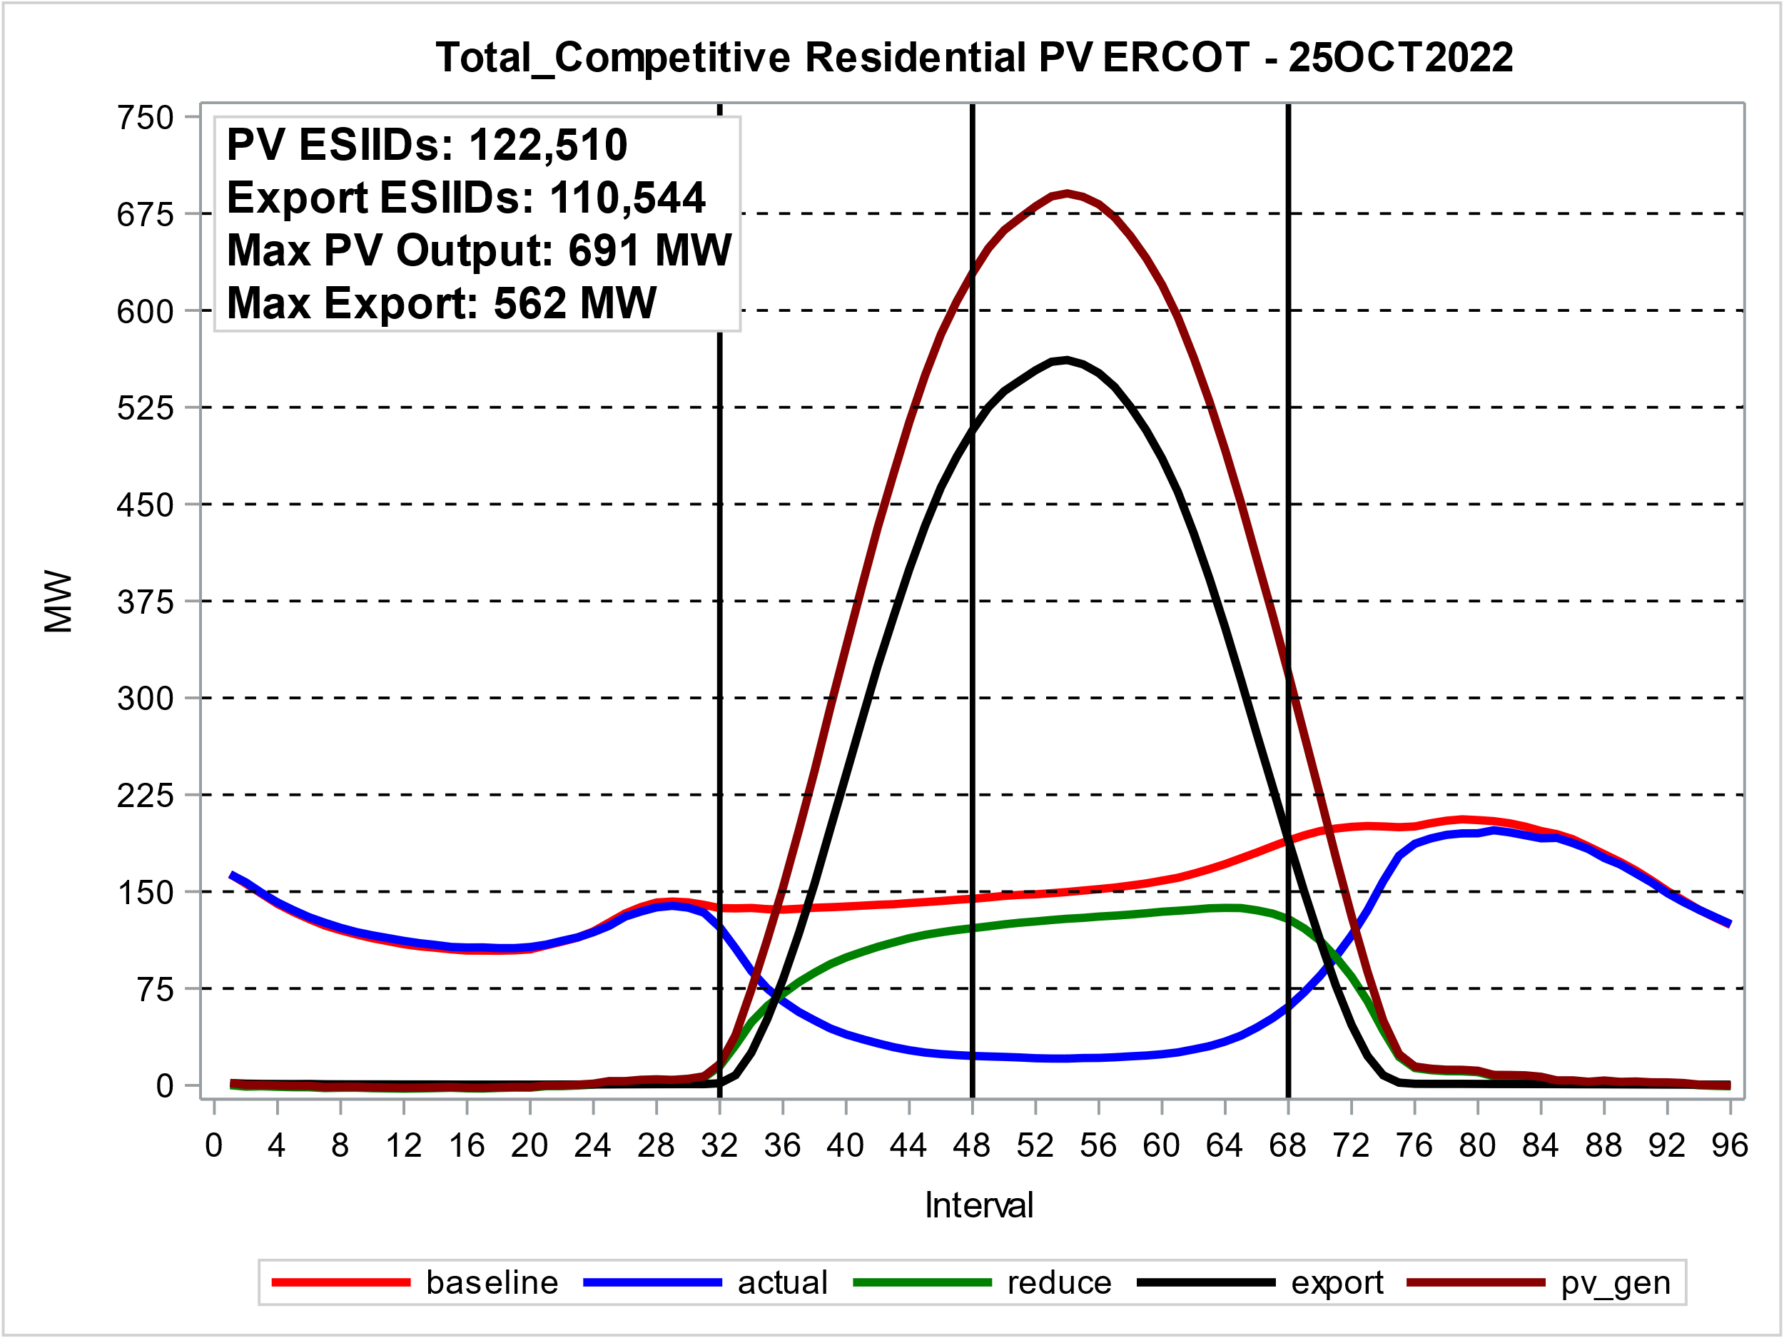
Residential PV – High 2022 PV Output Day
41.8 KWH of PV output per ESIID
39.6 Base KWH per ESIID
6.3 KW of PV output per ESIID

Slide 5
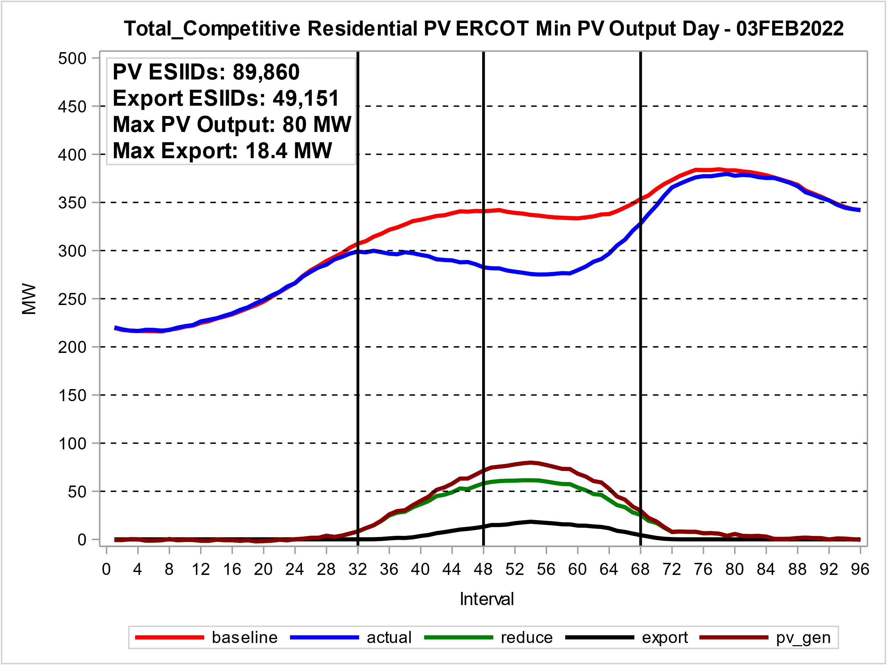
Residential PV – Low 2022 PV Output Day
5.9 KWH of PV output per ESIID
84.3 Base KWH per ESIID
0.9 KW Peak of PV output per ESIID

Slide 6
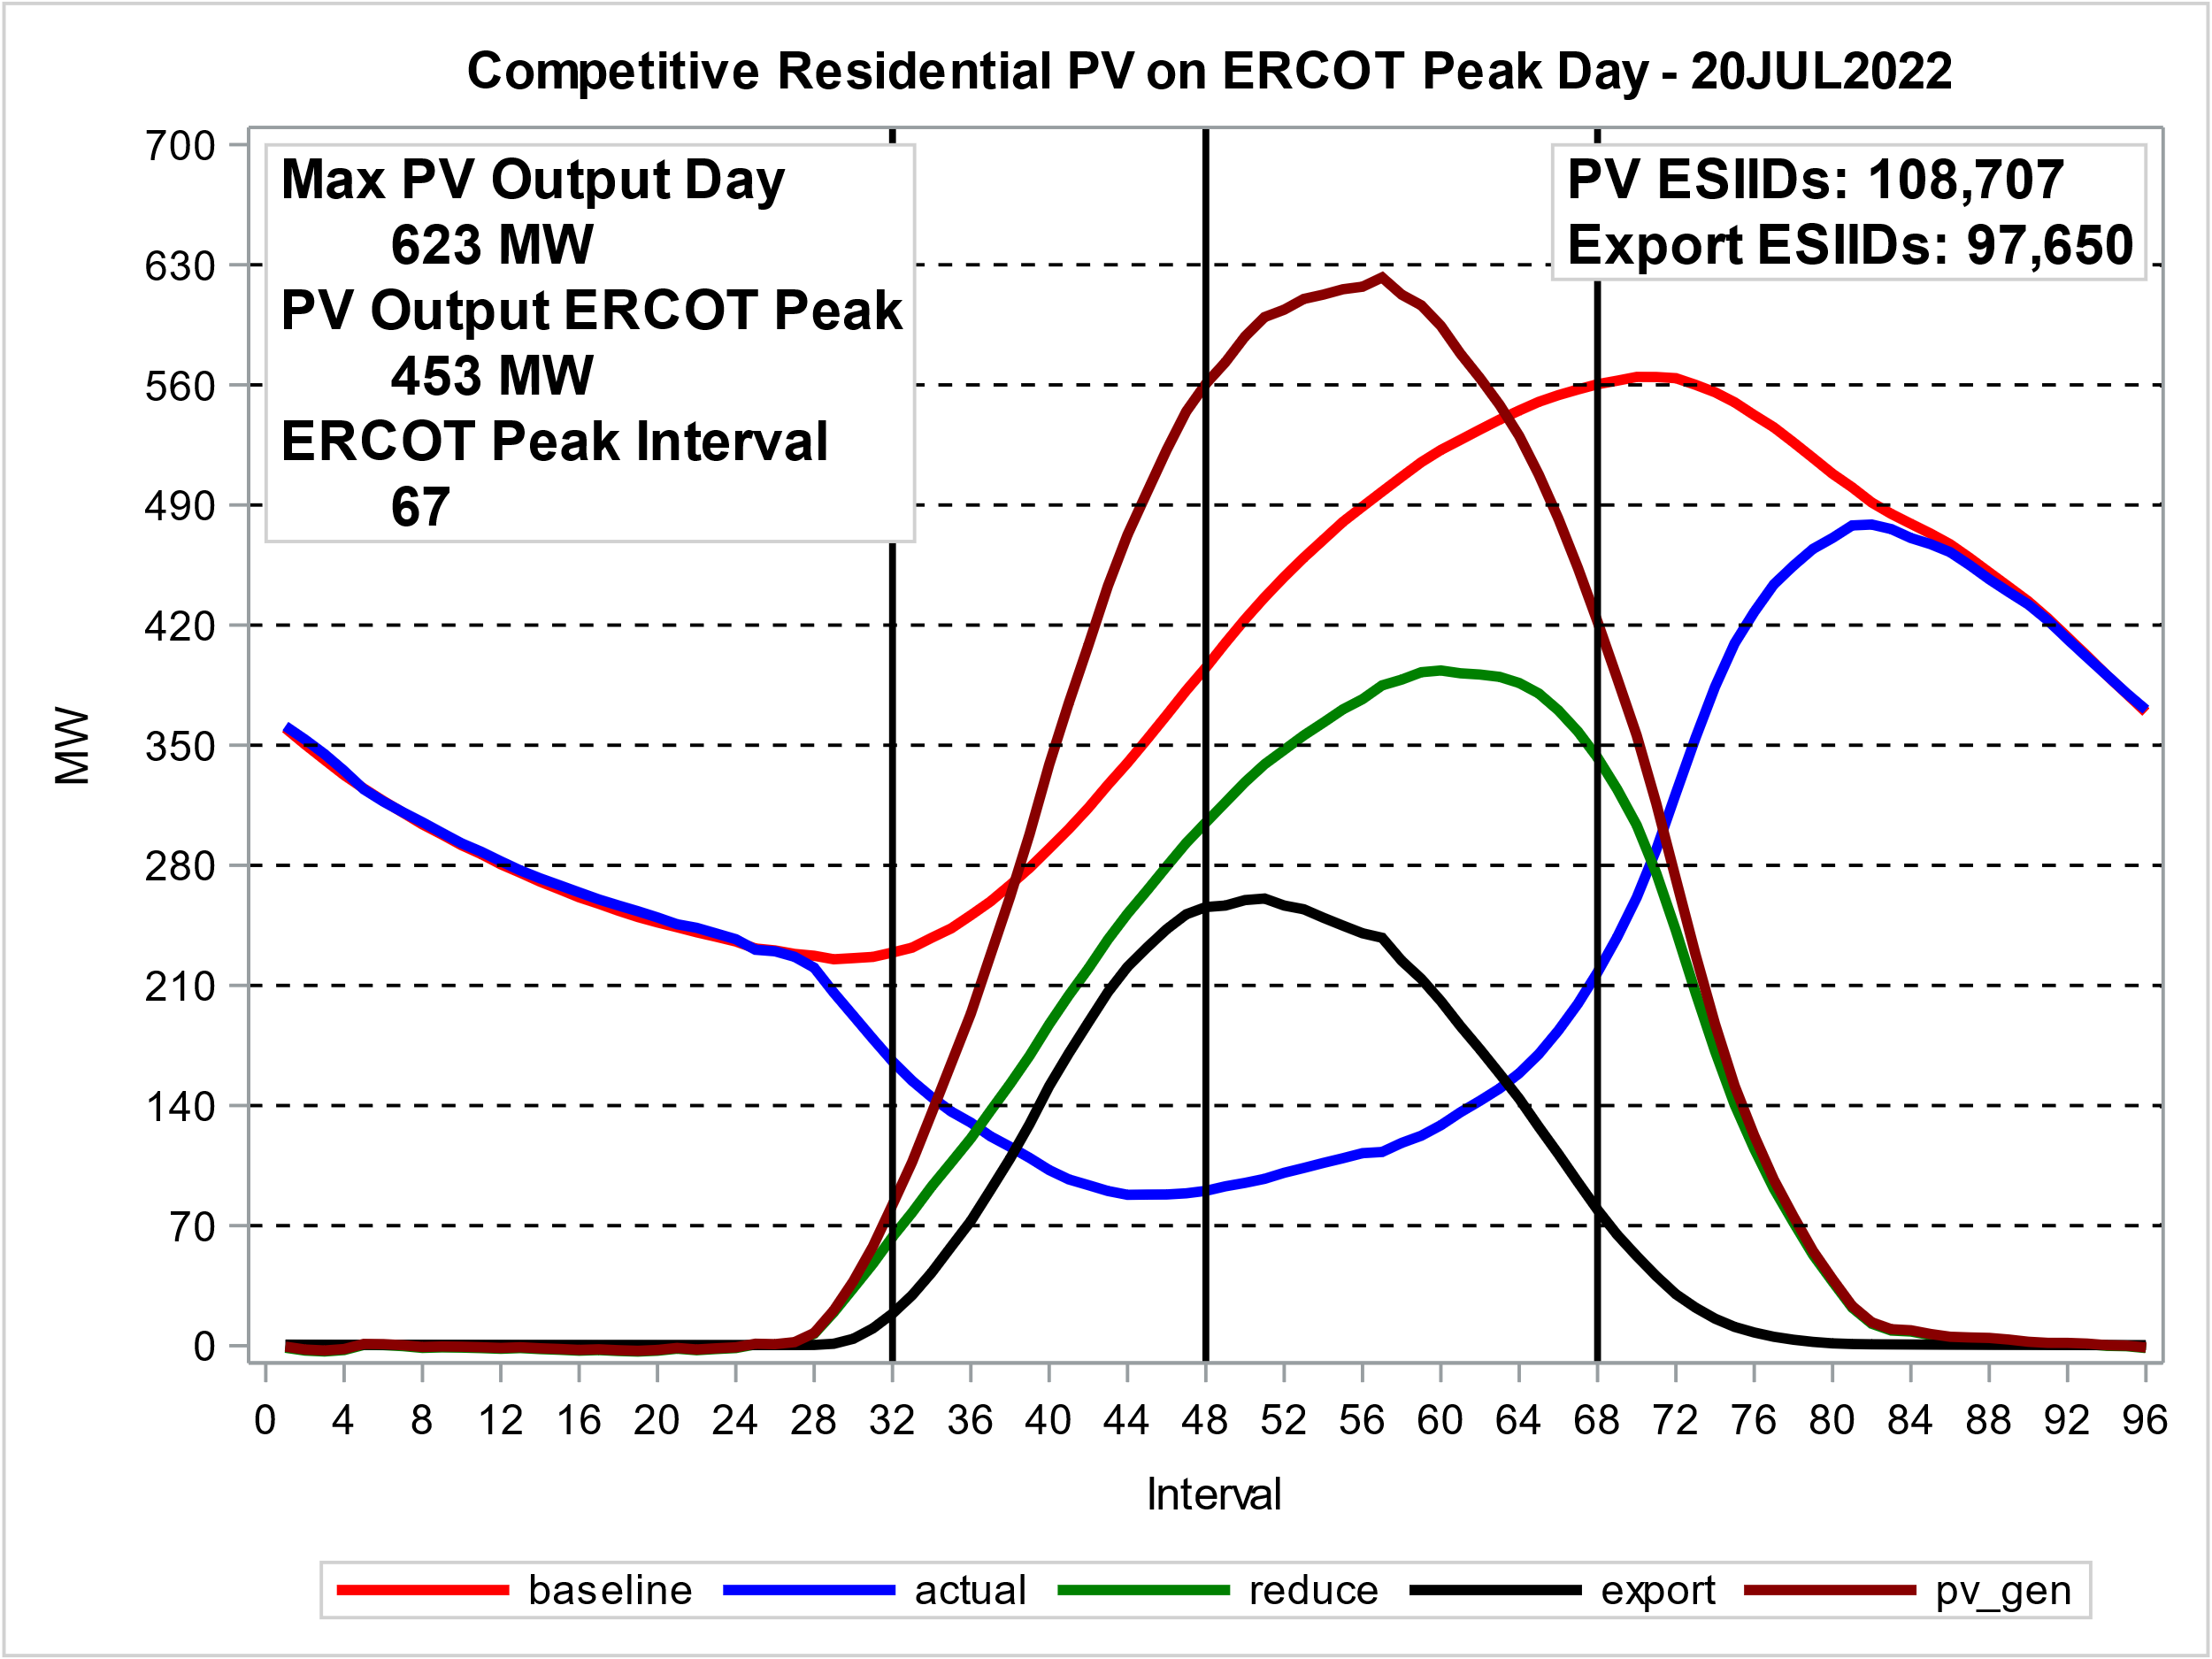
PV Output During ERCOT 2022 Summer Peak
3.6 KW of PV output per ESIID at ERCOT peak (Int 67)
5.7 KW Peak of PV output per ESIID
45.4 KWH PV output per ESIID -- 75.9 Base KWH Per ESIID

Slide 7
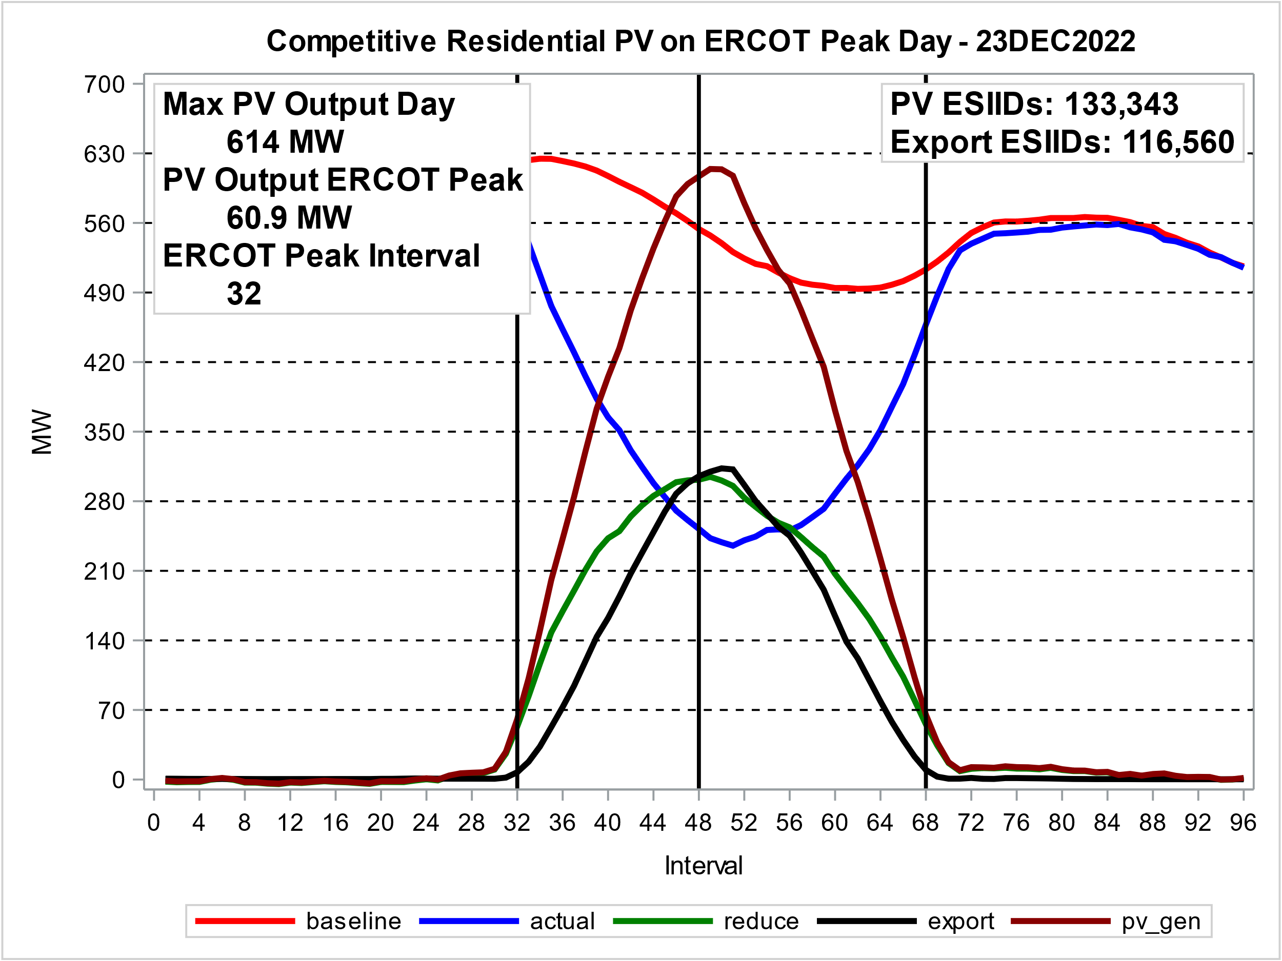
PV Output During ERCOT 2022 Winter Peak
0.05 KW of PV output per ESIID at ERCOT peak (Int 32)
0.5 KW Peak of PV output per ESIID
27.3 KWH PV output per ESIID -- 100.7 Base KWH Per ESIID

Slide 8
Growth ESIIDs and Monthly Max PV Output

Slide 9
Growth ESIIDs and Monthly Max PV Output
ESIIDs
  Added since 2013: 145,612
  Average Annual Growth 2013 – 2022: 53%
Peak PV MWs
  Added since 2013: 1,001 MW
  Average Annual Growth 2013 – 2022: 65%

Slide 10
REPs with PV ESIIDs as of 30May2023
152,614 Active Residential ESIIDs with PV profile
84 Reps with 1 or more PV ESIIDs
8 Reps have 81% of PV ESIIDs
14 Reps have 90% of PV ESIIDs
28 Reps have less than 20 PV ESIIDs
242 PV ESIIDs currently de-energized

Slide 11
Residential PV – Performance by Install Year
PV output KWh increase:
5,100 to 13,800
PV output KW increase:
3.0 to 7.4
Baseline KWh decrease:
21,500 to 18,300

Slide 12
Residential PV – Performance by Install Year
Import KWh decrease:
18,300 to 12,500
Export KWh increase:
3,000 to 7,800
Load Offset KWh increase:
3,200 to 5,800

Slide 13
Residential PV – Performance by Month

Slide 14
Residential PV – Performance by Month

Slide 15
Residential PV – Performance by Install Year
Slope= -110 KWh/yr
Slope= -140 KWh/yr
Slope= -50 KWh/yr
Slope= -110 KWh/yr

Slide 16
Residential PV – Performance by Install Year
Slope= -100 KWh/yr
Slope= -270 KWh/yr
Slope= -140 KWh/yr
Slope= -80 KWh/yr

Slide 17
PV Profile Posting
Excel workbook with 2021 data was posted to PWG meeting page for June 13, 2022.
Separate Tabs Actual, Export and PV Output
Update for 2022 needed?

Slide 18
Questions?
ON
OFF
craish@ercot.com 512/248-3876

Slide 19
Appendix
PV Growth by Weather Zone

Slide 20
Growth ESIIDs and Monthly Max PV Output by Wzone

Slide 21
Growth ESIIDs and Monthly Max PV Output by Wzone

Slide 22
Growth ESIIDs and Monthly Max PV Output by Wzone
Coast
East
FWest
NCent

Slide 23
Growth ESIIDs and Monthly Max PV Output by Wzone
North
SCent
South
West

