Slide 1
LFLTF: Large Load Voltage Ride-Through Requirements
Jeff Billo
Operations Planning
May 31, 2023

Slide 2
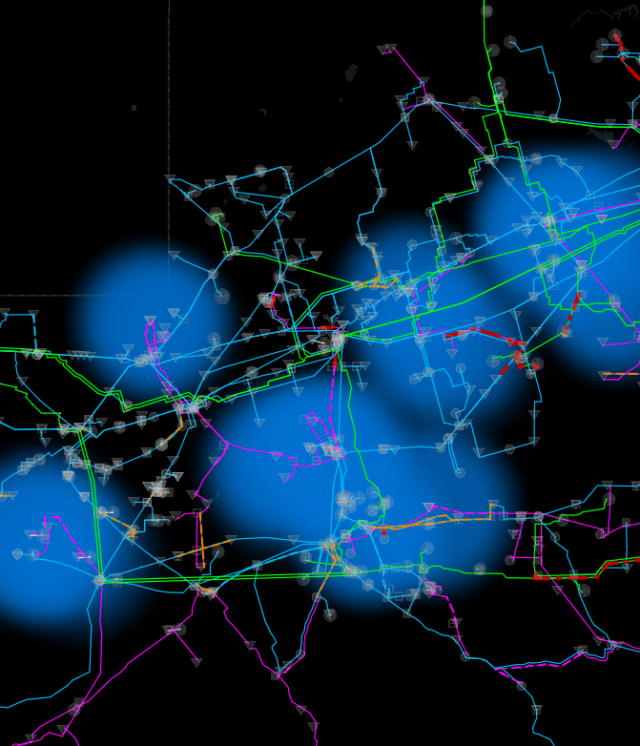
Voltage Ride-Through (VRT)
When there is a fault on the system, voltage at the location of the fault can go to zero volts and voltage in the vicinity of the fault will be depressed
Equipment that is not designed to stay online (“ride-through”) during the depressed voltage can cause or exacerbate reliability problems
  Frequency instability
  Voltage instability (low or high)
  Other issues

Slide 3
VRT Events
The ERCOT system has experienced multiple events in the last year that included loads failing to ride-through a voltage depression
Largest load loss event to-date:
  Multiple faults on 138 kV lines near Odessa at 3:50 AM on December 7, 2022
  Reduction in load of ~1,600 MW
  Load reduction included mix of LFLs, oil/gas load, and other industrial loads
  Two thermal generators tripped during the event, totaling 112 MW
  System frequency spiked to 60.235 Hz

Slide 4
Considerations
Historically, engineers have considered some load reduction/ tripping during a fault/ low voltage as permissible and sometimes preferable, particularly for loads that increase real or reactive power consumption at lower voltages
However, as the amounts of voltage-sensitive loads increase and system strength decreases, the likelihood of large amounts (GWs) of load loss during a voltage excursion increases, which can lead to frequency instability and potentially other reliability issues
To address this reliability risk, ERCOT has developed a ride-through standard proposal for large loads
Consideration given to IBR ride-through requirements, CBEMA (1970s), ITIC (1990s), and IEEE 1668 (2017)¹
1 https://standards.ieee.org/ieee/1668/6798/

Slide 5
Large Load Voltage Ride-Through Standard Proposal (1/2)
Large Loads that interconnect to the ERCOT Transmission Grid must ride through and shall not cease its power consumption for the following operating conditions in Tables A and B, as measured at the Large Load’s Point of Interconnection:
From ITIC Curve
Based on IEEE 1668 Single-Phase and Phase-Phase Curve
Based on proposed IBR requirements in NOGRR245
Based on ITIC Curve, but extended to ride-through fault duration

Slide 6
Large Load Voltage Ride-Through Standard Proposal (2/2)
Large Loads that interconnect to the ERCOT Transmission Grid and that consist of primarily power electronic equipment and/or variable speed drives must use constant current control and may not use constant power level control.
The purpose of this requirement is to prevent loads that are riding-through the voltage excursion from exacerbating the low voltage conditions.
A similar recommendation was made in the NERC-WECC paper on electric vehicle charging performance: https://www.nerc.com/comm/RSTC/Documents/Grid_Friendly_EV_Charging_Recommendations.pdf

Slide 7
Next Steps
Provide feedback
ERCOT will include draft language in the LFL revision requests

