Slide 1
UFLS Options
Bill Blevins
LFLTF - May 31, 2023

Slide 2
Agenda
No Change
ERCOT Option 1
Cholla Option
ERCOT Option 1 simplified
ERCOT new Option

Slide 3
Concept
Require connecting Large Loads to register as either Firm/Native Load or LFL
Based on this selection apply UFLS rules
LFL loads would be required to install and maintain UFLS based on same settings as Firm/Native Load UFLS.
LFL loads would certify their UFLs and provide details to TSP and ERCOT when established or modified.
LFLs will be required to have a minimum 5% of UFLs.
LFL stage would be established by the amount of load they can place behind the UFLs relay.
Take this out of the TSP obligation for Flexible Loads.
Consider if the obligation can be simpler and flexible to ensure Flexible Loads contribute but allow for some variation in how the LFL sets the UFLs.
Set the UFLs in the 5 stage settings using NOGRR 247.
Have the LFLs who set at 5% stage 1 implement the anti stall settings as well.

Slide 4
NOGRR 247
Frequency Threshold | TO Load Relief | Delay to Trip
59.3 Hz | At least 5% of the TO Load | At least six cycles but no more than 30 cycles
59.1 Hz | A total of at least 10% of the TO Load | At least six cycles but no more than 30 cycles
58.9 Hz | A total of at least 15% of the TO Load | At least six cycles but no more than 30 cycles
58.7 Hz | A total of at least 20% of the TO Load | At least six cycles but no more than 30 cycles
58.5 Hz | A total of at least 25% of the TO Load | At least six cycles but no more than 30 cycles

Slide 5
UFLS example on an LFL site
6895
5000
5500
5800
6000
6800
LD
-
1
-
LD
-
2
LD
-
3
LD
-
4
LD
-
5
LD-6
5%
UFLS
UFLS
Meets
requirement
Would be stage 1
H

Slide 6
UFLS example on an LFL site
6895
5000
5500
5800
6000
6800
LD
-
1
-
LD
-
2
LD
-
3
LD
-
4
LD
-
5
LD-6
12%
UFLS
UFLS
Meets
requirement
Would be stage 2
H

Slide 7
UFLS example on an LFL site
6895
5000
5500
5800
6000
6800
LD
-
1
-
LD
-
2
LD
-
3
LD
-
4
LD
-
5
LD-6
>25%
UFLS
UFLS
Meets
requirement
Would be stage 5
H

Slide 8
UFLs examples

Slide 9
UFLS Examples

Slide 10
Summary
LFLs would have a UFLs obligation of at least 5% but could put more and would need to set their trip setting depending on the amount they would have set to trip on UFLs.
Simpler than ERCOT original option.
Addresses TO concerns for LFLs who may or may not be operating if TO has the obligation.
Simpler than the Cholla option
Appears to help the existing UFLs stages meet reliability objective.

Slide 11
New idea
Have the Distribution Load be handles the way it has i.e. each DSP has to cover the 5 stages at 5%.
Have all Transmission Large Loads placed in a separate group.
ERCOT randomly assigns the stage for the sites in this group to match the 5 stages of Distribution Load.
ERCOT communicates to the TDSP the load which were selected and the stage the load needs to be assigned.
This group isn’t counted against the TDSP if the load is off when the event occurs.

Slide 12
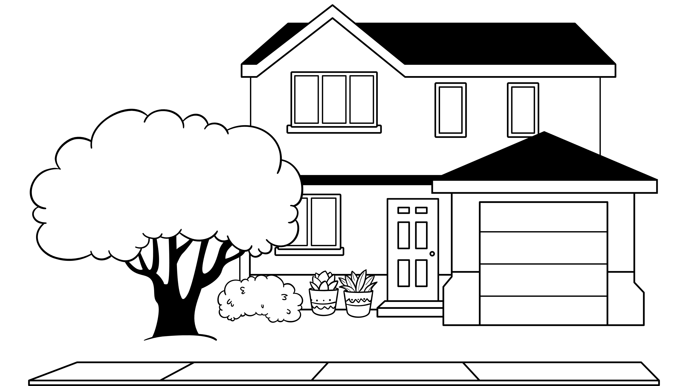
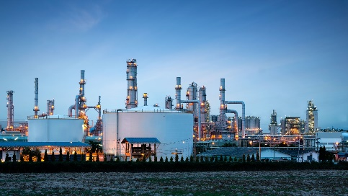
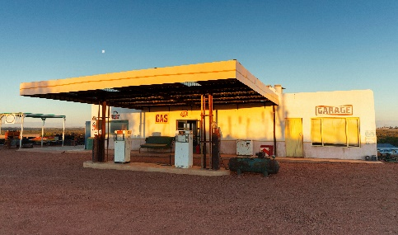
Example New Idea
Transmission Loads ERCOT sums all these Loads and randomly selects load and stage for Load and request the TSP to install the UFLs. This isn’t counted against the DSP Native Load and is accounted for in the overall UFLS. ERCOT attempts to match the stages of the other loads.
Typical Distribution Loads handle same as before. DSP has to cover 5% up to 25% and sets the relays

Slide 13
New Idea
Is this simpler?
Is it easier?
It addresses issues with some TSPs that have small native load but also have some large Industrial type loads which may be ramping to respond to price.
This still keeps the certification of UFLs being done by the TDSPs.
Does allow for some flexibility if tripping a particular Large Load has safety impacts.
Having more non-weather-sensitive load in the UFLS program makes the UFLS stage amounts less variable due to differing weather conditions

