Slide 1
CDR and SARA Review
Pete Warnken
Resource Adequacy
ERCOT Public
May 19, 2023

Slide 2
Capacity, Demand and Reserves Report

Slide 3
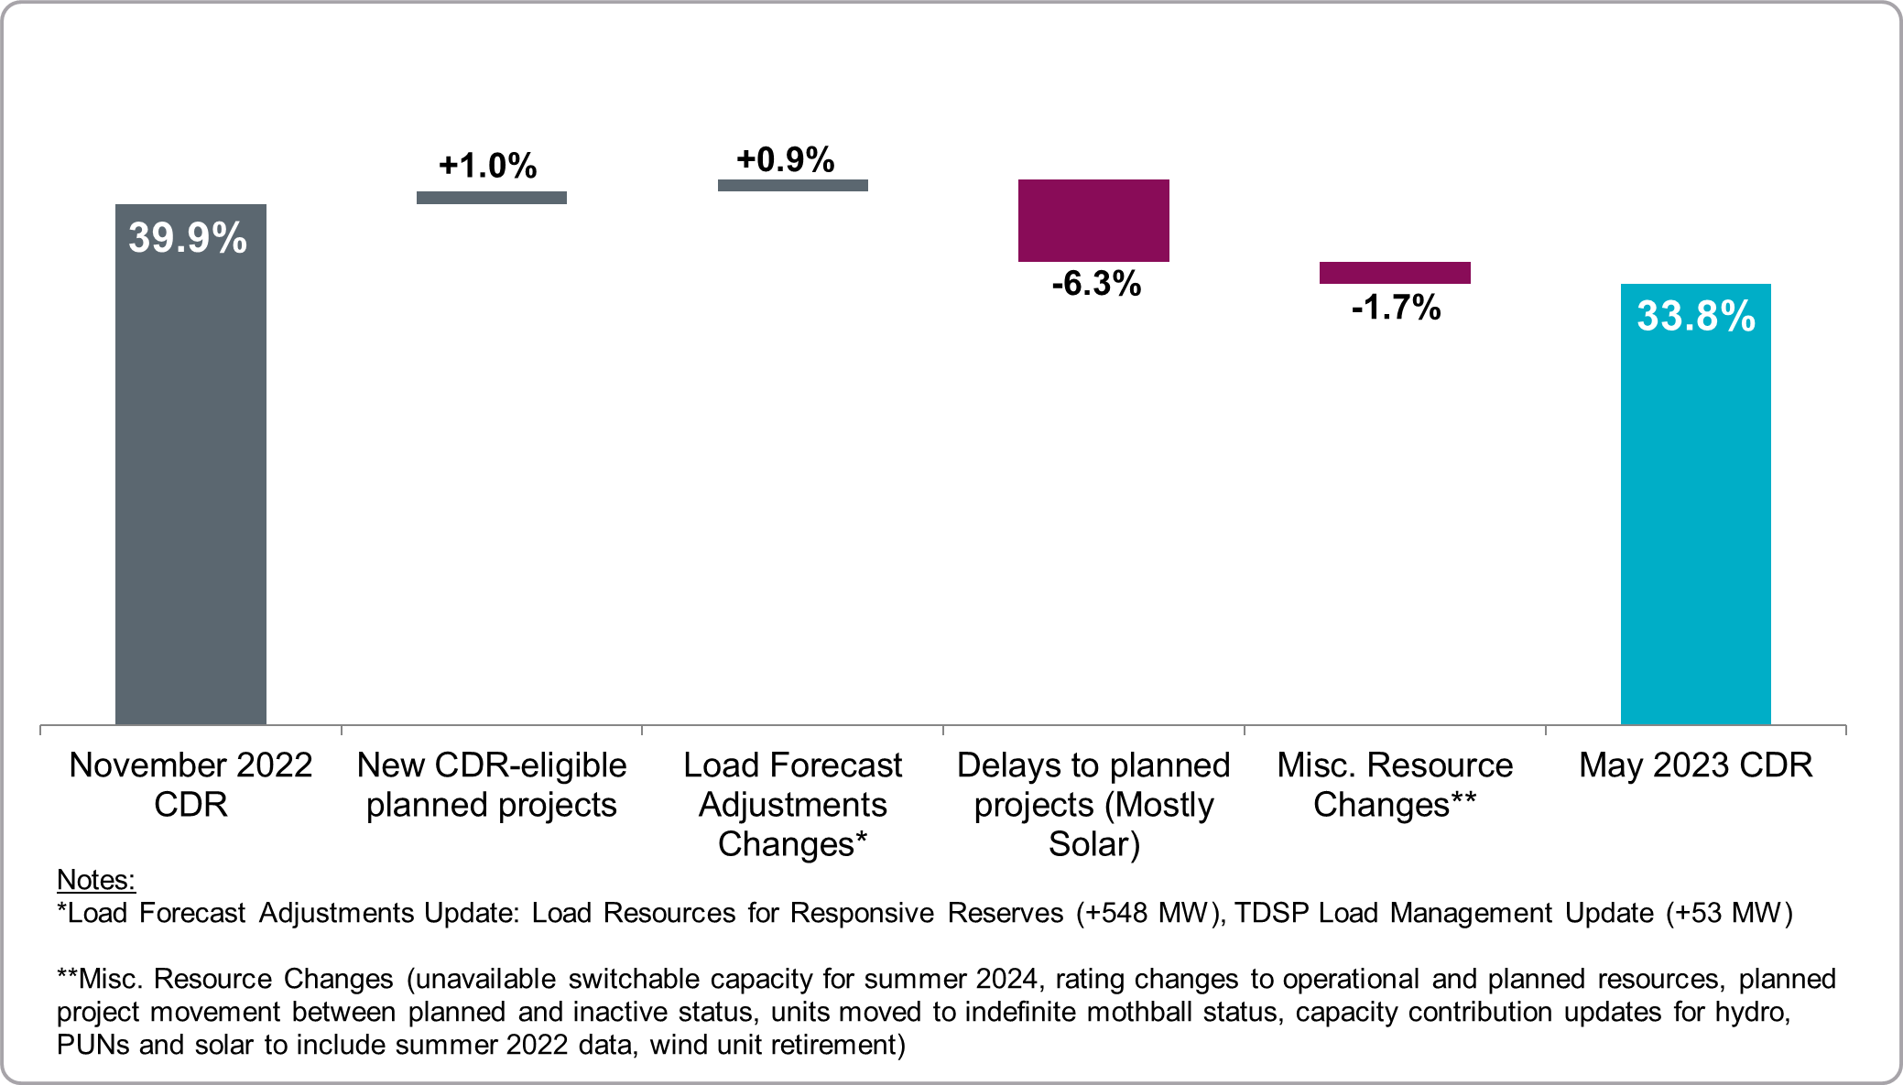
Summer 2024 Reserve Margin, Component Changes November 2022 CDR to May 2023 CDR

Slide 4
CDR Highlights
As a longer-term planning assumption, Large Flexible Loads do not consume power during the peak load hours (i.e., are fully curtailable when needed by ERCOT)
The owner of one of the Kiamichi Switchable Generation Resource (150 MW) notified ERCOT that the unit would be serving SPP
Includes a new supplemental tab that compares Reserve Margin calculations with a 9 PM version that accounts for lower solar production, lower load, and higher wind
The 9 PM Reserve Margin is 8.8 percentage points lower than the traditional 5 PM Reserve Margin
Two new planned natural gas projects became eligible for CDR inclusion since the November 2022 CDR (Remy Jade II Power Station – 104 MW, and Sky Sealy – 129 MW). Current CDR eligible planned thermal projects total 1,568 MW

Slide 5
CDR Highlights, continued
On the Horizon: U.S. EPA pending/proposed regs that may impact the availability of fossil-fueled generation units:
Federal Implementation Plan (FIP) for interstate transport of ozone-forming emissions (“Good Neighbor Plan”)
Coal Combustion Residuals Standards
Mercury and Air Toxics Standards
Proposal to implement SO₂ Best Available Retrofit Technology (BART) requirements for certain Texas generation units under the Regional Haze rule
EPA proposed rule to control Greenhouse Gas emissions through changes to New Source Performance Standards and emission guidelines for existing generation units (issued May 8, 2023)

Slide 6
Summer 2023 Seasonal Assessment of Resource Adequacy (SARA) Report

Slide 7
Base and Risk Scenarios

Slide 8
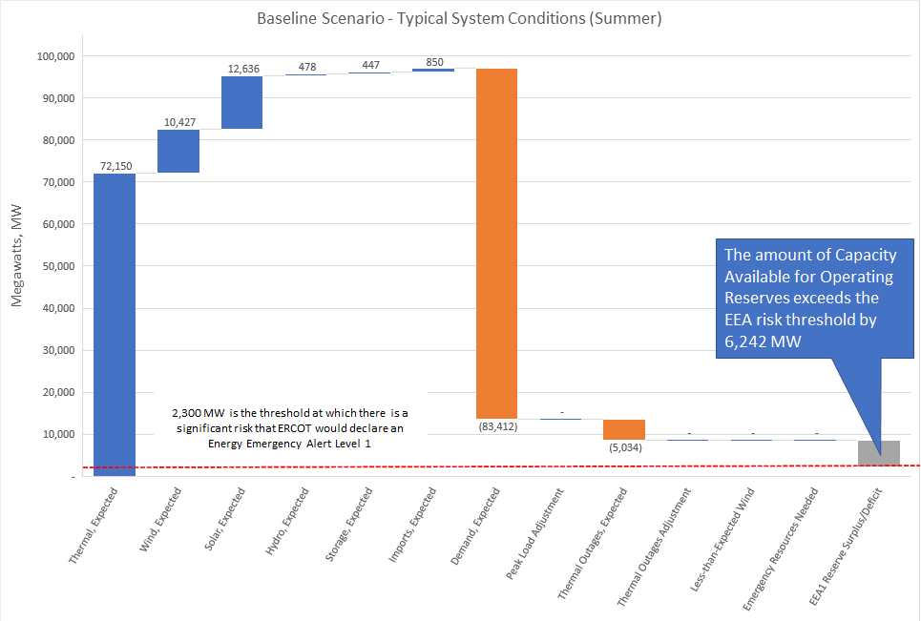
Base Scenario – Waterfall Chart

Slide 9
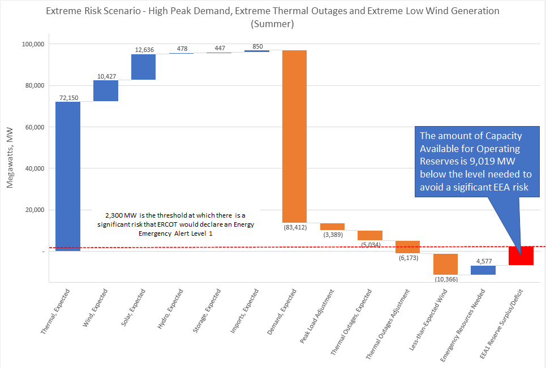
Most Extreme Scenario – Waterfall Chart

Slide 10
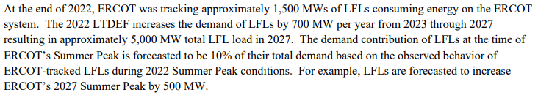
Large Flexible Loads
For the peak demand forecast, 220 MW is the amount of stand-alone LFLs that are not expected to be curtailed for the summer peak demand hour
Methodology description from the Long-Term Hourly Peak Demand and Energy Forecast methodology document:
220 MW = (1,500 MW + 700 MW growth by Summer 2023) x 10%
Due to more recent information regarding LFL interconnections and behavior, ERCOT decided to update both the stand-alone and co-located using the same interim methodology for consistency

Slide 11
Large Flexible Loads, continued
Interim methodology applied to all LFLs:
Determined the 20 hours over each of the past three years with the lowest average Physical Responsive Capability
For each hour, compared the LFL’s historical Load Zone price with the Bitcoin mining breakeven cost
If the market price is lower than the breakeven cost, then the load's peak summer consumption is the maximum observed consumption at the site according to internal project tracking
If the market price is higher than the breakeven cost, then the LFL was assumed to be fully curtailed except for 3% of the load's maximum capability
Average the consumption values for the 60 low PRC hours
Resulting amounts are: 837 MW for stand-alone, 488 for co-located – total of 1,325 MW
Since the demand forecast includes 220 MW, this amount is deducted from 1,325 MW to avoid double-counting (1,150 MW)

Slide 12
Battery Storage Capacity Contribution
Battery storage capacity contribution, 447 MW, based on SCED interval analysis of available discharge energy (minimum of State of Charge and High Ancillary Service Limit (HASL) for the 2022 summer hours that are expected to experience the most discharging, HE16-HE19
Not confident that the capacity contribution increases linearly with the large increase in installed capacity since the summer 2022 SARA—1,509 MW; as a result, did not scale-up the value based on expected summer 2023 capacity levels
Battery storage energy is also accounted for in Responsive Reserve Service included as an EEA resource (Fast Frequency Response and some Primary Frequency Response)

