Slide 1
Public API Capabilities
Presented by: Omar Soberanis and Michael Ackermann
Date: 5/18/2023

Slide 2
ERCOT Public API Updates
Project Timelines
Historical Data and 35 Reports
UTC Date Standards
OpenAPI Specifications

Slide 3
Public API Timenline
June 2022
Concept and Initiation Phase
(Planning)
May 2023
Planning
(Team Composition and POC)
August 2023
Execution - Development Completed
Sept 2023
Execution - Testing
Oct 2023
Public and Market Training
Nov 2023
Production Release

Slide 4
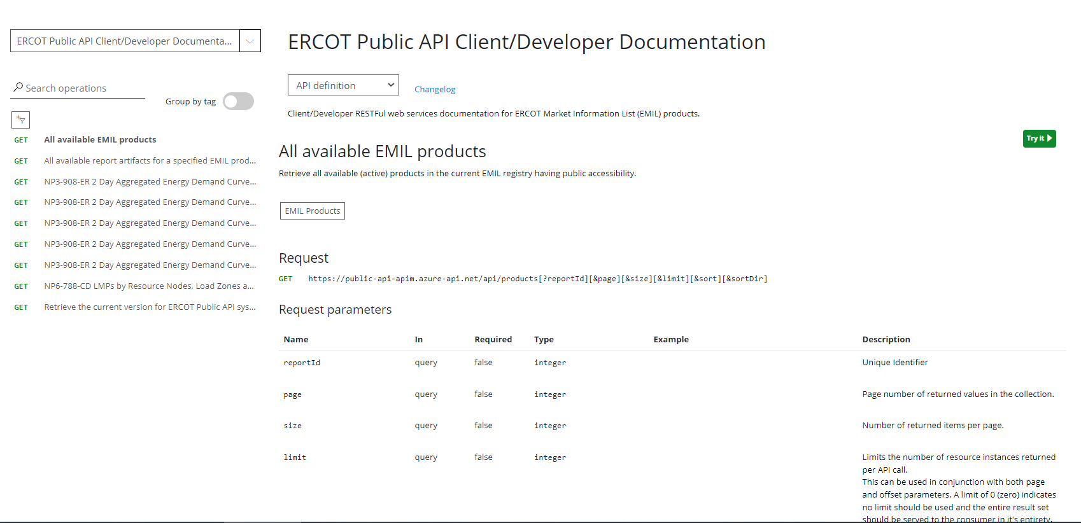
ERCOT Developer Portal

